Slide 1
Project Presentation of IOHE
On
EDGE CLOUD MONITOR
Hitanshi-(2210991668)
Ishika-(2210991687)
Harmandeep Singh-(2210991610)
Hardik Bhardwaj-(2210991607)
Supervised By
Mr. Ajay Kumar
Department of Computer Science and Engineering,
Chitkara University, Punjab

Slide 2
Introduction
The rapid growth of Internet of Things (IoT) devices and real-time applications has significantly increased data generation, leading to major advancements in data center technologies.
Traditional cloud computing provides centralized processing, scalability, and cost efficiency, but it suffers from limitations such as high latency, increased bandwidth usage, and slower response times for real-time applications. To overcome these challenges, edge computing has emerged as a solution that processes data closer to the source.
The integration of cloud and edge computing creates a hybrid architecture that improves system performance, reduces latency, and enables efficient real-time decision-making.
2

Slide 3
Cloud Computing in Data Centers
Cloud computing plays a crucial role in modern data centers by enabling scalable and flexible resource management. It uses virtualization and distributed systems to efficiently allocate computing resources.
Cloud platforms support different service models such as Infrastructure as a Service (IaaS), Platform as a Service (PaaS), and Software as a Service (SaaS).
These technologies improve resource utilization, reduce operational costs, and support large-scale data processing and storage.

Slide 4
Edge Computing Overview
Edge computing is a decentralized computing approach where data is processed near the source instead of relying entirely on centralized cloud servers.
This significantly reduces latency and bandwidth consumption while improving system responsiveness. Edge computing is widely used in applications such as IoT systems, healthcare monitoring, autonomous vehicles, and industrial automation.
It enables real-time data processing, which is essential for time-sensitive applications.

Slide 5
Hybrid Cloud-Edge Architecture
The hybrid architecture combines the strengths of both cloud and edge computing. In this model, edge devices handle real-time data processing, while the cloud manages large-scale storage and complex computations.
This architecture is typically divided into three layers: the IoT layer (data generation), the edge layer (local processing), and the cloud layer (advanced analytics and storage).
This layered approach ensures efficient workload distribution and improved performance.

Slide 6
Role of Cloud Computing
Cloud computing provides scalability, flexibility, and centralized control in data centers. It enables dynamic allocation of resources such as CPU, memory, and storage based on demand through mechanisms like auto-scaling and load balancing.
Cloud platforms support big data analytics, artificial intelligence, and machine learning workloads, making them essential for modern applications. Additionally, centralized dashboards allow administrators to monitor system performance, manage resources, and ensure security.
Cloud computing also simplifies software updates and maintenance, contributing to efficient system management.

Slide 7
Role of Edge Computing
Edge computing plays a critical role in reducing latency by processing data closer to the source, thereby minimizing round-trip communication time. This leads to faster response times and improved user experience.
It optimizes bandwidth usage by processing and filtering data locally before sending only necessary information to the cloud. Edge computing also enhances data privacy and security by limiting data transmission across networks.
Furthermore, it enables real-time analytics and decision-making and ensures system functionality even in cases of network disruptions, making it highly reliable for critical applications.

Slide 8
Benefits of Cloud-Edge Integration
The integration of cloud and edge computing improves system performance by combining the strengths of both technologies. It reduces latency, optimizes bandwidth usage, and lowers operational costs.
This hybrid approach optimizes bandwidth usage, reduces operational costs, and enhances energy efficiency. This hybrid approach enhances system reliability, scalability, and fault tolerance.
It is particularly useful for modern applications such as smart cities, industrial automation, and intelligent transportation systems.

Slide 9
Challenges and Limitations
Despite its advantages, cloud-edge integration faces several challenges. Edge devices have limited computational resources compared to cloud data centers.
Security risks increase due to decentralized systems, making them vulnerable to cyberattacks. Managing distributed systems is complex and requires advanced orchestration techniques.
Additionally, the lack of standardization creates interoperability issues between different platforms and technologies.

Slide 10
Applications
Cloud and edge computing are widely used in various real-world applications. In smart cities, they enable traffic management and energy optimization.
In healthcare, they support real-time patient monitoring and telemedicine. Autonomous vehicles rely on edge computing for real-time decision-making, while the cloud handles data storage and AI model training.
In industrial IoT, they enable predictive maintenance and automation, improving efficiency and productivity.

Slide 11
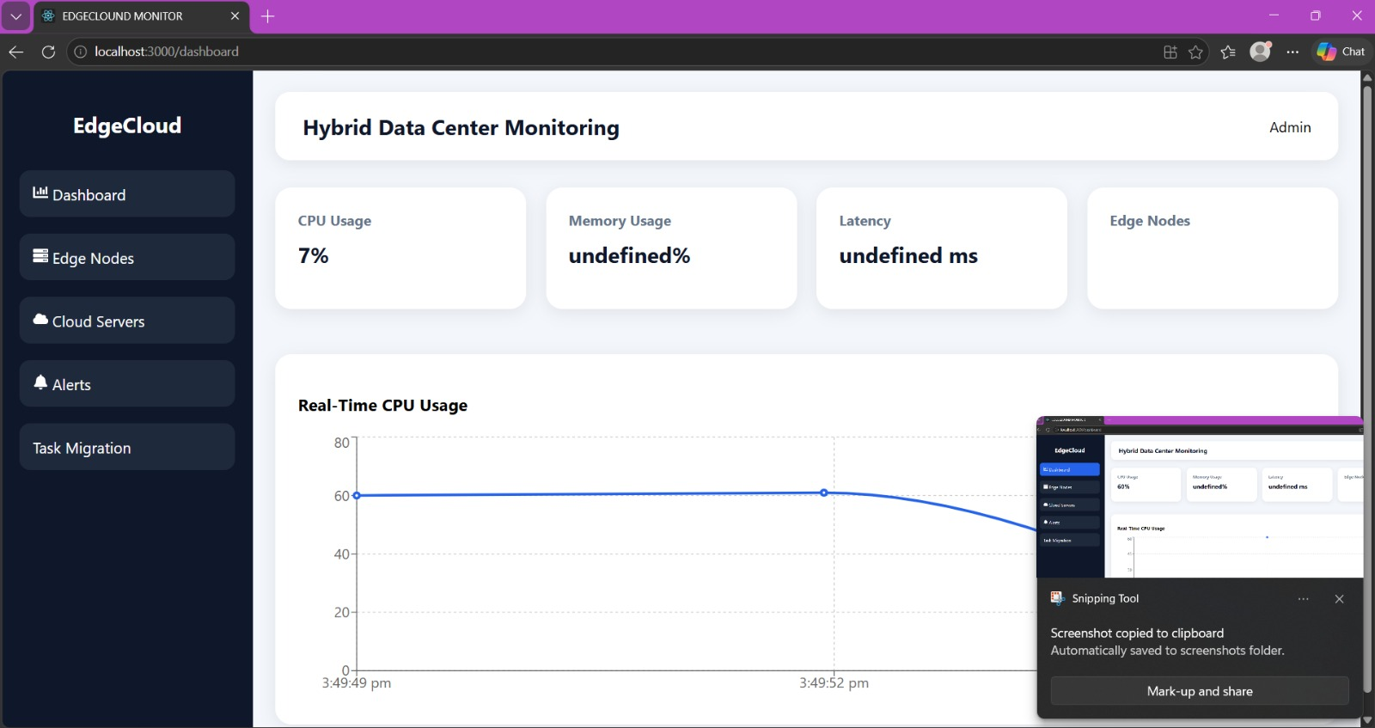
Snapshots of the Project:

Slide 12
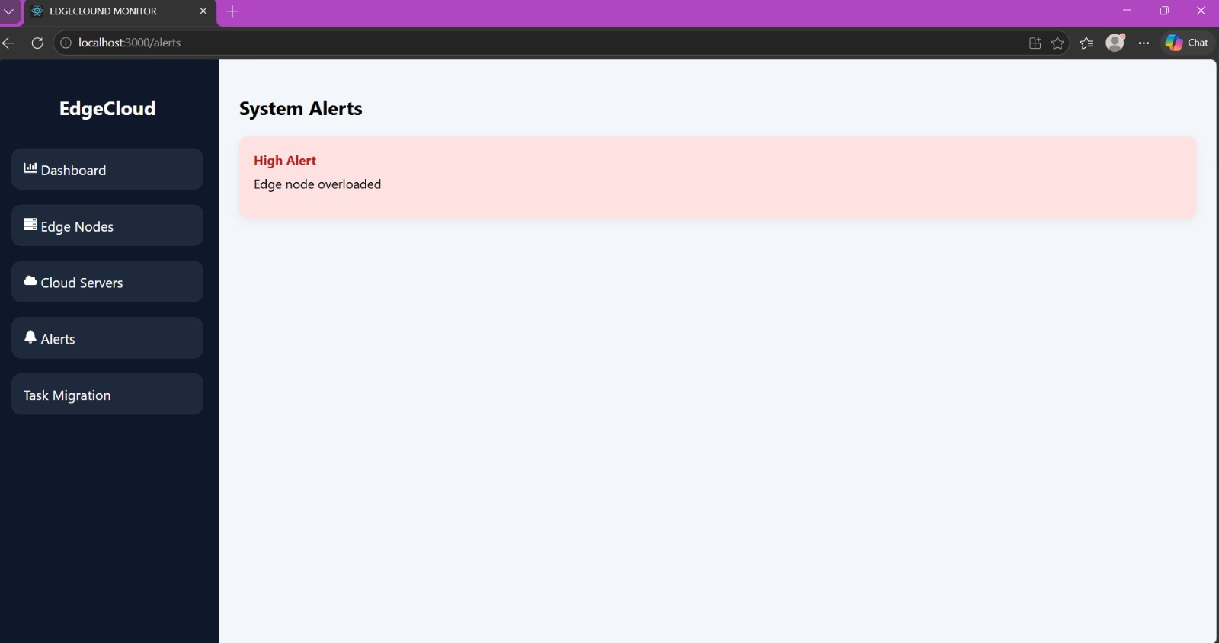

Slide 13
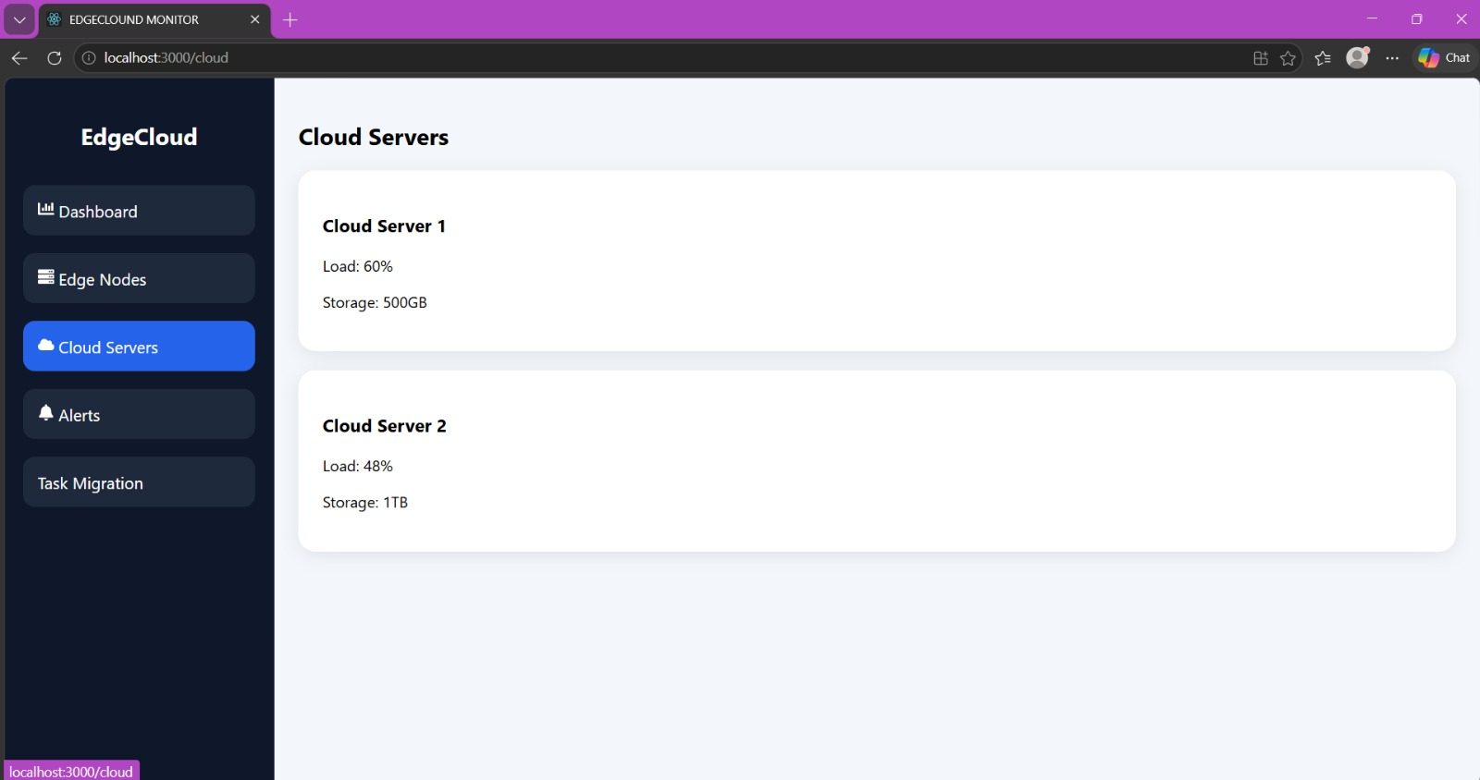

Slide 14
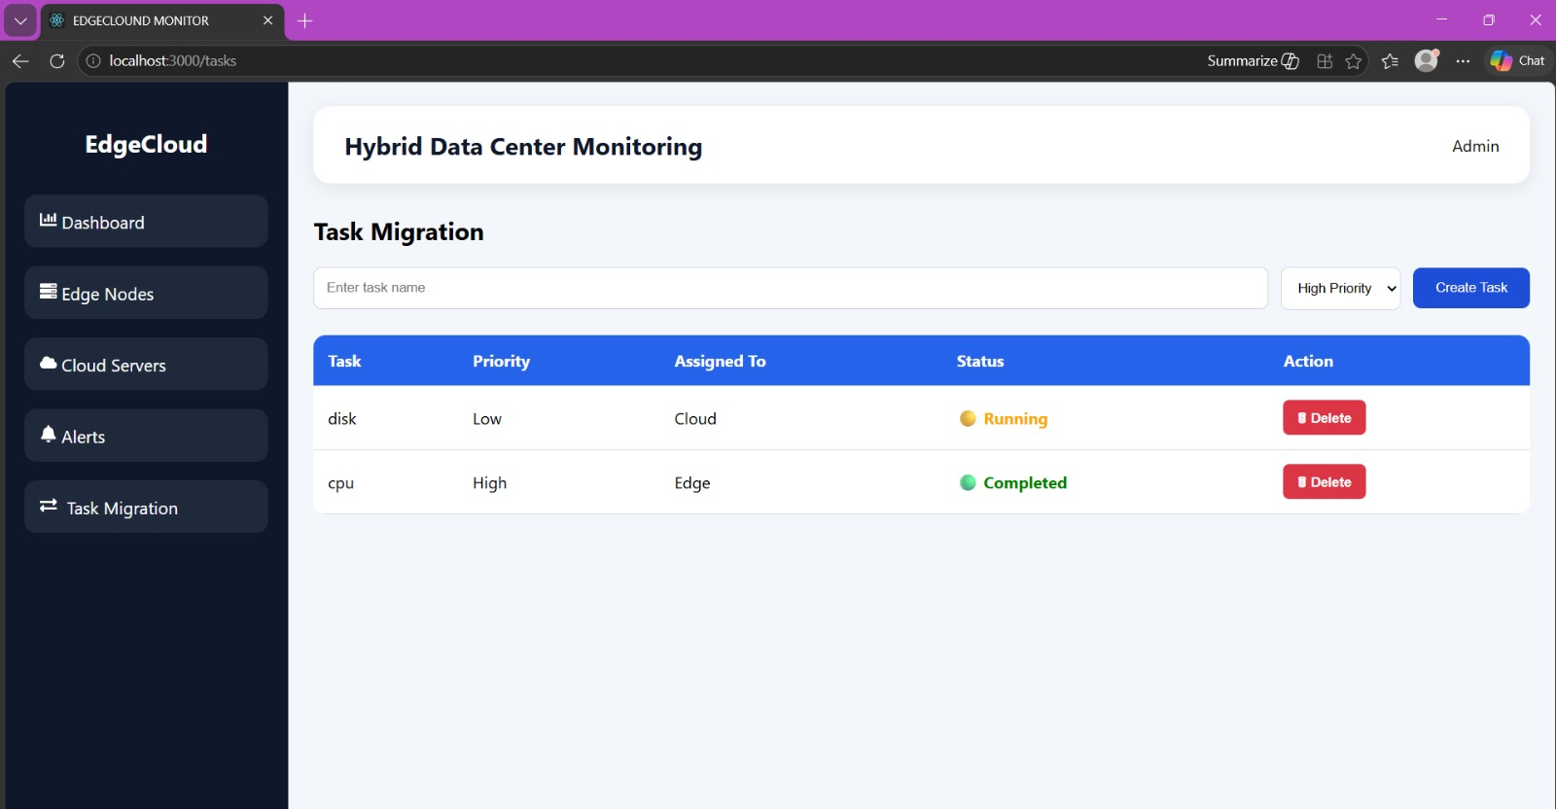

Slide 15
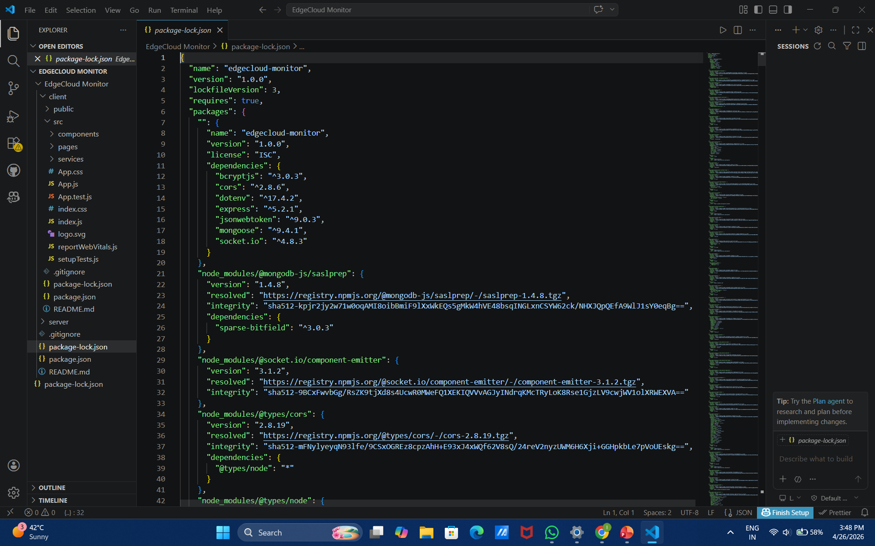
Code Snippet:

Slide 16
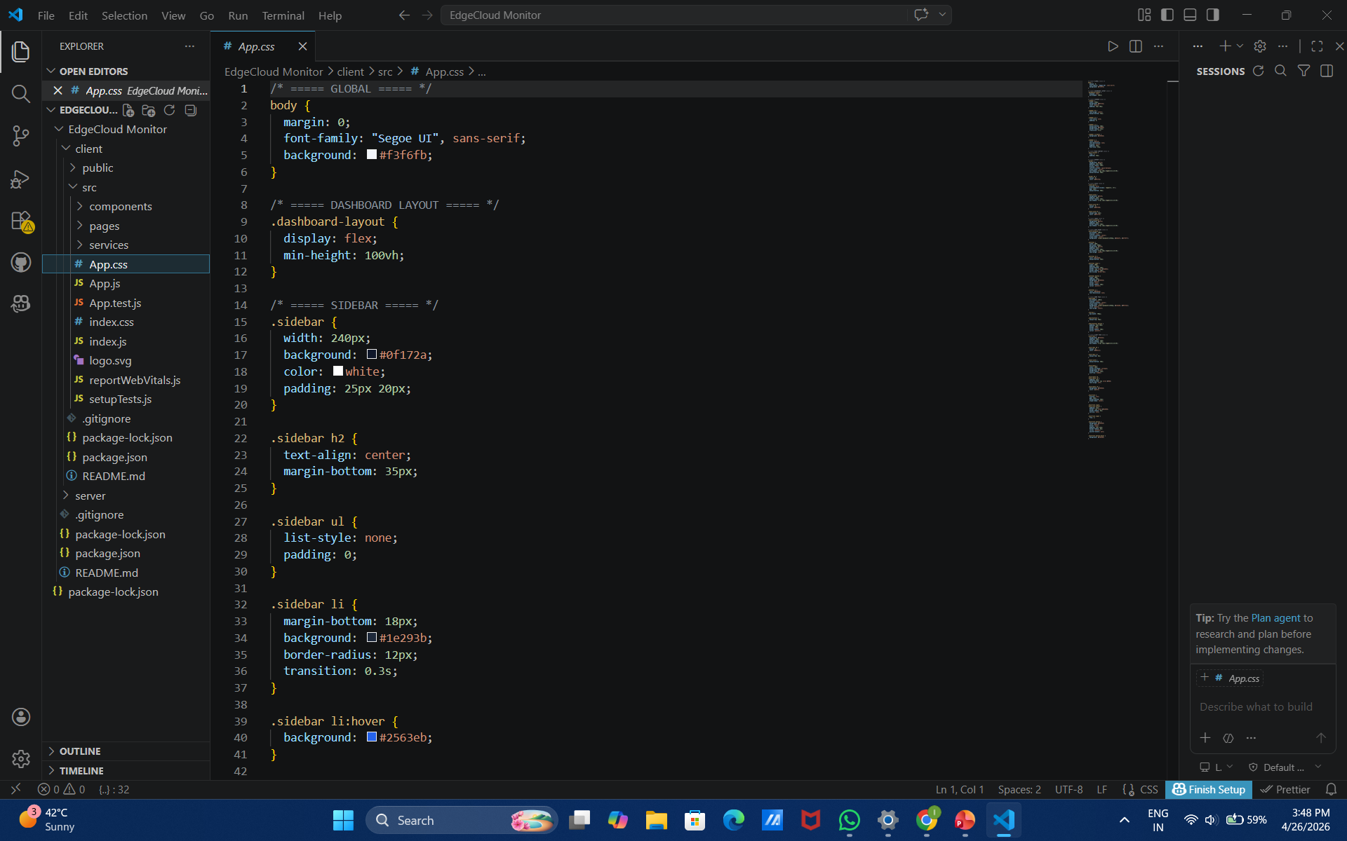

Slide 17
Future Trends
The future of cloud-edge computing is being shaped by emerging technologies such as artificial intelligence, 5G networks, and sustainable computing. AI and machine learning will enable intelligent resource management and automated decision-making at the edge.
The deployment of 5G networks will provide high-speed, low-latency communication, further enhancing real-time applications. Edge Computing as a Service (ECaaS) is gaining popularity, offering scalable and flexible solutions.
Additionally, there is a growing focus on developing energy-efficient and environmentally sustainable data centers. Serverless computing at the edge is also emerging, simplifying deployment and scaling processes.

Slide 18
Conclusion
Cloud and edge computing together form a powerful hybrid architecture that addresses the limitations of traditional data centers. While cloud computing provides scalability, high computational power, and centralized control, edge computing enables real-time processing, low latency, and improved responsiveness.
This integration is essential for supporting modern technologies such as IoT, artificial intelligence, and autonomous systems. Although challenges such as security risks and lack of standardization remain, ongoing research is developing effective solutions.
Overall, cloud-edge computing is expected to play a crucial role in shaping the future of data center technologies.

Slide 19
Thank You
19

