Slide 1
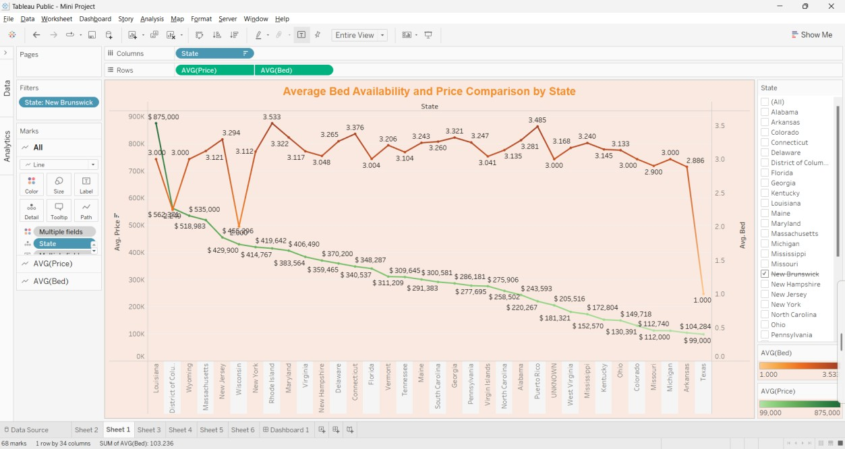
Mini Project DEV
Hitanshu Shah – 60009220164
Title : House price Analysis Visualizations :
This graph compares the average cost of a property and the average number of beds available for those properties.
The green line shows the average price per state. Higher points indicate more expensive properties on average.
The orange line shows the average number of beds available per property in each state. Higher points indicate more beds typically available on average.

Slide 2
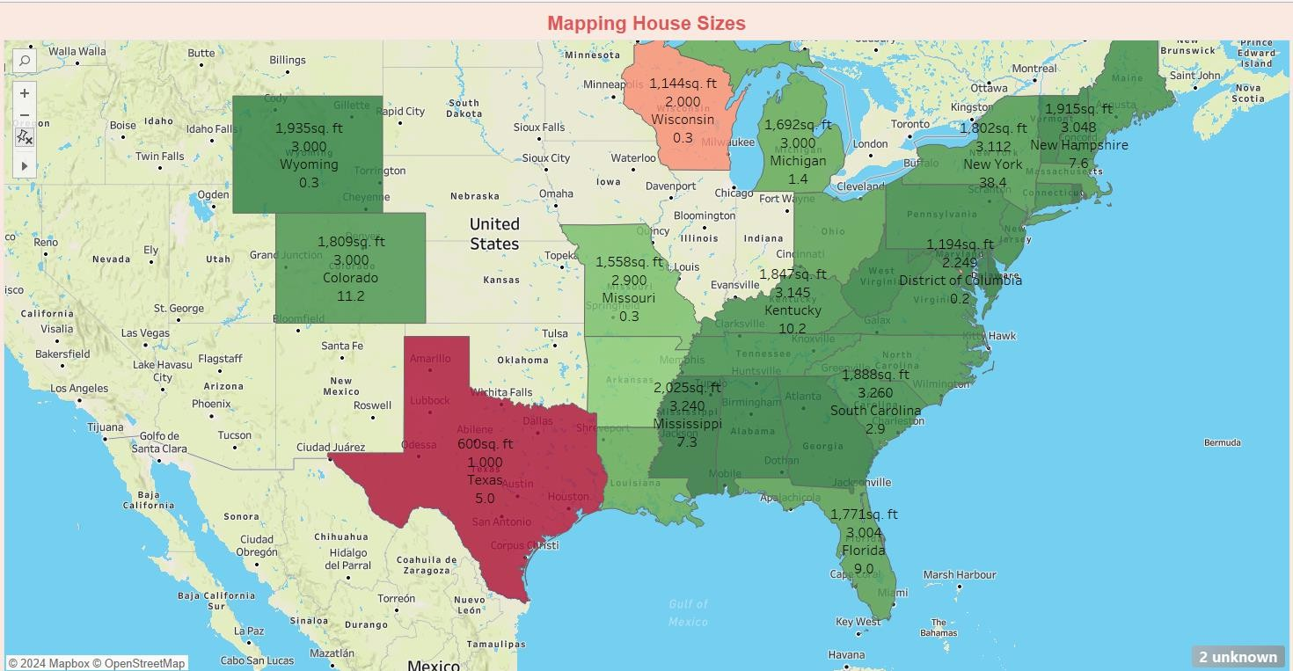
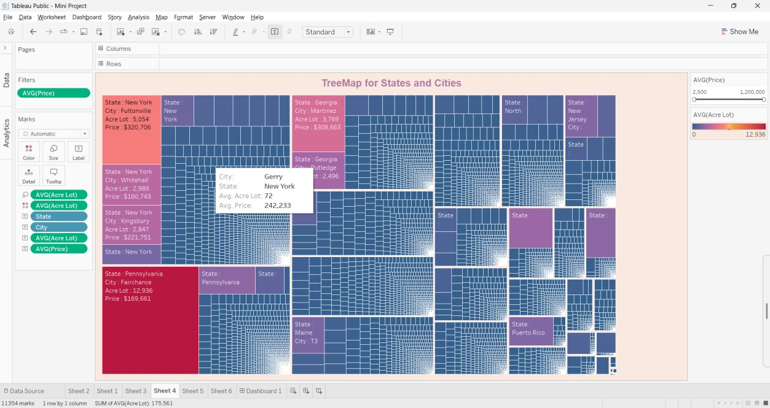
By looking at both lines for a particular state, you can see how price compares to bed availability. For example, a state with a high green line and a low orange line might have expensive properties with fewer beds available on average.
The graph provides a clear visualization of how average house size varies across the United States.
States with the largest average home sizes (dark green) include Wyoming (over 2,800 sq ft), Utah (around 2,800 sq ft), and Idaho (over 2,300 sq ft).
States with the smallest average home sizes (light blue) include Massachusetts (around 1,600 sq ft), New Jersey (around 1,600 sq ft), and Connecticut (around 1,500 sq ft).

Slide 3
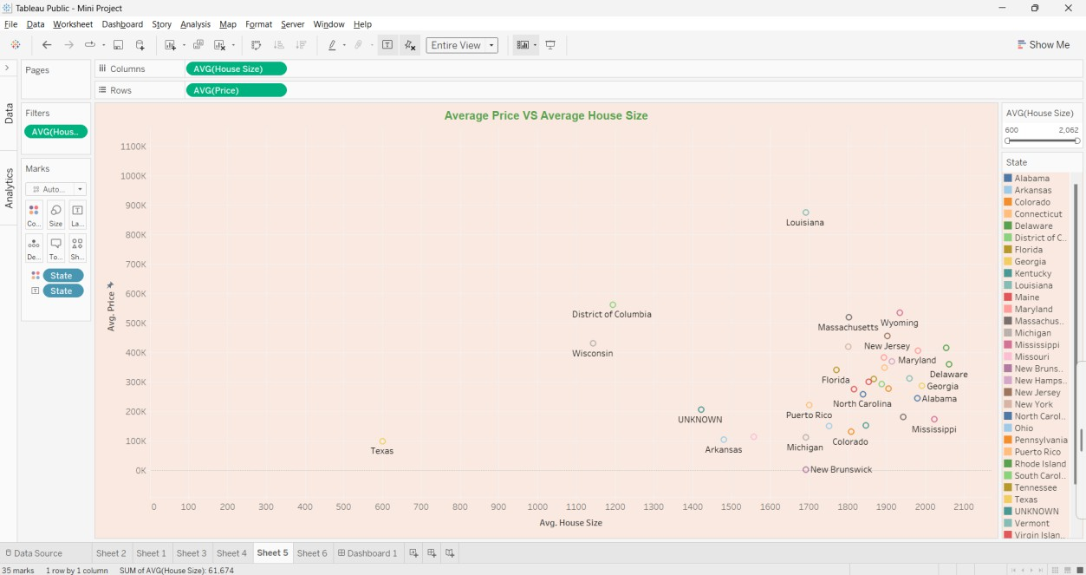
Large Boxes: These represent the average price (and possibly average lot size) for an entire state.
Smaller Boxes Nested Within: These represent the distribution of prices (and possibly lot sizes) for individual cities within that state.
This scatter plot provides a clear visualization of how average home size varies across the United States. By looking at the bars, you can easily compare the average home size in different states.
Dots: Each state is represented by a dot on the graph. The position of the dot depends on two factors:
Horizontal position (X-axis): This represents the average house size.
Vertical position (Y-axis): This represents the average price.

Slide 4
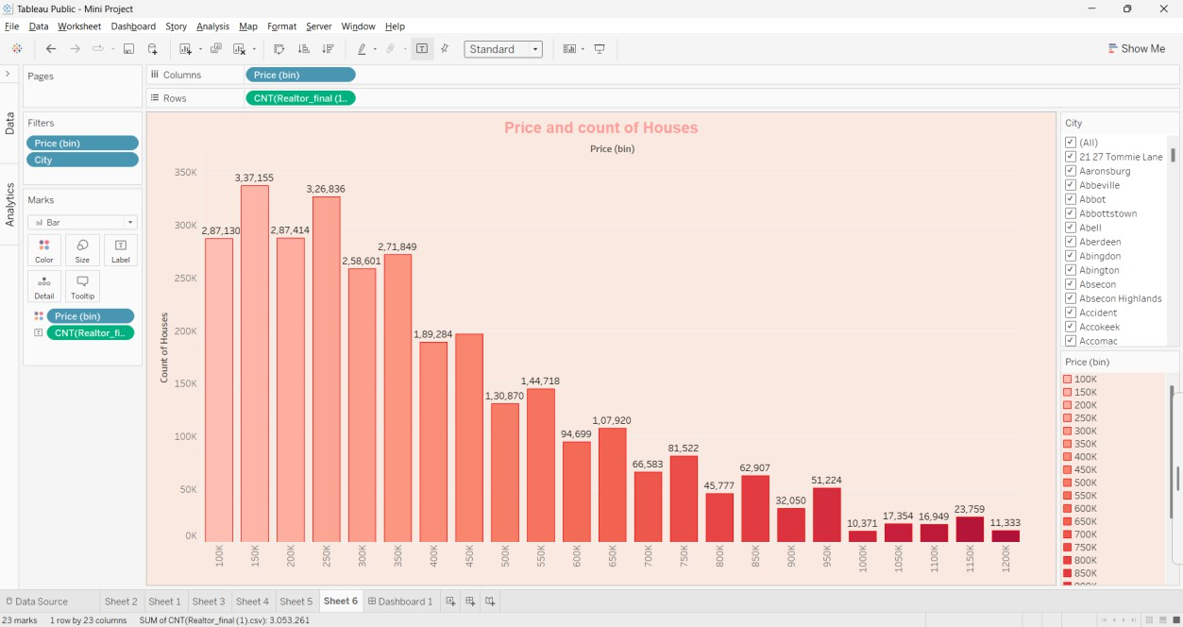
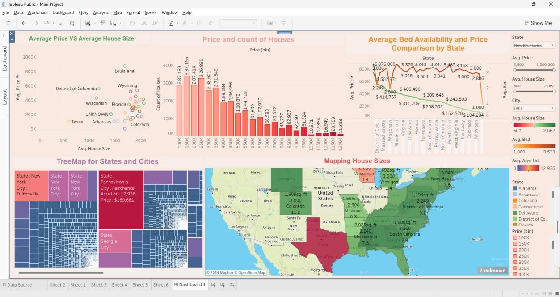
We have made bins for house price, that start at 100k and go up to 1200k with a progression of 50k
X – axis - has the values of the bins.
Y-axis – has the count of houses that lie between in those respective bins.
The graph provides a clear view of how many houses fall within specific price ranges, giving you a better understanding of the distribution of house prices.
A dynamic dashboard that can be used to compares the house prices of 2 or more states together at glance to give you a better understanding which state suits you the best according to your requirements.

