Slide 1
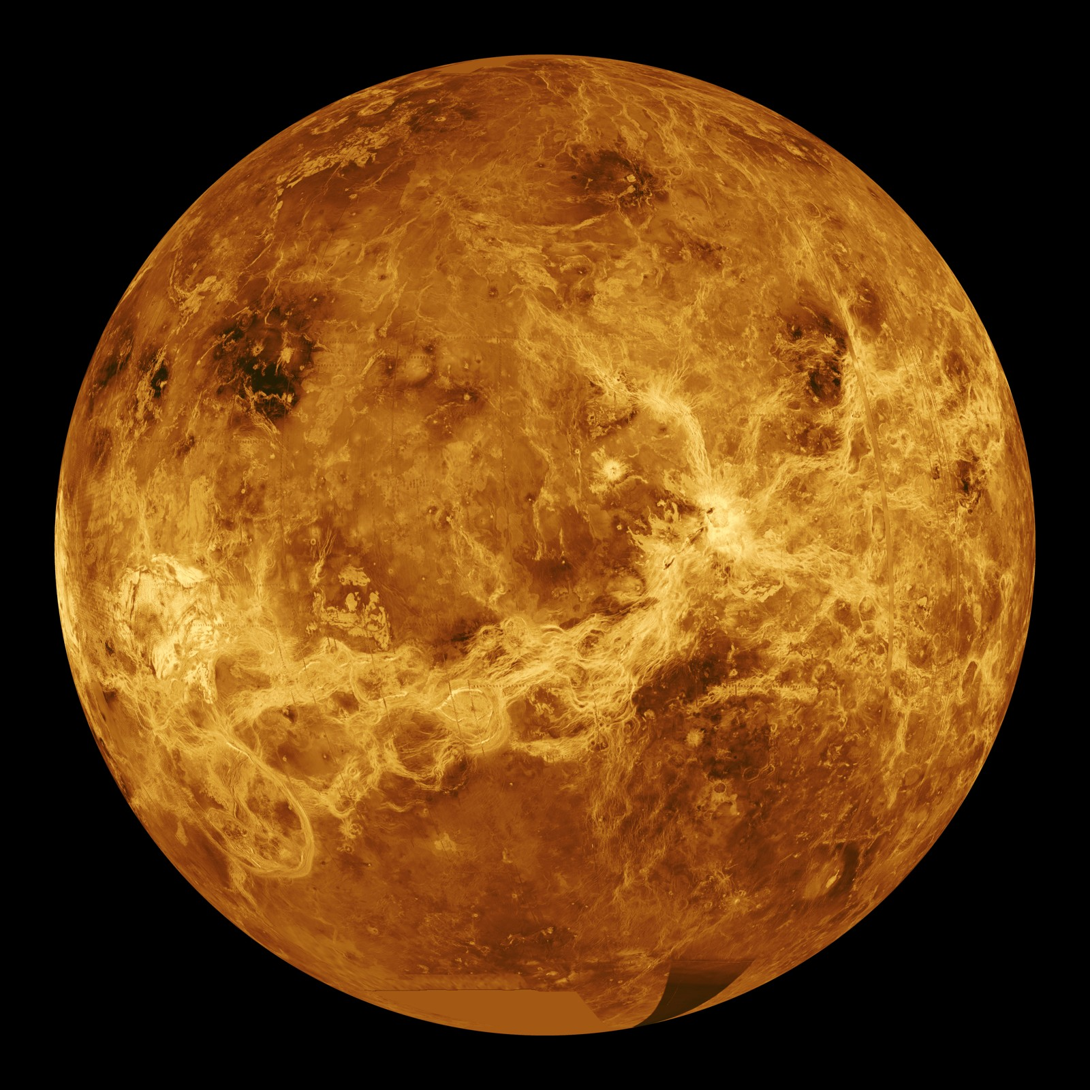
Venus Orbiter Thermal Control Design
Semi-Final Design Review
Member 1 · Member 2 · Member 3
Member 4 · Member 5 · Member 6
ME4550 Spacecraft Thermal Controls · Dr. Rez Rahman
November 10, 2026
Image: NASA/JPL, Magellan radar mosaic (PIA00104)
Notes:
Introduce the team and the mission in one sentence: a Venus orbiter that maps the surface by radar at 10 m resolution and measures the gravity field. Today we show the requirements, environment, design cases, the thermal model, and the analysis and trades done so far.

Slide 2
Design Approach and Team Responsibilities
Every number traces back to a requirement, a handbook source, or a stated assumption
Mission
Requirements
Environment
Design cases
Thermal model
Hot / cold analysis
Sizing & trades
Margins & verification
M1
M1
M2
M2
M3
M4
M4
M5
Complete
In progress
Next (final review)
Team member | Work package | Slides
Member 1 | Approach, mission and spacecraft configuration | 2–4
Member 2 | Component requirements and power by mode | 5–6
Member 3 | Environment, orbit geometry, design cases | 7–9
Member 4 | Heat paths, thermal model, verification | 10–12
Member 5 | Hot case, cold case and heaters, transients | 13–15
Member 6 | Design trades, margins, remaining work | 16–19
The question we are answering
“Why will this thermal design work for the entire mission?”
Not only “what temperature does the spacecraft reach?”
ME4550 Spacecraft Thermal Controls | Venus Orbiter Thermal Design | Semi-Final Review
2
Notes:
Our process follows the course guideline: mission, requirements, environment, cases, model, analysis, trades, then margins and verification. Milestones 1 and 2 are complete; 3 and 4 are mostly done; 5 is next. Each team member owns one work package and presents it.

Slide 3
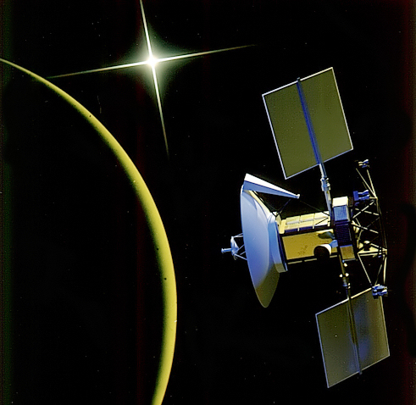
Mission Overview
The orbit phases define our thermal design cases
10 m radar mapping: X-band SAR, ~10× sharper than Magellan
Gravity field: two-way Ka-band Doppler tracking from a low circular orbit
Surface emissivity: Venus Emissivity Mapper (night side)
Cruise
Elliptical mapping
Aerobraking
Circular gravity survey
~5 months
486 days
~70 days
243 days
1.0 → 0.72 AU
294 × 8,540 km
P = 3.28 h, 2 cycles
Apoapsis lowered
by drag passes
250 km, i = 86°
P = 91.9 min, 1 cycle
Design life 4 years: coatings evaluated at end of life (EOL)
Near-polar orbit: full coverage, and the Sun angle changes through the Venus year
Heritage: NASA Magellan (1989–1994) mapped 98% of Venus at ~100 m and aerobraked into a near-circular orbit in 1993.
Image: NASA/JPL
ME4550 Spacecraft Thermal Controls | Venus Orbiter Thermal Design | Semi-Final Review
3
Notes:
We follow Magellan's flight-proven profile: an elliptical polar orbit for radar mapping, then aerobraking into a low circular orbit for gravity. The low circular orbit at 250 km is close to Venus, so reflected sunlight is strong there - that becomes our hot case. Cruise near Earth and the long eclipses become our cold cases.

Slide 4
Spacecraft Configuration and Attitude
The radiator face (−Y) never sees direct sunlight
HGA 2.0 m
2-axis gimbal (tracks Earth)
Item | Decision | Why
Attitude | Nadir-pointing; yaw flip when β crosses 0° | Keeps the Sun on +Y, radiator always shaded
Radiator | OSR on −Y: 1.20 m² + 0.05 m² battery | No direct sun; sees Venus edge-on (F = 0.32)
Electronics | Boxes bolted to radiator panel | Short conduction path to the sink
Insulation | MLI, Beta-cloth cover, ε* = 0.03 | Durable in UV and aerobraking
Battery | Li-ion 1,500 Wh, own radiator + heater | Narrow +5 to +35 °C range
Propulsion | Hydrazine tank in MLI + heater | Hydrazine freezes at +2 °C
HGA | 2-axis gimbal | Earth link without changing thermal attitude
Bus
1.6 × 1.4 × 1.8 m
MLI blankets
+Y sun side
MLI (Beta cloth)
−Y radiator
OSR, 1.20 m²
+ battery patch
→ deep space
Sun
Solar arrays on ±X
(into / out of page)
+Z nadir
SAR, VEM
VENUS
ME4550 Spacecraft Thermal Controls | Venus Orbiter Thermal Design | Semi-Final Review
4
Notes:
Picture this view looking along the flight direction. The spacecraft points its bottom face at Venus. Twice a Venus year the Sun crosses the orbit plane; we yaw-flip 180 degrees so the Sun always stays on the +Y side. That keeps the -Y radiator in permanent shade. The gimballed antenna lets us talk to Earth without rotating the whole spacecraft, so one thermal attitude covers every science mode.

Slide 5


Component Thermal Requirements
Limits come from the Gilmore handbook and course examples, not guesses
Component | Op min | Op max | Surv min | Surv max | Source
Electronics (C&DH, GNC, power, telecom, SAR, VEM) | −5 °C | +50 °C | −15 °C | +60 °C | Gilmore Table 15.10 (analysis and qualification ranges)
Li-ion battery | +5 °C | +35 °C | −10 °C | +45 °C | Course Li-ion heater example; Gilmore §3.5
Hydrazine tank and lines | +10 °C | +40 °C | +5 °C | +50 °C | Freezes at +2 °C; JPL +5 to +50 °C (Gilmore §19.3)
Solar arrays (not modeled) | – | +115 °C | – | – | Magellan heritage (OSR-populated arrays)
Margin convention (positive = pass)
Margin policy
Passive (hot limits): ≥ 11 °C, Gilmore §15.6
Heater-controlled (cold limits): ≥ 25% heater capacity at 24 V minimum bus
Requirement: every component inside its limits in every case, with these margins
ME4550 Spacecraft Thermal Controls | Venus Orbiter Thermal Design | Semi-Final Review
5
Notes:
Every limit has a source. Electronics use the Lockheed Martin ranges listed in Gilmore Table 15.10. The battery uses the Li-ion values from the course heater example. Hydrazine freezes at +2 C, so the tank stays above +10 C in operation. Margins: hot sides must sit at least 11 C inside the limit; cold sides are held by heaters, which get 25 percent extra capacity at the lowest bus voltage.

Slide 6
Internal Power Dissipation by Operating Mode
Gravity mode drives the hot case; safe mode drives the cold case
Unit (W) | Gravity survey | SAR pass | SAR off | Safe / cruise
Flight computer + recorder | 35 | 45 | 40 | 30
Guidance & navigation electronics | 40 | 40 | 40 | 30
Reaction wheels (4) | 30 | 30 | 30 | 20
Power conditioning losses | 35 | 55 | 40 | 20
Ka/X transponder | 30 | 30 | 30 | 25
Ka-band amplifier (TWTA) | 45 | 0 | 45 | 0
X-band amplifier (safe link) | 0 | 0 | 0 | 5
SAR electronics | 15 | 250 | 15 | 0
Venus Emissivity Mapper | 25 | 25 | 0 | 0
Total, electronics node | 255 | 475 | 240 | 130
475 W
SAR imaging pass, 40 min per elliptical orbit (peak)
255 W
Gravity survey, continuous → hot case
130 W
Safe / cruise mode → cold case
Dissipation = DC power turned into heat inside the bus (radio power sent out by antennas is excluded). Battery adds 8 W charging, 15 W in eclipse. Estimates scaled from Magellan (~1.2 kW).
ME4550 Spacecraft Thermal Controls | Venus Orbiter Thermal Design | Semi-Final Review
6
Notes:
These are engineering estimates scaled from Magellan, which needed about 1.2 kW. The gravity survey keeps the Ka-band link on continuously, so 255 W runs all the time in the low, hot orbit. The SAR pass is the highest power but only lasts about 40 minutes per orbit. Safe mode at 130 W is the cold case.

Slide 7



Venus Thermal Environment
Reflected sunlight (albedo ≈ 0.8) is the dominant planetary load
Parameter | Cold | Nominal | Hot | Source
Solar flux S (W/m²) | 2,579 | 2,614 | 2,650 | Gilmore Eq. 2.9
 | aphelion | mean | perihelion | Table 2.5
Albedo a (–) | 0.78 | 0.80 | 0.82 | Gilmore T. 2.9
Planetary IR (W/m²) | 138.5 | 153 | 178.4 | Gilmore T. 2.10
Coatings | Start of life | – | End of life | Gilmore Ch. 4
Loads on a surface of area A
F = view factor to Venus, αs = solar absorptance, ε = emittance
Why Venus is different
Fully cloud-covered: albedo ≈ 0.8 (Earth ≈ 0.3)
Near the subsolar point, reflected sunlight a·S ≈ 2,100 W/m², almost as strong as direct sun
Cold cloud tops: planetary IR (153 W/m²) is lower than Earth’s
Handbook check
Gilmore Table 2.9 lists 2,759 W/m² at perihelion, but its own Eq. 2.9 gives 2,650 W/m². We use the equation.
ME4550 Spacecraft Thermal Controls | Venus Orbiter Thermal Design | Semi-Final Review
7
Notes:
Hot values use perihelion, the highest albedo and IR, and end-of-life coatings. Cold values use aphelion, the lowest albedo and IR, and fresh coatings. The key physics: Venus reflects about 80 percent of sunlight, so at 250 km the reflected light is nearly as strong as direct sunlight. We also caught an inconsistency in the handbook table and used the handbook's own equation instead.

Slide 8
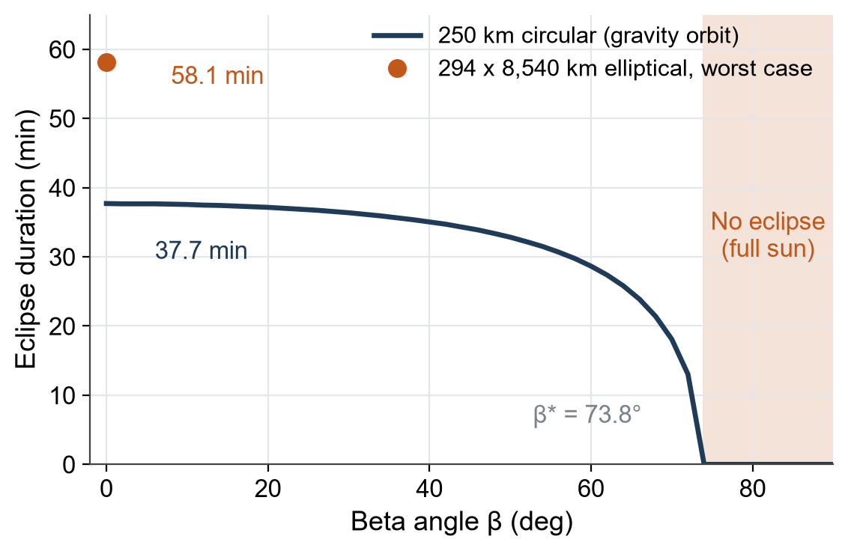
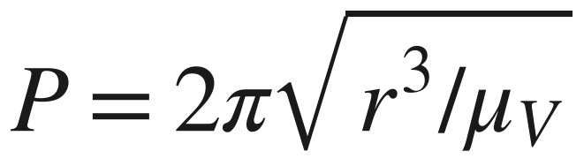
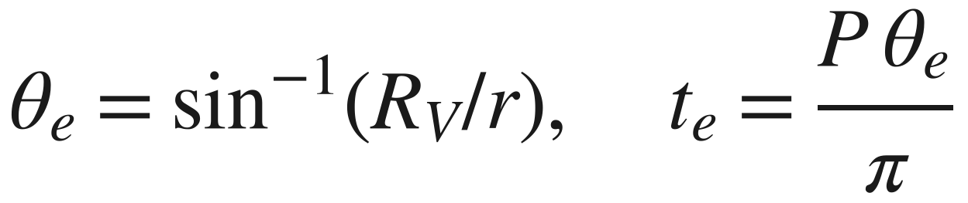
Orbit Geometry: Eclipse, Beta Angle and View Factors
β sweeps 0–90° every Venus year, so both full-sun and longest-eclipse orbits occur
Orbit | Period | Longest eclipse | View factor nadir / side
250 km circular | 91.9 min | 37.7 min | 0.92 / 0.32
294 × 8,540 km | 3.28 h | 58.1 min | 0.91 / 0.31*
Venus turns once every 243 days, so the orbit plane stays nearly fixed while Venus circles the Sun (225 days)
No eclipse when β > β* = sin⁻¹(R/r) = 73.8°
* at periapsis; numerical view factor matches (R/r)² exactly
ME4550 Spacecraft Thermal Controls | Venus Orbiter Thermal Design | Semi-Final Review
8
Notes:
Beta is the angle between the Sun and the orbit plane. Because Venus rotates so slowly, our near-polar orbit plane is almost fixed in space, so beta slowly sweeps through every value over a Venus year. At beta zero we get the longest eclipse, 37.7 minutes in the circular orbit and 58 minutes in the elliptical orbit. Above 73.8 degrees there is no eclipse at all. We designed for both ends.

Slide 9
Thermal Design Case Matrix
Each case fixes environment, power, attitude and coating condition
Case | Orbit / β | Environment | Internal power | Coatings | Purpose
Hot operational | 250 km, β swept 0–90° (worst 30°) | Perihelion, a = 0.82, IR 178 | 255 W | EOL | Size radiator
Peak payload | Elliptical, periapsis over subsolar point | Perihelion, hot | 475 W for 40 min | EOL | SAR transient
Hot survival | 250 km, β = 30° | Perihelion, hot | 130 W (safe) | EOL | Check survival max
Cold operational | 250 km β = 0° and 90°; elliptical β = 0° and 90° | Aphelion, a = 0.78, IR 138.5 | 255 W / 240–475 W | BOL | Min temps; eclipse transient
Cold survival, Venus | Elliptical, 58-min eclipse; β = 90° | Aphelion, cold | 130 W (safe) | BOL | Heater sizing; survival transient
Cold survival, cruise | Near 1 AU, no planet | S = 1,368 W/m² on +Y | 130 W (safe) | BOL | Worst heater demand
All Venus cases: nadir-pointing, Sun on +Y. MLI ε* = 0.03: top of the handbook range, conservative for both hot and cold. EOL/BOL = end/start of life.
ME4550 Spacecraft Thermal Controls | Venus Orbiter Thermal Design | Semi-Final Review
9
Notes:
The guideline says a case defined only as hot or cold is not enough, so every case fixes the environment, power, attitude and coating condition. Hot cases stack everything that heats us: perihelion, high albedo, end-of-life coatings and maximum continuous power. Cold cases stack the opposite: aphelion, fresh coatings, safe-mode power and the longest eclipse. Cruise near Earth is coldest because there is no planet at all.

Slide 10
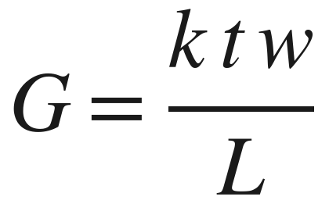
Thermal Architecture: Where Every Watt Goes
Electronics heat takes a short conduction path to a radiator that never sees the Sun
Heat sources
Heat paths
Heat sinks
Electronics boxes 130–475 W
Bolted box feet + interface pads + doublers, G = 20 W/K
−Y OSR radiator, 1.20 m² → deep space (main sink)
Battery 3–15 W
Internal radiation, black interior (ε = 0.89)
Battery radiator, 0.05 m² → deep space
Thermostatic heaters
Isolating mounts: battery 0.3 W/K, tank 0.4 W/K
Sun on +Y MLI
MLI-covered faces (small leak)
MLI blankets, ε* = 0.03
Venus albedo + IR
Box-to-radiator conductance: spreading through facesheet + doubler controls (interface pads are ~1,300 W/K, negligible). 10 boxes, k = 167 W/m·K, t = 1.5 mm, w = 1.3 m, L = 0.15 m → G ≈ 21 W/K; we use 20 W/K.
ME4550 Spacecraft Thermal Controls | Venus Orbiter Thermal Design | Semi-Final Review
10
Notes:
Every significant watt has a path. Electronics heat conducts through the box feet and doublers into the radiator panel, then radiates to deep space from the shaded -Y face. The battery has its own small radiator and a heater, isolated from the bus. The tank is wrapped in MLI and isolated. The bus walls are covered in MLI, so only a small leak goes through them. We estimated the key conductance from the Week 10 spreading method.

Slide 11
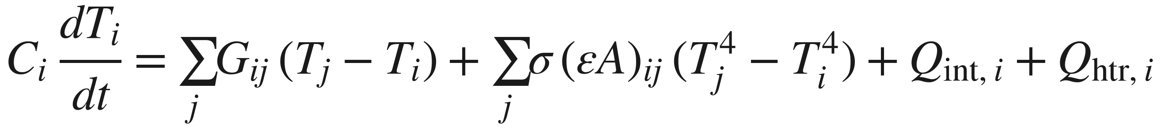

Thermal Network Model
Five lumped nodes, solved at steady state and in time
Electronics
144 kJ/K
Radiator
13.5 kJ/K
Deep space
3 K
+ Sun, albedo, IR
Steady state: orbit-average loads, Newton iteration
Heater sizing: hold a node at its thermostat ON temperature, solve for heater power
Transient: RK4 time stepping, dt = 10 s, thermostats with 3 °C deadband
Environment: view factors to Venus integrated over the visible disk; albedo falls off with Sun angle
G = 20 W/K
εσAT⁴
+ heater
radiation
Bus
162 kJ/K
1.5 W/K + rad.
MLI leak
0.4 W/K + MLI
0.3 W/K + MLI
Tank
257 kJ/K
Battery
16.5 kJ/K
εσAT⁴
MLI leak through each blanket
+ heater
+ heater
ME4550 Spacecraft Thermal Controls | Venus Orbiter Thermal Design | Semi-Final Review
11
Notes:
This is the same method as the class CubeSat and Mars rover examples, scaled up to five nodes. Each node is one temperature with a heat capacity. Links are conduction, radiation, or leaks through MLI. We solve the orbit-average steady state for sizing, and step through time with RK4 for eclipses, with on/off thermostats on the electronics, battery and tank heaters.

Slide 12
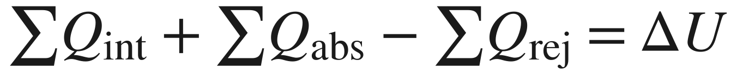
Model Verification
The model matches exact solutions and the handbook, and conserves energy
Check | Model | Reference | Difference
View factor to Venus, nadir, 250 km | 0.9222 | (R/r)² = 0.9222 | < 0.001%
Eclipse, 250 km, β = 0° | 37.71 min | Exact 37.69 min | 0.05%
Black sphere at 607 km, β = 0°: max / min | 121.2 / −105.7 °C | Gilmore T. 2.11: 122 / −105 °C | ≤ 0.8 °C
Black sphere at 607 km, β = 90° | 67.1 °C | Gilmore T. 2.11: 67 °C | 0.1 °C
Radiator area, hand calculation | 1.12 m² | Model sizing 1.10 m² | 2%
Energy balance, one orbit (eclipse case) | 2 J residual | In = out + stored | 0.0001%
Time step, dt = 10 s vs 5 s | – | – | 0.01 K
Energy balance, one orbit
Internal + heaters: 1.605 MJ
Absorbed: 0.362 MJ
Radiated: 1.697 MJ
MLI loss: 0.184 MJ
Stored: 0.085 MJ
Code, inputs and results: github.com/hitarth101/ME4990-Term-Project (Python + NumPy; one command reproduces every number in this deck)
ME4550 Spacecraft Thermal Controls | Venus Orbiter Thermal Design | Semi-Final Review
12
Notes:
Before trusting the model we checked it. The view factor and eclipse time match exact formulas. Our environment code reproduces the handbook's Venus reference-sphere temperatures within one degree. A one-node hand calculation gives nearly the same radiator area. And over an orbit, energy in equals energy out plus energy stored, to 2 joules out of about 2 megajoules. The code is on our GitHub.

Slide 13
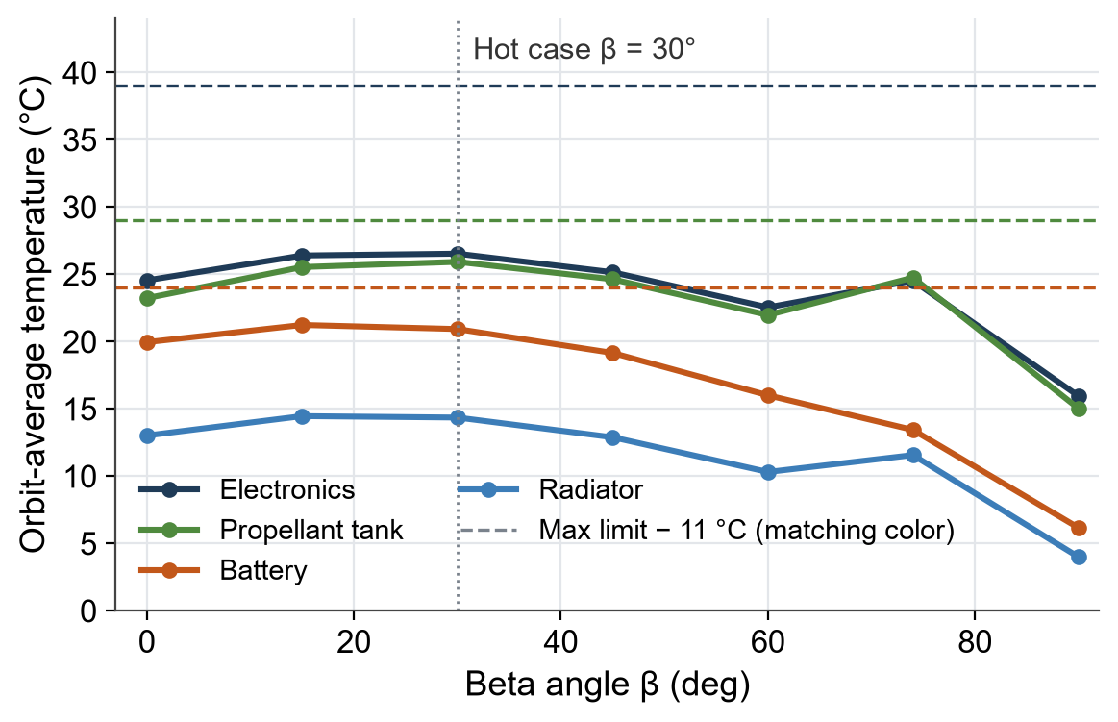
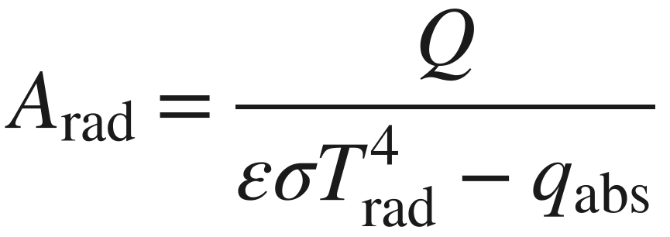
Hot Case and Radiator Sizing
The hydrazine tank, not the electronics, sets the radiator size
1. Sweep β = 0–90° (perihelion, EOL, a = 0.82): worst at β ≈ 30°
2. Smallest OSR area with all margins met: 1.10 m²
3. Add 0.10 m² for blockage and panel edges → 1.20 m²
4. Hand check: 255 W needs 1.12 m²
1.20 m²
+14.1 °C
OSR radiator on −Y
Tank hot margin (limit 40 °C)
Why β ≈ 30°: the radiator still sees bright sunlit Venus while the +Y blanket is partly sunlit. At 90° the orbit flies over the day/night line.
ME4550 Spacecraft Thermal Controls | Venus Orbiter Thermal Design | Semi-Final Review
13
Notes:
We swept beta and found the hottest orbit is around 30 degrees, not 0 or 90. At 90 degrees the spacecraft flies over the day-night line and the radiator only sees the dark side. The tank sits at the bus temperature, and the bus is warmed by the sunlit blanket, so the tank's 29 C design limit is what sizes the radiator. The electronics have 23 C of margin.

Slide 14
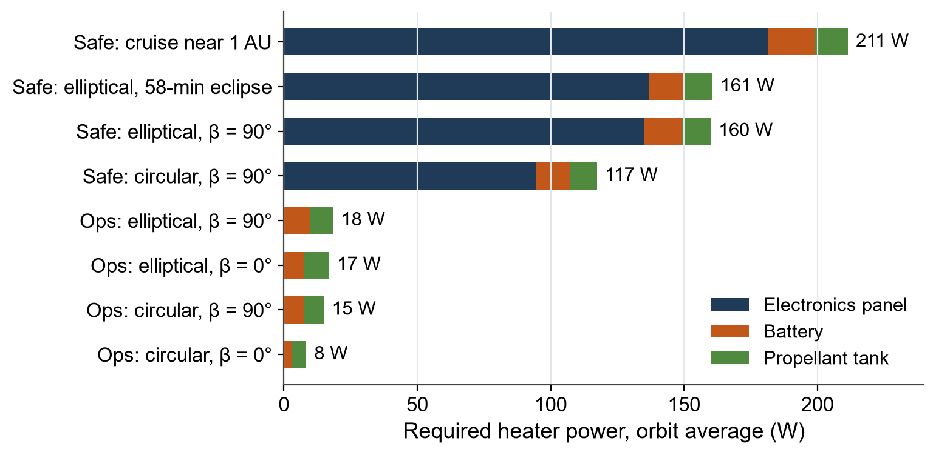

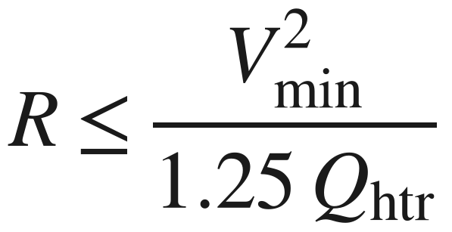
Cold Cases and Heater Sizing
Safe mode in cruise near Earth needs the most heater power, not Venus orbit
Heater | Required | At 24 V | Resistance | ON/OFF (°C)
Electronics panel | 181 W | 230 W | 4 × 10 Ω | 0 / +3
Battery | 17 W | 22 W | 26 Ω | +10 / +13
Propellant tank | 13 W | 16 W | 36.5 Ω | +13 / +16
In normal operations the electronics need no heat; battery and tank need ~10 W each
Primary + redundant elements: with heaters failed off in cruise, electronics drop to −52 °C
ME4550 Spacecraft Thermal Controls | Venus Orbiter Thermal Design | Semi-Final Review
14
Notes:
For each cold case we hold the electronics, battery and tank at their heater ON temperature and solve for the heater power needed. The worst case is safe mode in cruise near Earth: no planet, radiator facing deep space, 211 W total. We add 25 percent and size the resistance at the lowest bus voltage, 24 V. Every heater is redundant because a failed heater would drop the electronics far below survival.

Slide 15
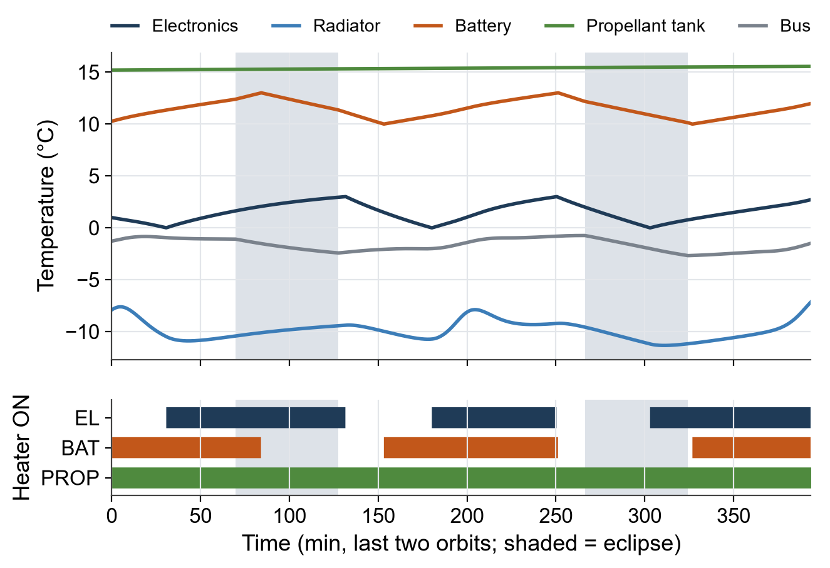
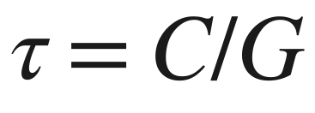
Transient Analysis: Eclipse and Safe Mode
Thermal mass carries the electronics through eclipse; heaters hold the battery and tank
Case (°C) | Electronics | Battery | Avg heater
Ops, 37.7-min eclipse | 8.1 to 8.6 | 10.0 to 13.0 | 10 W
Safe, 58-min eclipse | 0.0 to 3.0 | 10.0 to 13.0 | 170 W
SAR pass (hot) | 11.7 to 15.8 | 10.0 to 13.0 | 6 W
Electronics: τ ≈ 144 kJ/K ÷ 41 W/K ≈ 1 h, longer than any eclipse → swings only 0.5–3 °C
Radiator: τ ≈ 8 min, follows the environment
SAR pass: +220 W for 40 min ≈ 4 °C rise, not the hot driver
Safe mode, elliptical orbit, 58-min eclipse (worst Venus survival case). The tank heater cycle is tens of hours long.
ME4550 Spacecraft Thermal Controls | Venus Orbiter Thermal Design | Semi-Final Review
15
Notes:
The transient shows what controls each part. The electronics have a time constant of about an hour, longer than the eclipse, so their own heat capacity carries them through with only a few degrees of swing. The radiator is light and follows the environment. The battery and tank sit inside their thermostat bands, so heater authority controls them. The radar pass adds only about 4 degrees.

Slide 16
Design Trades: Radiator Finish and Location
A quartz-mirror OSR on the −Y face gives the smallest radiator and the least heater power
Method: the model re-sizes every concept to the same hot-case margins, then runs all 8 cold cases.
Trade 1: radiator finish
Trade 2: radiator location
Concept | Area (m²) | Ops heater (W) | Survival heater (W)
A: Quartz-mirror OSR | 1.20 | 19 | 211
B: Silvered Teflon | 1.30 | 20 | 222
C: Z93 white paint | 1.30 | 50 | 264
Concept | Area (m²) | Ops heater (W) | Survival heater (W)
A: Anti-sun side (−Y) | 1.20 | 19 | 211
B: Zenith (−Z) | 1.55 | 91 | 275
C: Ram (+X) | 1.80 | 101 | 317
OSR wins: white paint darkens in sunlight (αs 0.20 → 0.48), so it must be oversized and then over-cools early in life.
−Y wins: never sunlit. Zenith takes full sun at orbit noon; ram also takes aerobraking heating.
Disadvantages we accept: OSR tiles are brittle and costly and need a conductive coating against charging; the yaw flip at β = 0° is now mandatory.
ME4550 Spacecraft Thermal Controls | Venus Orbiter Thermal Design | Semi-Final Review
16
Notes:
We did not pick the radiator first. The model re-sized each option to the same margins. OSR is smallest and needs the least heater power because it barely degrades. White paint darkens in UV and Venus has about twice Earth's UV. For location, the -Y face is the only one that never sees the Sun. Magellan also used OSRs.

Slide 17
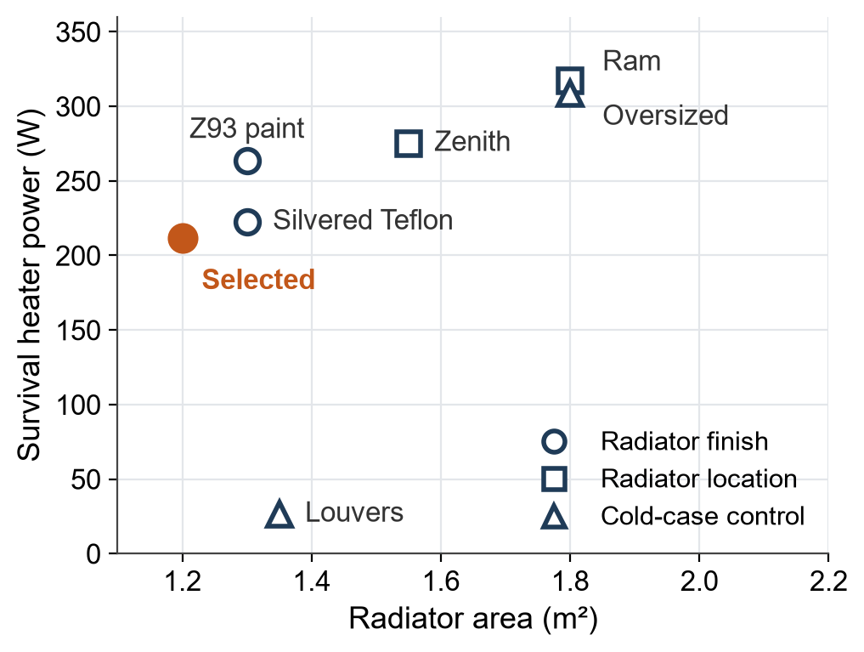
Design Trade: Louvers vs. Heaters
Fixed radiator + heaters selected; louvers kept as a fallback
Concept | Area (m²) | Mass (kg) | Ops heater (W) | Survival heater (W)
A: Fixed radiator + heaters | 1.20 | 4.5 | 19 | 211
B: Louvered radiator | 1.35 | 11.1 | 4 | 26
C: Oversized (1.5×) radiator | 1.80 | 6.7 | 94 | 309
For louvers
Cut survival heater power by 185 W
Flight-proven on Magellan
Against louvers
+6.6 kg and a moving mechanism
Stuck closed in the hot case: electronics reach 74 °C (survival max 60 °C)
Power saved is affordable: safe mode ≈ 340 W vs ~1.5 kW array
All 7 concepts from the three trades; lower-left is better.
Revisit trigger: if the power team cannot supply ~340 W in safe mode, switch to louvers.
ME4550 Spacecraft Thermal Controls | Venus Orbiter Thermal Design | Semi-Final Review
17
Notes:
Magellan used louvers, so we checked whether we need them. Louvers cut survival heater power by about 185 W, but they add mass and a mechanism, and if they stick closed in the hot case the electronics reach 74 C, above survival. The power we would save is only needed in safe mode, and the arrays can supply it. So we selected the fixed radiator with heaters and keep louvers as the fallback.

Slide 18
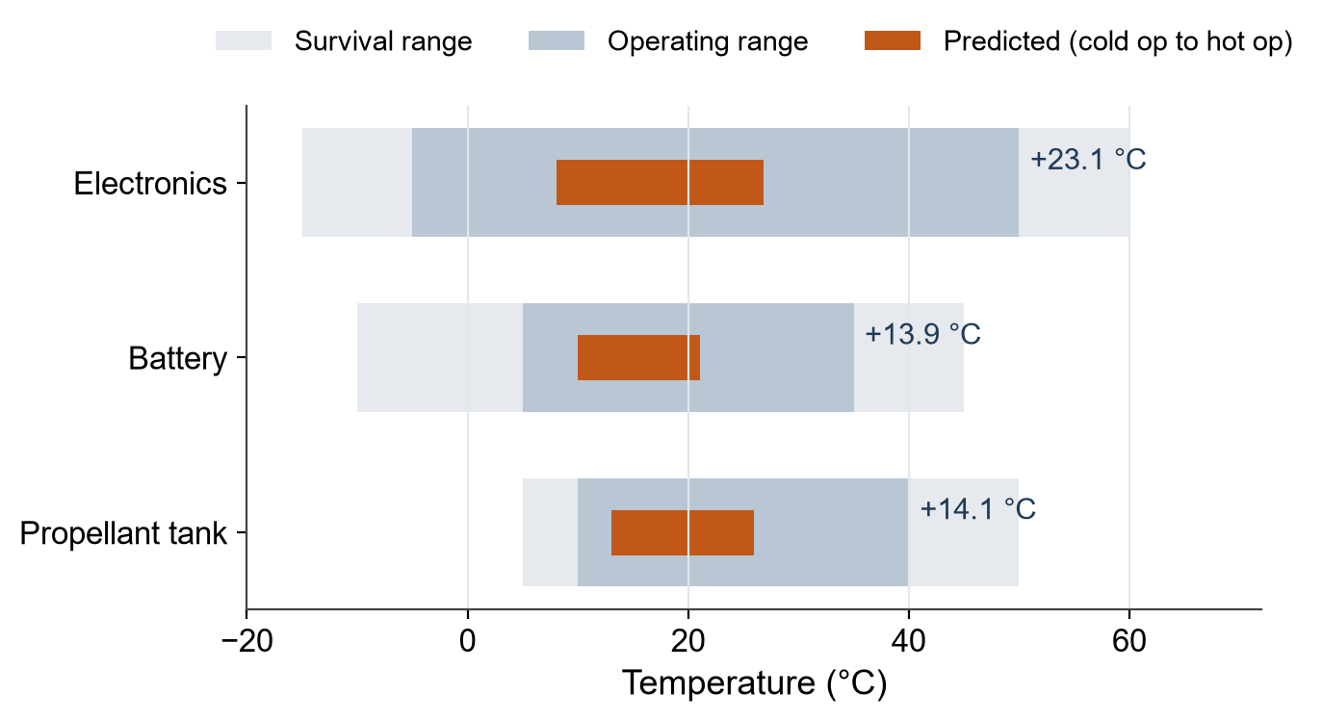
Selected Design and Preliminary Margins
All components pass; the smallest margin is the battery hot side (+13.9 °C)
Selected thermal design
OSR radiator on −Y: 1.20 m² + 0.05 m² battery patch
Beta-cloth MLI on all other faces (ε* ≤ 0.03)
Boxes bolted to radiator with interface pads and doublers
Isolated battery and tank, each with own heater
Redundant thermostatic heaters: 230 / 22 / 16 W
Yaw flip at β = 0° keeps the radiator shaded
Labels show hot margin to the operating max. Cold sides are heater-held with 25% capacity margin.
Next: 13.9 °C is above our 11 °C policy but below Gilmore’s 17 °C early-design value. The sensitivity study will test it.
1.20 m²
268 W
+13.9 °C
OSR radiator
Heaters at 24 V
Smallest margin
ME4550 Spacecraft Thermal Controls | Venus Orbiter Thermal Design | Semi-Final Review
18
Notes:
This is our design so far. Every component is inside its operating range in every case with margin. The smallest hot margin is the battery at 13.9 C, with the tank close behind. That passes our 11 C policy, but the handbook recommends 17 C this early in design, so it is the first thing our sensitivity study will check.

Slide 19
Remaining Work and Team Plan
How we close Milestones 3–5 before the final review
M1 Define Complete
M2 Bound Complete
M3 Model ~80%
M4 Analyze ~75%
M5 Verify Started
Remaining task | Milestone | How we will do it | Owner
Sensitivity and uncertainty | M5 | Vary ε*, box conductance, EOL αs, albedo, power ±20% one at a time; find the most sensitive input | Member 4
Box-level limits and line heaters | M4 | Check each box’s vendor-class limits; size propellant-line heaters per meter | Member 2
Aerobraking blanket check | M4 | Bound outer-layer temperature for an assumed heating rate; confirm Beta-cloth rating | Member 3
Verification and test plan | M5 | Requirement → method → measurement → pass/fail; thermal-vacuum and thermal-balance tests; thermocouple map | Member 6
Repository and documentation | M3 | Keep code, inputs and results current; add report and final slides | Member 5
Final report (≤ 20 pages) and defense | M6 | Guideline section order; each member writes and defends their own part | All
ME4550 Spacecraft Thermal Controls | Venus Orbiter Thermal Design | Semi-Final Review
19
Notes:
Milestones 1 and 2 are complete; the model and most of the analysis are done. Remaining: a sensitivity study using the existing model, checks on individual boxes and propellant lines, a bound on aerobraking heating of the blankets, and the verification and test plan with thermal-vacuum and thermal-balance tests. Owners are placeholders until we finalize assignments.

Slide 20
Key References
D. G. Gilmore (ed.), Spacecraft Thermal Control Handbook, Vol. I: Fundamental Technologies, 2nd ed., The Aerospace Press / AIAA, 2002. Ch. 2 (Venus environment, Tables 2.5, 2.9–2.11), Ch. 4 (finishes, degradation), Ch. 5 (MLI), Ch. 9 (louvers), §15.6 (margins), §19.3 (test temperatures).
R. Rahman, ME4550 Spacecraft Thermal Controls lectures (Weeks 9–12), LEO CubeSat and Mars rover heater examples, and Term Project Guideline, Cal Poly Pomona, Fall 2026.
NASA NSSDC, Venus Fact Sheet, nssdc.gsfc.nasa.gov/planetary/factsheet/venusfact.html (accessed Nov. 2026).
NASA NSSDC, Magellan Mission Plan (mapping cycles, orbits, aerobraking), nssdc.gsfc.nasa.gov/planetary/mgncycles.html.
NASA JPL, Basics of Space Flight, Ch. 11: Typical Onboard Systems (Magellan OSRs and solar arrays).
G. Cascioli et al., “The Determination of the Rotational State and Interior Structure of Venus with VERITAS,” Planetary Science Journal, 2021 (VERITAS orbit and gravity science).
Images: NASA/JPL (Magellan radar mosaic PIA00104; Magellan spacecraft artist depiction).
ME4550 Spacecraft Thermal Controls | Venus Orbiter Thermal Design | Semi-Final Review
20
Notes:
Our main source is the Gilmore handbook, used for the environment, coatings, insulation, louvers and margins. Mission numbers come from NASA's Venus fact sheet and Magellan mission records.

