Slide 1
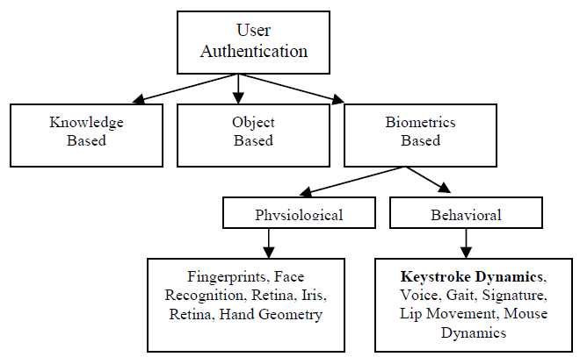
User Authentication Approaches
Notes:
The first and foremost step in preventing unauthorized access is user Authentication. User authentication is the process of verifying claimed identity.
Conventionally, user authentication is categorized into three classes:
• Knowledge - based, • Object or Token - based, • Biometric - based.
-The knowledge-based authentication is based on something one knows. The examples of knowledge-based authenticators are commonly known
passwords and PIN codes.
-The object-based authentication relies on something one has and is characterized by possession.
-Behavioural characteristics are related to what a person does, or how the person uses the body. Voiceprint, gait
Traditional keys to the doors can be assigned to the object-based category. Usually the token-based approach is combined with the knowledge-based approach. An example of this combination is a bankcard with PIN code. In knowledge-based and object-based approaches, passwords and tokens can be
forgotten, lost or stolen. There are also usability limitations associated with them. For instance, managing multiple passwords / PINs, and memorizing and recalling strong passwords are not easy tasks. Biometric-based person recognition overcomes the above mentioned difficulties of knowledge-based and object based approaches.

Slide 2
Keystroke Dynamics
Automated method of identifying or confirming the identity of an individual based on the typing rhythms
Involves something one is or does
Unique biometric pattern can be developed from typing rhythms
The Keystroke features roughly characterize each user uniquely

Slide 3
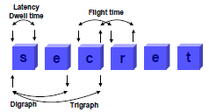
Keystroke Dynamics
Converts biometric data to feature vector can be used for classification
Keystrokes latencies (flight)
Duration of a specific keystroke (dwell)
Pressure (Force of keystrokes)
Typing speed
Frequency of error

Slide 4
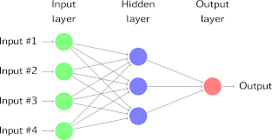
Neural Networks
Easy to learn and adapt
Supports multiple features
Easy to comprehend and classify

Slide 5
Why neural networks over other approaches
Statistical Methods (Drawbacks) :
Probabilistic modeling: Chooses probability over rules
Cluster analysis: early bad judgments cannot be rectified because of hierarchical nature.
Distance measure: Results are greatly influenced by variables having large values
Machine Learning Algorithms
Fuzzy logic: Requires a lot of test cases
Support vector machine: Difficult to tune the parameters
Decision tree: Calculations may get very complex
Notes:
Classification aims to find the best class that is closest to the classified pattern. A table of some sort is maintained that contains a user’s details along with associated reference signature collected during the enrolment process. When those access details are entered, the system looks up the respective details and performs a similarity measure of some sort. The user’s keystroke dynamics extracted during log-in session is compared and classified with the stored reference signature in the database. If they are within a pre- scribed tolerance limit – the user is authenticated. If not – then the system can decide whether to lock up the workstation – or take some other suitable action. The following sections categorize into seven classes the major publications in classification methods in identifying legitimate user’s features. They are statistical methods, neural networks, pattern recognition techniques, hybrid techniques and other approaches.
--The basic idea of the statistical approach is to compare a reference set of typing characteristics of a certain user with a test set of typing characteristics of the same user or a test set of a hacker. The distance between these two sets (reference and test) should be below a certain threshold or else the user is recognized as a hacker. (from another paper): A reference signature is mostly calculated using the distance measure of keystroke latency and duration. The standard statistical measures like mean, standard deviation, etc. of the reference signature are used for generating template and classification.
--Neural Networks process first builds a prediction model from historical data, and then uses this model to predict the outcome of a new trial (or to classify a new observation). (from another paper): Rather than performing a sequential set of instructions, neural networks are capable of exploring many competing hypotheses in parallel. Because of this quality, neural networks are considered to have the greatest potential in the area of biometrics.
--Pattern recognition is the scientific discipline whose goal is the classification of objects or patterns into a number of categories or classes.
--Hybrid techniques: Many researchers have proposed methods of combination of various neural networks, pattern recognition, statistical measures, etc.

Slide 6
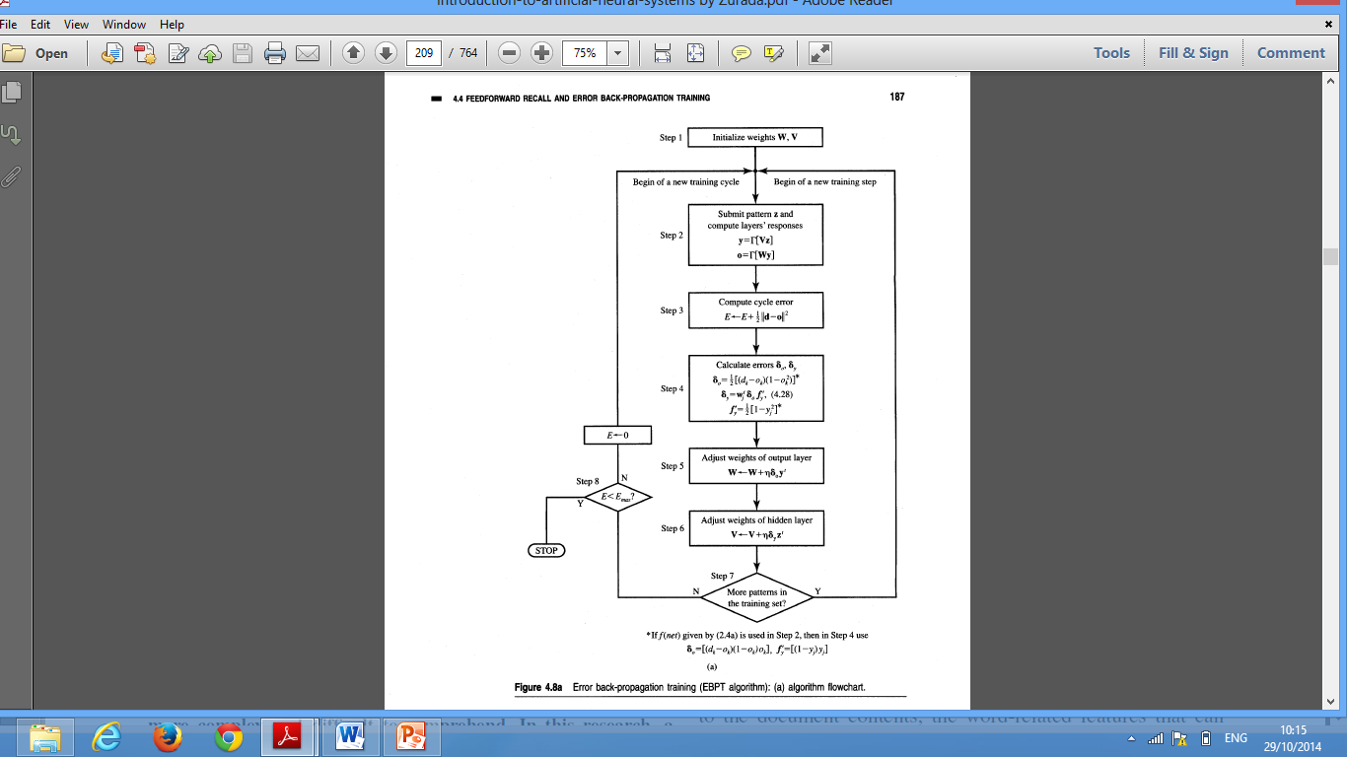
Back Propagation Algorithm

Slide 7
Components of System
Data collector module
Password check module
Key stroke recognition module
Pressure analyzer module
Pattern matching
Decision module

Slide 8
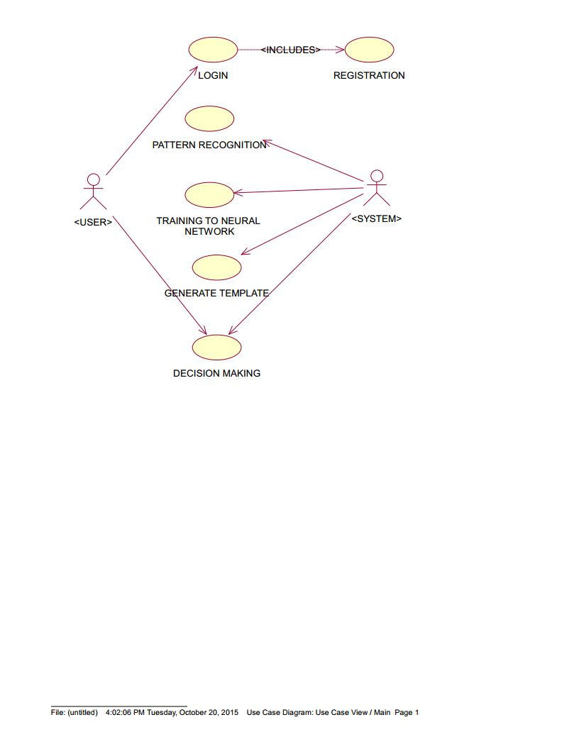
Use Case Diagram

Slide 9
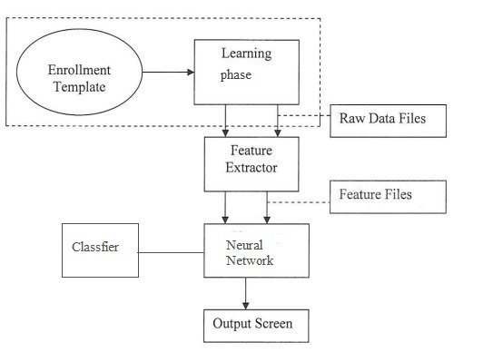
Architecture

Slide 10
Training Phase
Algorithm for Keystroke Dynamics Using Neural Network
Neural Network Training
Gathering the Training Dataset
Gathering the features of the keystroke patterns
Input the features to the feed forward neural network
Train the neural network using Back Propagation Algorithm
Classification of user

Slide 11
Testing Phase
Algorithm for Keystroke Dynamics Using Neural Network
Neural Network Testing
Extracting keystroke features
Input the features to back propagation network
Network authenticates the user
Notes:
The Training phase adjusts the weight vectors of the network such that it easily classifies the user as authenticated or fake.
In this phase, the user tries to prove its identity by typing the password.
The keystroke recognition module fetches the keystroke info as the user enters the password.
The password check module verifies the password first.
If found correct, the pattern matching module (Neural Network) will classify the user.
The Decision module, will display correct message accordingly.

Slide 12
Specifications in our approach
Incorporated 80 input neurons as there are 8 features need to be extracted from each key (10 keys) , 8 hidden neurons(based on trial and error) and 2 output neurons.
randomized the weights between the range:
[(-3)/sqrt(oi), (3)/sqrt(oi)]
Where oi= Number of processing elements
For normalization purpose we used the following formula: x(n)=x-x(min)/x(max)-x(min).
Learning rate=0.6
30 user iterations with 120 more randomly generated iterations with slight variations .

Slide 13
RESULTS (Training inputs)
Password (Six digit) | Dwell Time | Flight Time | Finger Pressure | Co-ordinates X Y |  | Digraph Time | Trigraph Time | Finger Size
Button 1 | 0.0018833 | 0.001466 | 1.0 | 0.0590 | 0.0576 | NA | NA | 0.0266
Button 2 | 0.0015 | 0.0021 | 1.0 | 0.0435 | 0.0571 | 0.00485 | NA | 0.0278
Button 3 | 0.0014333 | 0.002566 | 1.0 | 0.0492 | 0.0580 | 0.005033 | 0.0083833 | 0.0141
Button 4 | 0.0014333 | 0.00085 | 1.0 | 0.0499 | 0.0600 | 0.005433 | 0.0090333 | 0.0207
Button 5 | 0.0010333 | 0.002366 | 1.0 | 0.0552 | 0.0571 | 0.0033166 | 0.0073166 | 0.0247

Slide 14
Accuracy
FAR(False acceptance rate):
Probability of illegitimate users being falsely considered as legitimate.
Show calculations here.
FRR(False rejection rate):
Probability of legitimate users being falsely considered as illegitimate.
Accuracy may vary greatly considering the similarities and dissimilarities in behavioral biometrics of two users.

Slide 15
Conclusions and Future Scope
Provides a second level of security
Cope up with new challenges
Future Scope
Online payment
/*Please add something*/

Slide 16
Advantages of keystroke dynamics
Software Only method. (No Additional Hardware)
Simple To Deploy and Use (username & passwords) – Universally accepted
Unobtrusive, Non-Invasive, Cost Effective
It provides a simple natural way for increased computer security
Can be used over the internet

Slide 17
Drawbacks of Keystroke Dynamics
User’s susceptibility to fatigue
Dynamic change in typing patterns
Injury, skill of the user
/*Add some images or more info if you feel*/

Slide 18
Applications
Mainly used as a very specific form of surveillance.
Verification of users following security procedures.
Verify that no software licenses are being shared.

