Slide 1



Implementing “Rethinking the usage of batch normalization and dropout in the training of deep neural networks” Authors: Guangyong Chen, Pengfei Chen, Yujun Shi, Chang-Yu Hsieh, Benben Liao, Shengyu Zhang
CS-7150 Deep Learning Project
-Aishwarya, Aveek, Harshita
Notes:
Hello Everyone, The application of deep neural networks can involve millions of data entries and complicated model training to achieve state-of-the-art performance.
Finding ways to increase deep neural networks training efficiency has become a critical challenge.
Today, Me, Aishwarya and Aveek are here to present our Deep Learning Project that is based on a paper proposing a new training method to tackle the challenge.
The paper is “Rethinking the usage of batch normalization and dropout in the training of deep neural networks”.
We have reproduced a part of author’s work as part of our Project.

Slide 2
Rethinking the Usage of Batch Normalization and Dropout in the Training of Deep Neural Networks
Guangyong Chen, Pengfei Chen, Yujun Shi, Chang-Yu Hsieh, Benben Liao, Shengyu Zhang2
Idea
Whitening inputs of neural network → better performance & faster convergence
Contribution
Combine Batch Normalization and Dropout in Independent-Component (IC) Layer
Performance
More stable training process, faster convergence speed and better convergence limit on CIFAR 10/100 and ILSVRC2012

Slide 3
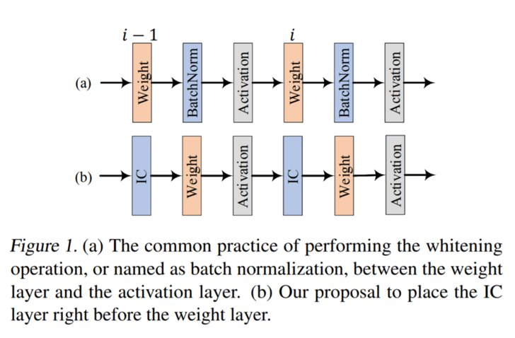
Why IC?
BatchNorm to replace ZCA
Dropout to replace the rotation step
Notes:
The Authors, “A group of researchers from Tencent Technology” have combined two commonly used techniques — Batch Normalization (BatchNorm) and Dropout and integrated into an Independent Component (IC) layer inserted before each weight layer to make inputs more independent.
The work “is based on an excellent idea that whitening the inputs of neural networks can achieve a fast convergence speed.” Whitening is a preprocessing technique that seeks to make data less correlated and standardize variance. Previous attempts to leverage whitening at every activation layer were computationally expensive and eventually led to the usage of BatchNorm as an input normalization technique. BatchNorm has however since drifted away from its goal of whitening, and the new research proposes a way for it to refocus on that.
Researchers combined BatchNorm with the regularization technique Dropout to construct independent activations for neurons in each intermediate weight layer. To overcome the computational complexity involved in determining independent components, researchers used BatchNorm to replace ZCA (zero-phase component analysis), which serves as the first step for the ICA (independent component analysis) methods but is computationally expensive.
High computation cost is hindering the development of wide neural networks where many neurons often exist in an intermediate layer. Researchers used Dropout to replace the rotation step in their novel IC layer. Dropout introduces independent random gates for the neuron in a layer and improved convergence speed when added to DNN training.

Slide 4

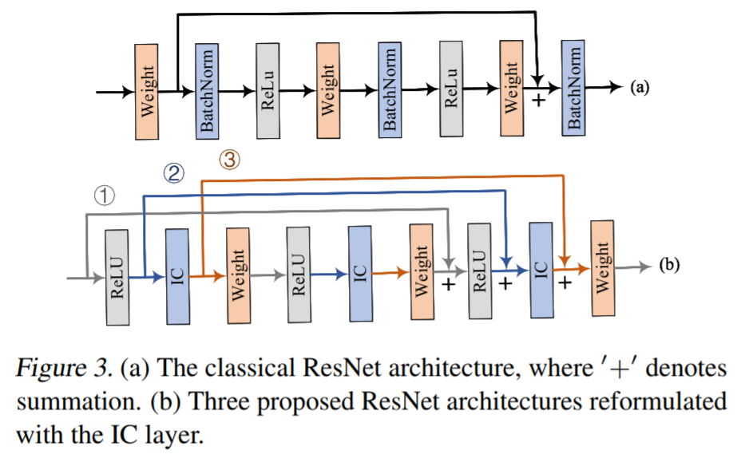
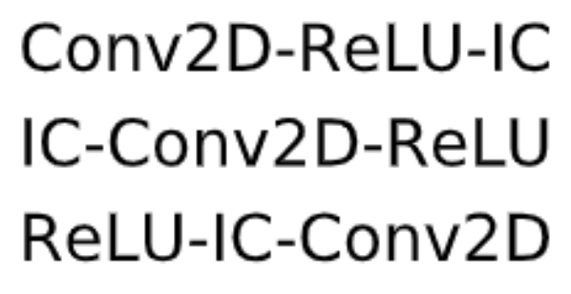


ARCHITECTURES:
Notes:
The idea is to implement ResNet with a stack of -IC-Weight-ReLU-layers.
The three different types of residual units are observed, each of which has a unique short path as shown in Fig. 3(b) and aim to find the best residual unit.
Due to the training cost of deep models, The bottleneck design is also compared which replaces each residual unit by a bottleneck unit. For example, the corresponding bottleneck design of the first type of residual unit, consisting of 2×ReLU-IC-Weightlayers, is 3×ReLU-IC-Weight, where the first and last weight layers are 1×1 convolutions instead.

Slide 5
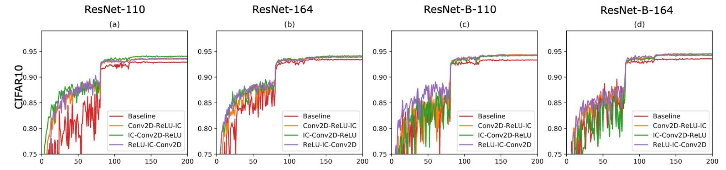
PAPER’s Results:
The testing accuracy of implementing ResNet and ResNet-B with the IC layer on the CIFAR10 dataset with respect to the training epochs.
ResNet110 on CIFAR 10.
ResNet164 on CIFAR 10.
ResNet-B 110 on CIFAR 10.
ResNet-B 164 on CIFAR10.
Notes:
One of the methods that authors used to evaluate the performance is on the CIFAR10 dataset.
Their results displayed in slide shows the method’s implementation improves classification performance of new networks in three aspects:
“ i) more stable training process, ii) faster convergence speed, and iii) better convergence limit.”
In particular, it was found that the residual unit with ReLU-IC-Conv2D always achieves the most stable training performance among all types of residual units implemented with the both ResNet and ResNet-B architectures on CIFAR dataset.
We wanted to see if it stays true in our implementation.

Slide 6
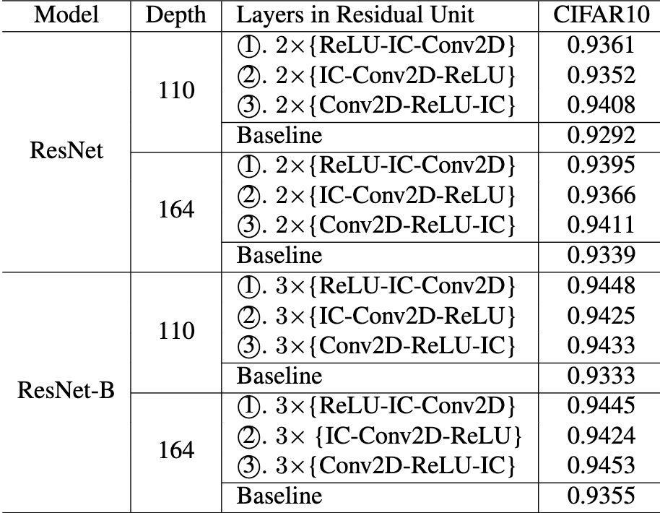
COMPARISON
Model | Depth | Layers in Residual Unit | CIFAR10
ResNet | 110 | 2×{ReLU-IC-Conv2D} | 0.8226
 |  | 2×{IC-Conv2D-ReLU} | 0.8429
 |  | 2×{Conv2D-ReLU-IC} | 0.8449
 |  | Baseline | 0.6454
 | 164 | 2×{ReLU-IC-Conv2D} | 0.8076
 |  | 2×{IC-Conv2D-ReLU} | 0.8279
 |  | 2×{Conv2D-ReLU-IC} | 0.8402
 |  | Baseline | 0.8183
ResNet-B | 110 | 3×{ReLU-IC-Conv2D} | 0.8251
 |  | 3×{IC-Conv2D-ReLU} | 0.8355
 |  | 3×{Conv2D-ReLU-IC} | 0.8389
 |  | Baseline | 0.8159
 | 164 | 3×{ReLU-IC-Conv2D} | 0.8218
 |  | 3×{IC-Conv2D-ReLU} | 0.8455
 |  | 3×{Conv2D-ReLU-IC} | 0.8498
 |  | Baseline | 0.8254
Epochs: 100
LR: 0.001
The testing results of implementing ResNet and ResNet-B with the IC layer on the CIFAR10 dataset at the end of training.
Notes:
So, as course of this project we executed the modified ResNets architectures on the benchmark CIFAR10 dataset to evaluate the practical usages of the IC layer and to reproduce the author’s results.
We train all ResNets with depths 110 (n= 18) and 164 (n= 27) and ResNet-Bs with depths 110 (n= 12) and 164 (n= 18) by Adam for 100 epochs with 64samples in a mini-batch. We used 100 epochs instead of 200 from paper due to computational limitations.
Learning rate was set to 0.001 and is divided by 10 at 80th epoch. The dropout rate for all experiments is set as 0.05.
The slide contains our results and as it can be seen, …….

Slide 7
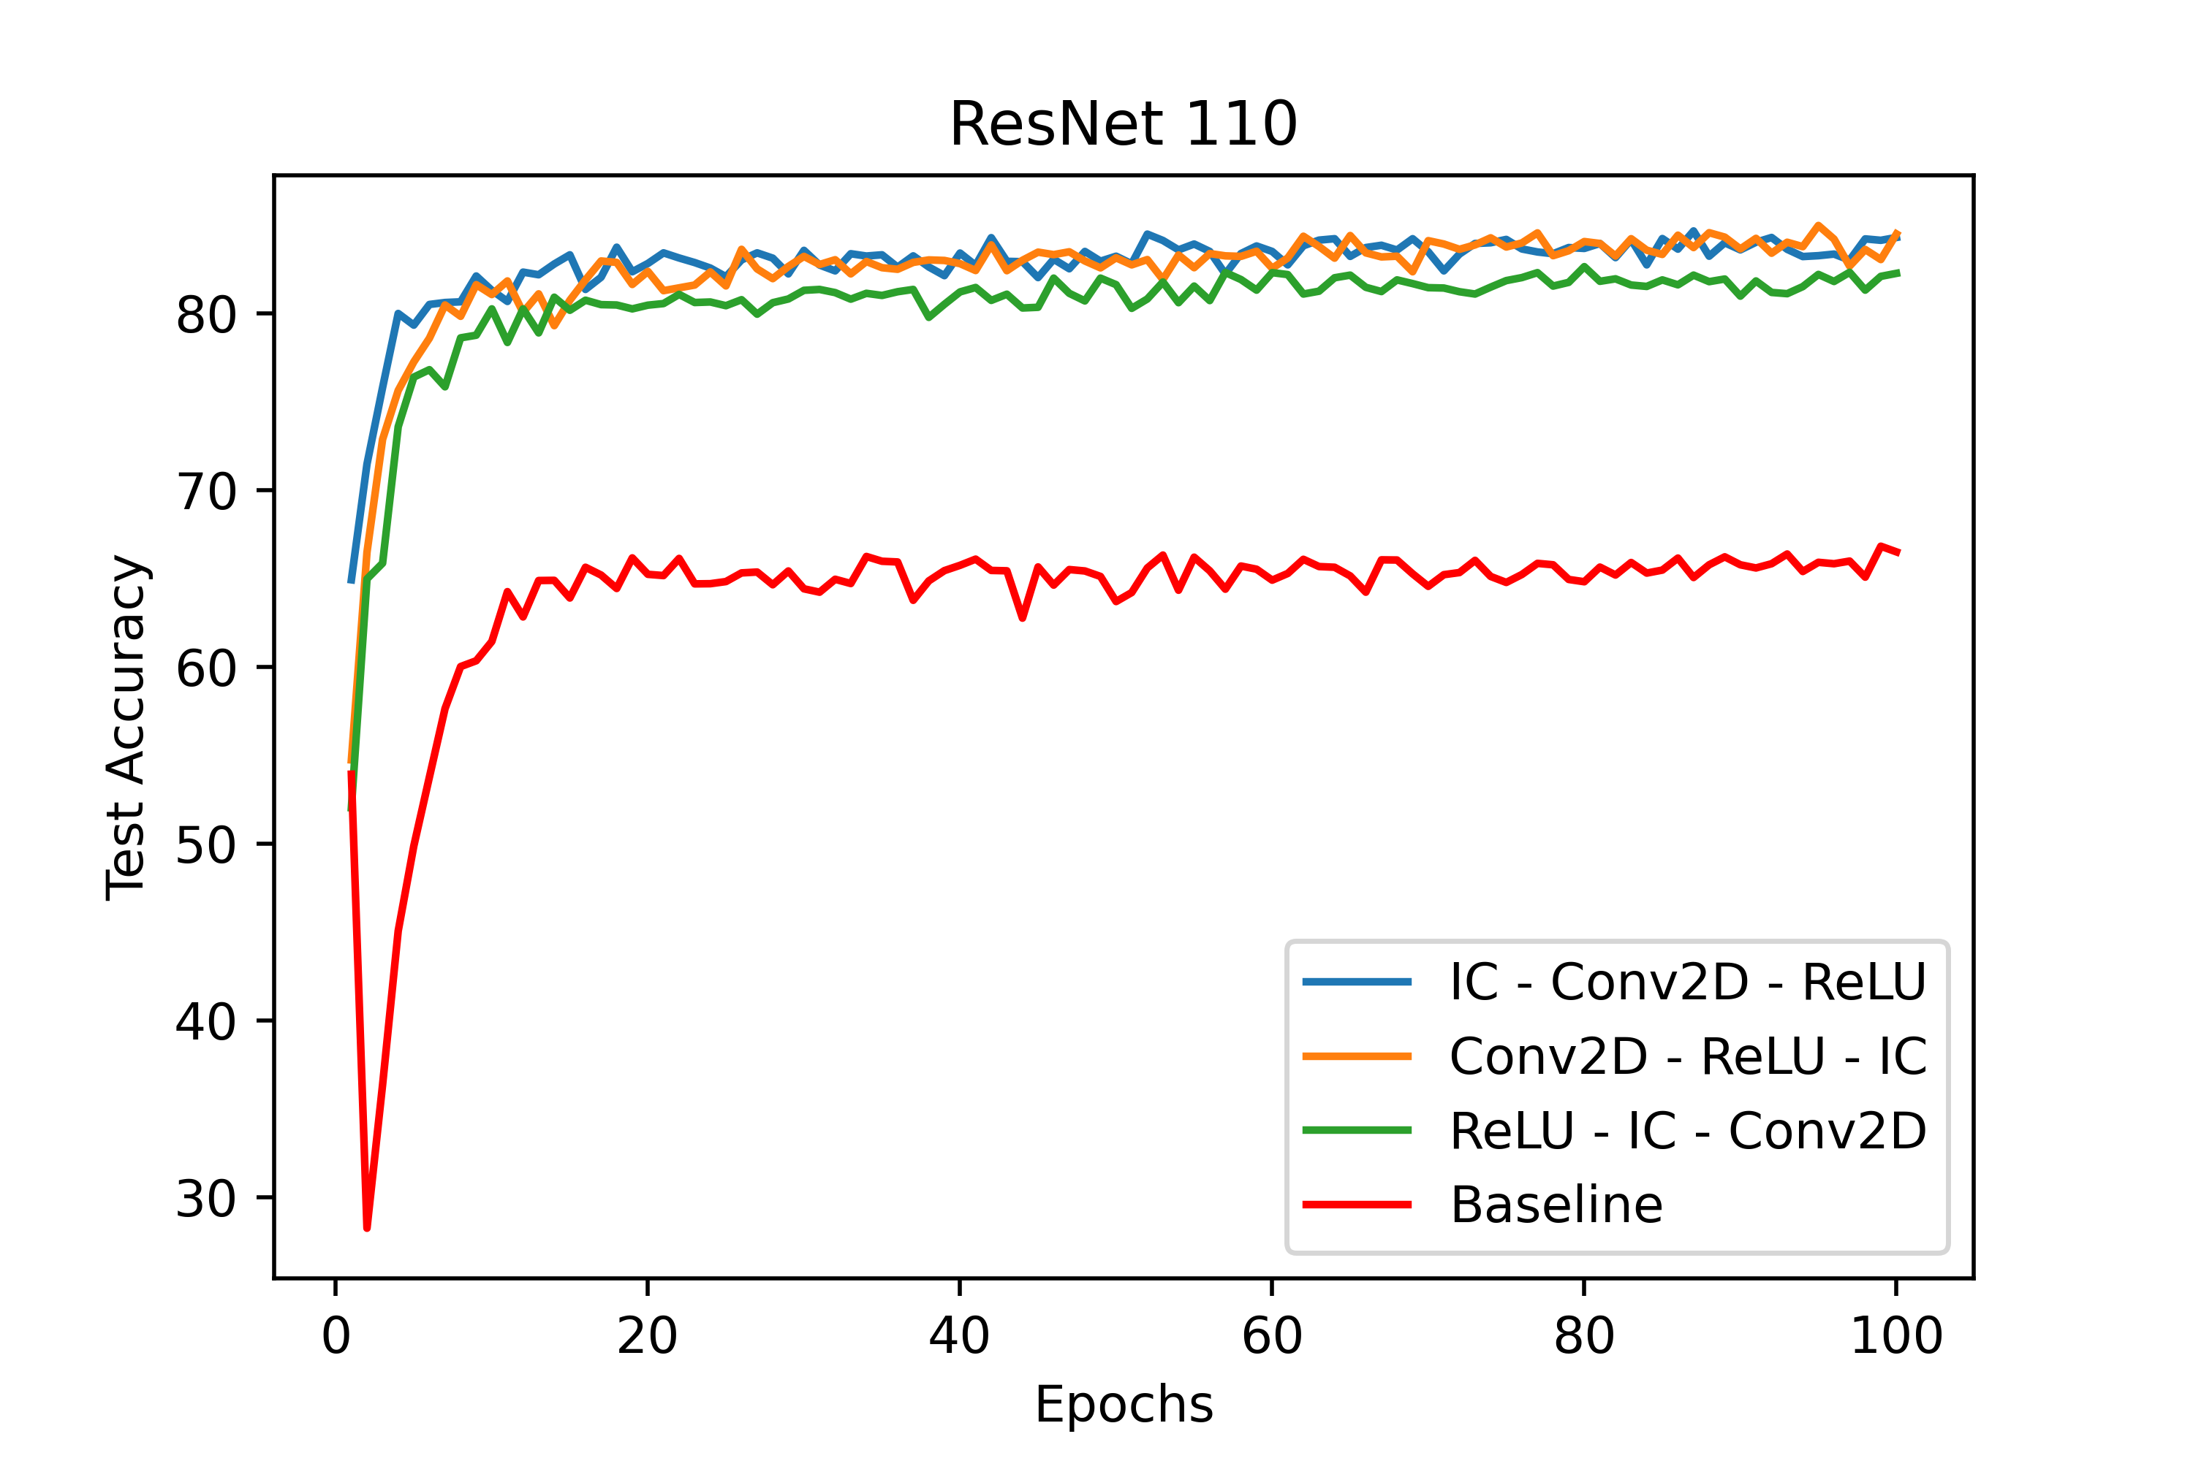
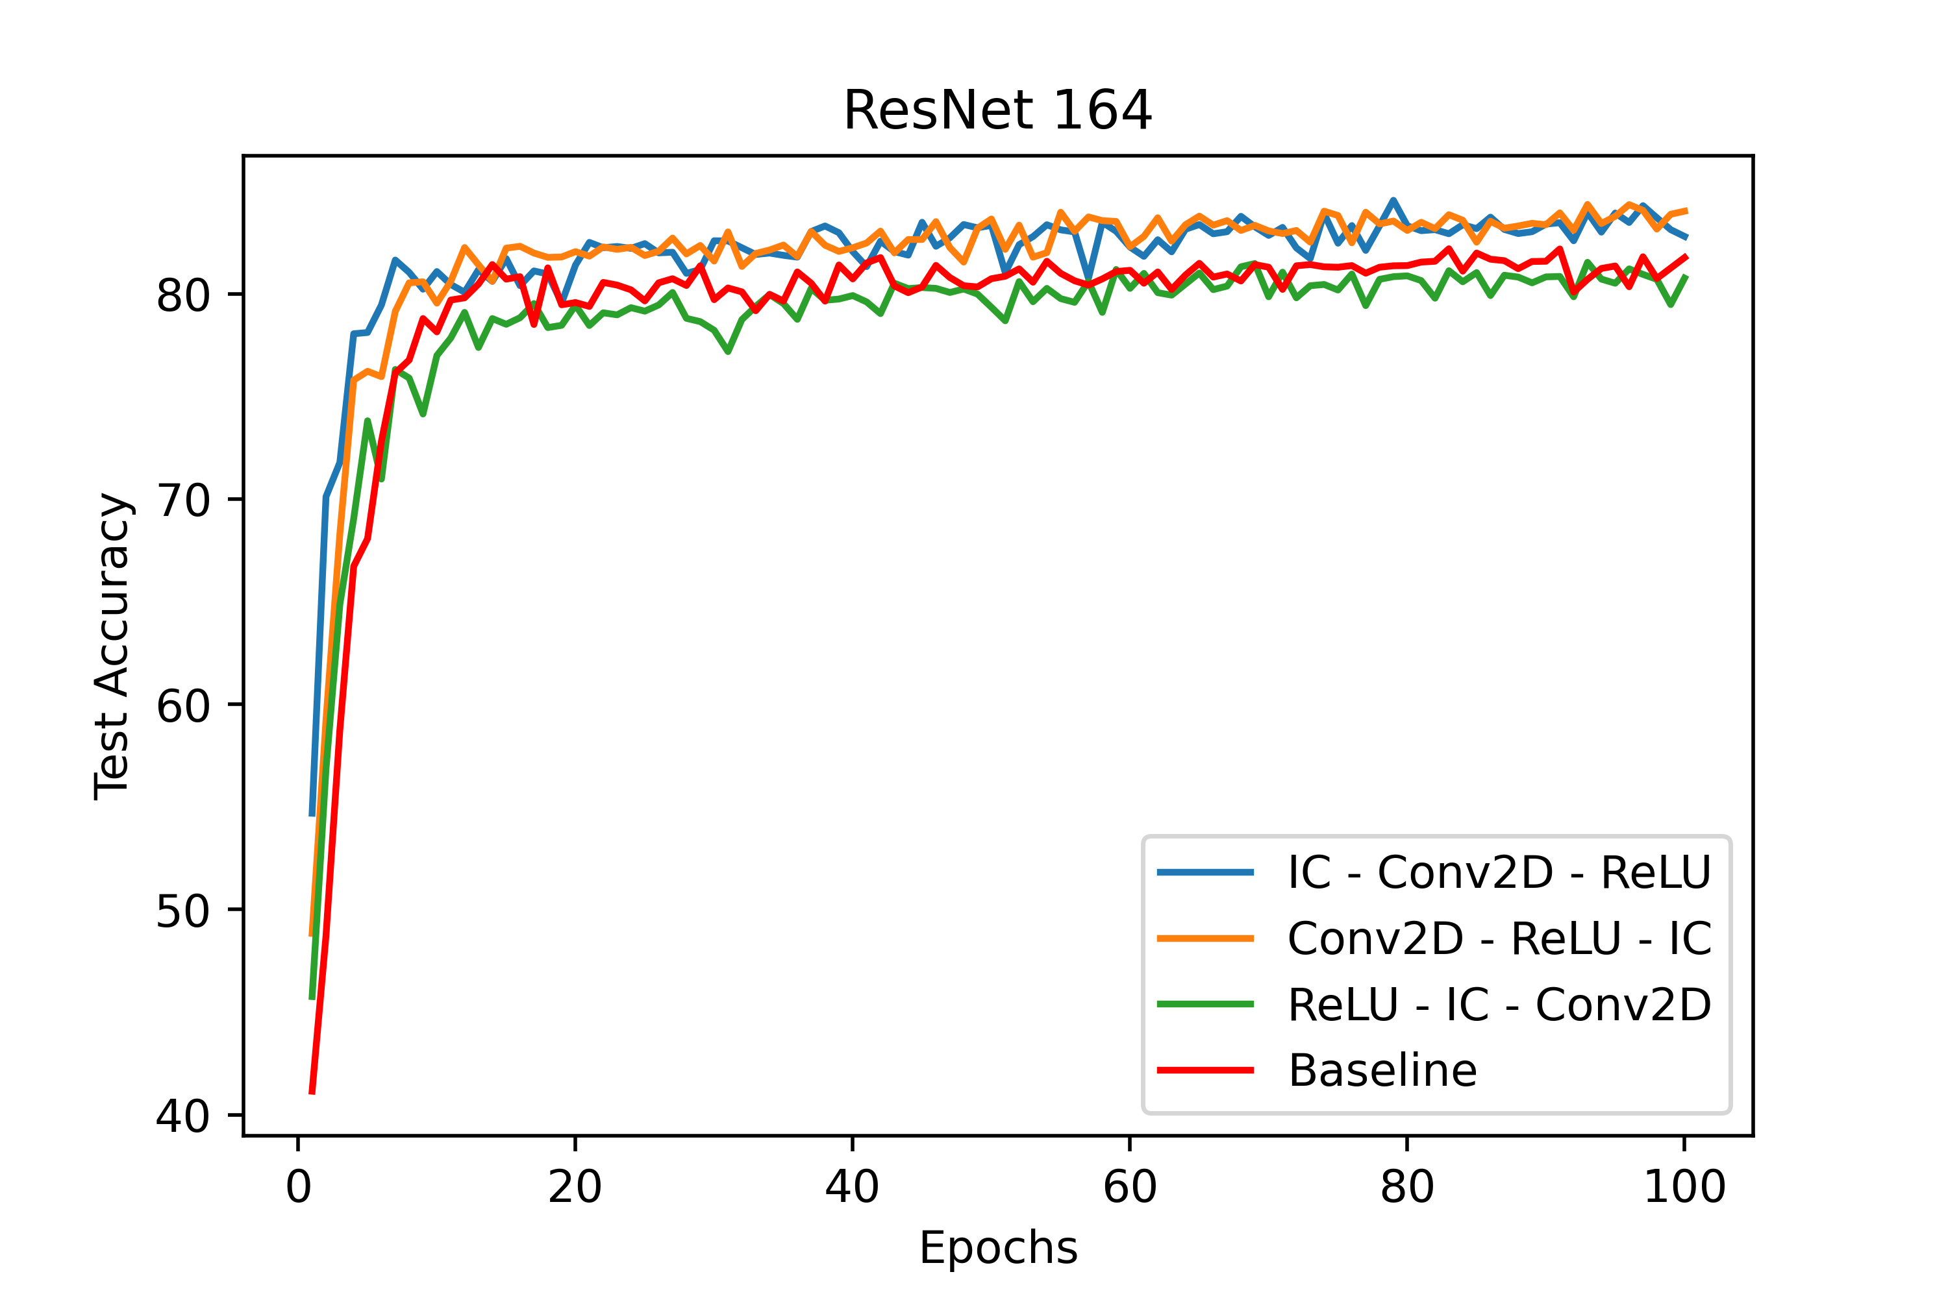
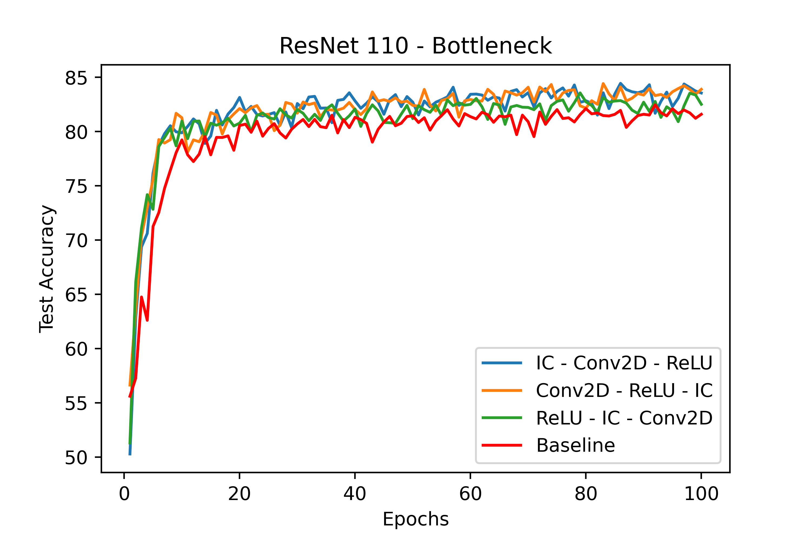
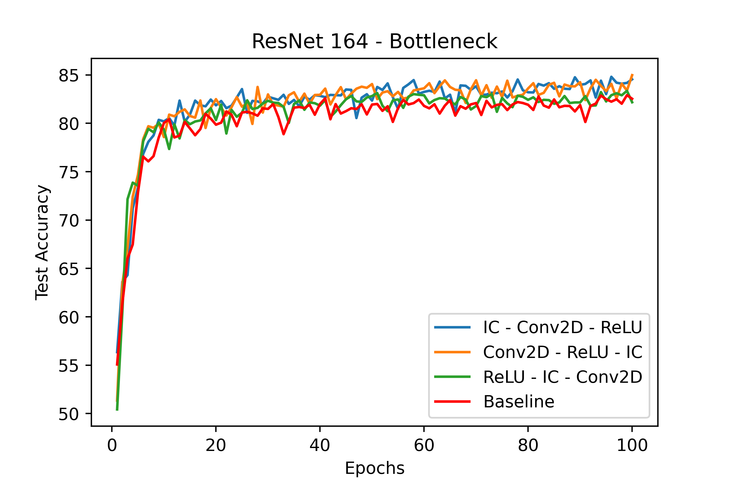
Our Results
The testing accuracy of implementing ResNet and ResNet-B with the IC layer on the CIFAR10 dataset with respect to the training epochs.
ResNet110 on CIFAR 10.
ResNet164 on CIFAR 10.
ResNet-B 110 on CIFAR 10.
ResNet-B 164 on CIFAR10.
Notes:
BN + Dropout can be used as IC layer → and we need to put this right before the weight layer.

Slide 8



Challenges
Computation Power
Architecture clarification
Changed 200 Epochs to 100
LR was fixed to 0.001
Choose Bottleneck architectures from reference papers instead of official implementation

Slide 9
CONCLUSION
1
Successfully implemented the IC layer in the network
2
3
Evaluated performance and got more stable learning, faster convergence and better performance with proposed method
Found that the residual unit with ReLU-IC-Conv2D always achieves the most stable training performance among all types of residual units implemented

Slide 10
THANK YOU
QUESTIONS????

Slide 11
Our Implementation
CIFAR 10 - Test Accuracy
Epochs: 100
LR: 0.001
{IC-Conv2D-ReLU}
84.49%
{Conv2D-ReLU-IC}
Baseline
66.54%
81.59%
0
0
0
81.83%
82.79%
83.55%
83.89%
84.02%
84.29%
0
{ReLU-IC-Conv2D}
82.26%
82.51%
80.76%
ResNet-110
ResNet-B-110
ResNet-164
ResNet-B-164
Notes:
So, as course of this project we executed the modified ResNets architectures on the benchmark CIFAR10 dataset to evaluate the practical usages of the IC layer and to reproduce the author’s results.
We train all ResNets with depths 110 (n= 18) and164 (n= 27) and ResNet-Bs with depths 110 (n= 12)and164 (n= 18) by Adam for 100 epochs with 64samples in a mini-batch. We used 100 epochs instead of 200 from paper due to computational limitations.
Learning rate was set to 0.001 and is divided by 10 at 80th epoch. The dropout rate for all experiments is set as 0.05.
The slide contains our results and as it can be seen, …….

