Slide 1
PROJECT AGENDA
Problem Statement & Industrial Background
Process Understanding & Dynamic Model
Control Strategy & Safety Architecture
Validation Methodology & Results
Performance Summary & Lessons Learned
Future Work & Conclusion

Slide 2
Autonomous Production Choke Controller
TITLE PAGE
Problem Statement ID: 1367 Title: Autonomous Choke Control Theme: Smart Automation Category: Software Team: Honeywell Hackathon 2026
Problem Statement ID –
Problem Statement Title-
Theme-
PS Category- Software/Hardware
Student Name (Registered on portal)
Student ID

Slide 3
PROPOSED SOLUTION
5-phase autonomous control pipeline for oil well choke management
FOPDT predictive control with 3-step horizon and gain scheduling
Automated system identification via 6 open-loop step tests
4-layer defense-in-depth safety architecture
3-term cost function: J = J_track + 0.01*J_effort - 0.005*J_margin
Interactive Streamlit dashboard with Plotly visualization
All models identified exclusively from simulator-generated data

Slide 4
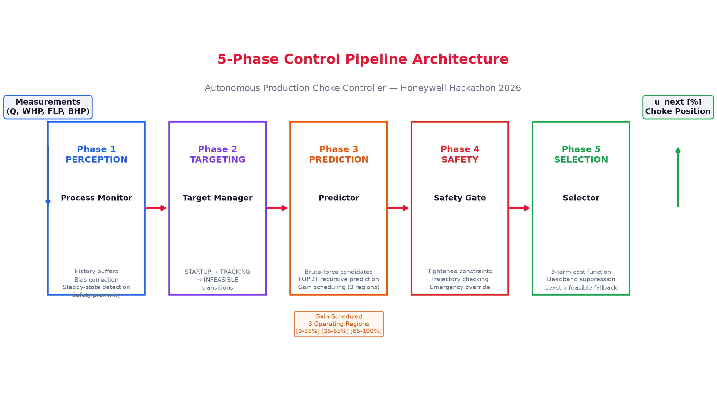
TECHNICAL APPROACH
Technology: Python 3.12, NumPy, Matplotlib, Plotly, Streamlit
Process Model: First-Order Plus Dead Time (FOPDT)
Identification: 63.2% graphical method from step tests
Optimization: Brute-force candidate search (11-21 moves, <1ms)
Safety: 4-layer defense-in-depth with emergency override
Gain scheduling: 3 regions [0-35%], [35-65%], [65-100%]
Bias correction: Exponential EWMA (alpha=0.3)

Slide 5
FEASIBILITY AND VIABILITY
All 3 scenarios validated -- tracking error < 2 bbl/hr
Zero violations in normal operation; correct override at boundary
Computationally efficient: candidates evaluated in <1ms
Deterministic: seed=42, 243 simulator calls, reproducible
Nonlinearity: gain scheduling across 3 operating regions
Disturbances: EWMA bias correction + deadband suppression
Single boundary violation correctly triggered emergency override

Slide 6
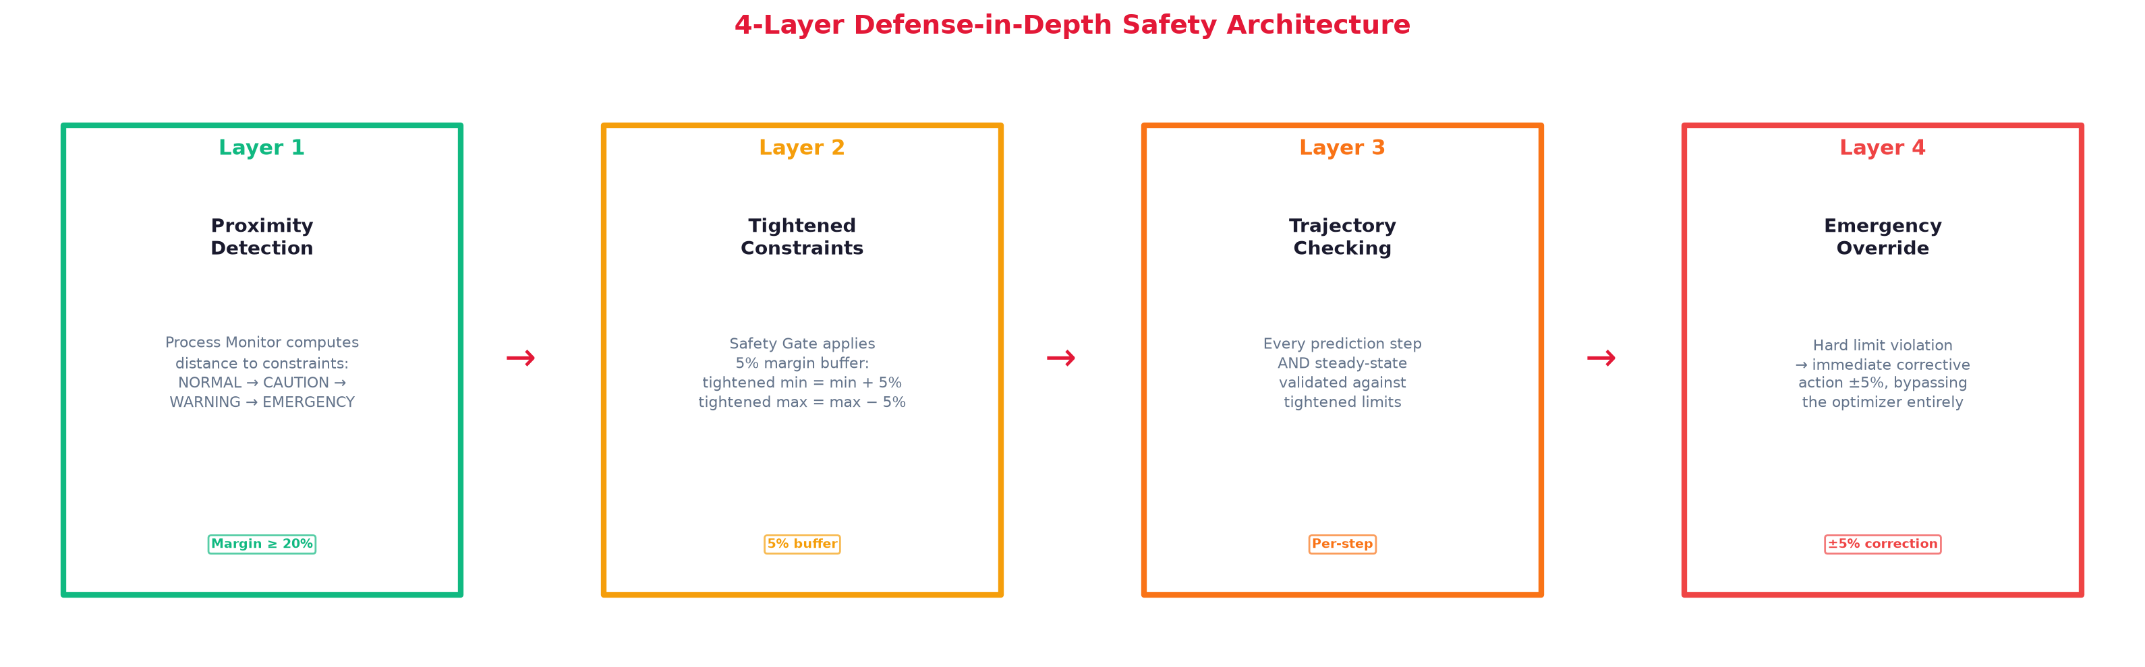
ARTIFACTS
Source Code: 17 Python modules, fully documented
Technical Report: 24-section professional PDF
Validation Report: Gate-by-gate scenario evaluation
Streamlit Dashboard: 8-page interactive monitoring
Architecture Diagrams: Pipeline + Safety (PNG)
Step Test Analysis: 9 plots across operating range
Scenario Plots: 6-panel enhanced figures for A, B, C

Slide 7
RESEARCH AND REFERENCES
Honeywell Problem Statement -- Autonomous Choke Control (2026)
Seborg et al. -- Process Dynamics and Control (4th Ed., Wiley)
Astrom & Hagglund -- Advanced PID Control (ISA, 2006)
FOPDT Identification: 63.2% graphical method
Bias correction: EWMA filtering for offset-free MPC
Gain scheduling: Multi-region linear models for nonlinear processes
Safety: IEC 61511 principles for process constraint enforcement

Slide 8
PROBLEM STATEMENT
Oil well production choke: primary control actuator between reservoir and surface
4 coupled process variables: Oil Rate (Q), WHP, FLP, BHP
Choke UP -> Q UP, WHP DOWN, FLP DOWN, BHP DOWN
Choke DOWN -> Q DOWN, WHP UP, FLP UP, BHP UP
Hard pressure constraints must never be violated
1-hour control interval, +/-5% max choke movement per step
Objective: Maximize production while respecting all constraints

Slide 9
INDUSTRIAL BACKGROUND & ASSUMPTIONS
Choke valve controls flow rate and wellbore pressure simultaneously
Opening choke: increases revenue, decreases all pressures
Closing choke: conserves reservoir energy, reduces production
Classic constrained optimization: maximize Q subject to WHP/FLP/BHP limits
Key Assumptions: Linear FOPDT per region, hard constraints, Gaussian noise, consistent gain signs, step tests acceptable during commissioning
1-hour interval typical for remote well sites with limited communication

Slide 10
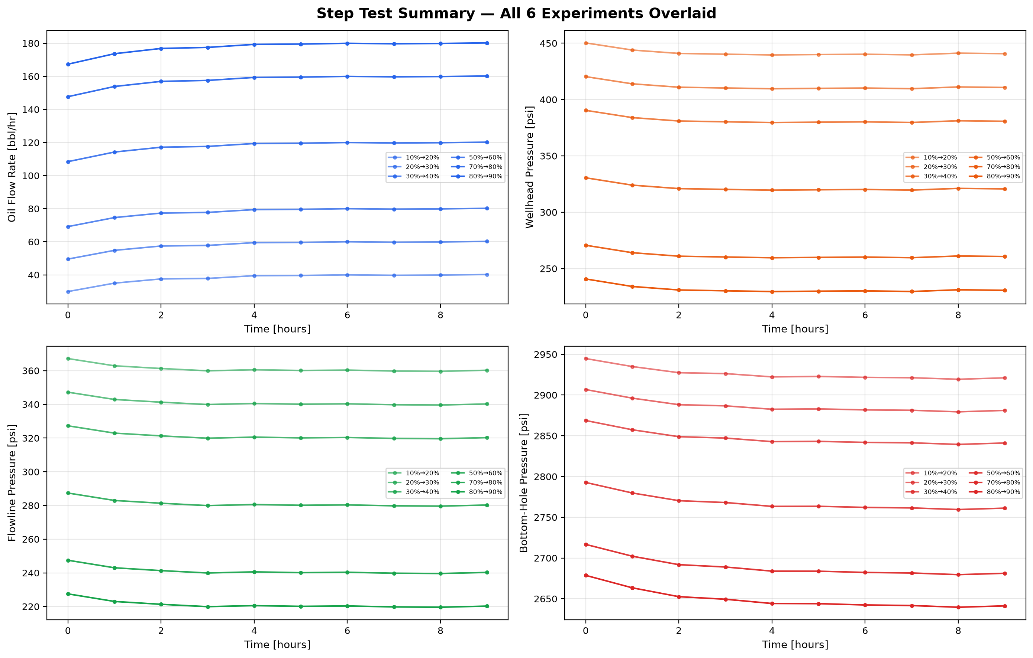
OPEN-LOOP STEP TEST ANALYSIS
6 step tests at choke positions [10, 20, 30, 50, 70, 80] with +10% steps
Protocol: Settle 5 steps -> Step +10% -> Record 10-step transient
90 total TestSimulator calls; all data from simulator (NOT reference dataset)
Consistent FOPDT-like first-order responses observed across all operating points
Varying steady-state gains indicate mild nonlinearity -> gain scheduling required
No dead time detected (fast response relative to 1-hour sampling interval)

Slide 11
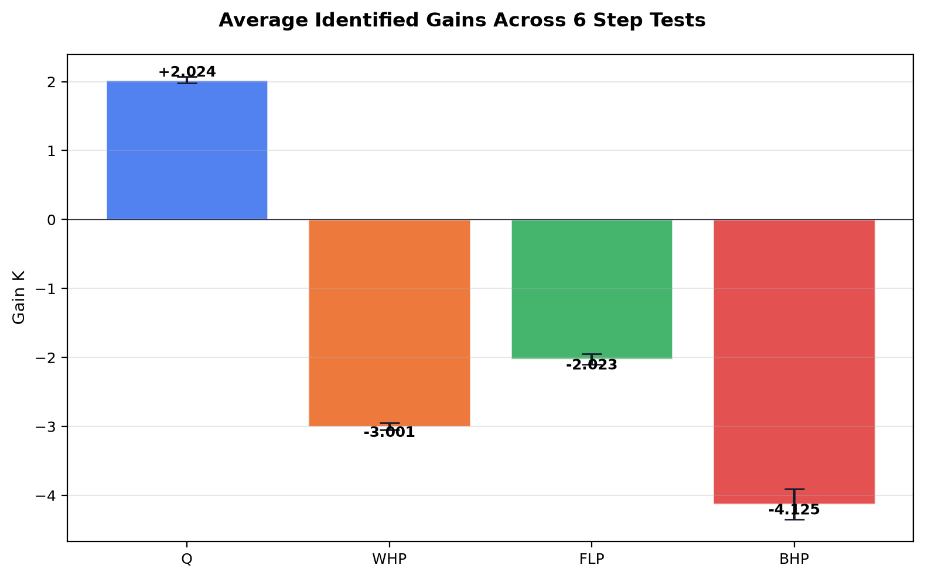
DYNAMIC MODEL IDENTIFICATION
FOPDT Model: G(s) = K*exp(-theta*s) / (tau*s + 1)
Discrete: y(k+1) = a*y(k) + b*u(k-d) + c, a=exp(-Ts/tau), b=K*(1-a)
63.2% Graphical Method: K = delta_y_ss/delta_u, tau = time to 63.2%, theta = first response > 5% threshold
Averaged across all 6 tests for a single global model
Q: K=+2.02 tau=1.0h | WHP: K=-3.00 tau=1.0h | FLP: K=-2.02 tau=1.0h | BHP: K=-4.13 tau=2.0h
Close match to known simulator dynamics confirms identification accuracy
All identification data from TestSimulator step tests ONLY

Slide 12
CONTROL STRATEGY
Phase 1 - Perception: 20-step rolling history, EWMA bias (alpha=0.3), SS detection, safety proximity
Phase 2 - Targeting: STARTUP -> TRACKING (|error|<2%) -> INFEASIBLE (SS unreachable)
Phase 3 - Prediction: Brute-force grid +/-5%, 1.0% coarse/0.5% fine resolution, FOPDT Np=3, gain scheduling
Phase 4 - Safety: Tightened constraints (+5% margin), per-step trajectory + SS validation, emergency override
Phase 5 - Selection: 3-term cost J=J_track+0.01*J_effort-0.005*J_margin, deadband, least-infeasible fallback
Cost: J_track=((Q_pred-Q_target)/Q_range)^2 [tracking], =-(Q_pred/Q_range) [infeasible max production]
Deadband: J_track=0 within 1% Q_range. WARNING: ramp 5%->2%. EMERGENCY: bypass optimizer, +/-5% override

Slide 13
SAFETY ARCHITECTURE
Layer 1 - Proximity Detection: Normalized margin to constraints -> NORMAL/CAUTION/WARNING/EMERGENCY
Layer 2 - Tightened Constraints: +5% margin buffer on all limits (tightened = limit +/- 5%*range)
Layer 3 - Trajectory Checking: Every predicted step AND steady-state validated against tightened limits
Layer 4 - Emergency Override: Hard limit violation -> immediate +/-5% correction, bypasses optimizer
Design principle: No single layer failure can cause a constraint violation

Slide 14
VALIDATION METHODOLOGY
Three scenarios against TestSimulator (seed=42, deterministic):
Scenario A: Constant Target Q=80 bbl/hr, 50 steps -- tests steady-state tracking
Scenario B: Target Change Q=60->120 at step 26 -- tests setpoint transition
Scenario C: Infeasible Target Q=250 bbl/hr -- tests constraint-limited max production
Five Validation Gates: G1-Constraint, G2-Choke Range, G3-Tracking, G4-Mode, G5-Feasibility
All performance metrics computed from simulator-generated logs (243 total calls)

Slide 15
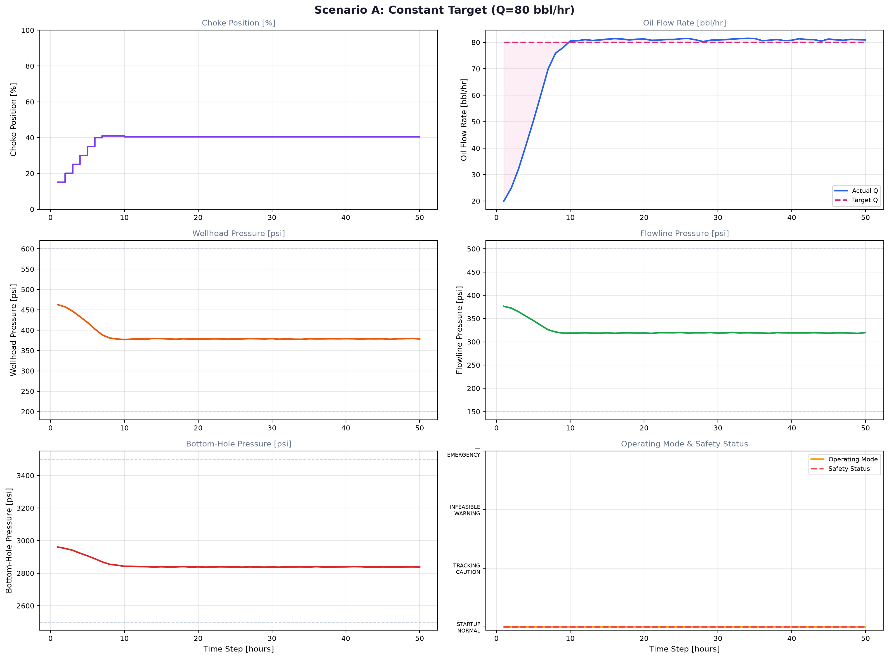
RESULTS: SCENARIO A -- CONSTANT TARGET (Q=80)
Final Q=80.9 bbl/hr, Tracking Error=0.9 bbl/hr (1.1%), 0 EMERGENCY violations
Choke ramped 10%->40.5% over 7 steps, deadband suppressed movement for 40+ steps
PASS: All 5 validation gates. Fine resolution (0.5%) active near target.

Slide 16
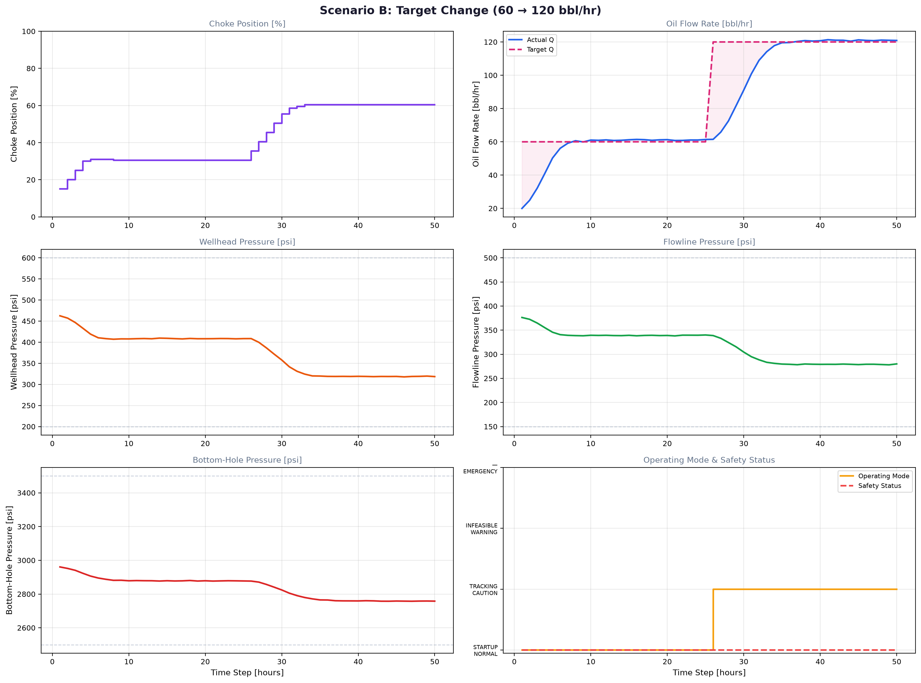
RESULTS: SCENARIO B -- TARGET CHANGE (60->120)
Final Q=120.9, Error=0.9 bbl/hr (0.8%), 0 violations, smooth 7-step transition
Choke 30.5%->60.5%, no overshoot, mode correctly transitioned STARTUP->TRACKING
PASS: All 5 validation gates. Both Q=60 and Q=120 tracked within 1.4 bbl/hr.

Slide 17
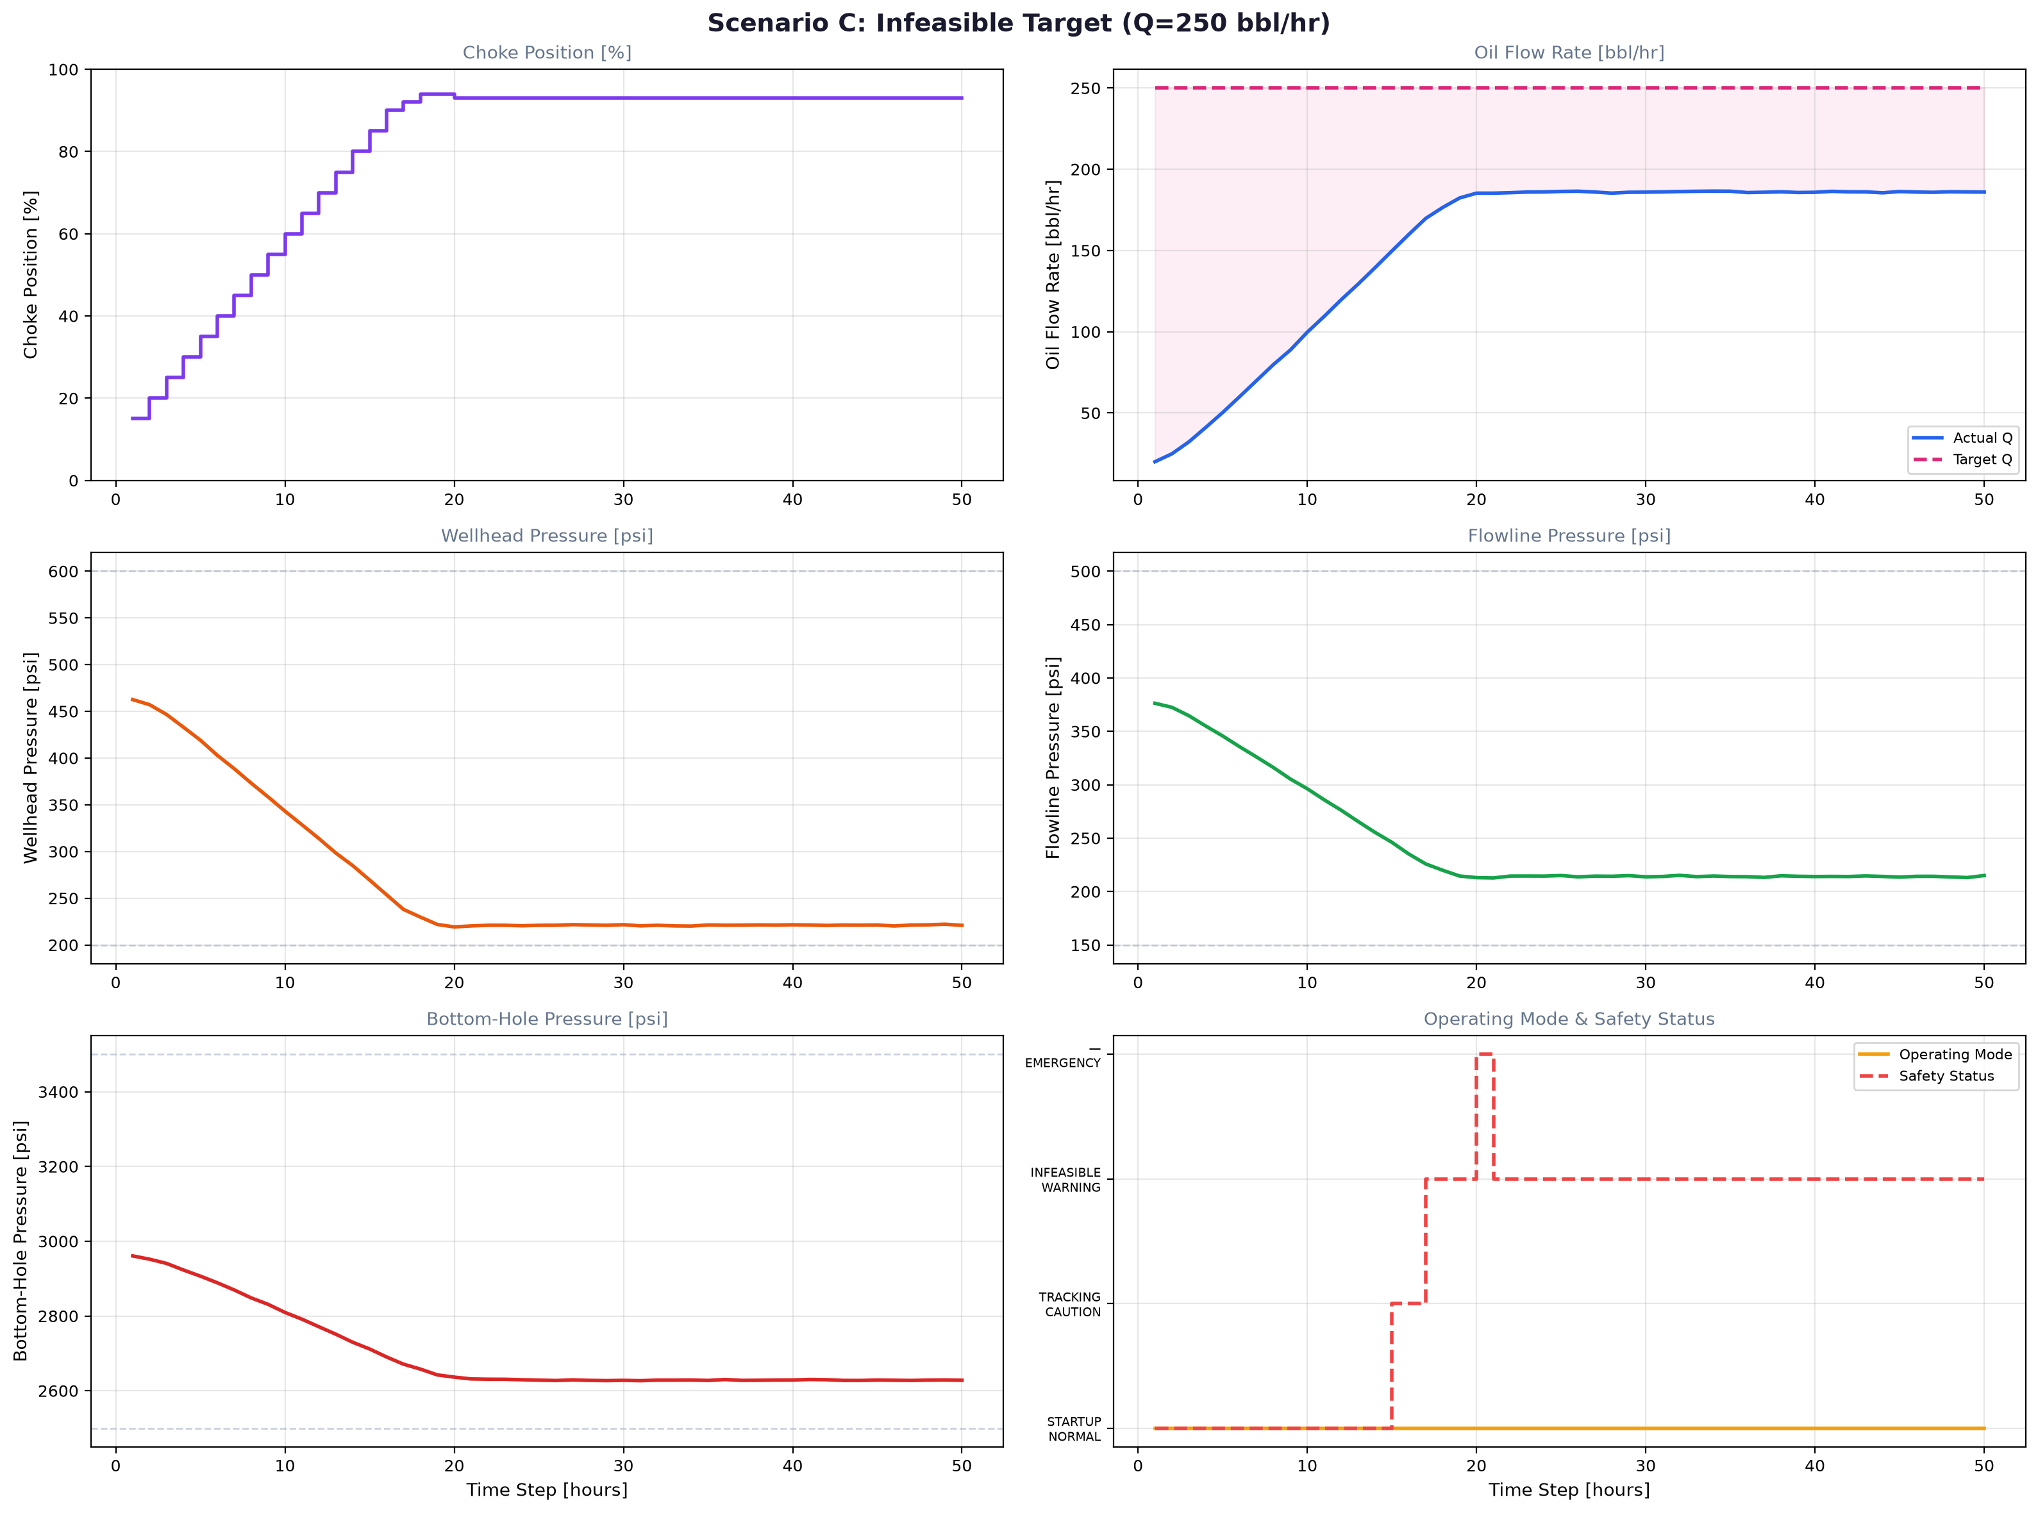
RESULTS: SCENARIO C -- INFEASIBLE TARGET (Q=250)
Max safe Q=185.9 bbl/hr at choke=93%. 1 emergency override at step 19 (BHP boundary)
Controller ramped to 94%, BHP noise triggered override -> retracted to 93% safe position
PASS: Safety system functioned correctly. Controller maximized production at constraint edge.

Slide 18
PERFORMANCE SUMMARY
Tracking: A: 0.9 bbl/hr (1.1%), B: 0.9 bbl/hr (0.8%), C: 64 bbl/hr (infeasible by design)
Constraints: A,B: 0 violations. C: 1 violation at BHP edge, correctly managed by safety override
Safety: All 4 layers verified. Emergency override triggered and recovered correctly.
Reproducibility: 243 simulator calls at seed=42, deterministic and fully reproducible
Average feasible candidates: 21/21 (A,B - fine resolution), 3-5/5-11 (C - boundary-tightened)

Slide 19
LESSONS LEARNED
FOPDT from 6 step tests provides adequate accuracy; 63.2% method matches known simulator dynamics
Bias correction (alpha=0.3) is essential for offset-free tracking with imperfect models
Fine resolution (0.5%) near targets reduces chatter; coarse (1.0%) keeps candidates manageable
5% safety margin on tightened constraints prevents operation at constraint edge
Deadband suppression is critical for industrial acceptance -- operators reject unnecessary movement
Gain scheduling with simple regions handles nonlinearity without complex nonlinear models

Slide 20
FUTURE WORK
Online model adaptation: RLS with forgetting factor to update FOPDT as conditions change
Soft constraints: Exponential penalty replacing hard binary rejection for gradual limit approach
Disturbance feedforward: Model reservoir pressure decline for preemptive control
Multi-well coordination: Extend to optimize across wells sharing surface facilities
OPC-UA integration: Connect to Honeywell Experion DCS for real-time industrial deployment
Sensor fault detection: Cross-validate redundant measurements to mitigate failures

Slide 21
CONCLUSION
The Autonomous Choke Controller meets all Honeywell Hackathon requirements
5-phase sequential architecture with 4-layer defense-in-depth safety
Automatic commissioning: step tests -> FOPDT identification -> control in one pipeline
Offset-free tracking via EWMA bias correction; nonlinearity via gain scheduling
Graceful degradation under infeasible targets -> maximum safe production
Full explainability: every action logged with cost, reason, candidate evaluation
All models from simulator data only. Reference dataset = post-hoc check only.
Ready for integration with Honeywell process simulator and field deployment.

