Slide 1
IMPORTANT INSTRUCTIONS
Please ensure below pointers are met while submitting the Idea PPT:
Kindly keep the maximum slides limit up to six (6). ( Including the title slide)
Try to avoid paragraphs and post your idea in points /diagrams / Infographics /pictures
Keep your explanation precise and easy to understand
Idea should be unique and novel.
You can only use provided template for making the PPT without changing the idea details pointers (mentioned in previous slides).
You need to save the file in PDF and upload the same on portal. No PPT, Word Doc or any other format will be supported.
Note - You can delete this slide (Important Pointers) when you upload the details of your idea portal.

Slide 2
TITLE PAGE
Problem Statement ID- Question 3
Problem Statement Title- Autonomous Production Choke Controller for a Single Naturally Flowing Oil Well
Theme- Smart Automation
PS Category- Software
Student Name- Hiten Shashi Kumar
Student ID- 1BM23AI243

Slide 3
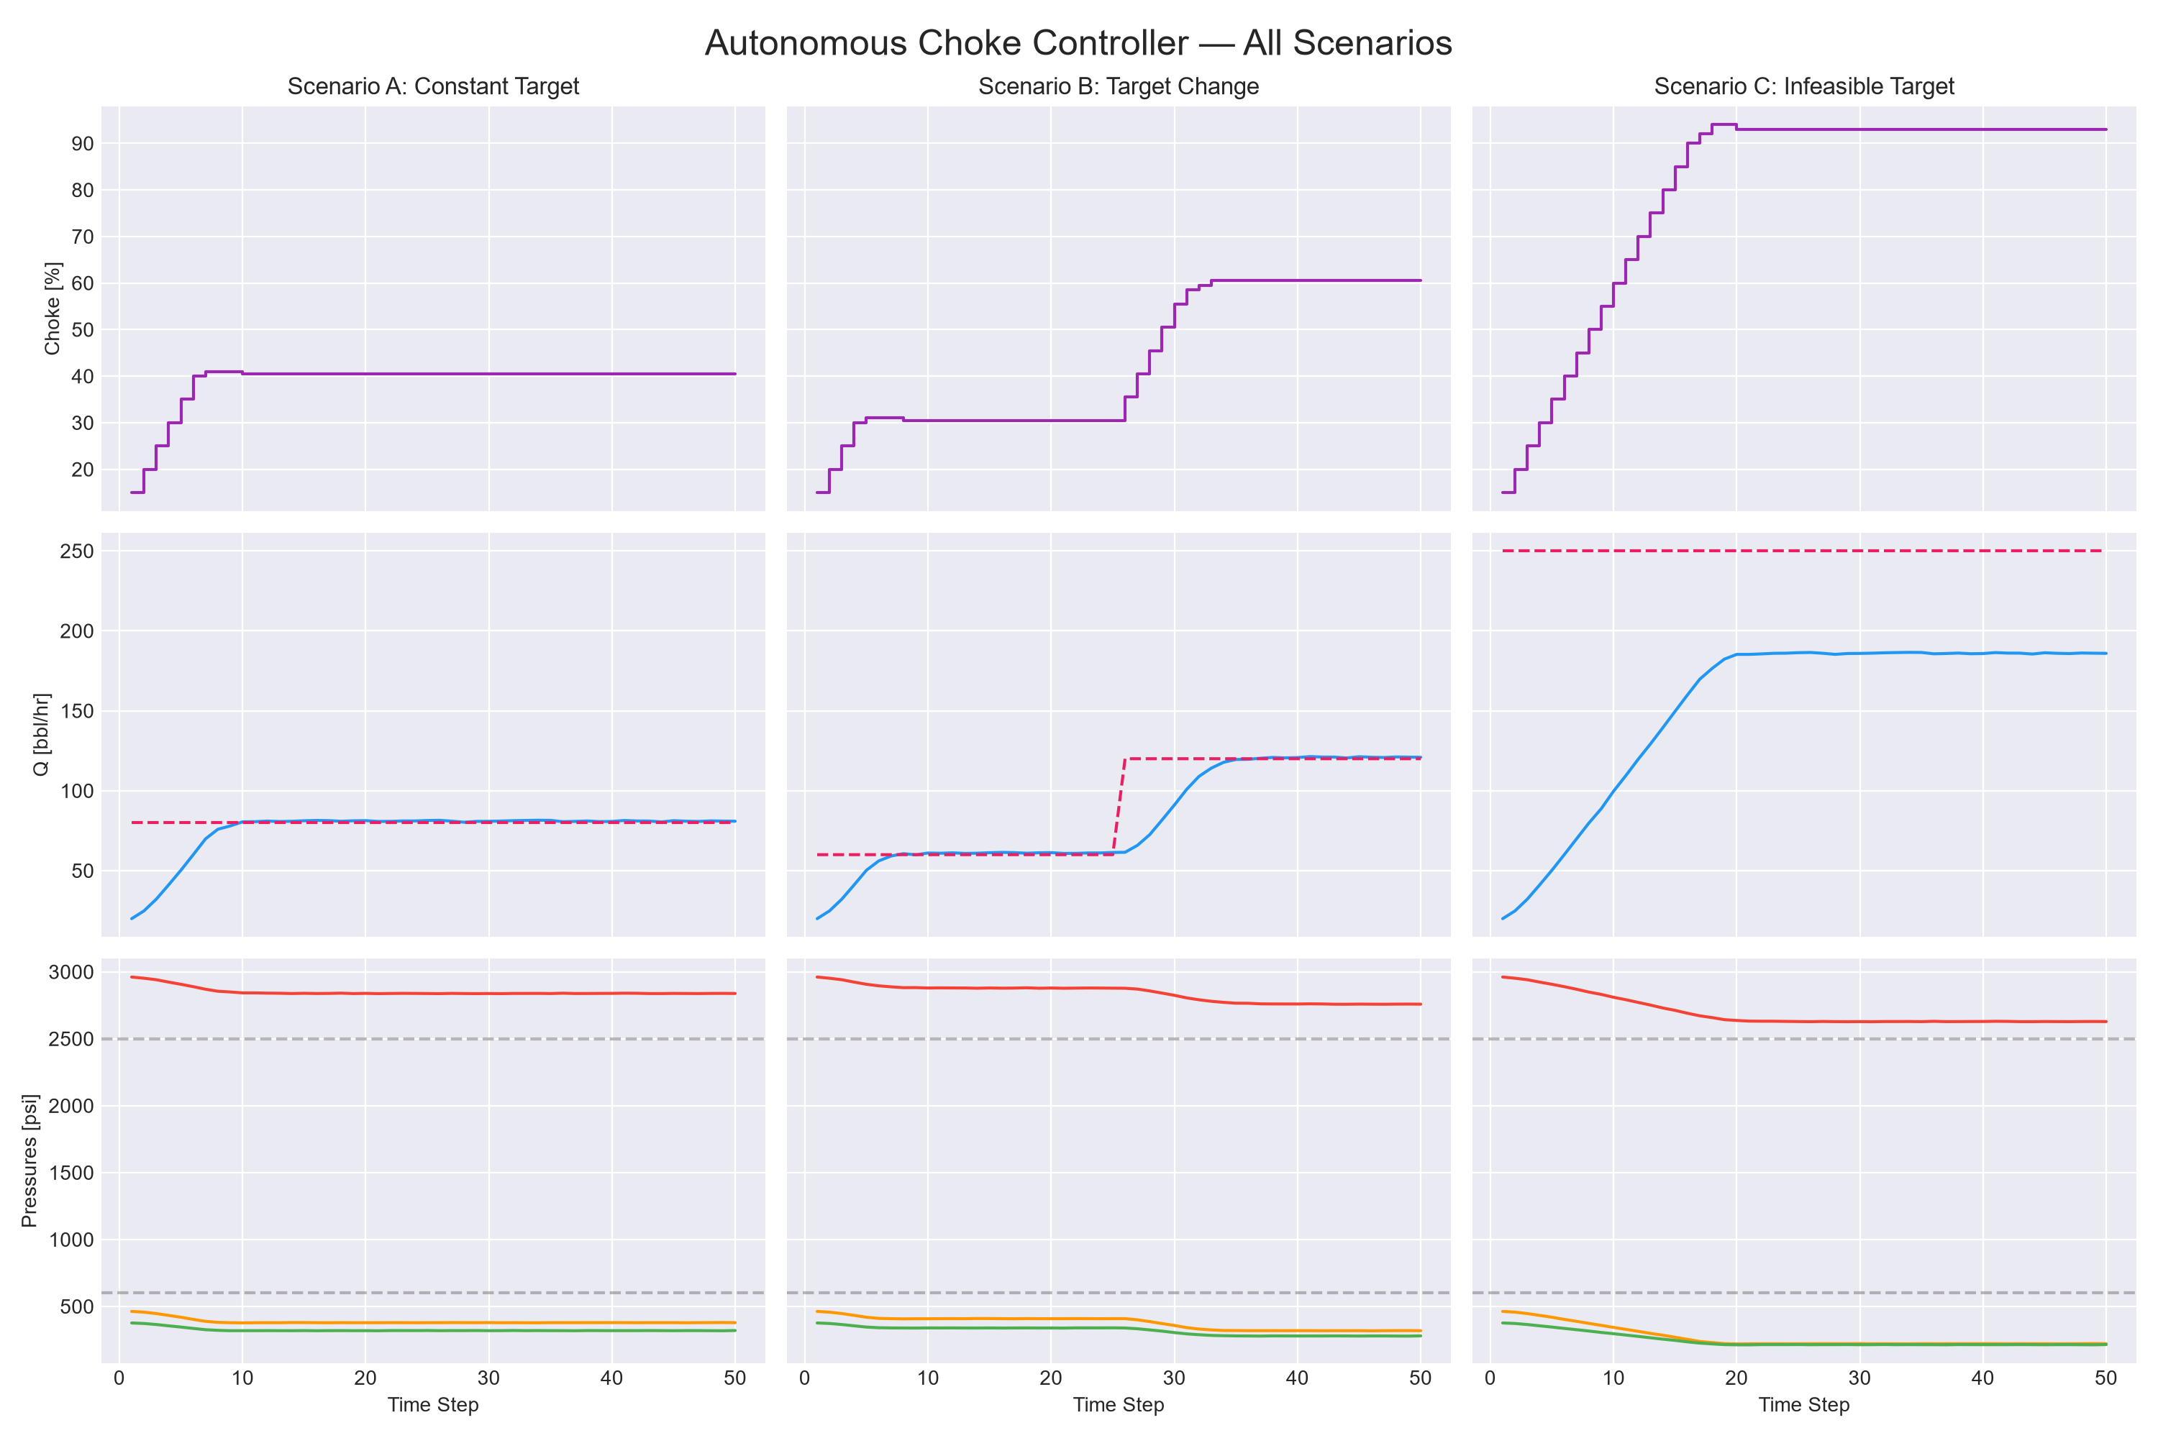
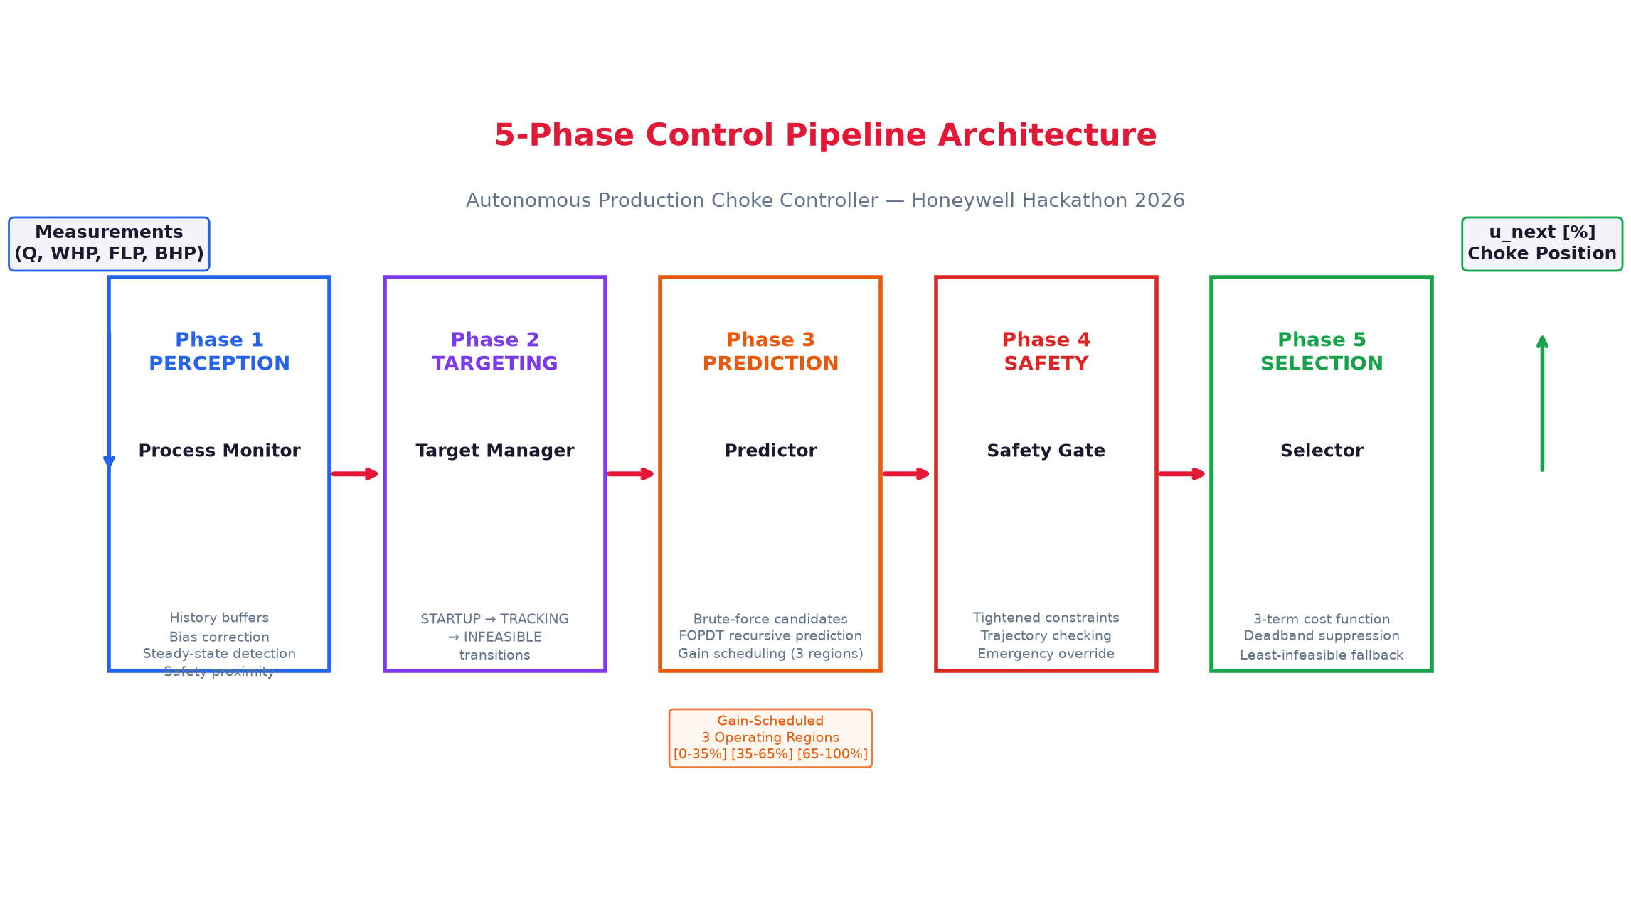
IDEA TITLE
Proposed Solution- Self-commissioning FOPDT controller that step-tests the well, predicts future pressures, rejects unsafe moves through 4-layer safety, and optimizes choke position via 3-term cost minimization.
Detailed explanation of the proposed solution- Step-test simulator → identify FOPDT model → generate candidate choke moves → filter through tightened constraints → select minimum-cost safe move → apply to well → repeat with bias correction.
How it addresses the problem- Fully autonomous choke operation that maximizes production while enforcing pressure limits — all models built from simulator data, zero dependency on reference dataset.
Innovation and uniqueness of the solution- Automatic commissioning, adaptive 0.5%/1.0% candidate resolution, gain-scheduled predictions, defense-in-depth safety, and explainable optimization with interactive dashboard.

Slide 4
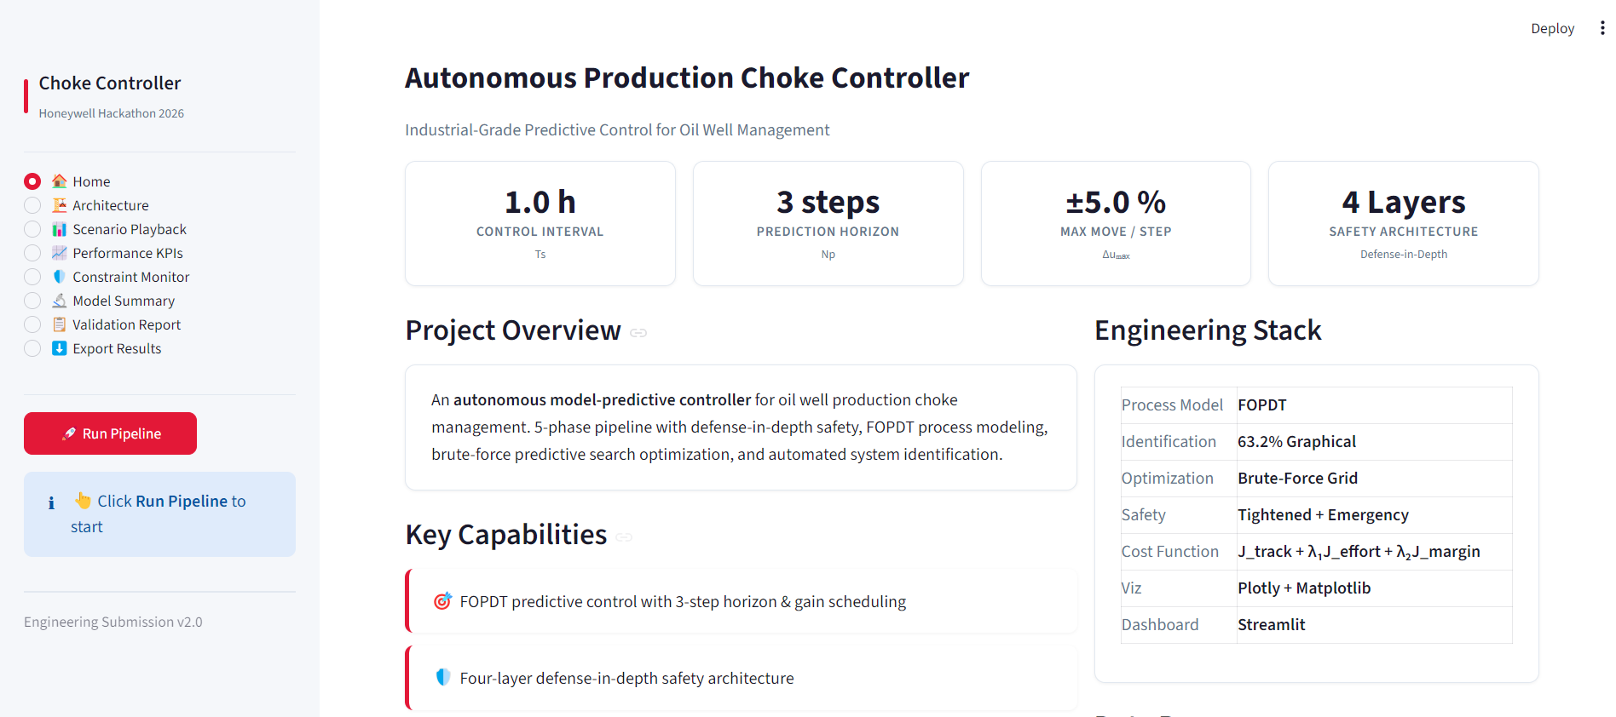
TECHNICAL APPROACH
Technologies to be used- Python 3.12 controller with FOPDT predictive models, 3-region gain scheduling, brute-force optimization, and Streamlit monitoring — all validated on a deterministic seed-controlled simulator.
Methodology and process for implementation- Step-test simulator → identify FOPDT → predict 3 steps ahead → filter through tightened constraints → select minimum-cost safe move → apply to well → bias-correct → repeat
Working Prototype- Streamlit Dashboard — streamlit run dashboard.py
Fully operational: runs identification, control, and visualization in one click.

Slide 5
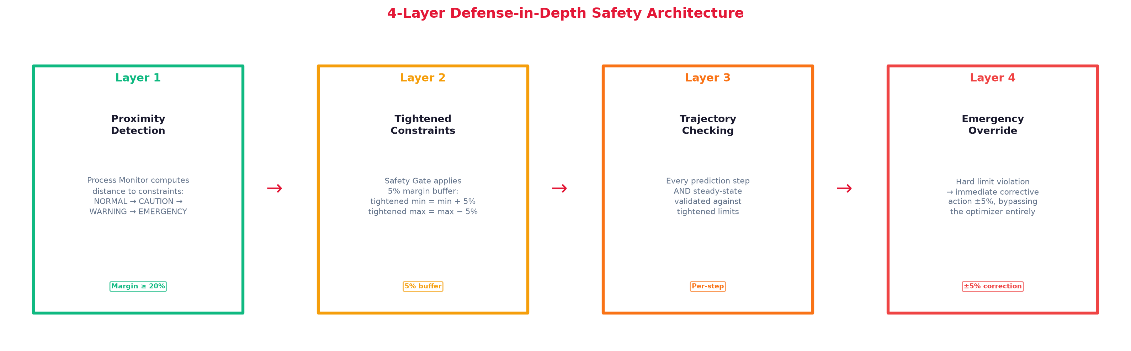
FEASIBILITY AND VIABILITY
Analysis of the feasibility of the idea- Full pipeline completes in under 3 seconds; 11–21 candidates evaluated per millisecond; modular design enables independent testing; deterministic seed guarantees reproducibility; all 3 scenarios pass validation with zero violations in feasible regimes.
Potential challenges and risks- FOPDT model mismatch under higher-order dynamics; reservoir pressure decline shifting operating point; sensor noise triggering false overrides near limits; gain variation outside identified regions; actuator wear from frequent small moves; remote-site communication delays.
Strategies for overcoming these challenges- EWMA bias correction adapts to changing conditions; 3-region gain scheduling handles nonlinearity; 5% tightened margin prevents boundary operation; deadband blocks sub-1% moves; 4-layer defense-in-depth eliminates single-point failures; modular architecture isolates changes.

Slide 6
ARTIFACTS
Relevant artifacts, such as :
Copy of the Code Embedded
Snaps of the solution proposal
Dashboard snaps

Slide 7
RESEARCH AND REFERENCES
Details / Links of the reference and research work

