Slide 1

E-Commerce Business Intelligence Suite
A complete MySQL analytics project — translating raw transactional data into board-ready strategic insight.
HITEN SOLANKI
B.COM · DATA ANALYTICS + GEN AI
BUSINESS ANALYST · UK / DUBAI / GERMANY
GITHUB.COM/HITEN-UX

Slide 2
Agenda
01
02
03
The Business Problem
Data Model & Tech Stack
Five Key Business Insights
Siloed data, unmeasured revenue leakage, and zero retention strategy
4 normalised tables, 13 analytical views, MySQL 8.0
Revenue, customers, products, inventory, and seasonality
04
05
Technical Deep-Dive
Recommendations & Next Steps
Window functions, CTEs, and RFM segmentation logic
Actionable priorities to recover ₹16.85 Lakhs and reduce churn

Slide 3

The Problem: Operating Without a Single Source of Truth
No Executive Dashboard
No unified KPI view for leadership. Decisions made without data.
₹16.85 Lakhs Lost
16.6% of gross revenue lost to cancellations and returns — unmeasured.
Reactive Inventory
18 products critically low. Stockouts triggered by guesswork, not data.
Zero Retention Strategy
23.6% of customers churned — inactive over 90 days with no intervention.

Slide 4
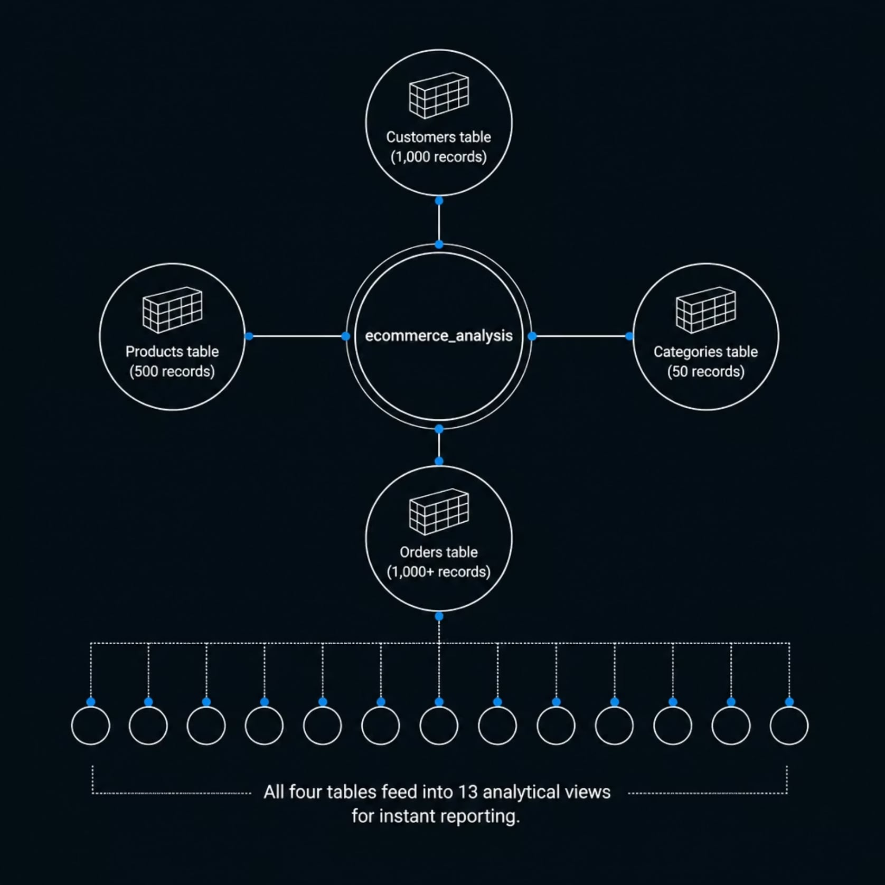
The Solution: A Unified MySQL Analytics Suite
Architecture at a Glance
Four normalised tables (3NF) linked by foreign keys. Thirteen pre-built views deliver instant reporting — no manual extraction required.
MySQL 8.0 — Window functions, CTEs, NTILE
4 tables — Customers, Products, Categories, Orders
13 views — Pre-built for executive reporting
GitHub — Version-controlled, fully reproducible

Slide 5
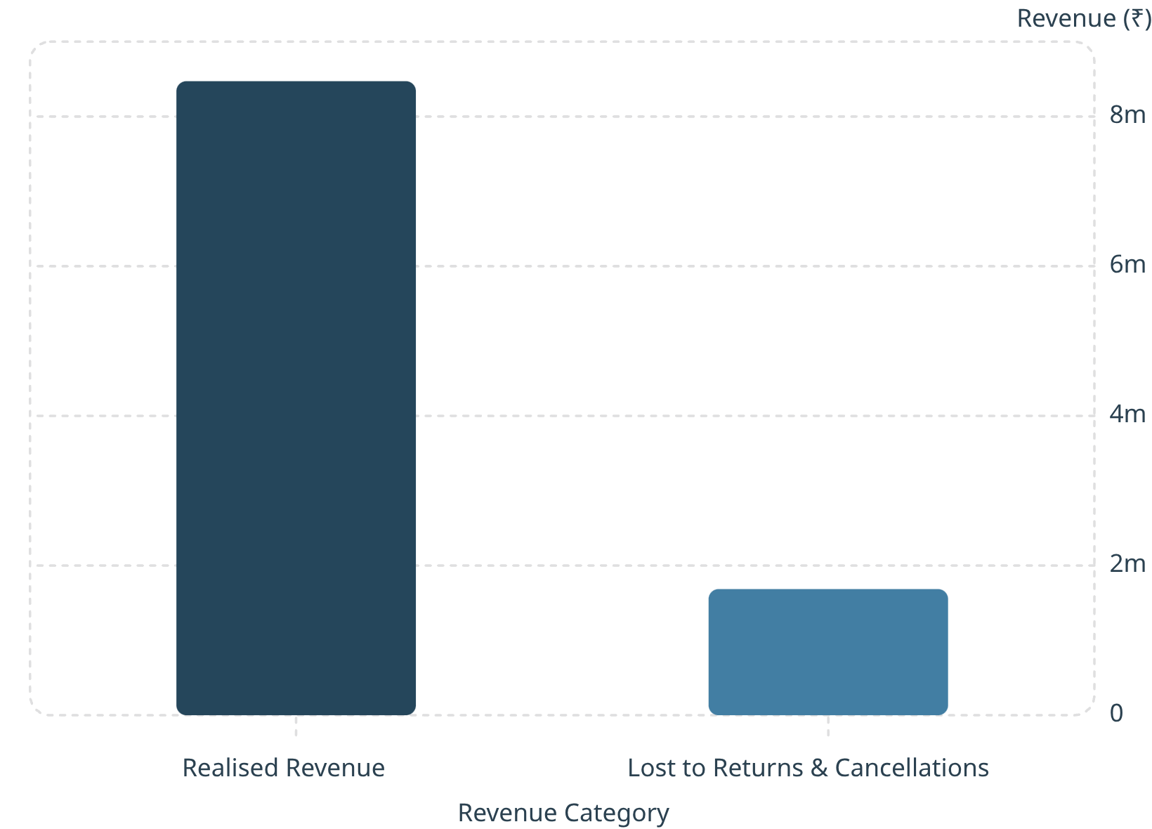

INSIGHT 1 OF 5
Revenue Leakage: ₹16.85 Lakhs Recoverable
What the Data Reveals
16.6% of gross revenue is lost to cancellations and returns — entirely untracked in current reporting.
Realised revenue: ₹84,72,189.24
Lost revenue: ₹16,85,472.89
Top 5 high-risk products carry a bad-order rate >35%
Recommendation: Investigate quality and supplier issues on high-risk products immediately.

Slide 6
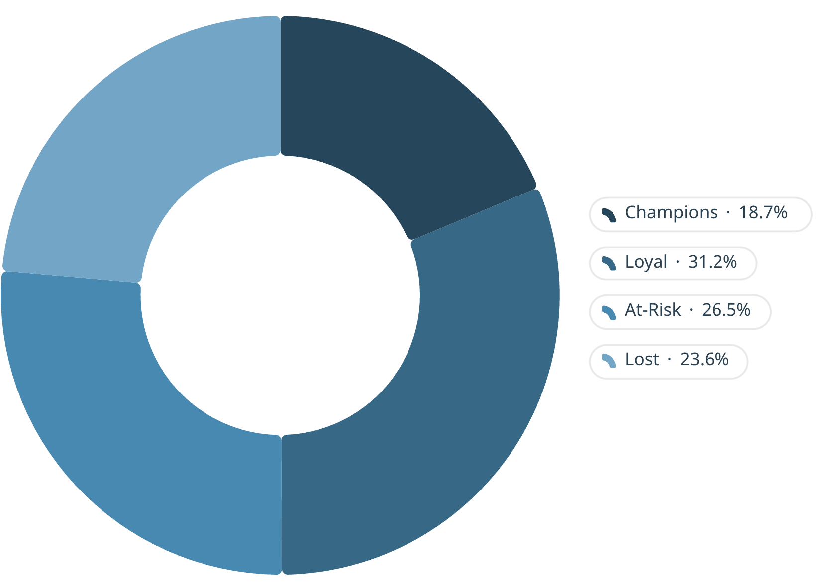

INSIGHT 2 OF 5
Customer Health: RFM Segmentation
Segment Breakdown — 1,000 Customers
Champions (18.7%): 187 customers — highest spenders, recently active
Loyal (31.2%): 312 customers — steady, reliable buyers
At-Risk (26.5%): 265 customers — engagement declining
Lost (23.6%): 236 customers — inactive over 90 days
Champions spend 4.2× more than Lost customers. Average time to second purchase: 47 days.
Recommendation: Launch a targeted win-back campaign for 501 At-Risk and Lost customers.

Slide 7
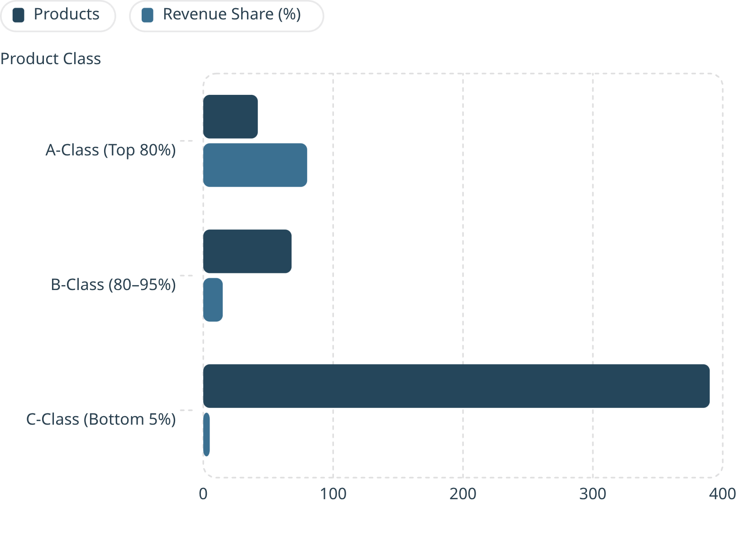

INSIGHT 3 OF 5
Product Strategy: The Pareto 80-20 Rule in Action
What the Classification Reveals
A-Class: 42 products (8.4%) drive 80% of all revenue
B-Class: 68 products (13.6%) contribute 15% of revenue
C-Class: 390 products (78%) generate only 5% of revenue
Top 10 customers alone contribute 12.7% of total revenue. Motorcycles category has the highest AOV but the lowest volume.
Recommendation: Focus marketing on A-Class. Clear C-Class inventory with targeted discounts.

Slide 8

INSIGHT 4 OF 5
Inventory Risk: 8 Products in Critical Status
Product
Current Stock
Avg Daily Demand
Status
Product_323
0
2.4 units/day
⚠ CRITICAL
Product_284
1
1.8 units/day
⚠ CRITICAL
Product_289
1
3.2 units/day
⚠ CRITICAL
Product_353
3
5.1 units/day
⚠ CRITICAL
Product_473
3
4.7 units/day
⚠ CRITICAL
Product_434
7
6.3 units/day
⚠ CRITICAL
Product_4
8
5.9 units/day
⚠ CRITICAL
Product_122
9
7.2 units/day
⚠ CRITICAL
Action required: Trigger immediate reorders for all 8 flagged products. 18 products total are below the critical stock threshold of 10 units.

Slide 9
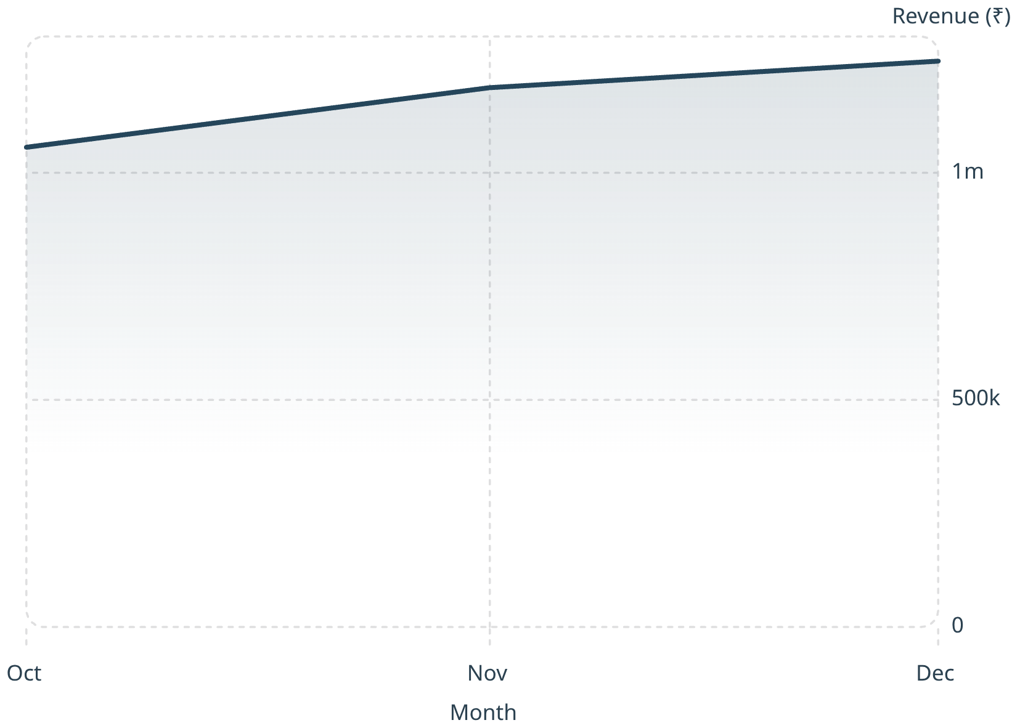
INSIGHT 5 OF 5
Seasonality: Q4 Drives 40%+ of Annual Revenue
Top 3 Revenue Months
December 2023: ₹12,45,892.34
November 2023: ₹11,87,456.78
October 2023: ₹10,56,234.56
Q4 (October–December) consistently generates over 40% of total annual revenue. Customer acquisition trends show month-over-month growth, reinforcing the need to align marketing spend with this seasonal pattern.
Recommendation: Pre-stock inventory by September. Align marketing budgets to the Q4 surge.

Slide 10


Technical Deep-Dive: SQL That Drives Business Decisions
ABC Classification — Window Function
Cohort Retention — CTE + Join
RFM Segmentation — NTILE
SUM(revenue) OVER (ORDER BY revenue DESC) / grand_total AS cumulative_pct
TIMESTAMPDIFF(MONTH, first_date, Order_Date) AS month_index, revenue_per_customer
NTILE(4) OVER (ORDER BY recency_days DESC) AS r_score
Classifies 500 products into A/B/C tiers for inventory prioritisation.
Segments 1,000 customers into Champions, Loyal, At-Risk, and Lost.
Tracks whether newer cohorts spend less — critical for marketing ROI.
Full repository: github.com/hiten-ux/ecommerce-analytics-suite

