Slide 1
Microcontroller Programming Project
Test area all possible layouts

Slide 2
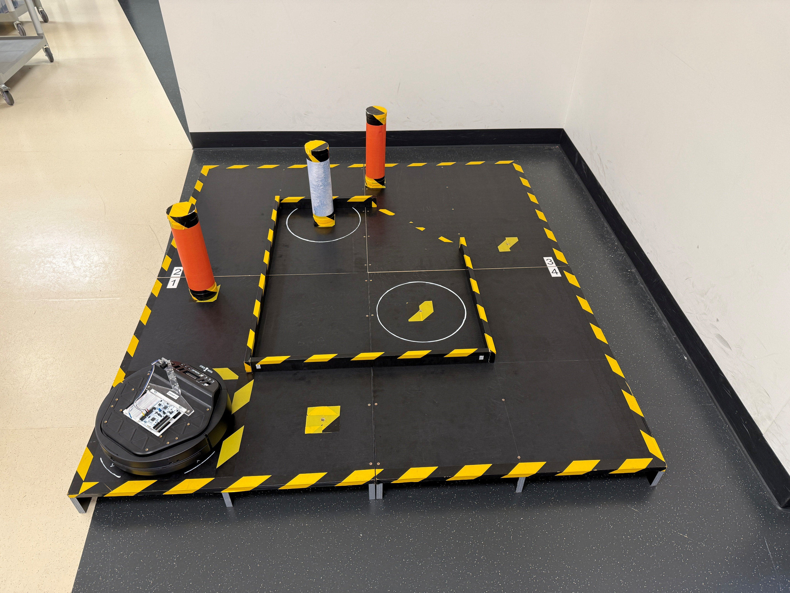
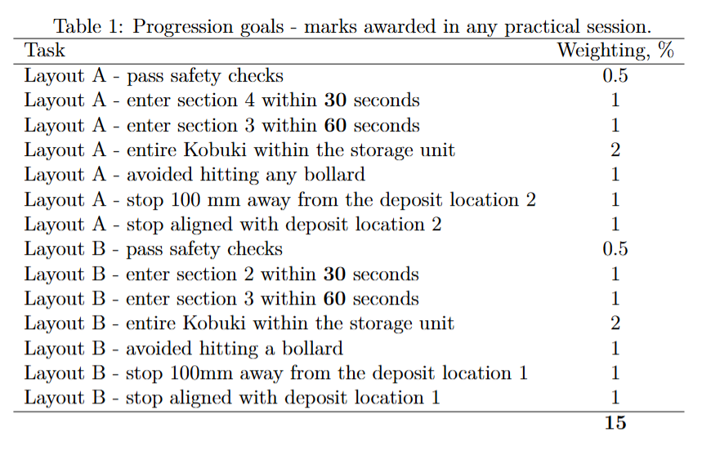
Layout A
Bollard D in D1 position
Bollard A2
Bollard D1
Bollard A1
Starting point – Random orientation

Slide 3
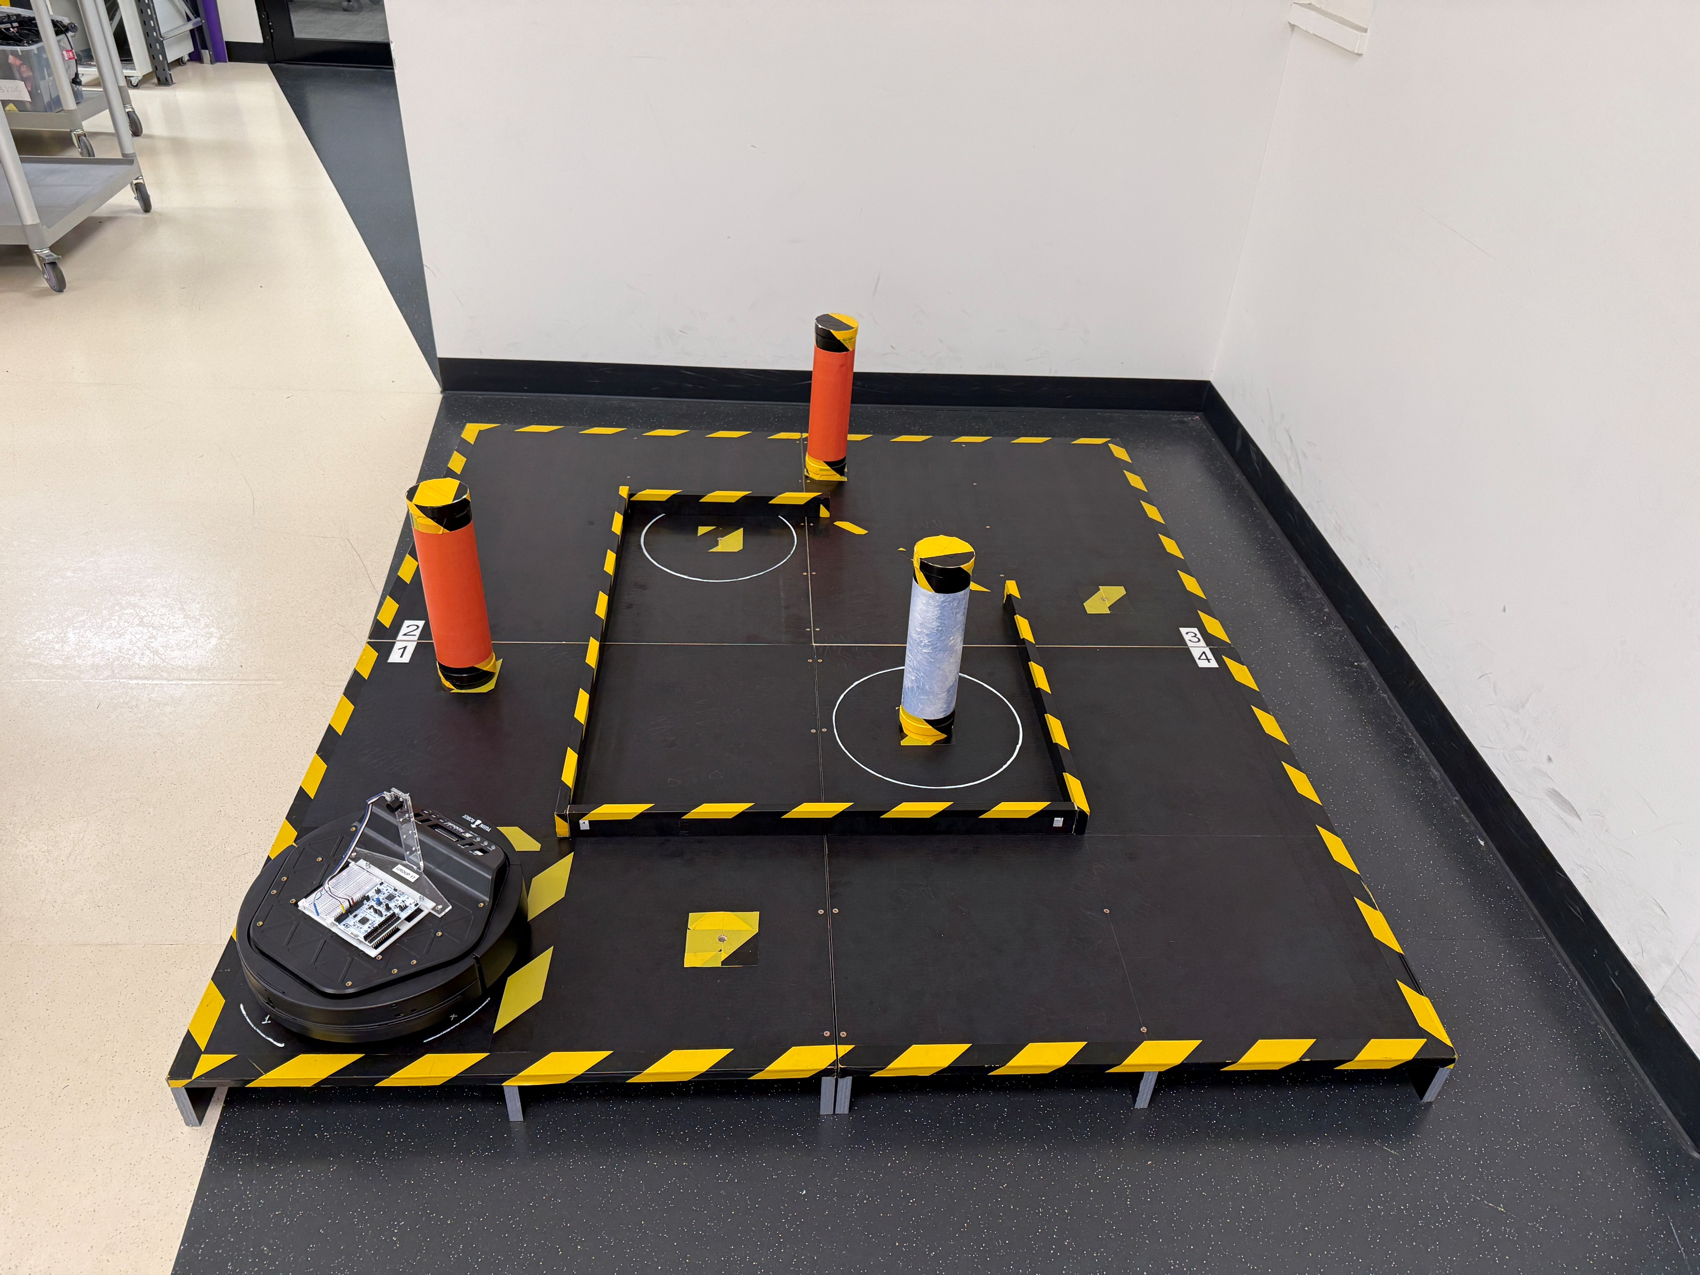
Layout A
Bollard D in D2 position
Bollard A2
Bollard A1
Bollard D2
Starting point – Random orientation

Slide 4
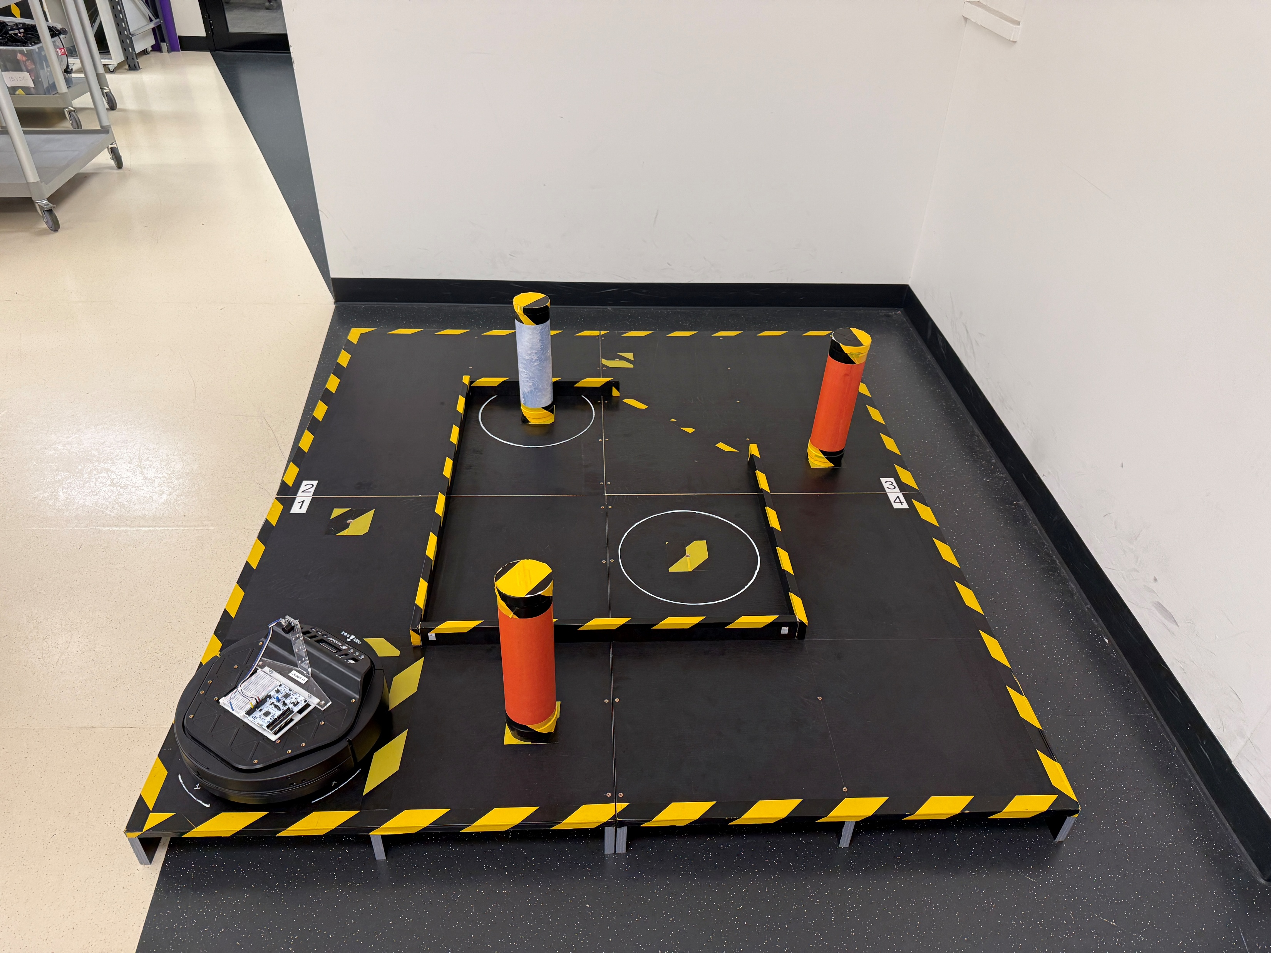
Layout B
Bollard D in D1 position
Bollard D1
Bollard B2
Bollard B1
Starting point – Random orientation

Slide 5
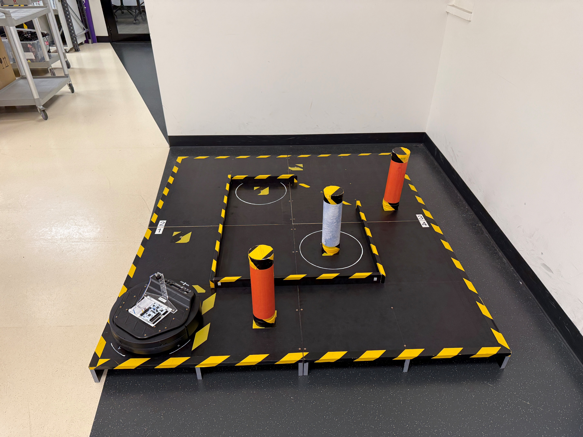
Layout B
Bollard D in D2 position
Bollard D2
Bollard B2
Bollard B1
Starting point – Random orientation

Slide 6
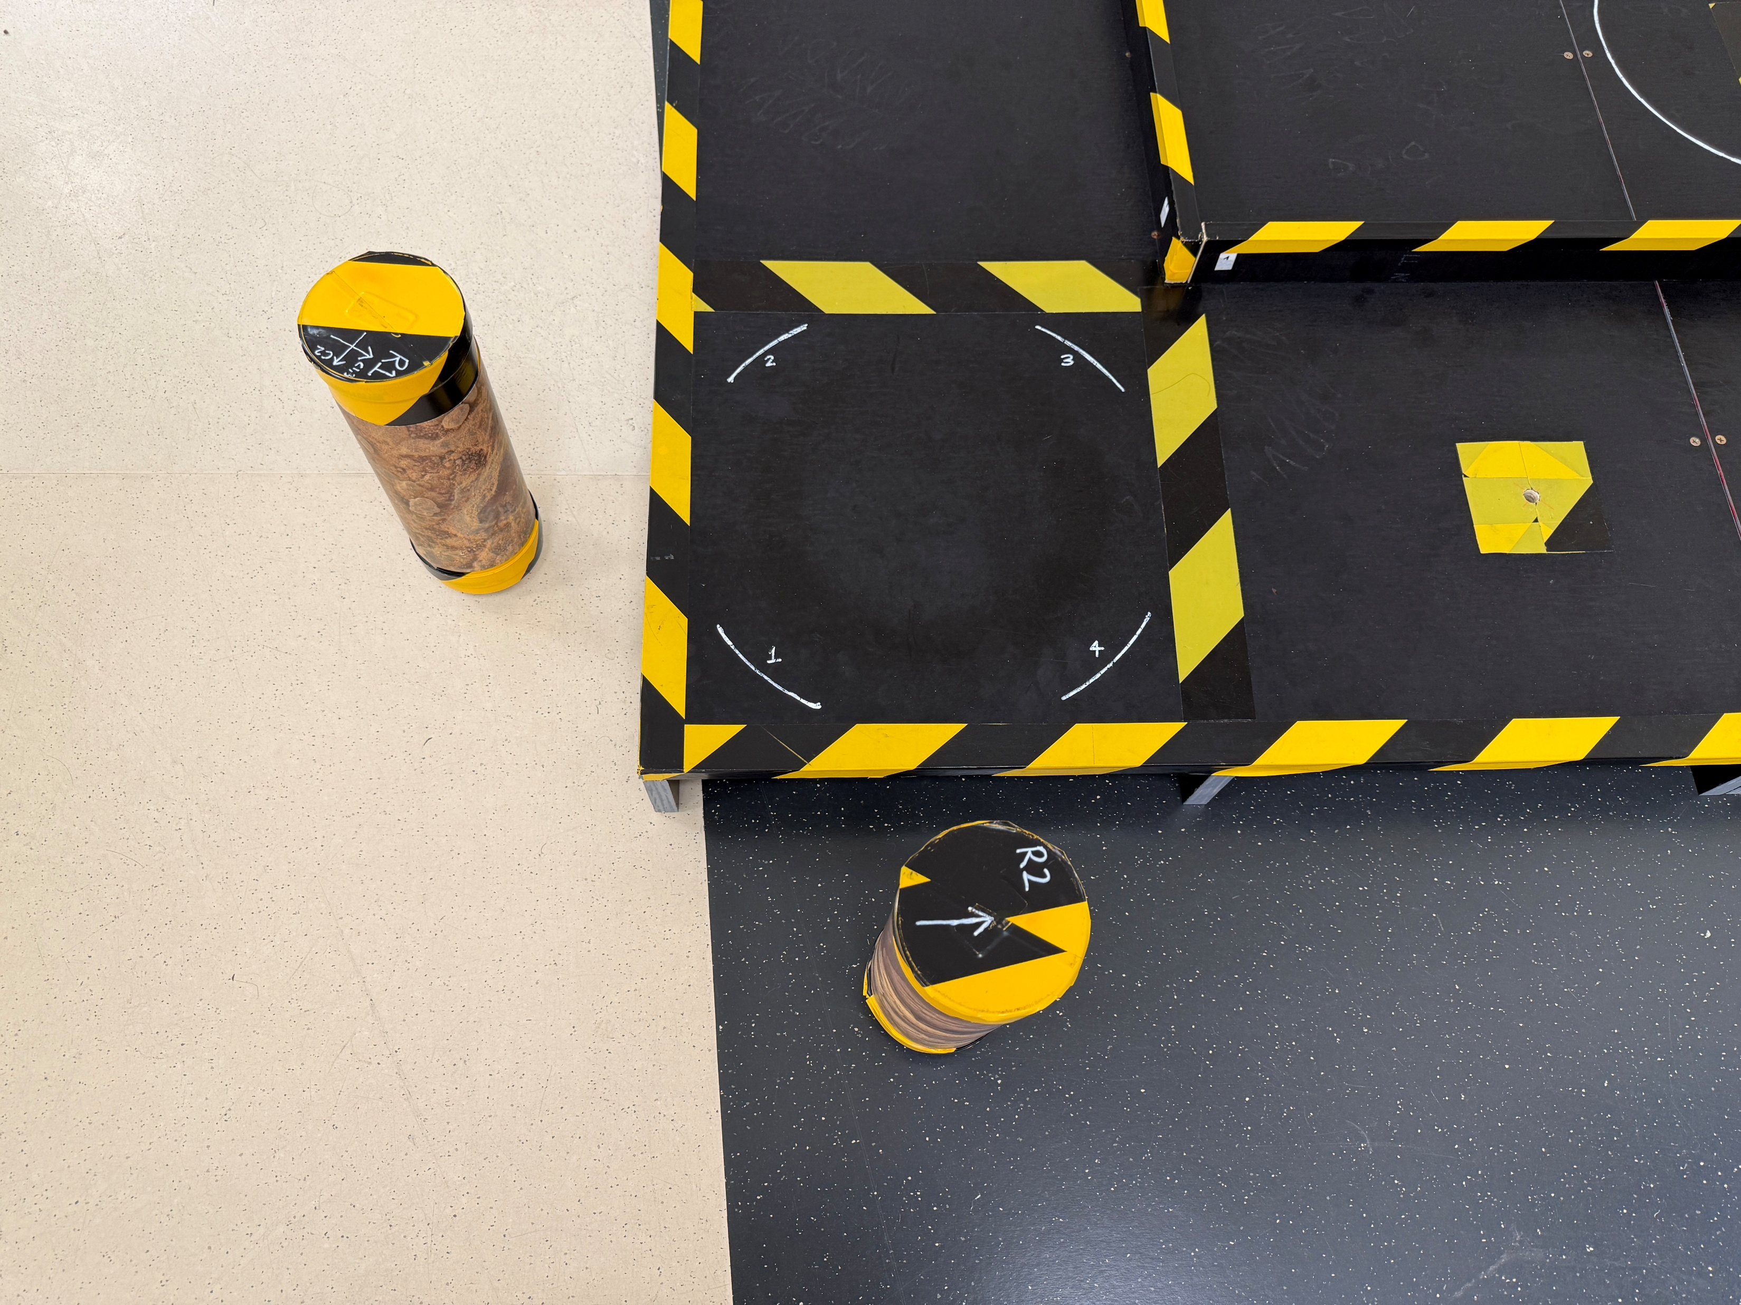
Random bollards to help with orientation – To be placed by students near the starting location.

Slide 7
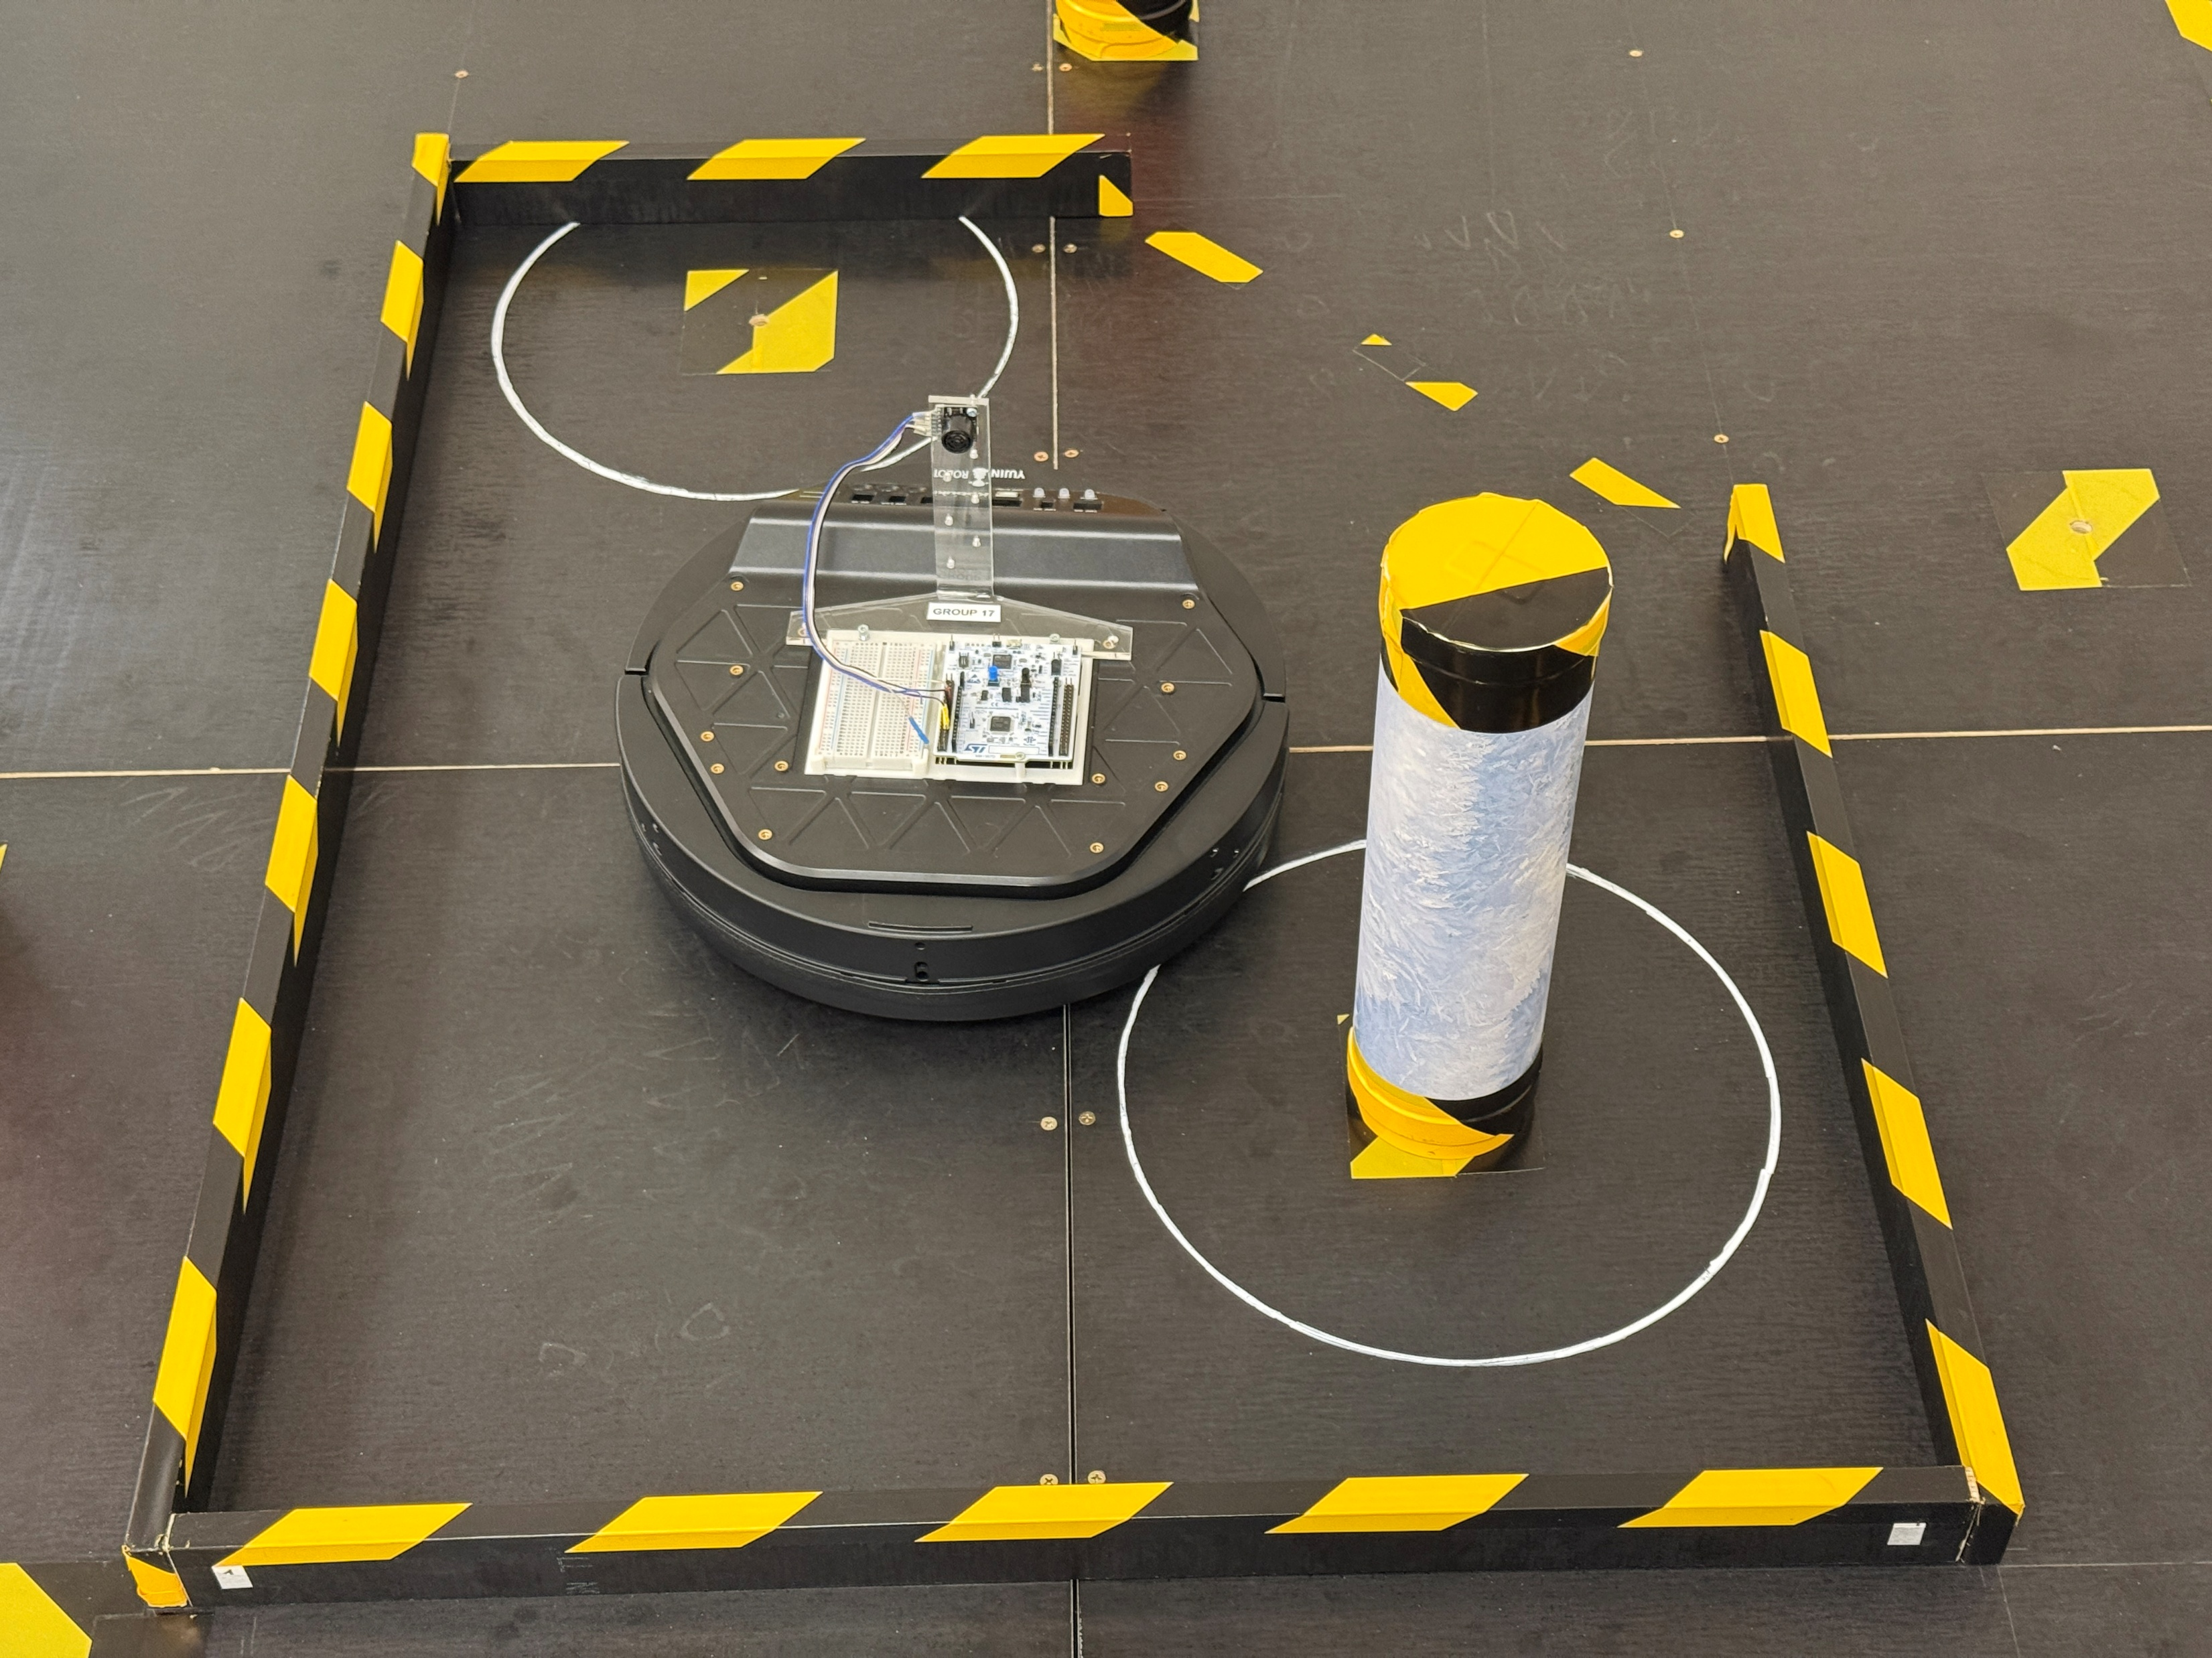
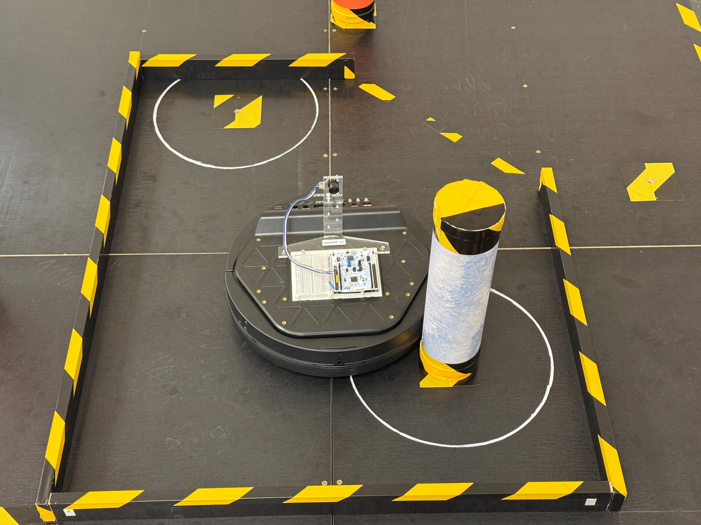
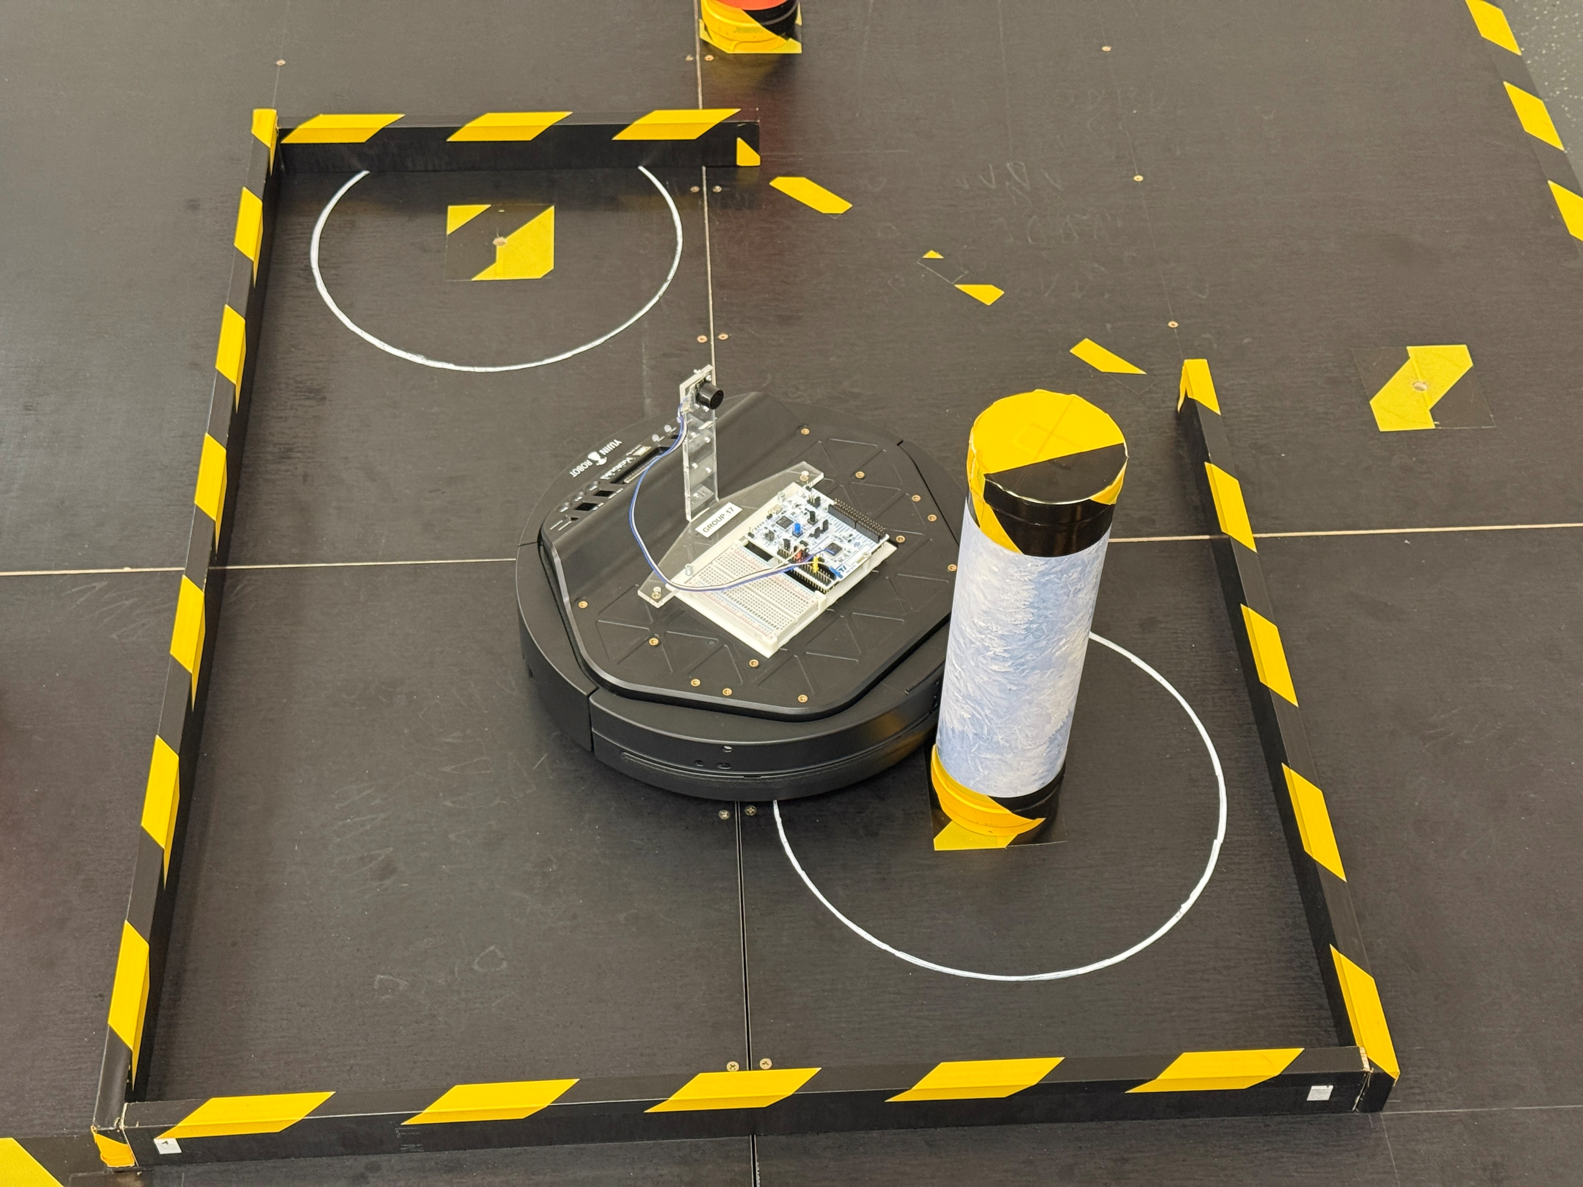
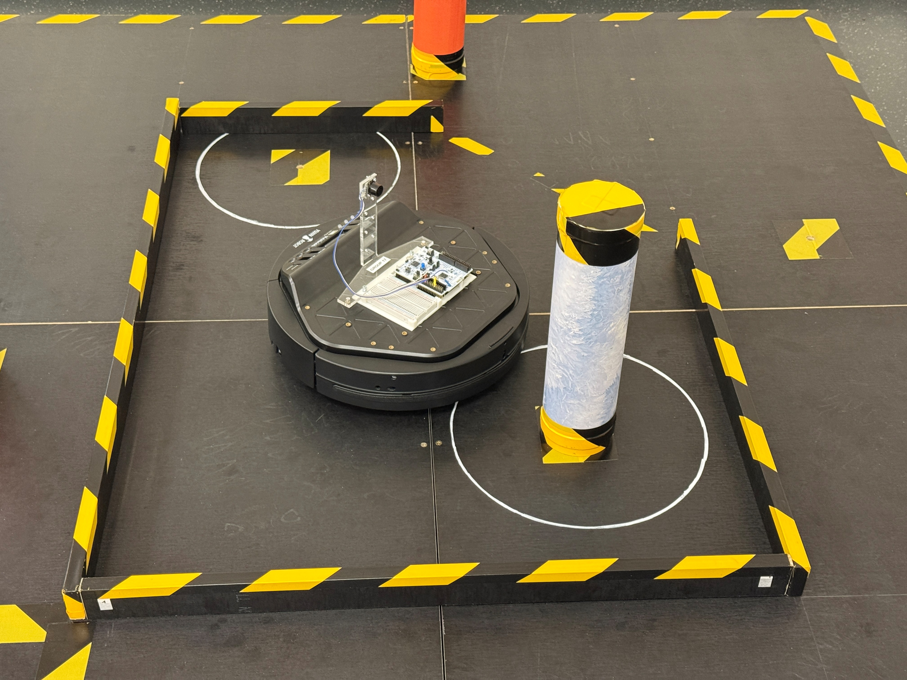
Alignment to the deposit

