Slide 1

ASP.NET Core - What's in it?
ASP.NET Core is a significant redesign of ASP.NET. Unlike other versions of the technology, this version is not an enhancement to the previous version. It is written from scratch to make the technology better and lighter.

Slide 2
How does ASP.NET Core application work?
When an ASP.NET Core application starts, it runs only the essential components that are needed to start the server and serve simple pages.
Unlike previous versions of ASP.NET, it doesn’t start a set of features that the application may or may not use. If we need a feature, we need to invoke the respective middleware. MVC, Entity Framework, Identity, Caching, Logging and any services that we need to use in lifetime of the application have to be loaded as middleware services.

Slide 3
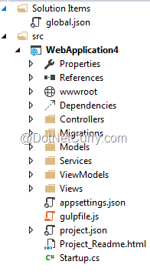
ASP.NET Core Project Structure
Startup.cs: It is the starting point of the ASP.NET Core application. It has a static void main method and as you would have already guessed, this method is the starting point of the application.
global.json: This file is present at root of the application folder and it contains solution level settings. By default, it contains names of the projects and SDK version. These settings are used for all projects under the solution.
appsettings.json: This file is used to store application settings. It may include things like database connection string, mail server to use while sending mails, folder path where uploaded files have to be saved and any such settings that are used by the application.
package.json: By default, these files are not visible in the solution explorer, we need to select the view all files option to see these files. The package.json file contains list of NPM dependencies.
wwwroot: This is the folder that would contain JavaScript, CSS, images and other static assets required by the application.
scripts: These are the tasks to be executed when the application is built or published.

Slide 4
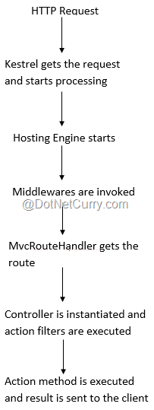
ASP.NET Core Request Life Cycle
Now that we know the different pieces of an ASP.NET Core application, let’s now take a sneak peek of what happens when a URL of an ASP.NET Core application is invoked. A figure shows what goes on after the request reaches the web server:

Slide 5
A quick look at ASP.NET Core improvements
Build and run cross-platform ASP.NET apps on Windows, Mac, and Linux
Built on .NET Core, which supports true side-by-side app versioning
New tooling that simplifies modern Web development
Single aligned web stack for MVC and Web API
Cloud-ready environment-based configuration
Integrated support for creating and using NuGet packages
Built-in support for dependency injection
Ability to host on IIS or self-host in your own process

Slide 6
Difference between ASP.NET Core and ASP.NET MVC 5
Single aligned web stack for ASP.NET Core MVC and Web APIs
Project(Solution) Structure Changes
ASP.NET Core targets Full .NET and .NET Core
ASP.NET Core apps don’t need IIS for hosting
wwwroot folder for static files
New approach to Server side and client side dependency management of packages.
Server-side packages save space in ASP.NET Core
Inbuilt Dependency Injection (DI) support for ASP.NET Core
User Secrets of ASP.NET Core
Cloud Ready Configuration
Mobile App Development
Performance and Scalability

Slide 7
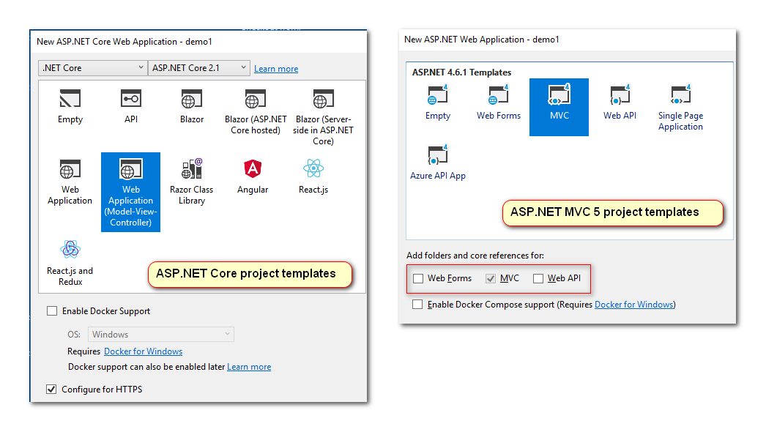
1 - Single aligned web stack for ASP.NET Core MVC and Web APIs
ASP.NET MVC 5 will give us option of choosing MVC or Web API or both while creating a web application. It was because web stack for MVC 5 and Web API was not the same.
ASP.NET Core MVC now has single aligned web stack for MVC and Web API. The image below shows checkbox is GREYED out for MVC and Web API while MVC 5 gives the option to add Web API.

Slide 8
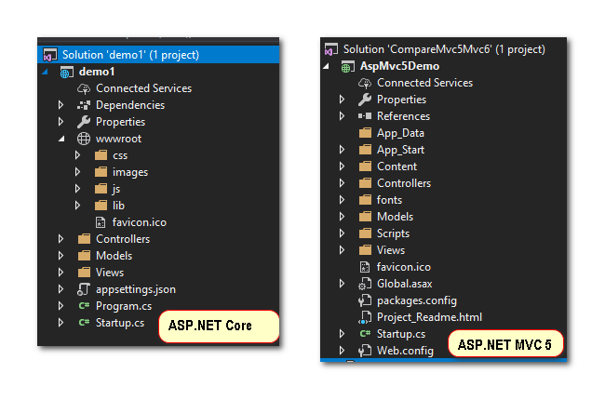
2 - Project(Solution) Structure Changes
If you see ASP.NET Core MVC solution explorer on the right-hand side, there is no Web.config, Global.asax. Then how it deals with configuration settings, authentication and application start specific code execution.
appsettings.json, custom configuration files are some files which do those work of missing files from ASP.NET MVC 5. There are many changes if we look at folder by folder.

Slide 9
3 - ASP.NET Core targets Full .NET and .NET Core
Yes, now we can develop ASP.NET Core web apps against the .NET core and run in either Windows or Linux or Mac.
Wait it’s not over yet, not only we can develop in Windows OS but also in Linux, Mac using Visual Studio Code or any other code editors like Vim, Atom, Sublime

Slide 10
4 - ASP.NET Core apps don’t need IIS for hosting
The goal of ASP.NET Core is to be cross-platform using .NET Core. With this in mind, Microsoft decided to host ASP.NET Core applications not only on IIS but they can be self-hosted or use Nginx web server on Linux. Kestrel will be an internal web server for request processing

Slide 11
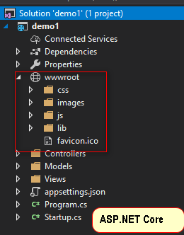
5 - wwwroot folder for static files
The wwwroot folder represents the actual root of the web app when running on a web server. Static files like config.json, which are not in wwwroot will never be accessible, and there is no need to create special rules to block access to sensitive files.
These static files might be plain HTML, Javascript, CSS, images, library etc.
In addition to the security benefits, the wwwroot folder also simplifies common tasks like bundling and minification, which can now be more easily incorporated into a standard build process and automated using tools like Grunt. The “wwwroot” folder name can be changed too.

Slide 12
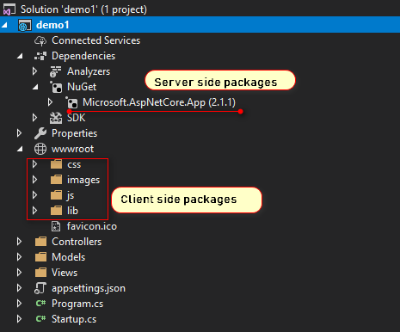
6 - New approach to Server side and client-side dependency management of packages.
Any .NET developer would be familiar that References folder holds all DLLs, NuGet packages for particular .NET Framework. Leverage the experience of working in Visual Studio IDE and deploy ASP.NET Core applications either on Windows, Linux or Mac using .NET Core.
Its Server-side management of dependencies. Client-side dependency management is more important because the client-side has more different packages from the server side.
Client side will surely have jQuery, Bootstrap, grunt, any JavaScript frameworks like AngularJS, Backbone etc., images, style files. Client-side package management in open source community has two names “LibMan” (newly launched) and “NPM”. They are part of “Dependencies”.

Slide 13
7 - Server-side packages save space in ASP.NET Core
We have been using NuGet package manager to add a reference to assemblies, library, framework or any third-party packages. They would have been downloaded from NuGet which creates “Packages” folder in project structure.
30 sample ASP.NET applications, all of them use NuGet packages to reference dependencies each costly approx. 70 MB disk space, so we end up nearly using 2GB disk space for storing packages even though they all are same. Some SMART developers know this issue, they have some workaround of their own.
ASP.NET Core came up with storing all the packages related to its development in Users folder and while creating ASP.NET Core applications, Visual Studio will reference them from Users folder. This feature is called Runtime Store for .NET Core 2 Now even if you have 100 sample ASP.NET Core applications, they all are referencing from dotnet in Users folder which is near to few MBs only.

Slide 14
8 - Inbuilt Dependency Injection (DI) support for ASP.NET Core
Dependency Injection (DI) achieves loosely coupled, more testable code, it’s very important because it helps with writing unit testing. In ASP.NET MVC 5/4 or classic ASPX based applications, we use to have separate DI containers used like Unity, AutoFac, StructureMap etc. We had to build up our project to use DI, its additional effort.
Now in ASP.NET Core applications, dependency injection is inbuilt i.e. no setup headache for DI. Just create some services and get ready to use DI. In fact sample Core MVC application has DI inbuilt in it, let’s open “Startup.cs” and look for “ConfigureServices(IServiceCollection services)” method Its main purpose is the configuration of services like EF, Authentication, adding MVC and handwritten custom services like IEmailServer and ISmsSender.

Slide 15
9 - User Secrets of ASP.NET Core
Many times we keep sensitive data during our development work inside project tree, often we mistakenly share these secrets with other through sharing of code, accidentally adding it TFS (source control).
Once in a while, we might have experienced this. ASP.NET Core based applications have now a concept of User Secrets; The Secret Manager tool provides a more general mechanism to store sensitive data for development work outside of your project tree.

Slide 16
10 - Cloud Ready Configuration
Unlike .NET Framework, .NET Core is designed with features to simplify development and deployment of cloud-based application. The developers can use ASP.NET to build a variety of cloud-based applications rapidly. Also, they can publish the applications directly to the cloud by availing the cloud-ready configuration included in ASP.NET Core.

Slide 17
11 - Mobile App Development
.NET Framework does not include any robust framework or tools to simplify mobile app development. But .NET Core compatible with Xamarin through the .NET Standard Library. Hence, developers can take advantage of Xamarin to write cross-platform mobile apps in C# with a shared code base and same set of APIs. They can further use the tools provided by Xamarin to customize the mobile app for individual mobile platforms like iOS, Android and Windows Phone.

Slide 18
12 - Performance and Scalability
.NET Core is more effective than .NET Framework to enhance the performance and scalability of applications. It enables developers to enhance the performance of applications drastically without deploying additional hardware or infrastructure.
Also, it allows developers to build, test and deploy applications directly in the cloud. Hence, the developers can switch to .NET Core to enhance the performance and scalability of their applications without putting extra time and effort.

