Slide 1

SMART TRAFFIC MANAGEMENT SYSTEM
FOR UNEVEN TRAFFIC DISTRIBUTION
Idea Lab
Academic Year: 2026–27
Team Members & Roll Numbers
• Hiten Borkar — 40
• Naman Agrawal — 51
• Isaac David — 64
• Sara Ahmed — 65
Guide / Mentor
Prof. Rasika Rewatkar
Department / School
School of Computer Science and Engineering

Slide 2

What problem are we addressing?
• Uneven traffic distribution overloads some roads/intersections while nearby roads remain underutilized.
• Peak-hour traffic causes increased congestion, longer queues, higher travel time and waiting/delay.
• Available road capacity is not used efficiently.
• The project focuses on a selected connected road corridor in Nagpur.
Who is affected?
Current Challenge
• Road users and commuters
• Traffic management authorities
• Roads/intersections facing excessive demand
Existing approaches often focus mainly on signal control and general traffic optimization rather than specifically addressing imbalance between overloaded and underutilized roads.
Why is it important?
Simulation can safely evaluate traffic-management strategies before real-world implementation.

Slide 3
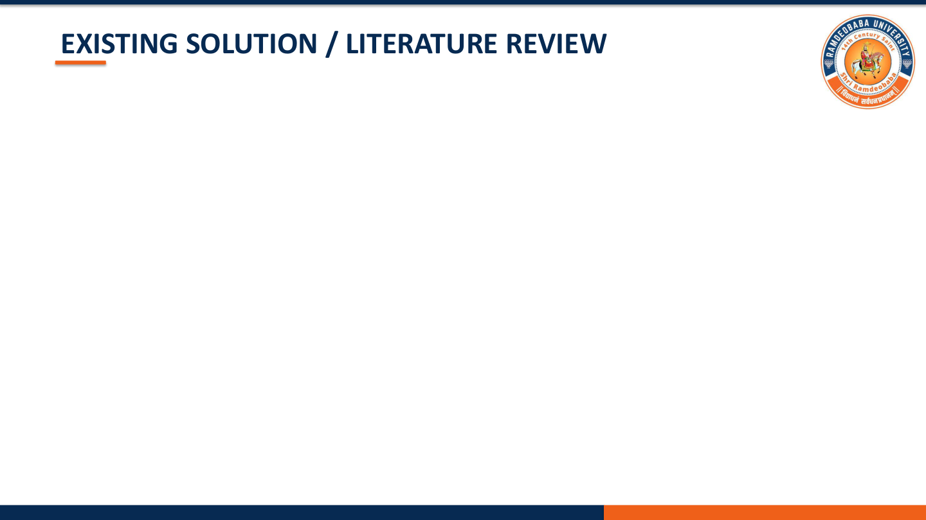
Existing Solutions
1. Adaptive Traffic Signal Control
2. SUMO-Based Traffic Control
Uses Reinforcement Learning (RL) for adaptive signal control and helps optimize traffic signals.
Uses SUMO and TraCI to develop and evaluate traffic controllers.
3. Coordinated Traffic Signal Control
4. Traffic Modelling with SUMO
Uses multi-agent Reinforcement Learning for signal optimization.
Provides frameworks for building and simulating traffic networks.
Limitations / Research Gap
Existing Approach
Limitation
Adaptive Signal Control
Does not specifically address uneven traffic distribution during peak hours.
SUMO Traffic Control
Does not focus on redistribution between overloaded and underutilized roads.
Coordinated Signal Control
Focuses on signal coordination rather than traffic imbalance.
SUMO Traffic Modelling
Does not specifically address peak-hour before–after strategy evaluation.
Research Gap: identify uneven traffic distribution, classify congestion using ML, and compare traffic-management strategies for separate peak periods.

Slide 4

Project Idea & Proposed Approach
Develop a Smart Traffic Management System using traffic simulation and Machine Learning to identify congestion and evaluate suitable traffic-management strategies.
1
Obtain selected Nagpur corridor from OpenStreetMap (OSM).
2
Convert and configure the road network in SUMO.
3
Generate demand for 9 AM–12 Noon and 4 PM–7 PM.
4
Run baseline simulation and analyse overloaded/underutilized locations.
5
Use ML to classify congestion as Low, Medium or High.
6
Simulate alternative traffic-management strategies.
7
Compare baseline and managed scenarios using traffic KPIs.
Key Innovation
Focus on uneven traffic distribution and period-specific management rather than only optimizing individual traffic signals.
Expected Outcome
Recommend a suitable traffic-management strategy separately for morning and evening peak periods.

Slide 5

OBJECTIVES
01
Traffic Simulation
02
Traffic & Congestion Analysis
Develop a SUMO-based simulation model representing the selected Nagpur corridor and traffic demand.
Analyse vehicle count, average speed, queue length, road/intersection and time period to identify congestion-prone and underutilized locations.
03
ML Congestion Classification
04
Strategy Evaluation
Develop an ML-based model to classify traffic congestion into Low → Medium → High.
Simulate and compare alternative traffic-management strategies for 9 AM–12 Noon and 4 PM–7 PM.
Expected measurable targets
Waiting time | Queue length | Travel time | Average speed | Throughput | Network delay

Slide 6
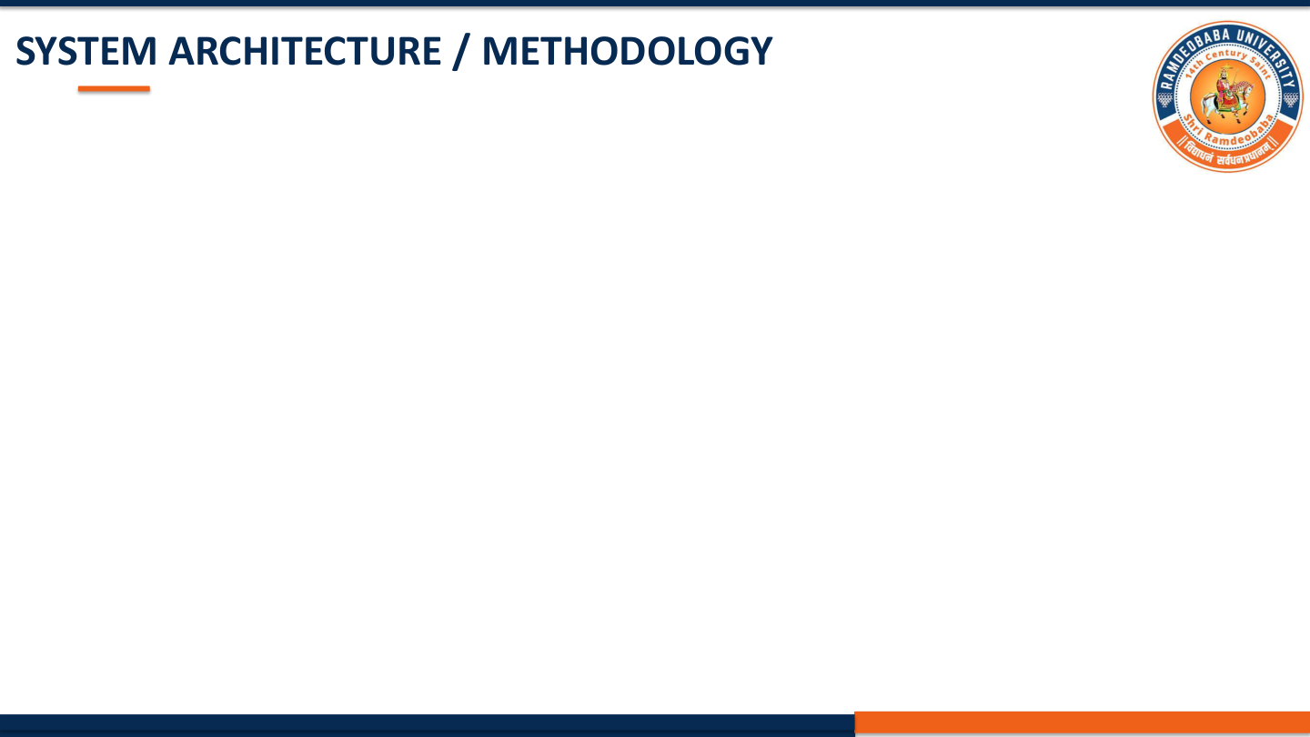
SYSTEM ARCHITECTURE / METHODOLOGY
OSM Road Network
+ Traffic Data
→
Peak-Hour
Traffic Demand
→
SUMO Baseline
Simulation
→
Traffic &
Congestion Analysis
→
ML Congestion
Classification
Traffic-Management
Scenarios
→
KPI
Comparison
→
Recommended Traffic
Management Plan
INPUT
PROCESSING
AI / ALGORITHM
OSM road network • Traffic demand • Vehicle count • Road capacity • Time period • Location
SUMO simulation • Traffic-flow analysis • Congestion identification
ML-based congestion classification:
Low → Medium → High
Congestion locations • Congestion levels • Scenario performance • KPI comparison • Recommended strategy
OUTPUT

Slide 7

IMPLEMENTATION
Programming
Traffic Simulation
Road Network Data
Python
SUMO + TraCI
OpenStreetMap (OSM)
Machine Learning
Data Processing
Visualization
Python-based traffic congestion prediction/classification
Pandas + NumPy
Matplotlib + Streamlit
Implementation Steps
• Road Network Preparation — extract corridor from OSM, convert to SUMO, configure roads/intersections/capacities.
• Traffic Demand Generation — create morning/evening demand, vehicle routes and traffic volumes.
• Baseline Simulation — run initial SUMO scenario and collect traffic parameters.
• ML Classification — feed selected parameters into ML model and classify Low/Medium/High.
• Scenario Simulation — test signal-timing adjustment, route redistribution and controlled traffic-flow changes.

Slide 8
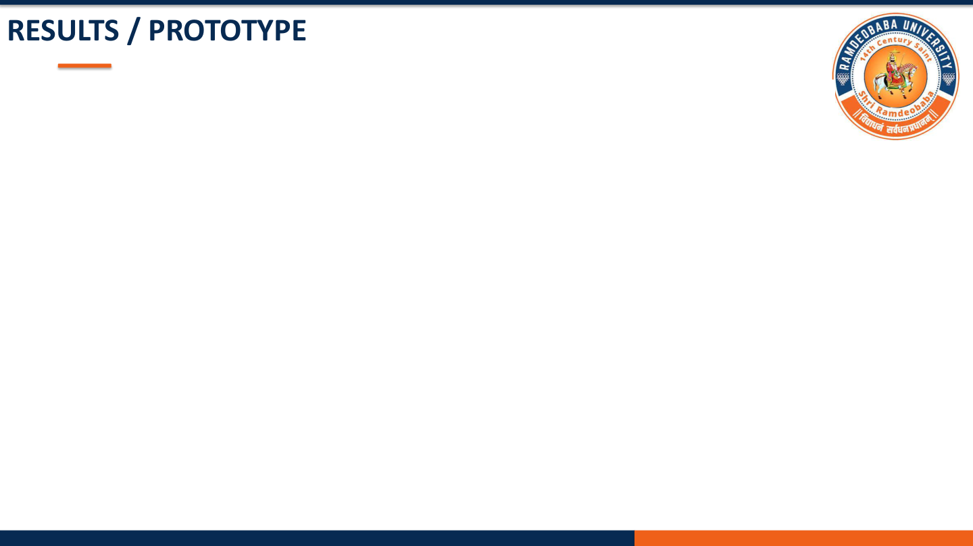
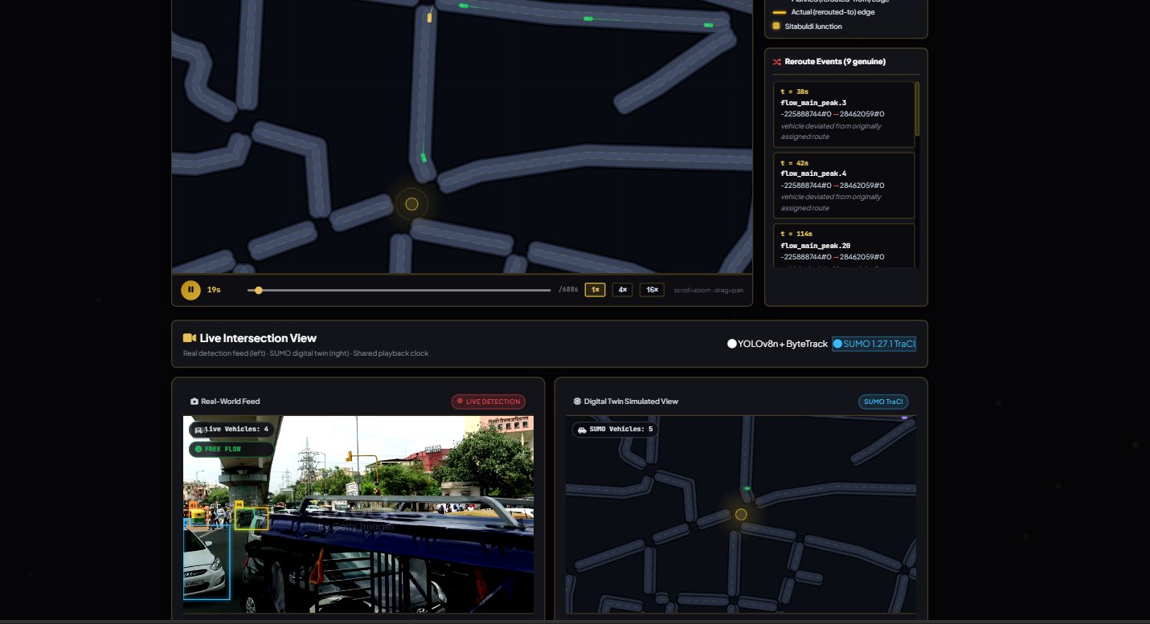
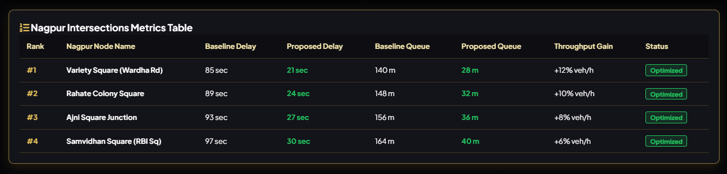
RESULTS / PROTOTYPE
No final experimental numerical results are provided yet; this slide therefore presents the planned prototype/results.
• SUMO road-network model for the selected Nagpur corridor
• Morning peak simulation: 9 AM–12 Noon
• Evening peak simulation: 4 PM–7 PM
• Congestion-prone road/intersection identification
• ML congestion classification: Low / Medium / High
• Baseline vs managed scenario comparison
• Traffic performance visualizations/dashboard
• Recommended traffic-management strategy
Key Performance Indicators
Average Waiting Time | Queue Length | Travel Time | Average Speed | Throughput | Network Delay

Slide 9

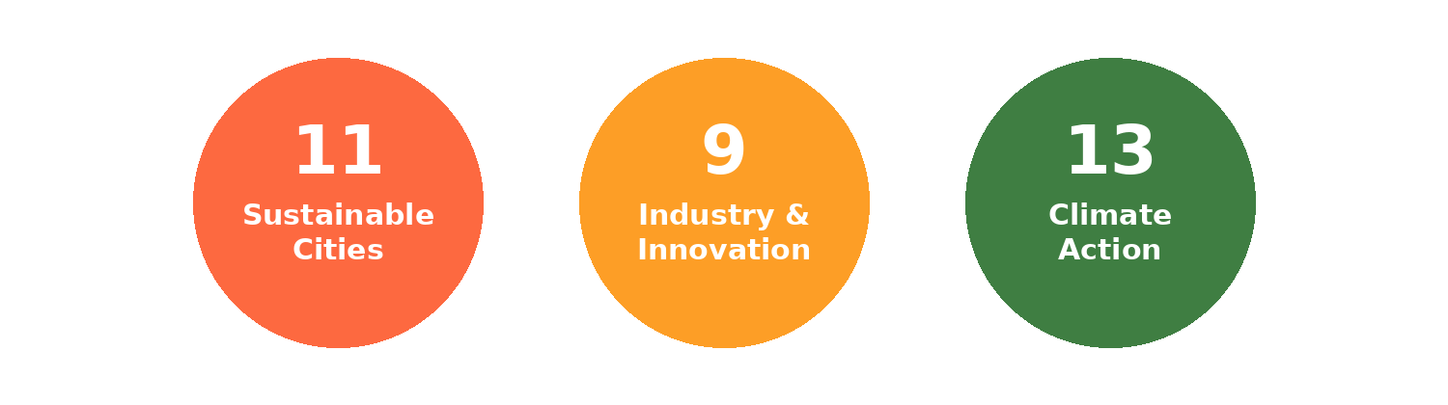
INNOVATION, IMPACT, DELIVERABLES & FUTURE SCOPE
★ INNOVATION
↗ IMPACT
• Focuses on uneven traffic distribution, not only signal optimization.
• Uses ML-based congestion classification.
• Evaluates strategies separately for morning and evening peak periods.
• Uses simulation for safe before–after strategy comparison.
• Better identification of overloaded roads/intersections.
• Improved understanding of underutilized road capacity.
• Data-driven traffic-management decisions.
• Reduced dependency on trial-and-error real-world changes.
DELIVERABLES
FUTURE SCOPE
• OSM-based SUMO road network and traffic-demand scenarios.
• Baseline and managed traffic simulations.
• ML congestion classification and KPI comparison.
• Visualization/dashboard and recommended traffic-management plans.
• Extension to additional road corridors.
• More detailed traffic-demand data.
• More advanced adaptive traffic-control techniques.
• Potential integration with real-world traffic systems in future.

Slide 10

CONCLUSION & REFERENCES
CONCLUSION
The proposed Smart Traffic Management System provides a simulation-based approach for addressing uneven traffic distribution in a selected Nagpur road corridor. It models traffic using OSM and SUMO, analyses peak-hour conditions, identifies overloaded/underutilized locations, classifies congestion using ML, tests alternative strategies and compares them using defined KPIs.
Scope Limitation
The project is limited to simulation and decision support. It does not directly control real traffic signals, deploy roadside hardware, or implement irreversible real-world traffic changes.
REFERENCES
• 1. Riehl, K., Kouvelas, A. & Makridis, M. A. — sumoITScontrol: Traffic Controller Collection for SUMO Traffic Simulations, 2026.
• 2. Reinforcement Learning for Adaptive Traffic Signal Control: An Overview, Transportation Research Procedia, 2026.
• 3. Ren, A. D., Zhang, B. G., Chang, F. & Huang, H. — Two-step deep reinforcement learning for traffic signal control, 2025.
• 4. Ren, F., Dong, W., Zhao, X., Zhang, F., Kong, Y. & Yang, Q. — Two-layer coordinated reinforcement learning for traffic signal control in traffic network, 2024.
• 5. Guastella, D. A., Montero-Porras, E., Morales-Hernández, A. & Bontempi, G. — Traffic Modeling with SUMO: A Tutorial, 2023.
Hiten Borkar • Naman Agrawal • Isaac David • Sara Ahmed | Prof. Rasika Rewatkar

