Slide 1


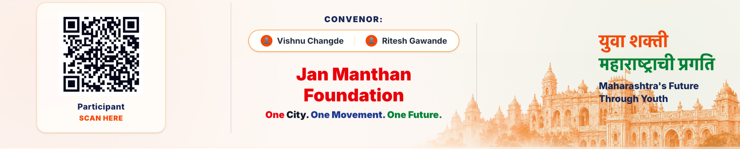
VIKASIT NAGPUR HACKATHON 2026
Project Name: Smart Traffic Management System for Uneven Traffic Distribution
Team name : Team TechnoVision
Theme: Smart City – Traffic Management
Problem Statement: Uneven Distribution of Traffic Over Planning Authority's Jurisdiction
Expected Solution: Traffic Management for Peak Hours (9 AM–12 Noon & 4–7 PM)
Designed Solution: SUMO + ML-Based Smart Traffic Management for a Nagpur Corridor

Slide 2
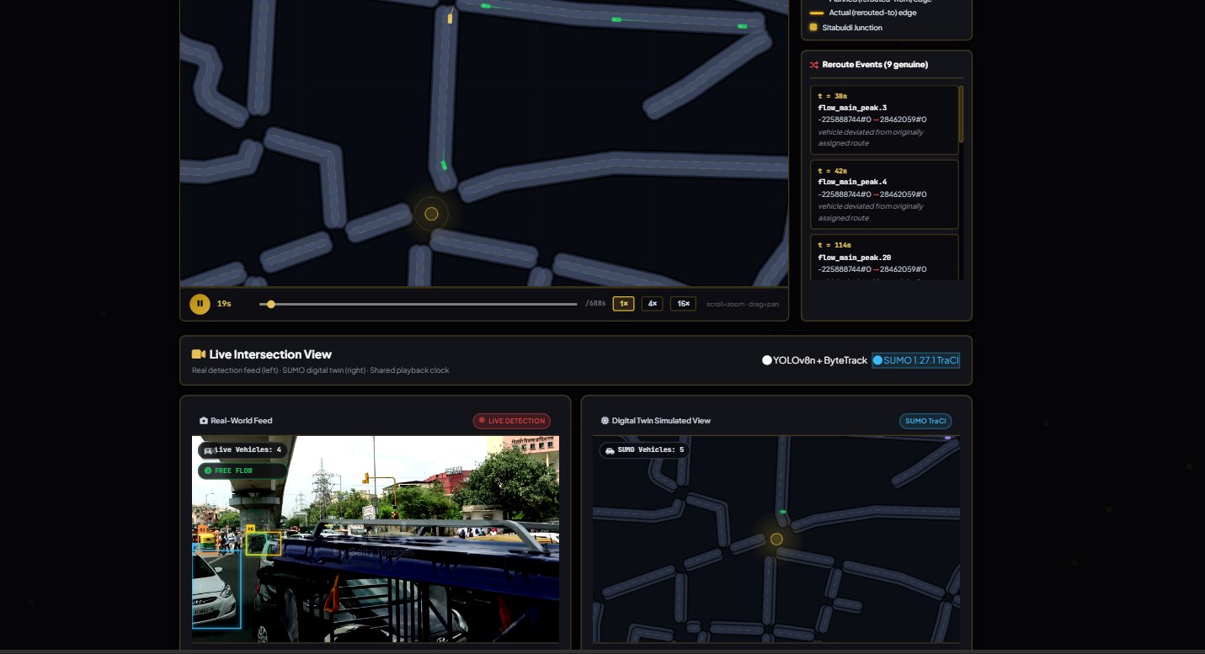
PROPOSED SOLUTION
Simulation-Based Smart Traffic Management for Uneven Traffic Distribution
SUMO simulation of a Nagpur road corridor modelling real traffic demand for the 9 AM–12 Noon and 4–7 PM peak windows
Identifies overloaded vs. underutilized roads and tests strategies to redistribute traffic across the corridor
ML-based congestion classification (Low/Medium/High) combined with peak-period-wise KPI comparison, not just signal control
Delivers a KPI dashboard (delay, queue length, travel time, throughput) to recommend the best strategy per peak period

Slide 3
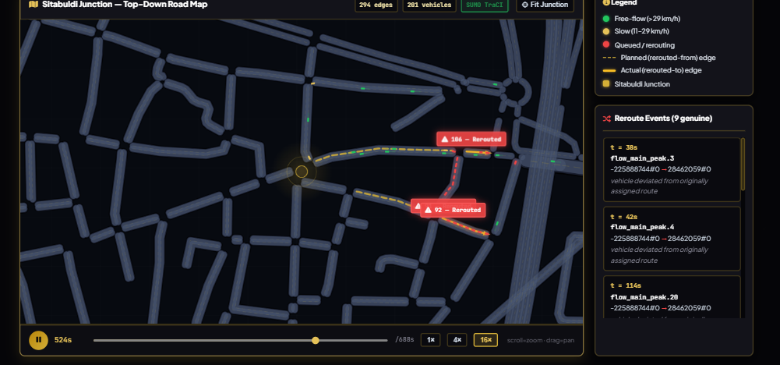
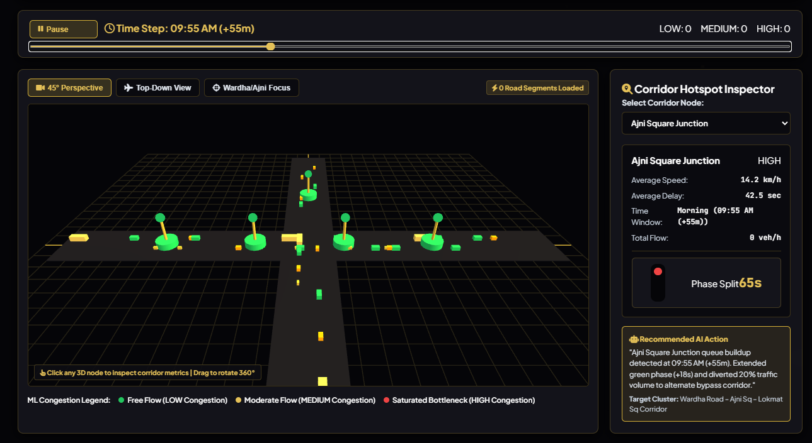
TECHNICAL APPROACH
Python, SUMO with TraCI, OpenStreetMap (OSM), Pandas & NumPy, Matplotlib/Streamlit, ML-based classification model
End-to-end pipeline (see diagram below), run separately for the 9 AM–12 Noon and 4–7 PM peak windows

Slide 4
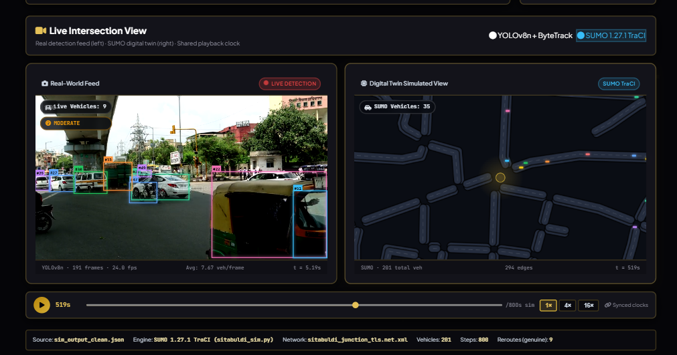
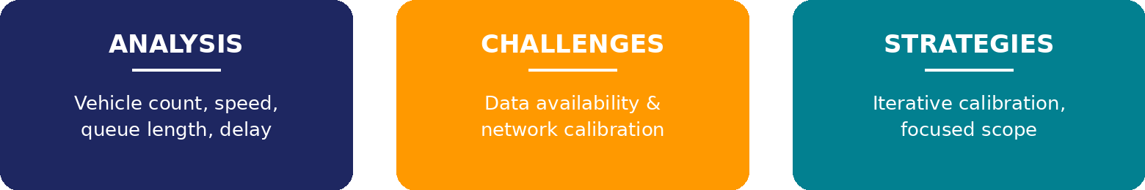
PRACTICAL IMPLEMENTATION
Baseline simulation captures vehicle count, speed, queue length, waiting time & travel time to flag congested roads/intersections
Limited real-world traffic-demand data; calibrating the SUMO network to actual Nagpur corridor conditions
Use OSM + available traffic observations with iterative calibration; scope scenarios tightly to the selected corridor & peak windows

Slide 5
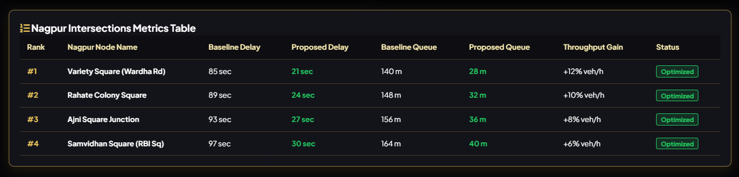
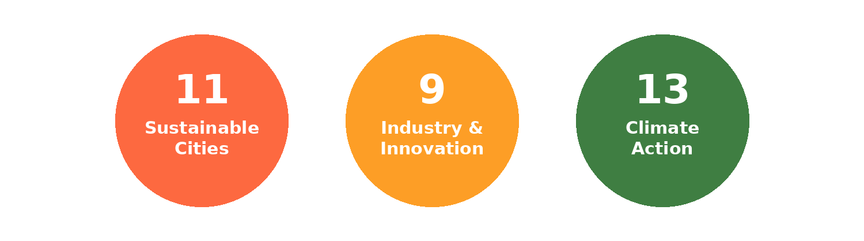
IMPACT AND BENEFITS
Reduced congestion, shorter queues & lower travel time for commuters; data-backed decisions for the planning authority
Supports SDG 11 (Sustainable Cities), SDG 9 (Industry & Innovation) and SDG 13 (Climate Action) via reduced idling emissions

Slide 6
RESEARCH AND REFERENCES
K. Riehl, A. Kouvelas & M. Makridis, “sumoITScontrol: Traffic Controller Collection for SUMO,” arXiv:2604.23240, 2026
F. Ren et al., “Two-layer coordinated reinforcement learning for traffic signal control,” Expert Systems with Applications, vol. 235, 2024
D. Guastella et al., “Traffic Modeling with SUMO: A Tutorial,” arXiv:2304.05982, 2023
K. Mehta, K. Raj & K. Brahmbhatt, “ML solutions for adaptive traffic signal control: A review,” WJAETS, vol. 13, no. 1, 2024
OpenStreetMap contributors — road network data for the selected Nagpur corridor

