Slide 1

EDA Presentation and proposed modeling technique
Advance NLP : Hate Speech detection using Transformers (Deep Learning)
Hiten Chadha
21.08.2022

Slide 2

Agenda
EDA Presentation
Proposed Modeling Technique

Slide 3
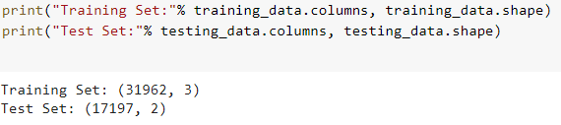
Checking the Shape of Training and Test Data
We have 31962 and 17197 tweets in the training and test data set respectively.

Slide 4
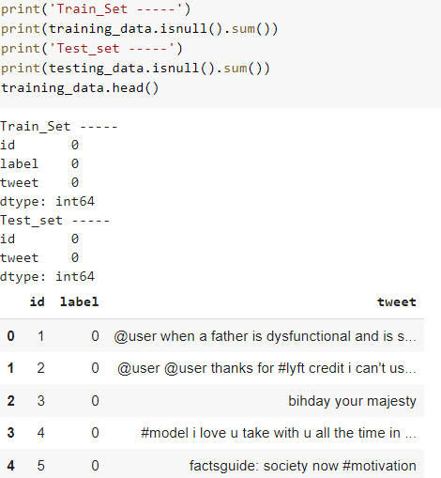
Null Data
There are no null data in the datasets.

Slide 5
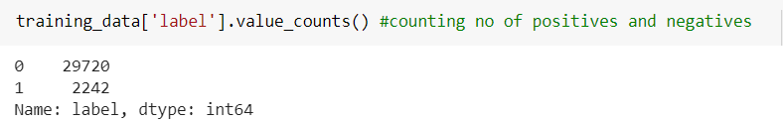
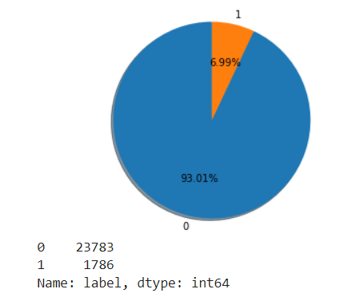
Positive and Negative Tweets
There are 2242 hate speech tweets (represented in yellow color in the given pie chart) in the training data and the rest contains no hate speech.

Slide 6
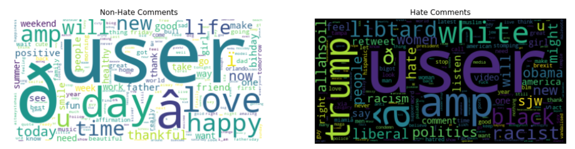
Most Frequent Hate Words
Visual representation of most frequent hate words

Slide 7
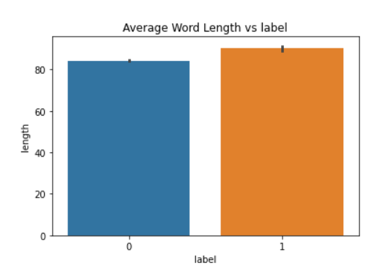
Average Word Lengths
Average word lengths for hate speech (orange) and non hate speech (blue) tweets.

Slide 8
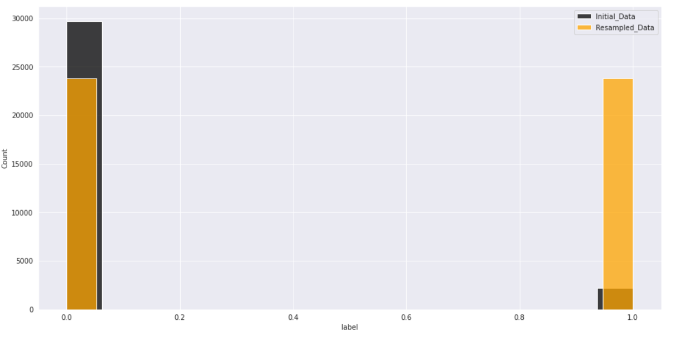
Undersampling and Overssampling results
Initial data(black) and after sampling data(orange) for hate and non hate words

Slide 9
Recommended Models
XGBClassifier
LogisticRegression
MultinomialNB
SGDClassifier
DecisionTreeClassifier
RandomForestClassifier
KNeighborsClassifier
LinearSVC
SVC
BERT
RoBERTa

Slide 10
Thank You

