Slide 1

Final Presentation
Advance NLP : Hate Speech detection using Transformers
Hiten Chadha
31.08.2022

Slide 2

Agenda
Problem Description
EDA Presentation
Proposed Modeling Technique
Tested Models
Chosen Model and Final Recommendatinon

Slide 3
Please Note
For week 13, I lost communication with my group and also was quite a bit occupied myself with work at my home university with my thesis finalization and stuff. So the work done for the last week was completed by just me and also I could not devote as much time as I wanted to for applying further advanced Deep learning models like BERT. I have tried classifiers that are known well to me and worked with good accuracy for this dataset. Hope it will be graded accordingly

Slide 4
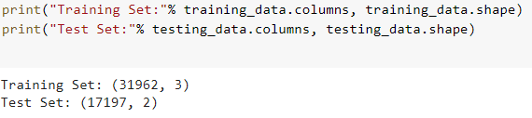
Checking the Shape of Training and Test Data
We have 31962 and 17197 tweets in the training and test data set respectively.

Slide 5
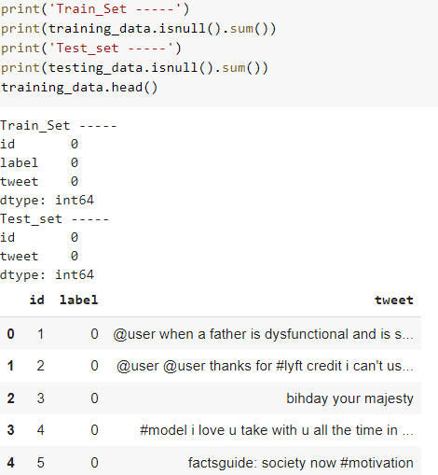
Null Data
There are no null data in the datasets.

Slide 6
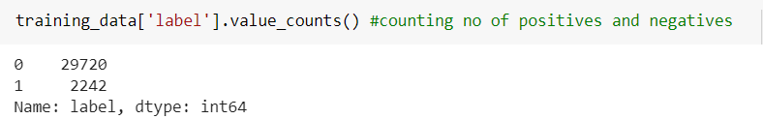
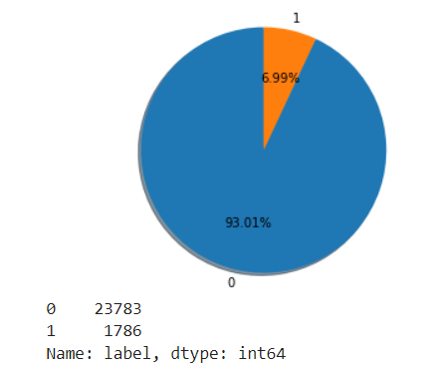
Positive and Negative Tweets
There are 2242 hate speech tweets (represented in yellow color in the given pie chart) in the training data and the rest contains no hate speech.

Slide 7
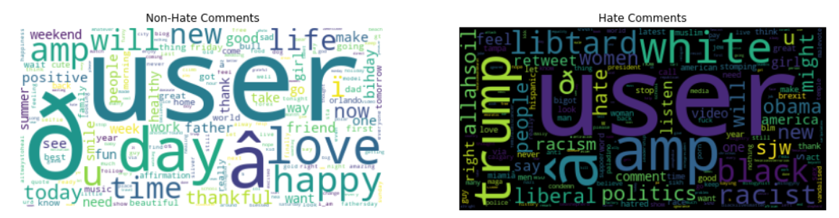
Most Frequent Hate Words
Visual representation of most frequent hate words

Slide 8
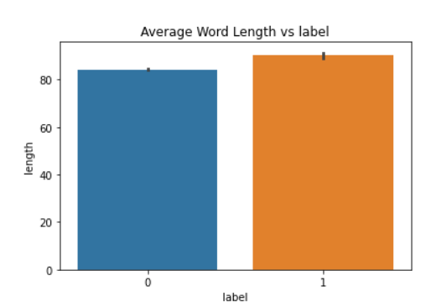
Average Word Lengths
Average word lengths for hate speech (orange) and non hate speech (blue) tweets.

Slide 9
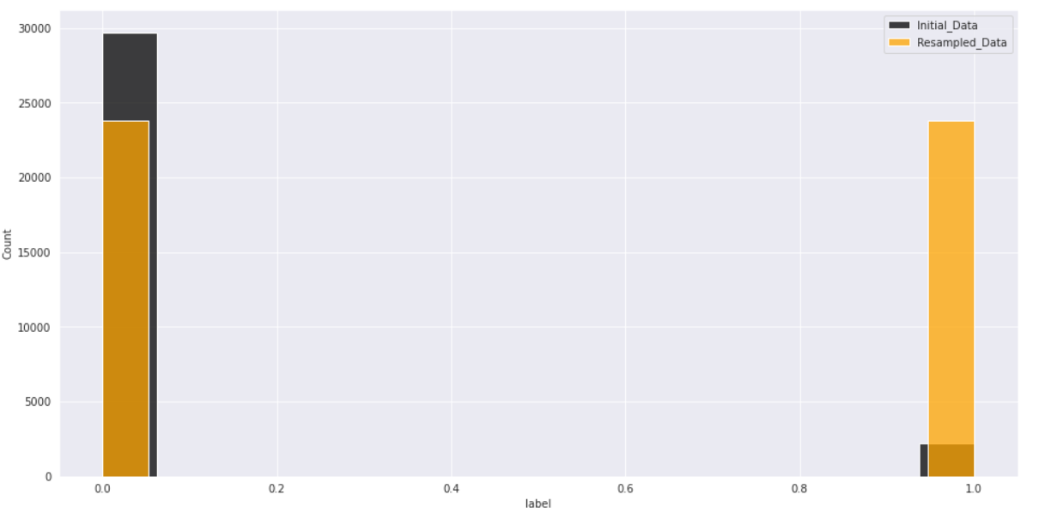
Undersampling and Overssampling results
Initial data(black) and after sampling data(orange) for hate and non hate words

Slide 10
Recommended Models
XGBClassifier
LogisticRegression
MultinomialNB
SGDClassifier
DecisionTreeClassifier
RandomForestClassifier
KNeighborsClassifier
LinearSVC
SVC
BERT
RoBERTa

Slide 11
Tested Models
CatBoost Classifier
LogisticRegression
MultinomialNB
SGDClassifier
KNeighborsClassifier
LinearSVC
DecisionTree Classifier
RandomForest Classifier
Adaboost Classifier
BERT(Failed to execute completely)

Slide 12
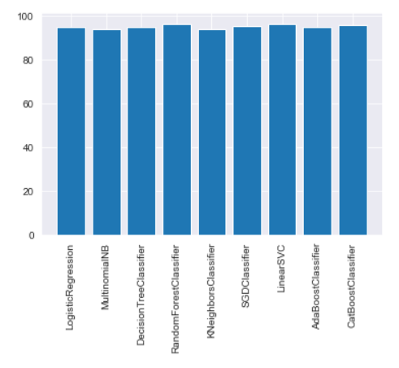
Tested Model Accuracies
RandomForestClassifier Accuracy Score : 96.03% AdaBoostClassifier Accuracy Score : 94.73% KNeighborsClassifier Accuracy Score : 93.87% LogisticRegression Accuracy Score : 94.82%
CatBoostClassifier Accuracy Score : 95.54% DecisionTreeClassifier Accuracy Score : 94.78% MultinomialNB Accuracy Score : 94.99%
SGDClassifier Accuracy Score : 95.28% LinearSVC Accuracy Score : 96.39%

Slide 13
Final chosen model
Linear SVC

Slide 14
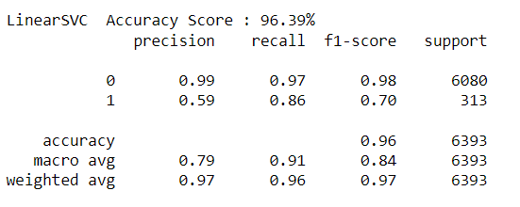
Chosen Model metrics

Slide 15
Final Recommendation
For the given problem, the recommended model used should be Linear SVC. However, Randomforest can be a good choice as well and might work better with other test data. BERT model might work even better but unfortunately I was unable to implement it in full, so the future work might be to test the data with the Huggingface library.

Slide 16
Thank You

