Slide 1
INSURANCE AI HUB
Multi-Agent AI Intelligence Platform
Built 100% on Snowflake Cortex
Agents
5
Tables
18
Semantic Views
4
Dashboard Pages
5
Hackathon 2026

Slide 2
THE PROBLEM
Insurance operations are fragmented across siloed tools
Pricing analysts use spreadsheets to compare benchmarks — no real-time competitive view
Retention teams have separate dashboards for churn monitoring — disconnected from billing
Product teams track recommendation acceptance in isolated reports — no feedback loop
Data quality issues are discovered reactively, not proactively — no root-cause analysis
No single interface for cross-domain questions spanning pricing + churn + recommendations
Result: Slow decisions, missed retention opportunities, no unified intelligence

Slide 3
THE SOLUTION
One question. Multiple agents. One answer.
Unified Dashboard
5 analytics pages in Streamlit-in-Snowflake
No external hosting
Multi-Agent AI
Orchestrator routes to 4 specialized agents
Cortex Agents with toolsets
Natural Language Q&A
Text-to-SQL via semantic views
Cortex Analyst
Document Search
Vector search over policy documents
Cortex Search + Arctic Embed
Routing Transparency
Real-time display of which agent handles query
CORTEX.COMPLETE (llama3.1-8b)
Conversational
Follow-up questions with context
Message history injection

Slide 4
ARCHITECTURE
Streamlit Dashboard (5 Pages + AI Assistant)
ORCHESTRATOR AGENT | 300s / 50K tokens
Routes queries to specialized child agents via agent toolsets
Product
Matching
Cortex Analyst +
Search
Price
Optimization
Cortex Analyst
Market
Intelligence
Cortex Analyst
Data
Quality
Cortex Analyst
SV_PRODUCT
MATCHING
SV_PRICE
OPTIMIZATION
SV_MARKET
INTELLIGENCE
SV_DATA
QUALITY
INSURANCE_AI_HUB Database
ANALYTICS (11 tables) | DATA_QUALITY (4 tables) | DOCUMENTS (2 tables)

Slide 5
DATA Model related objects
3 Schemas | 18 Tables | ~2,500+ Rows
Table | Rows | Purpose
CUSTOMERS | 200 | Customer profiles with risk tier, credit score, segment
POLICIES | 300 | Insurance policies with premium, coverage, loss ratio
CLAIMS | 400 | Claims with fraud scores, friction points, resolution time
BILLING | 500 | Invoices, payments, outstanding balances, late fees
PRODUCTS | 20 | Product catalog with eligibility rules
RECOMMENDATIONS | 300 | Recommendation audit trail with match scores
REC_FEEDBACK | 180 | Acceptance, ratings, feedback text
AT_RISK_POLICIES | 165 | Churn probability, revenue at risk, risk scores
MARKET_TRENDS | 384 | Time-series market indicators by region
COMPETITOR_RATES | 192 | Benchmark premiums by competitor, type, tier
DQ_SCORES | 28 | Quality scores per table over time
DQ_RULES | 50 | Rule definitions and execution results
DOCUMENT_CHUNKS | 24 | Chunked text with vector embeddings

Slide 6
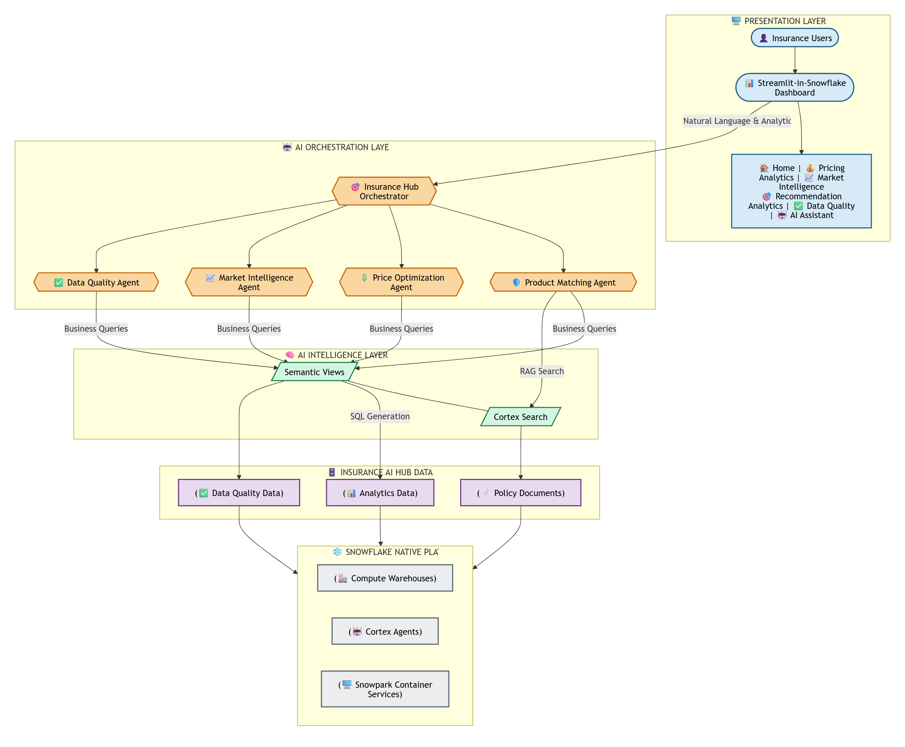
END TO END ARCHITECTURE

Slide 7
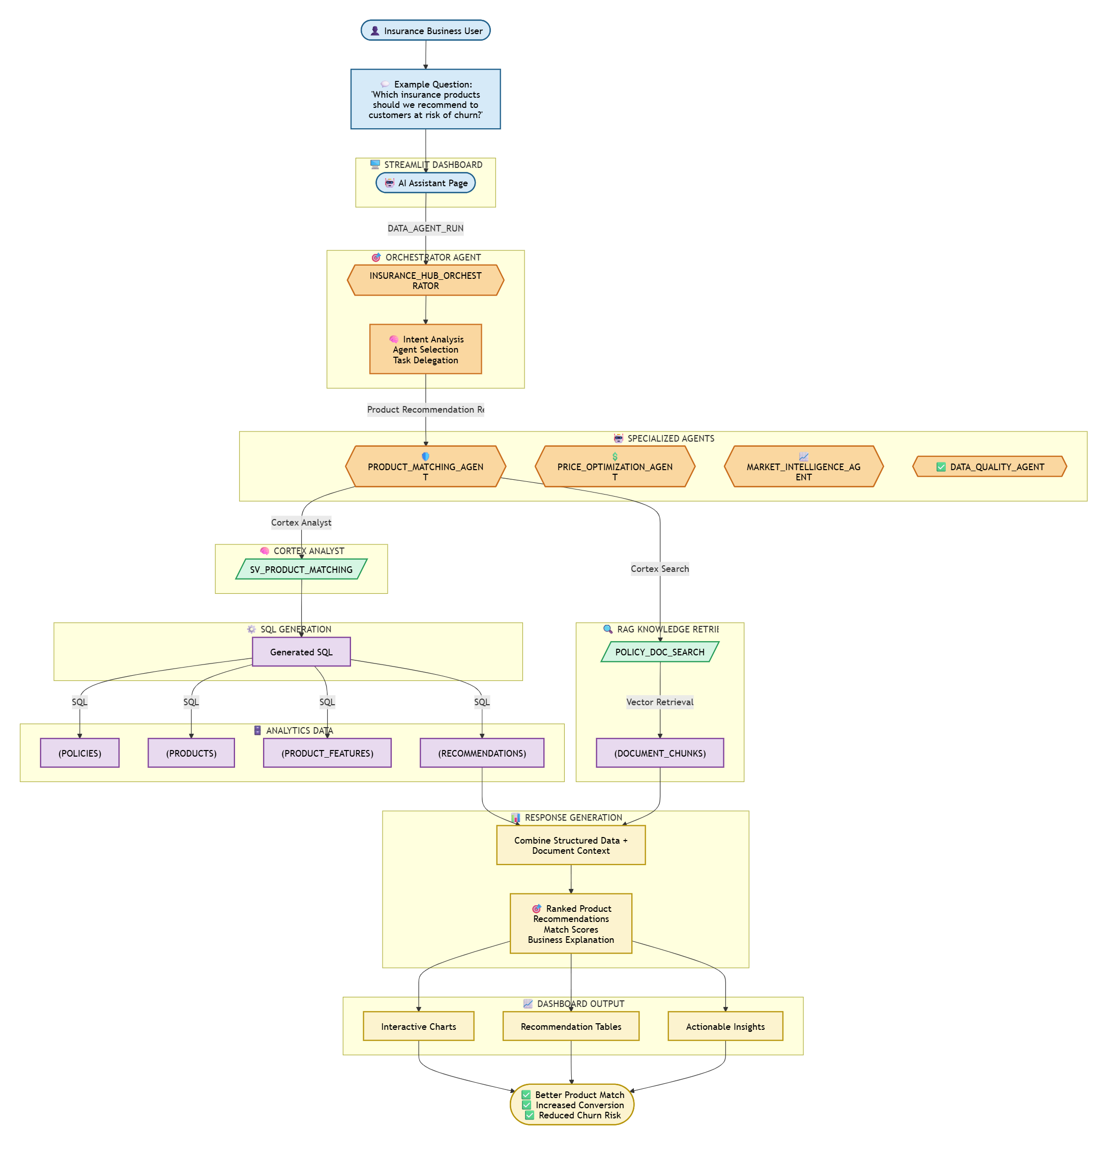
EXECUTION WORKFLOW VIEW

Slide 8
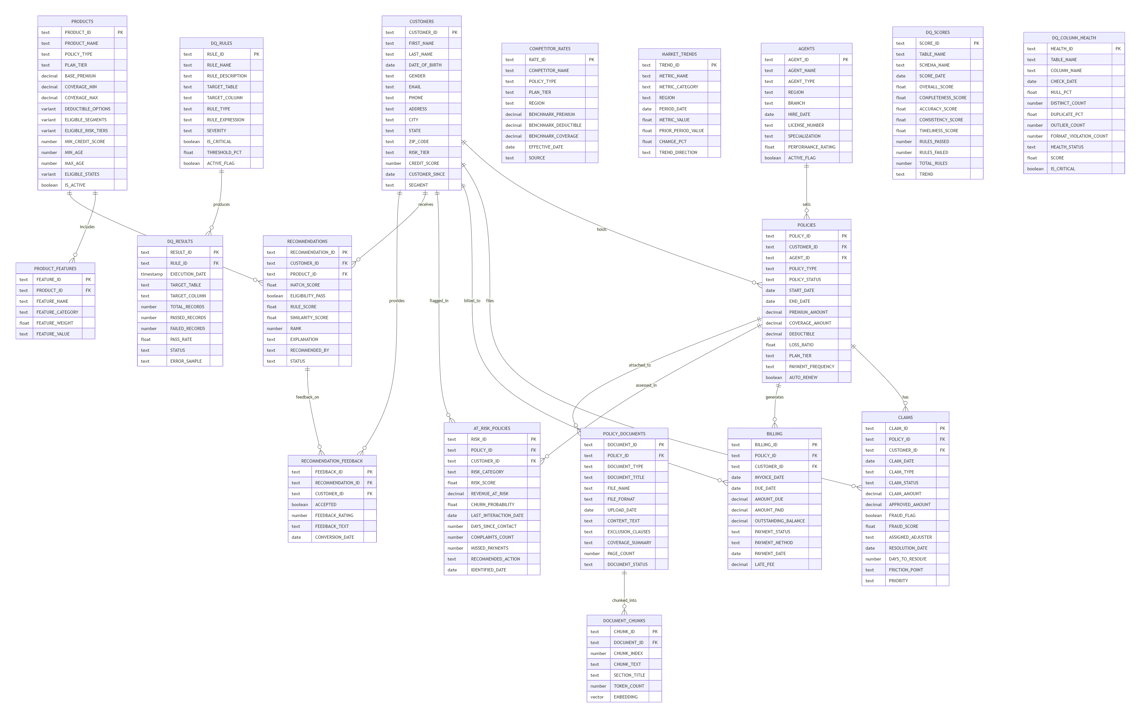
ERD DIAGRAM

Slide 9
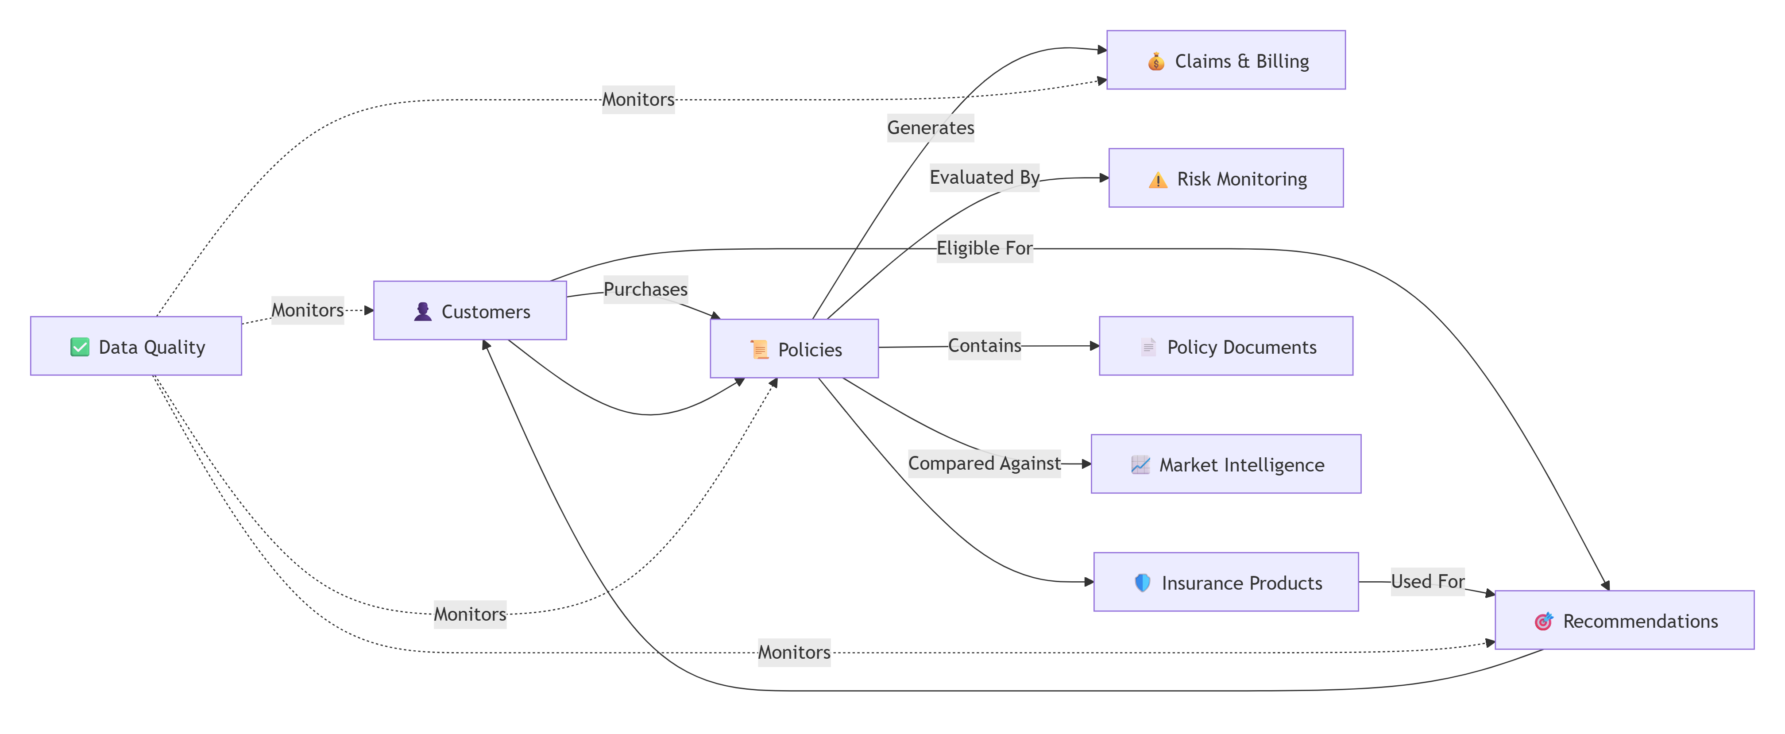
EXECUTION WORKFLOW VIEW

Slide 10
SNOWFLAKE CORTEX FEATURES
Cortex Agents
Multi-agent orchestration with agent toolsets
Cortex Analyst
Text-to-SQL via 4 semantic views
Cortex Search
Vector search over 24 policy document chunks
CORTEX.COMPLETE
LLM classification for real-time agent routing (llama3.1-8b)
DATA_AGENT_RUN
SQL function to invoke agents from Streamlit
Streamlit-in-Snowflake
Native dashboard — no external servers
Agent Toolsets
Orchestrator inherits child agent tools natively
Code Execution
Built-in Python sandbox for complex calculations
Data to Chart
Agent-generated visualizations from query results

Slide 11
WHAT MAKES THIS UNIQUE
100% Snowflake-Native
No external APIs, no LangChain, no vector DBs.
Everything runs inside Snowflake.
Multi-Agent Orchestration
Not a chatbot. A supervisor that reasons
about which specialist(s) to consult.
Routing Transparency
Users see which agent handles their query.
Powered by LLM classification.
Structured + Unstructured
Same platform handles SQL analytics
and document search.
Semantic Views as Truth
Business logic defined once, consumed
by all agents. No SQL hallucination.
Cross-Domain Reasoning
One question can trigger 3 agents
in sequence. Orchestrator chains results.

Slide 12
THANK YOU
Insurance AI Hub
Built 100% on Snowflake Cortex | Hackathon 2026

