Slide 2
What is Python?
Python programming language is a general purpose high level language which is structural, procedural, and object oriented programming. Like most programming languages, Python code supports classes, methods, static methods, inheritance, etc. And the most important part is, it supports modules and packages which encourages code reusability in a program work flow.

Slide 3
Why Learn Python programming language?
Here are some of the reasons but not limited to learn Python programming language.
It is very popular, probably because it’s easy to learn code for beginners.
It has a simple syntax (like a spoken language) which makes people understand without putting much effort. Because of this, newbies can quickly start working on simple programs or even understand the complex codes written by professionals.
This is the most versatile language I have ever come across. Because we can use it for the script purpose, web development, data analysis, reporting, and many more.
Its open source (free) and it support cross platform that means you can run this on Mac, Windows, Linux, and the other platforms as well.
Use this Python language to develop both windows and web applications.
The kind of resources that it has, including tutorials, forums, libraries that support this python development environment is unimaginable.
Moreover, it has large variety of libraries or python modules that support Data Scientists to analyze and visualize tutorial data.
Because of all the above features, Python interpreter helps for the rapid application development.

Slide 4
Python Basics
Variables
Global Variables
Local Variables
Datatypes
Type Conversion
Random Numbers
Download Library
Pip
String Modification (String Methods, Formatted string)
Unpacking of list

Slide 5
Python Tutorial on Operators
It is the best language to learn for the people who are new to programming and experienced with other languages. The first step is to install Python programming language on your operating system (if not installed by default).
Once the Python installation is completed, you can start learning from basic operators tutorial to Numpy and pandas modules. And tis language supports the following operators. Use this section to learn the basics of the programming.

Slide 6
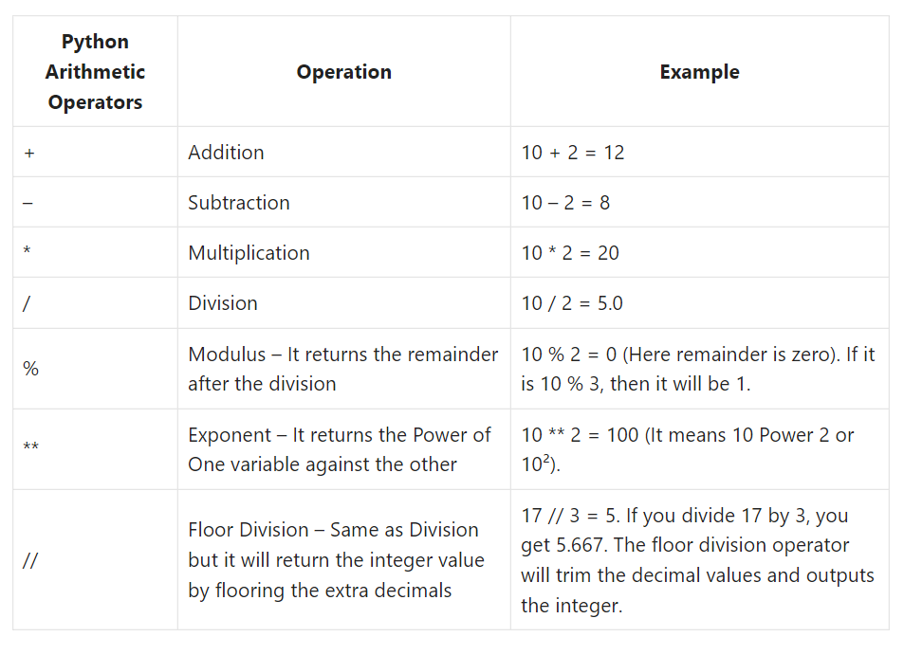
Python Arithmetic Operators
Python Arithmetic operators include Addition, Subtraction, Multiplication, Division, Floor Division, Exponent (or Power), and Modulus. All these Arithmetic are binary operators, which means they operate on two operands.

Slide 7
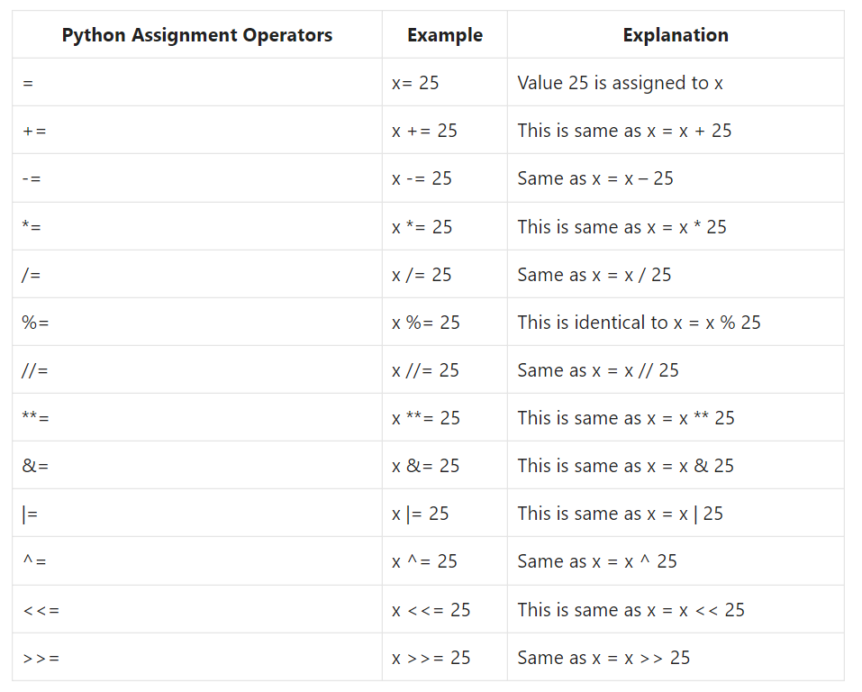
Python Assignment Operators
The Python Assignment Operators are handy to assign the values to the declared variables. Equals (=) operator is the most commonly used assignment operator in Python. For example: i =10

Slide 8
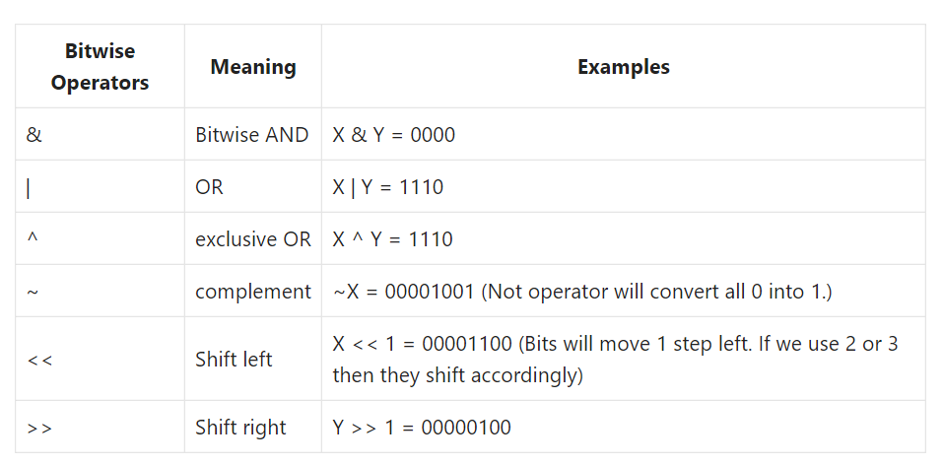
Python Bitwise Operators
Python Bitwise operators help perform bit operations. All the decimal values will convert into binary values (bits sequence, i.e., 0100, 1100, 1000, 1001, etc.). Next, the Python bitwise operators work on these bits, such as shifting left to right or transforming bit values from 0 to 1 and vice versa.
The next table shows the different Python Bitwise operators and their meaning. For example, Consider x = 6 and y = 8 and their values in binary form are: x = 0110 and y = 1000

Slide 9
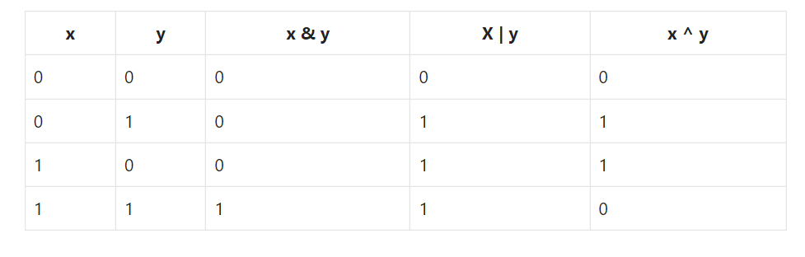
Python Bitwise Operators Cont.
The Truth Table behind Python Bitwise Operators is:

Slide 10
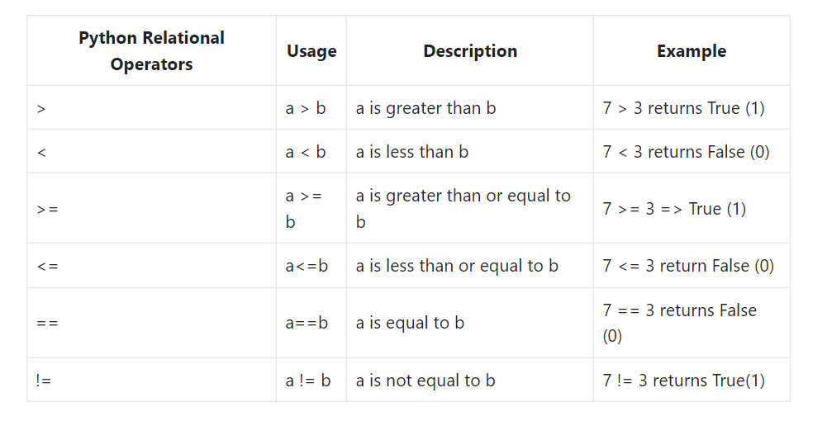
Python Comparison Operators
Python Comparison Operators are called Relational operators, and they are mostly used either in IF Statements or Loops. Comparison Operators in Python are usually used to check the relationship between two variables. If the relation is true, it returns TRUE, and if the relation is false, then it will return output as FALSE. The below table shows all the Comparison Operators.

Slide 11
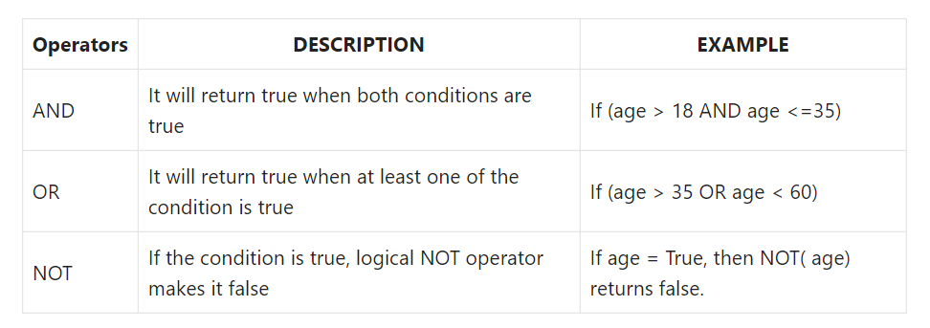
Python Logical Operators
Python Logical Operators are used to combine two or more conditions and perform the logical operations using Logical AND, OR, and NOT. The Python Comparison Operators are used to compare two variables, what if we want to match more than one condition? Very simple, Python logical operators will do the trick for you. The below table outlines the and, or, not operator with examples.

Slide 12
Python Tutorial on Flow Control Statements
Generally, flow control statements contain a condition followed by a block of code. The condition always returns either True or false. Based on the result, the flow control statement will execute the block of code.
If True, the true statements will execute. Otherwise, False statements execute or exit from a control flow statement.

Slide 13
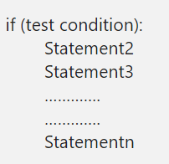
Python If Statement
The Python If statement is one of the most useful decisions making statements in real-time programming. Python If statement allows the compiler to test the condition first, depend upon the result, it executes the code block. while a given test condition is true, then only the code within the if block executes.
The if statement in Python Programming has a simple structure:
When the test condition in the Python If statement is true, Statement1, Statement2, ……., Statementn will execute. Otherwise, all too them will skip. Let us see the flow chart for a better understanding.

Slide 14
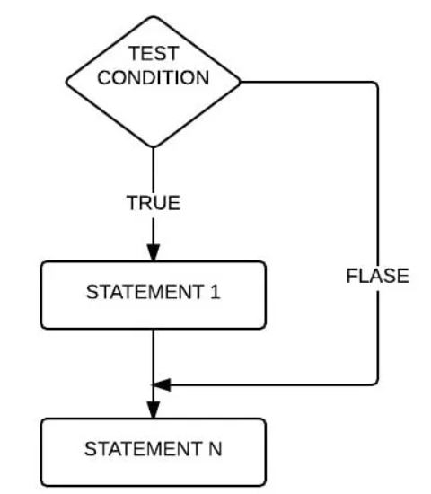
Python If Statement Flow Chart

Slide 15
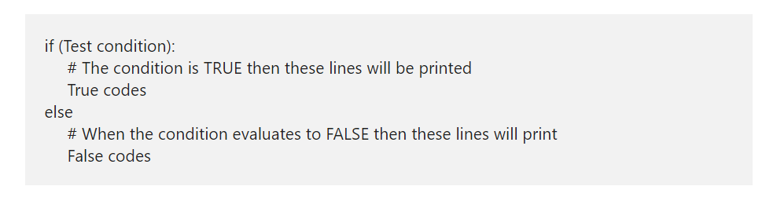
Python If Else Statement
The Python If Else Statement is an extension to the If (which we discussed in the earlier post). The If condition will only execute the code block when the given condition is true and when the condition is false, it will not execute the code.
In real-world, it would be nice to execute something when the expression fails. To do so, If condition is used and here, the Else block will run some code when the condition fails. The syntax of the Python If Else Statement is.
When the test condition present in the above Python If else structure is evaluated to true, True statements executed. When it return false, False code executed.

Slide 16
Python Nested If
Python Nested If Statement means to place one If inside another If Statement. Python If Else statement allows us to print different statements depending upon the expression result (TRUE, FALSE). Sometimes we have to check further even when the condition is TRUE. In these situations, we can use the Python Nested IF statements, but be careful while using it.
In the Python nested if statement example, every person is eligible to work if he is 18 years old or above. Else he is not qualified. However, companies won’t offer a job to every person. So, we use another If condition, also called Python Nested If Statement, to check his education qualifications or any specific company requirements.

Slide 17
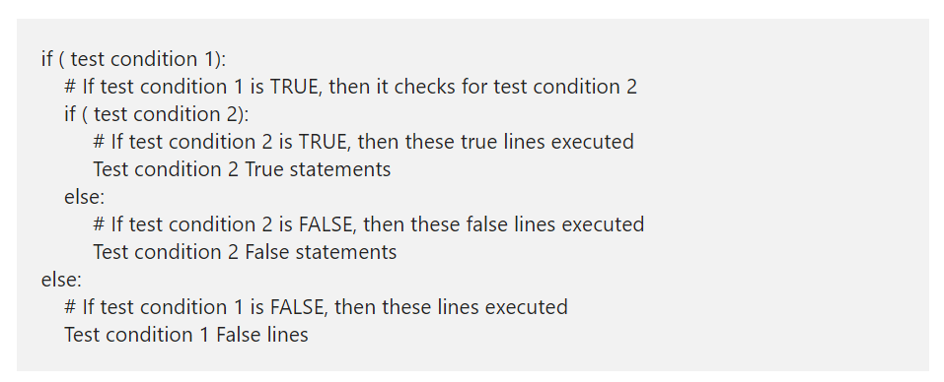
Python Nested If Statement Syntax
The Python Nested If Statement Syntax is

Slide 18
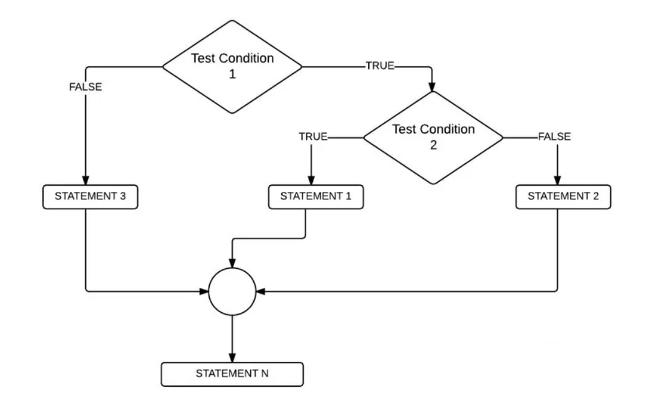
Nested if Flow Chart

Slide 19
Python elif Statement
The Python elif Statement also called as the Else If and it is very useful when we have to check several conditions. Apart from this Python elif, we can also use the Nested If to achieve the same. However, as the number of conditions increase, the Nested If else complexity will also increase. Let us see the syntax of the same.

Slide 20
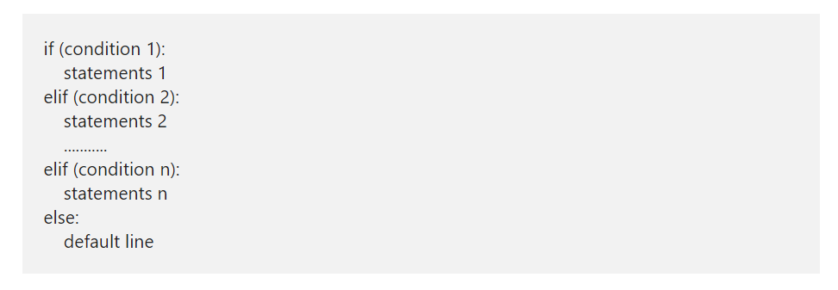
Python elif Syntax
The syntax of Python elif or else if statement is

Slide 21
Python elif Syntax Contd.
The Python Elif or else if statement handles multiple lines effectively by executing them sequentially. It means Python elseif or elif will check for the first condition, if the condition is TRUE then it will execute the statements present in that block.
If the condition is FALSE then Python elseif will check the Next one (Elif conditional statement) and so on. There will be some situations where condition 1, condition 2 is TRUE, for example:
x= 20, y=10
Condition 1: x > y # TRUE
Condition 2: x != y # TRUE
In these situations, block of code under the Condition 1 will be executed. Because Python elif conditions will only be executed if its previous if statement (else) fails.

Slide 22
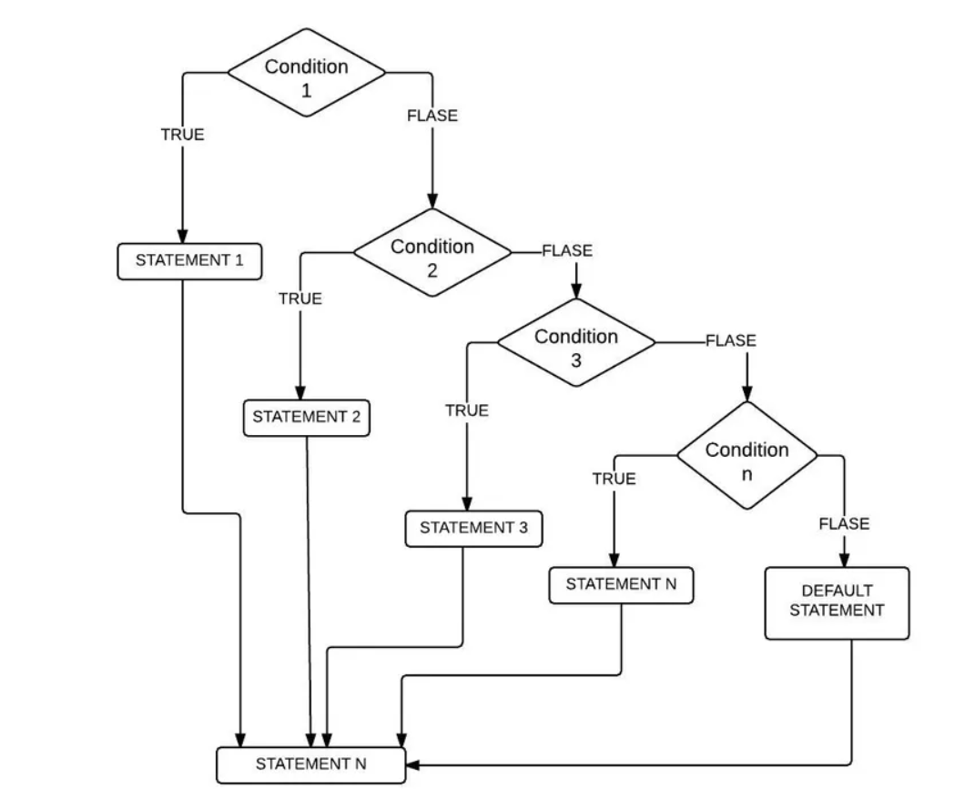
Elseif Statement Flow Chart

Slide 23
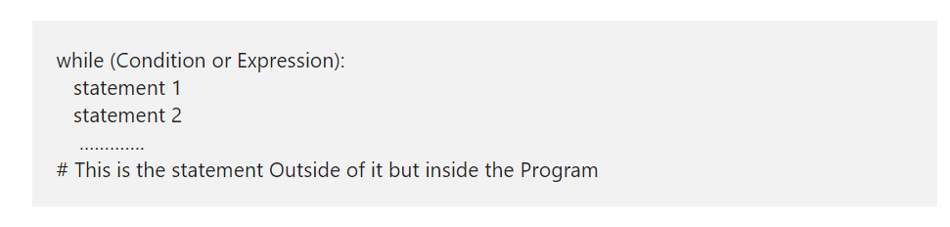
Python while Loop
The Python while Loop is used to repeat a block of statements for given number of times, until the given condition is False. A while loop in Python start with the condition, if the condition is True then statements inside it will be executed. If the given condition is false, it won’t execute at least once, which means, it may execute zero or more time and the syntax of it is:
The Python While Loop Syntax is as follows:

Slide 24
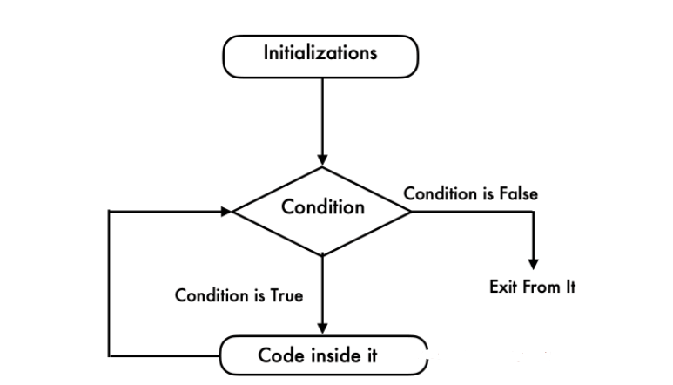
Python while Loop Flow Chart
This flow chart will explain you Visually and perfectly

Slide 25
Python while Loop Flow Chart Contd.
Python while loop will check for the condition at the beginning of it.
If the condition evaluates to True then it will execute the code inside it.
Next, we have to use Arithmetic Operator inside the Python while loop to increment and decrement the value.
After the value increments, it will again check the expression. As long as the condition is met, the statements in it will be executed.
If the expression becomes False then it will exit from it.

Slide 26
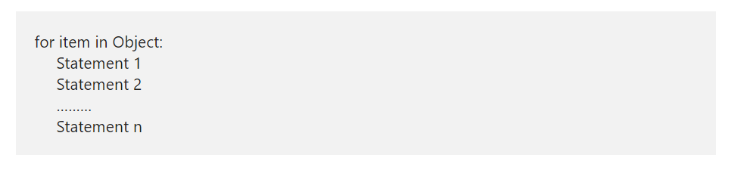
Python For Loop
The Python For Loop is used to repeat a block of statements until there are no items in the Object may be String, List, Tuple, or any other object. Let us see how to write the Python For Loop, range, and the else part with practical examples. Let us see the syntax of it, prior to getting into the details:
The syntax of the Python For Loop in is as follows:

Slide 27
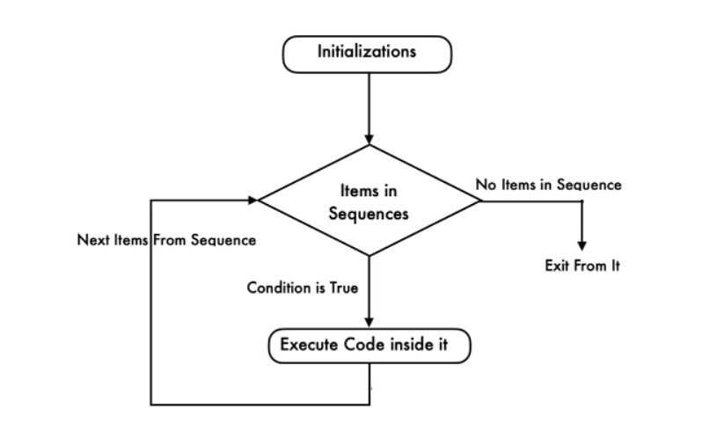
Python For Loop Flow Chart

Slide 28
Python For Loop Flow Chart Contd.
The execution process of the for loop in python is:
Initialization: We initialize the variable(s) here. Example i=1.
Items in Sequence / Object: Compiler will check the items in Objects. Example, individual letters in String word. If there are items in sequence ( True) then it will execute the statements within it or inside. If there is no item in sequence ( False) then it will exit.
After completing the current iteration, compiler will traverse to next item.
Again it will check the new items in sequence. As long as the items in sequence, the statements inside it will be executed.

Slide 29
Python break Statement
The Python break statement is very useful to exit from For, While and Nested Loops. While executing these code blocks, if the compiler finds this inside them, the compiler will stop executing the code inside it and exit immediately from the iteration.
For example, we have 5 lines of code inside the loop and we want to exit from it when certain condition is True otherwise, it has to execute them. In these situations we can place the Python Break statement inside the If condition.
If the condition is True then compiler will execute this statement. It means, the Python break Statement will exit the controller from the loop completely. Otherwise, it will execute all block of code.

Slide 30
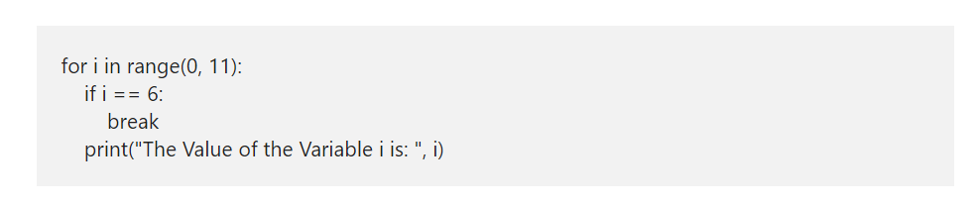
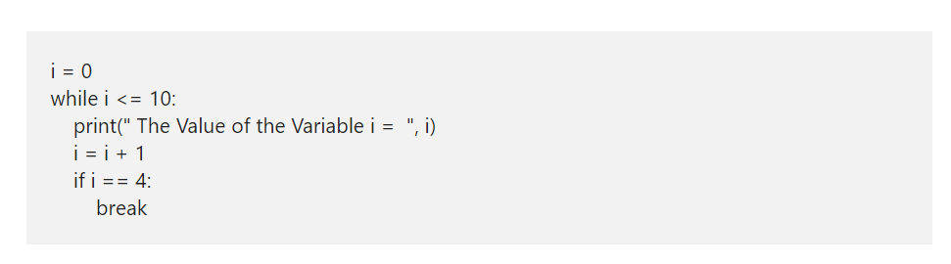
Python break Statement in For and While loop

Slide 31
Python continue
The Python continue statement is another one to control the flow of loops. Similar to Break statement, this Python continue statement is used inside For and While Loops. While executing these iterables, if compiler find this statement inside them, then compiler will stop the current iteration and starts the new iteration from the beginning.
For example, we have 10 statements inside the loop. And we want to skip executing the last 5 (statement6 — 10) when a certain condition is True or else it has to execute all the 10 statements inside a loop. In these situations, we place the condition after the 5th followed by the Python continue statement. If the condition is True then it will stop executing statement6 to 10 otherwise, it will execute lines 1 to 10.

Slide 32
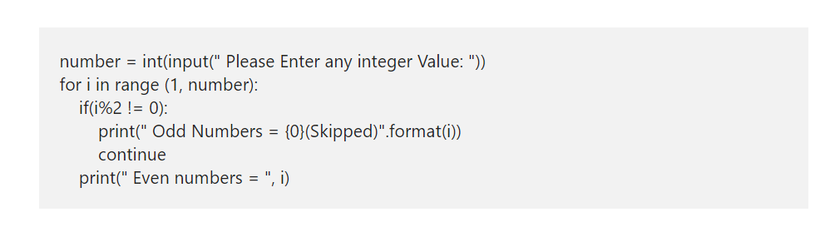
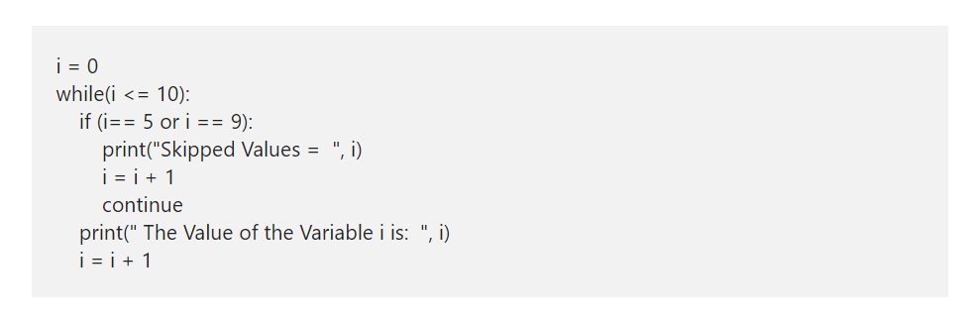
Python continue Syntax

