Slide 1
Surgical instrument and anatomy segmentation of endoscope videos for robotic surgery
2019.04.04
Team: Zhaoshuo Li, Hao Ding, Mingyi Zheng

Slide 2
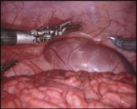
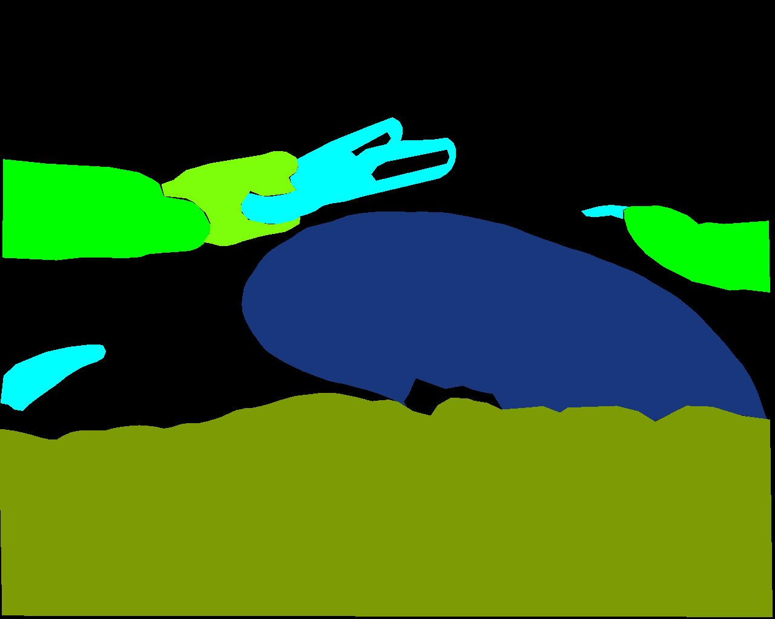
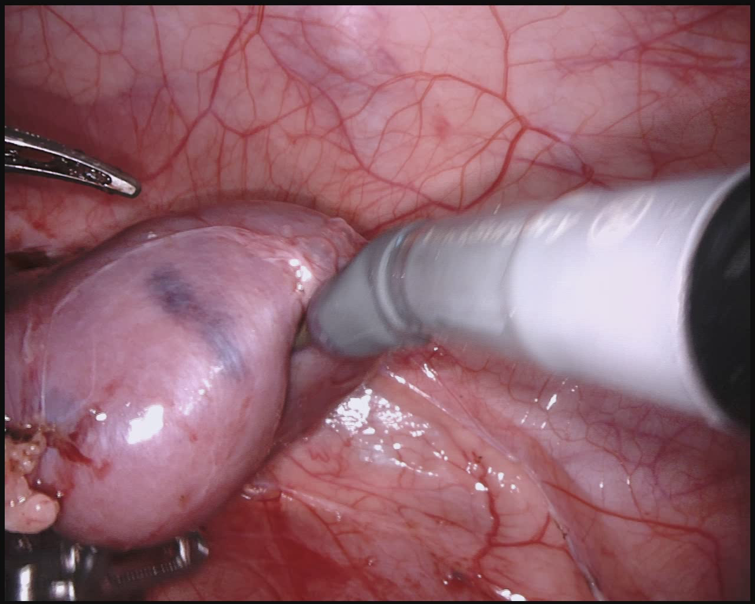
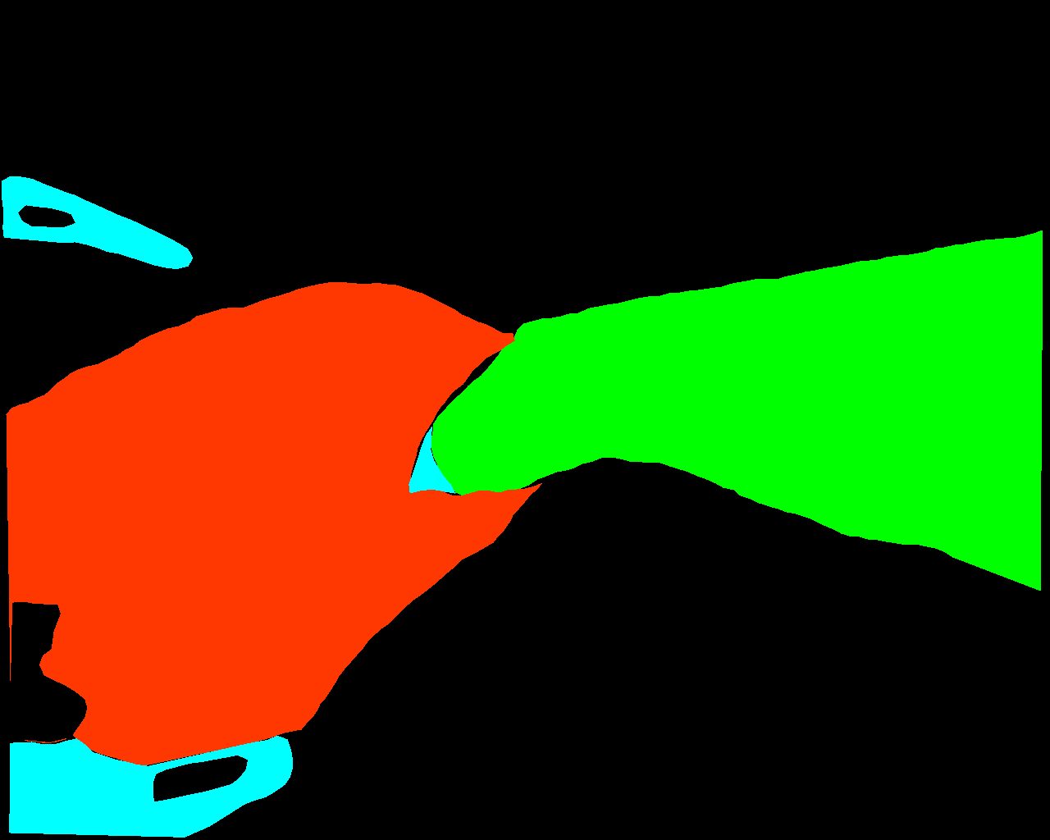
Problem Description
Motivation: Semantic segmentation allowing the robot to understand surgeon's action in the context of the current environment.
Challenge:
Similar features between classes: 11 in total, e.g. covered kidney vs. kidney parenchyma
Limited data: 2384 images subsampled from videos
Examples:
Fig1. covered kidney
Fig2. kidney parenchyma

Slide 3
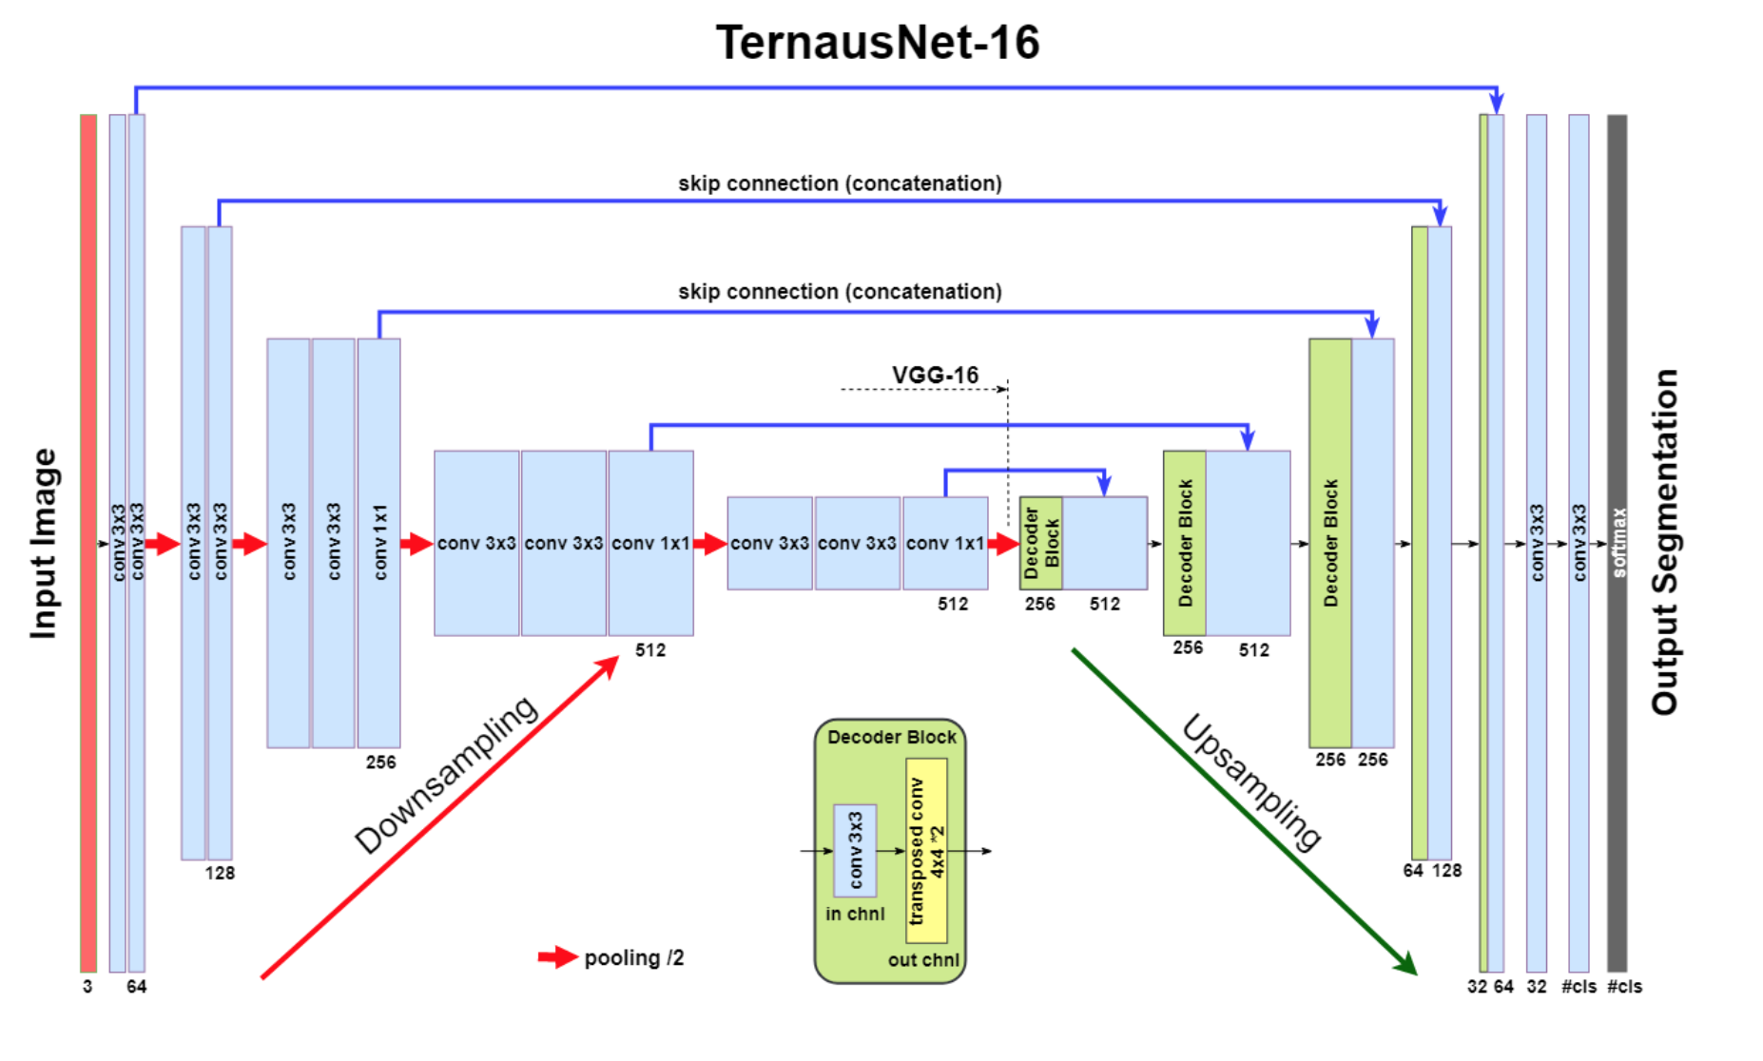
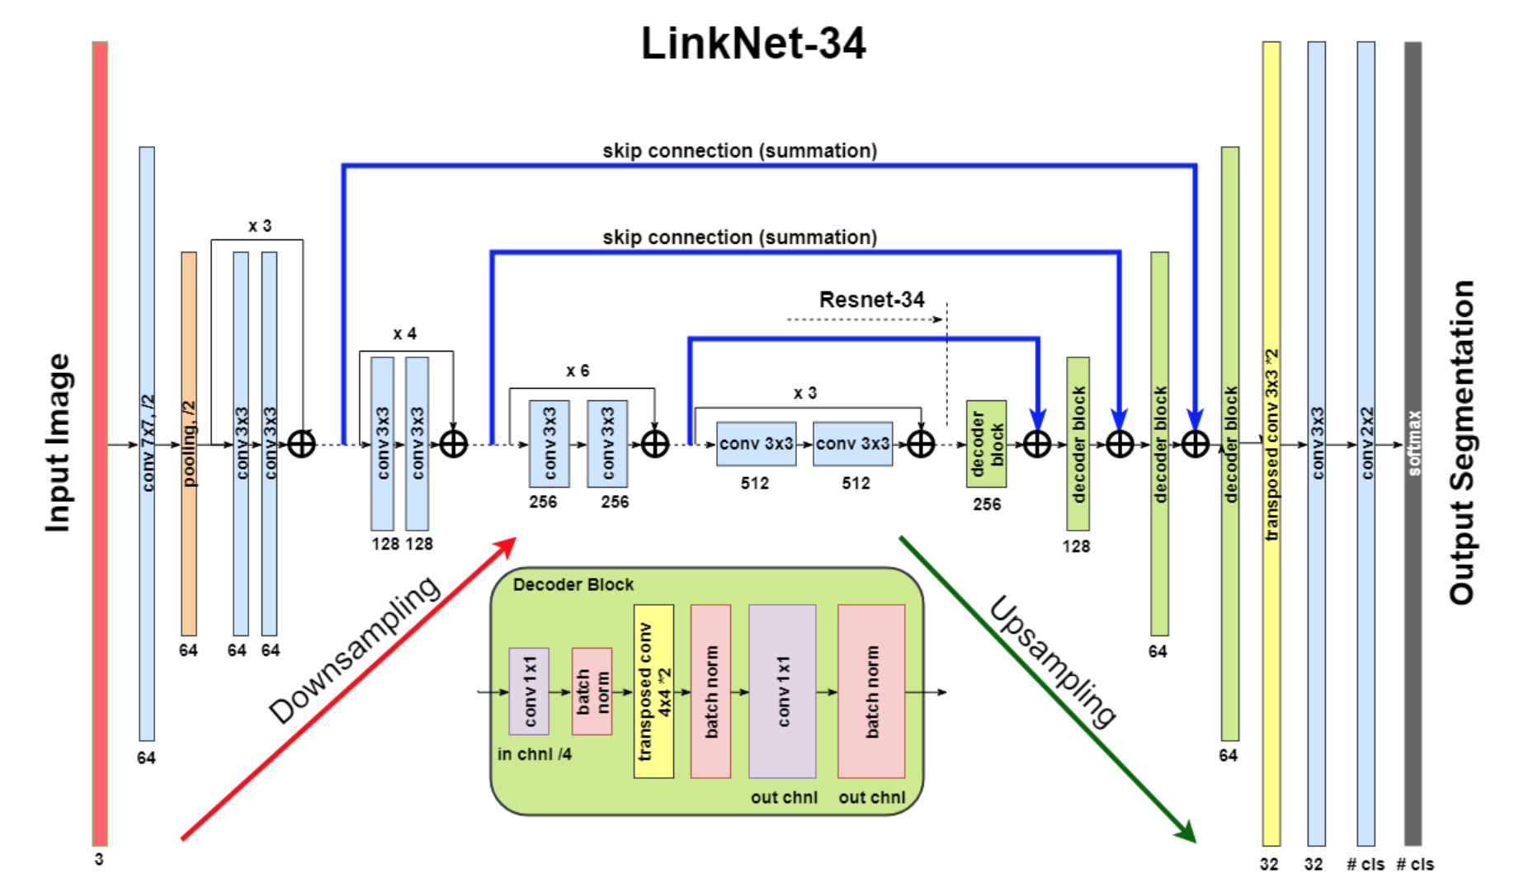
Related Work
1. Improved UNet:
Improvement over Unet:
VGG as encoder - TernausNet
ResNet for better gradient - LinkNet
2017 EndoVisSub winnder
https://github.com/ternaus/robot-surgery-segmentation
Shvets, Alexey A., et al. "Automatic instrument segmentation in robot-assisted surgery using deep learning." 2018 17th IEEE International Conference on Machine Learning and Applications (ICMLA). IEEE, 2018.

Slide 4
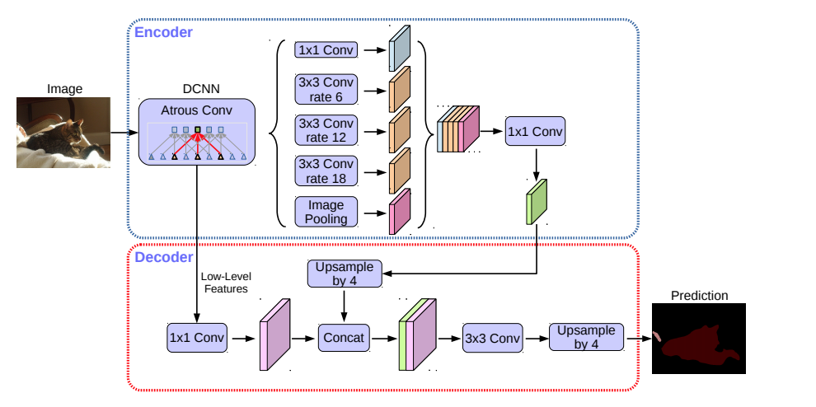
Related Work
2. Deeplab v3+:
Improvement:
Atrous Conv: increase receptive field
Decoder module: shaper object boundaries
2018 EndoVisSub winnder
https://github.com/tensorflow/models/tree/master/research/deeplab
Encoder-Decoder with Atrous Separable Convolution for Semantic Image Segmentation, Liang-Chieh Chen, Yukun Zhu, George Papandreou, Florian Schroff, and Hartwig Adam, arXiv: 1802.02611, 2018.
Notes:
The 2018 winner of the competition was depplab v3+, it introduced dilated convolution kernels to use in decoder part to increase the receptive field of the conv kernel. And it used pyramid pooling in encoder which is introduced by pspnet.

Slide 5
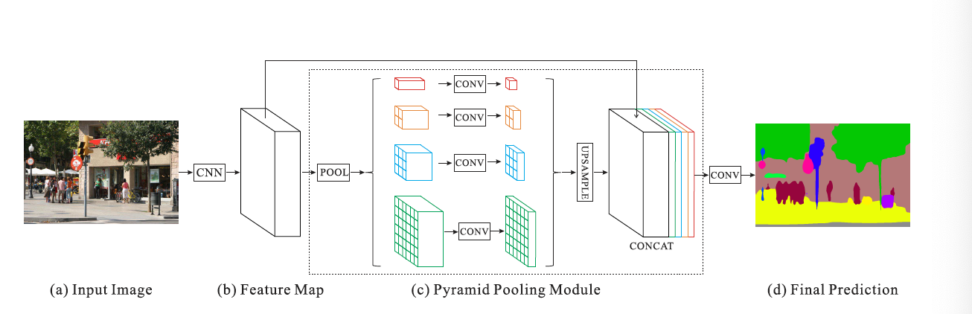
Related Work
3. PSPNet:
Improvement:
introducing Pyramid pooling module
more effective global context
Previous PASCAL VOC 2012 winner
https://github.com/hszhao/PSPNet
Zhao, Hengshuang, Shi, Jianping, Qi, Xiaojuan, Wang, Xiaogang and Jia, Jiaya Pyramid Scene Parsing Network. (2016). , cite arxiv:1612.01105Comment: CVPR 2017 .
Notes:
This module helps provide features of different scales. So that the features not only have local spatial information but also have global context for segmentations.

Slide 6
Our Method (rough ideas):
Adapting existing segmentation networks
Super label training for lower layers
Data augmentation by transformation and self-supervised pre-training
Potentially adding time sequence information to the training process
Notes:
As for our method, we will try to adapting existing state-of-art networks and try to improve it with some ideas like super labels for hierarchical training, and data augmentation methods. Also we will potentially try to add time sequence information to the training process since the images are subsampled from a video.

Slide 7
Thanks！ Question？

