Slide 1
Leaf Classification Using Shape, Color, and Texture Features
Authors: Abdul Kadir, Lukito Edi Nugroho, Adhi Susanto, Paulus Insap Santosa
Paper Link: https://arxiv.org/ftp/arxiv/papers/1401/1401.4447.pdf
Group ID: 9
Members:
Arushi Madan (2015B3A70639P)
Rigvita Sharma (2016A7PS0067P)
Hitesh Sagtani (2015B3A70655P)

Slide 2
Introduction
In this research, shape and vein, color, and texture features have been incorporated to classify a leaf.
A neural network called Probabilistic Neural network (PNN) has used as a classifier.
Various features like Fourier descriptors of PFT, three kinds of geometrics features, color moments, vein features, and texture features have been inputted into the identification system.

Slide 3
Contribution by Members
Arushi Madan- PPT and Code
Rigvita Sharma- PPT and Code
Hitesh Sagtani- PPT and Code

Slide 4
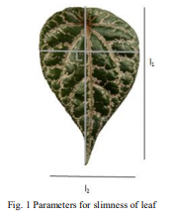
Feature Extraction
Shape Features:
Geometric Features:
Slimness: l _{l} /l₂
Roundness: 4ℼA/P²
Fourier descriptors of PFT: Polar form of the image is used for the computation of the PFT. Normalization of the PFT gives the Fourier descriptors.
Color Features: Features like mean, standard deviation, skewness and kurtosis have been used to characterize a color image.
Vein Features: Have been extracted by using morphological on the gray scale image by dividing the total pixels of the vein by total pixels on the part of the leaf.
Texture Features: A fractal measure called lacunarity helps to distinguish between two fractals with the same fractal dimension.
Feature Normalization: It is done as a precaution when the feature values vary in different dynamic ranges.

Slide 5
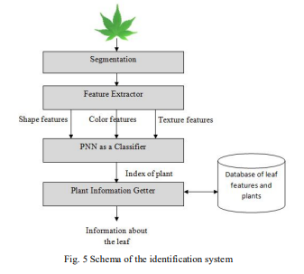
Proposed System
First, an image of the leaf is inputted into the system for classification. The features of the leaf are extracted by Feature Extractor.
Then, PNN (that has been trained before classification once) is used to process the features. The result is an index that represents a plant.
Then, Plant Information Getter translates the index
into the name of the plant.

Slide 6
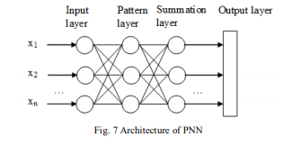
Architecture of PNN
The input layer accepts an input vector.
The pattern layer is used to process the input vector by using weight vector derived from the training dataset. This layer indicates how close the input is to a training input.
In the Summation layer, a vector of probabilities is found by summing up the contributions for each class and is sent to the output layer.
The last layer produces a classification decision, in which a class with maximum probabilities will be assigned 1 while the other classes will be assigned 0.

Slide 7
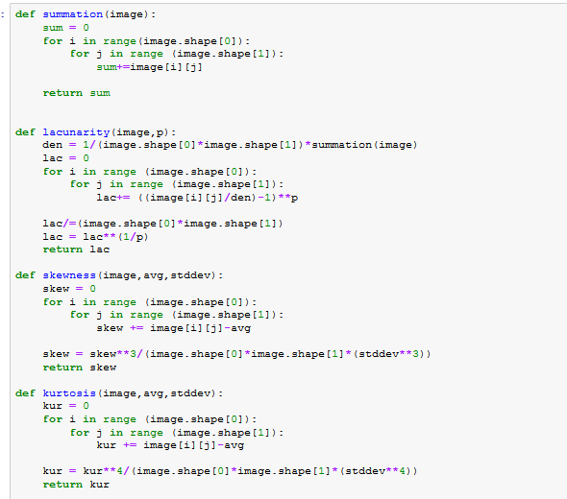
Implementation (Feature extraction)

Slide 8
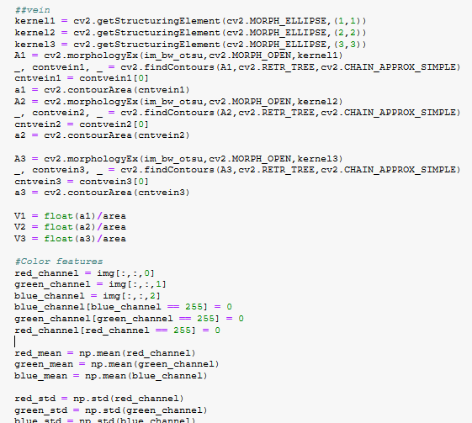
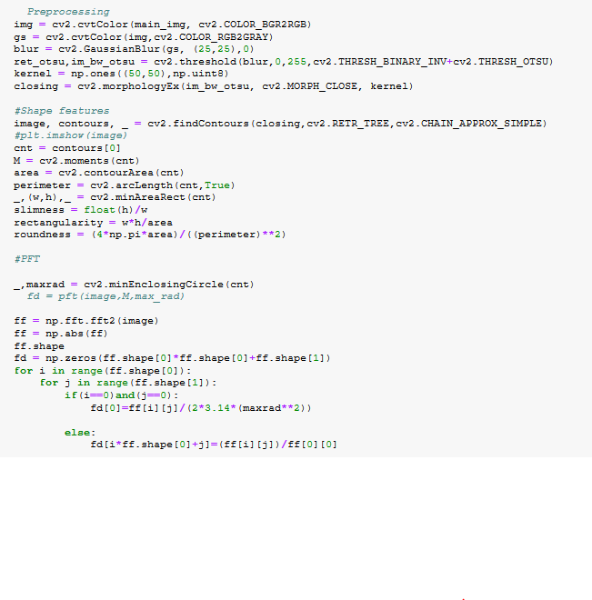

Slide 9
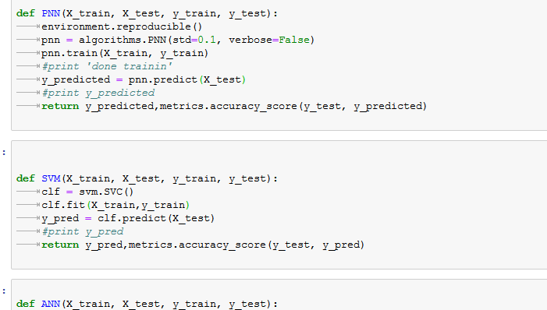
Implementation
First part is preprocessing including normalization and splitting of data into
training and test data
We implemented 3 classifiers SVM, PNN and (MLP)Multilayer perceptron

Slide 10
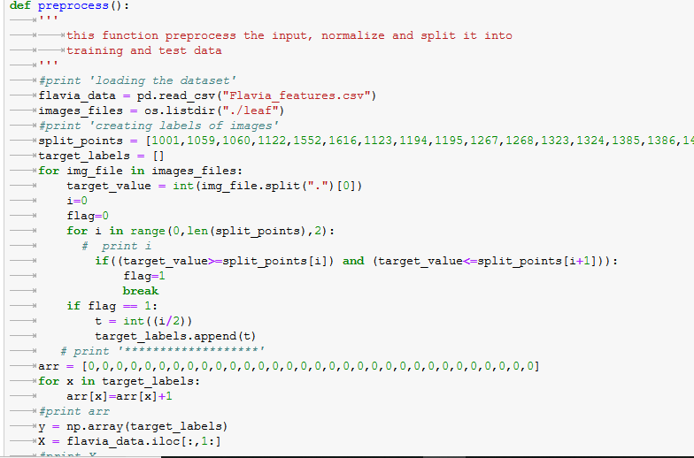
Implementation

Slide 11
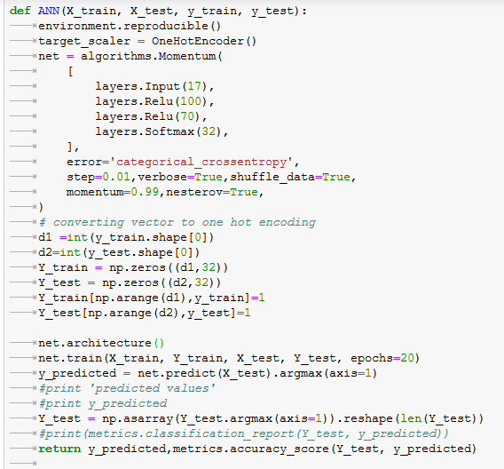

Slide 12
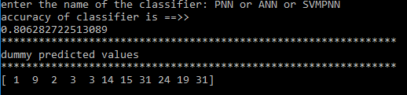
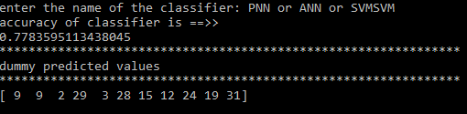
Experimental Results
A dataset called Flavia has been used to test the proposed method.
Dataset contains total 3621 images and 32 species and training and testing data is split in 70:30 ratio.
Classifiers are also tested on dummy dataset whose predicted values
Are shown
Performance has been calculated by dividing the number of relevant images by total number of queries.
Performance of the classifiers are as follows:
MLP : 78%
SVM : 77.8%
PNN: 80.62%

Slide 13
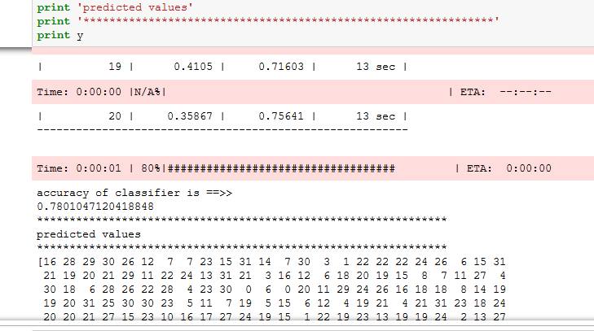
Conclusion
The PNN gives 80.62% of accuracy, which is slightly better than the other neural network classifiers like MLP and ML classifier like SVM.

Slide 14
References

