Slide 1
DAA PROJECT
KNIGHT’S TOUR
GRAPH TRAVERSAL PROBLEM
NISHCHAL MN - PES1201701523
HITESH KUMAR - PES1201701511

Slide 2
ABSTRACT
The knight’s tour problem is a sub chess puzzle where the objective is to find the combinations made by the knight so that it visits every square of the chess board exactly once.
This project consists of three approaches to solve this problem.
The first one is using the brute-force algorithm followed by backtracking . The next approach is using warnsdorff's rule which is a heuristic for finding knight’s tour.

Slide 3
PROBLEM DEFINITION
Knight’s Tour is a classical problem on the chess board. In this, a knight is moved in sequence of squares such that it visits every squares exactly once. This problem is most often dealt as mathematical problem and a most popular problem appearing in Artificial Intelligence. Knight’s Tour is a more general form of Hamiltonian path problem.
Further, this problem isn’t only applicable to the standard 8x8 chess board. All the boards with size n*n with n>=5 is applicable to the problem. There exists at least one knight’s tour on such board.

Slide 4
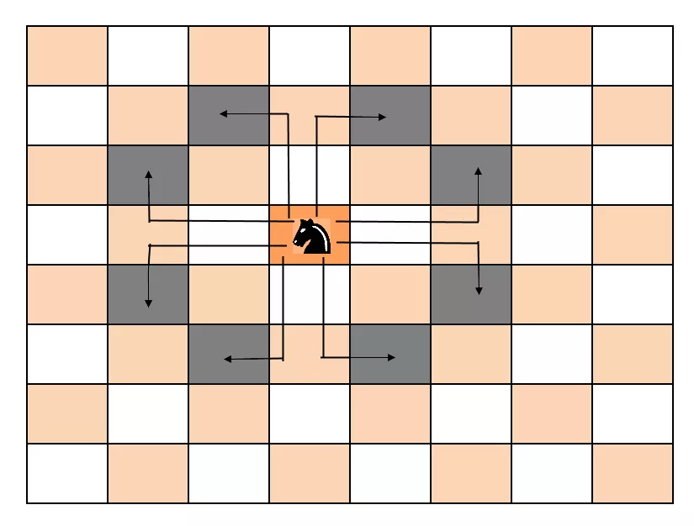
KNIGHT’S MOVE IN A CHESS BOARD
.

Slide 5
INTRODUCTION
Chess is a two player game played on square board. A knight’s tour is a sequence of squares such that all pairs of consecutive squares are adjacent in a graph and no square appears in the sequence more than once. In general, it is a Hamiltonian path problem with nodes as squares of the chessboard and the nodes are adjacent to each other only if a knight can move to the other node in single step. In this problem, we traverse the graph such that every nodes are visited exactly once and no nodes are left unvisited.
This project is intended to build a program that solves a Knight’s tour in a chess boards of size 8*8;

Slide 6
DESIGN
1.The brute force algorithm tries every possible permutation of moves and see if they are valid.
2. Backtracking works in an incremental way to attack problems.
Create a solution matrix of the same structure as chessboard.
Start from 0,0 and index = 0. (index will represent the no of cells has been covered by the knight)
Check current cell is not already used if not then mark that cell (start with 0 and keep incrementing it, it will show us the path for the knight).

Slide 7
Check if index = N*N-1, means Knight has covered all the cells. return true and print the solution matrix.
Now try to solve rest of the problem recursively by making index +1. Check all 8 directions. (Knight can move to 8 cells from its current position.) Check the boundary conditions as well.
If none of the 8 recursive calls return true, BACKTRACK and undo the changes ( put 0 to corresponding cell in solution matrix) and return false.

Slide 8
3. visiting the squares with the fewest available moves first pushes the knight to visit the squares around the edges of the board first. This ensures that the knight will visit the hard-to- reach corners early and can use the middle squares to hop across the board only when necessary. Utilizing this kind of knowledge to speed up an algorithm is called a heuristic.
This solution is using warnsdorff's rule which suggests : “Always move to an adjacent, unvisited square with minimal degree”.
Construct a knights path on a n*n board as follows :
Let (n+1)th square of the path to be the square which :
i) is adjacent to the nth square .
ii) is unvisited ( that hasn't appeared in the path )
iii) has minimal number of adjacent visited squares .

Slide 9
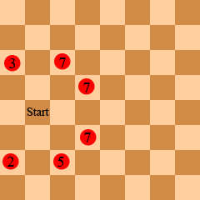
WARNSDORFF'S ALGORITHM PICTORIALLY
.

Slide 10
IMPLEMENTATION
Following are implementations for Knight’s tour problem. It prints one of the possible solutions in 2D matrix form. Basically, the output is a 2D 8*8 matrix with numbers from 0 to 63 and these numbers show steps made by Knight.

Slide 11
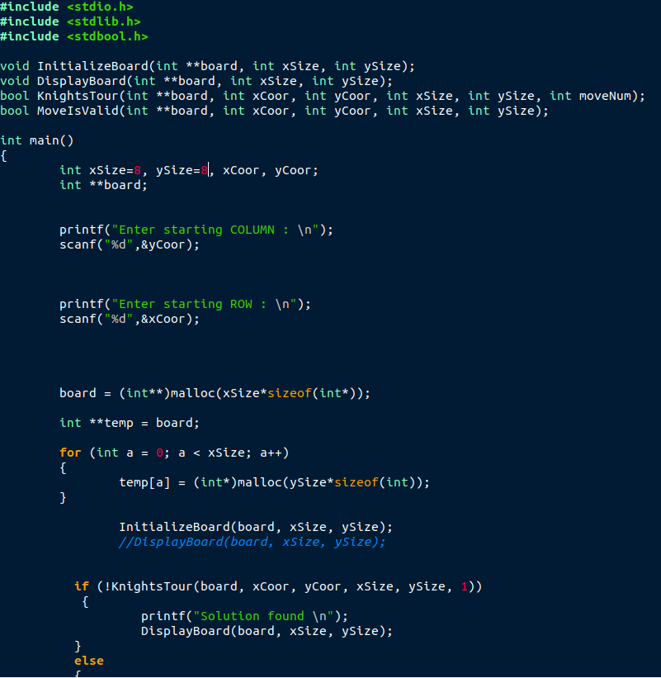
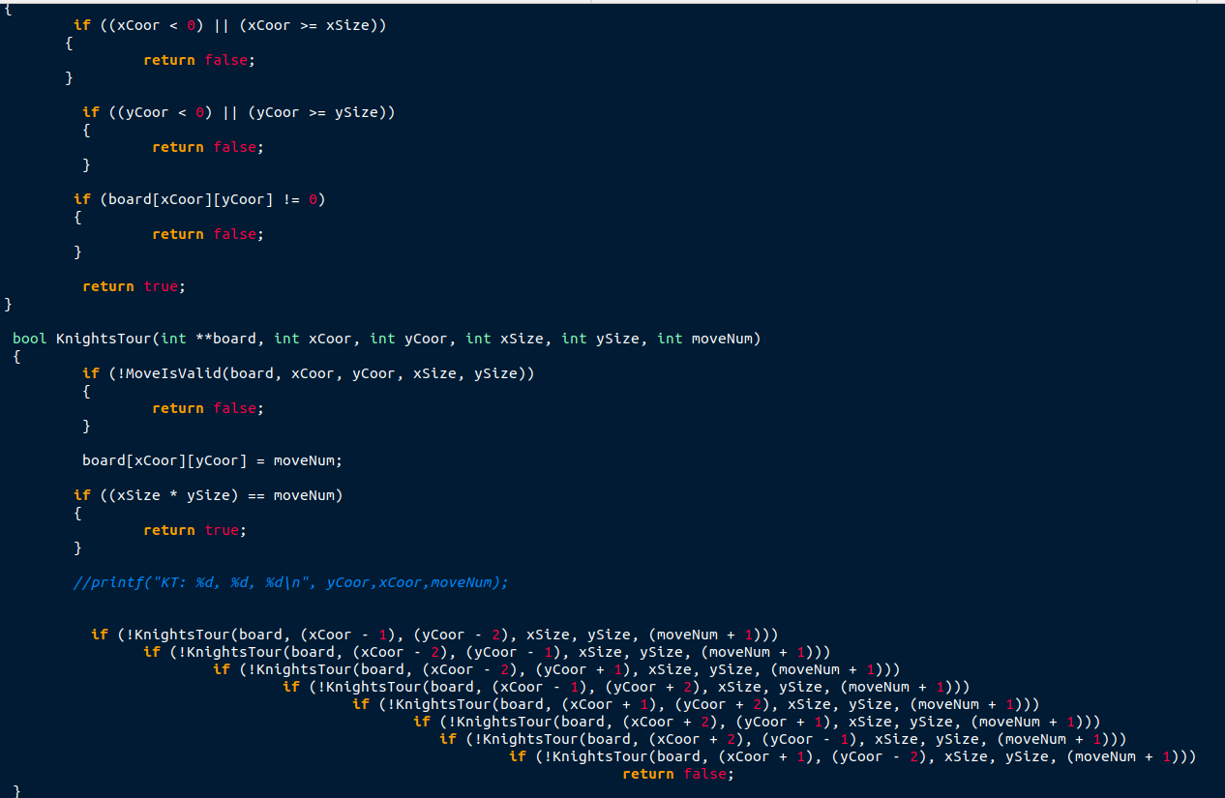
BRUTE FORCE

Slide 12
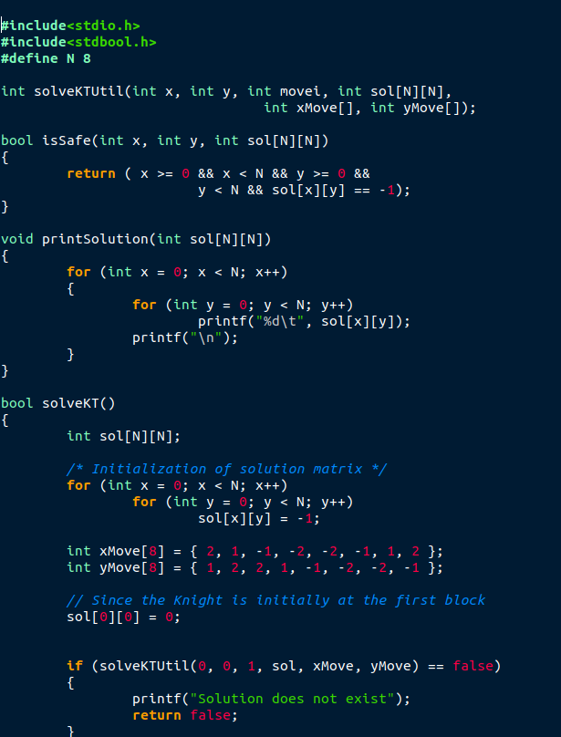
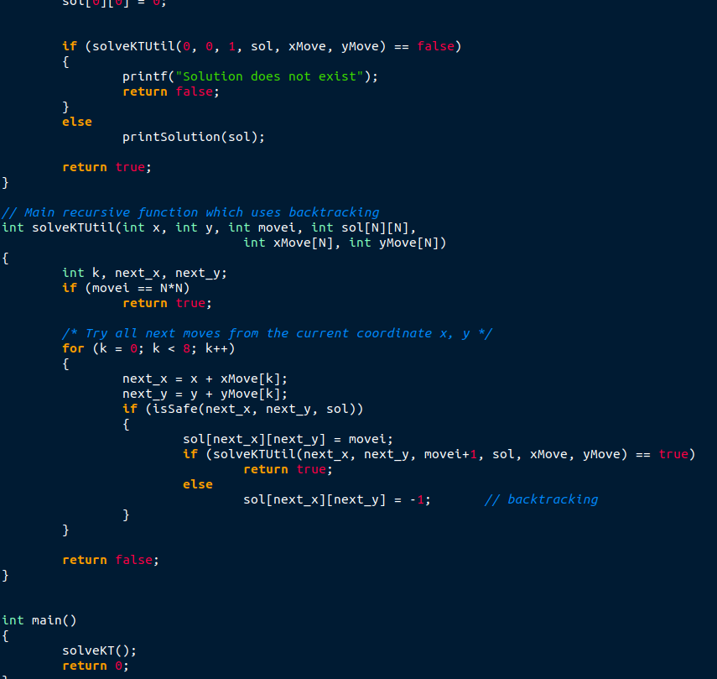
BACKTRACKING

Slide 13
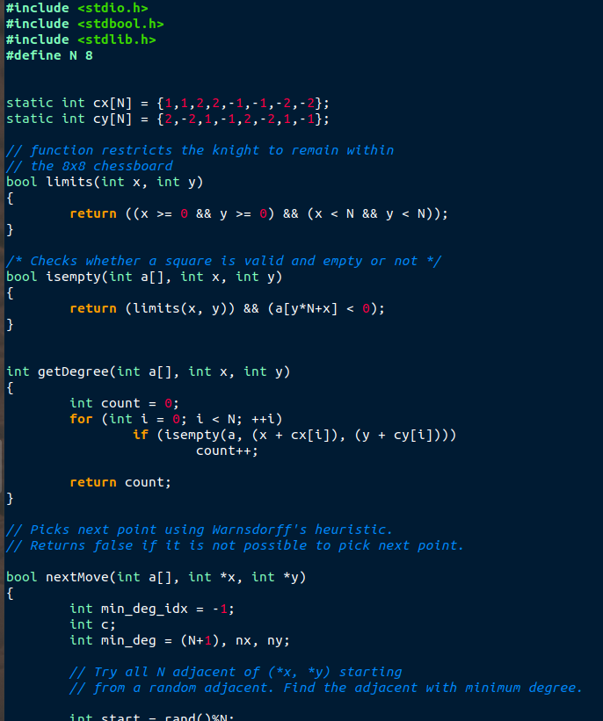
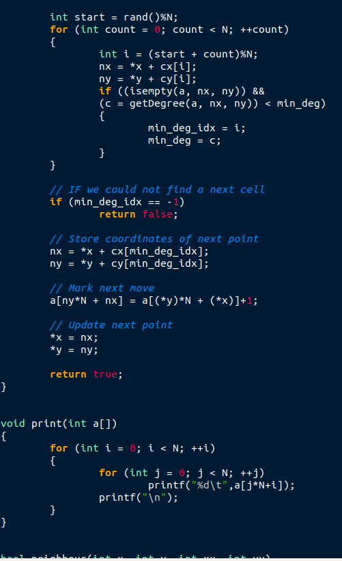
WARNSDORFF'S ALGORITHM

Slide 14
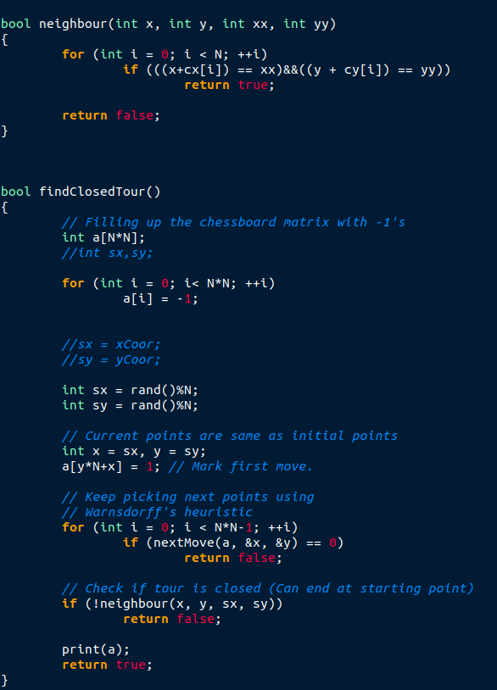

Slide 15
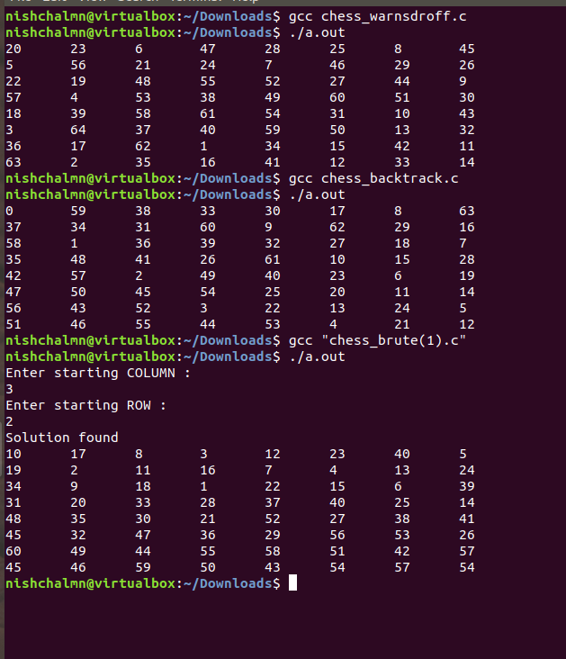
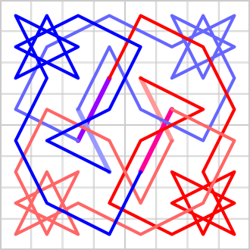
OUTPUT

Slide 16
CONCLUSION
Considering the running time of the backtracking algorithm , the big-O notation is O(8^(N^2)),but we don't have to make 8 choices for each cell .
Even considering this our running time will be reduced by a factor and will become O(k^(N^2)) instead of O(8^(N^2)),where k is a small integer constant. This is indeed an extremely a bad running time.
Warnsdorff's algorithm is the best and efficient way to solve a Knight's tour .
Warnsdorff's algorithm always gives a closed tour . This algorithm gives the tour in linear time.

Slide 17
REFERENCES
https://en.wikipedia.org/wiki/Knight%27s_tour
https://bradfieldcs.com/algos/graphs/knights-tour/
https://www.quora.com/How-does-the-Warnsdorffs-algorithm-work
https://stackoverflow.com/questions/19214109/how-to-optimize-knights-tour-algorithm

Slide 18
THANK YOU

