Slide 1
MACHINE LEARNING PROJECT
NAIVE BAYES CLASSIFIER
TEAM NUMBER : 15
HITESH KUMAR - PES1201701511
NISHCHAL M N - PES1201701523
SURAJ M M - PES1201701551

Slide 2
PROBLEM STATEMENT
The problem is to classify the data using Naive Bayes Classifier .
The dataset has fifteen (independent variables ) different attributes which has qualitative data stating either “yes” or “no”.
The dependent variable has only two types of output values either “Democrat” or “Republican” .
The Problem is to implement the Naive Bayes algorithm from scratch and train the dataset and predict the output for the test dataset .

Slide 3

PRE-PROCESSING
Initially the missing values in the dataset has been handled . Since the data is qualitative the missing values has been filled by the most frequent data in the respective column . The data is later encoded into ones and zeros for easy calculation . The dependent variable attribute yes has been converted to ‘1’ and no to ‘0’ . Similarly output variable has also been encoded where ‘1’ represents Republican and ‘0’ represents Democratic.

Slide 4
IMPLEMENTATION
We have divided the dataset into 5 folds and used 4 folds for training and 1 for testing using random folds . We have used the following formula to classify the testing data :
Naive Bayes Classifier : V_{NB} = argmax_{vj ∈ V} P( v_{j} ) π_{i} P( a_{i} | v_{j} )
v_{j} takes values “Democrat” and “Republic” .
a_{i} takes values which are “Yes” or “No” of the 15 different attributes
Finally we take the maximum of which corresponds to either
Democrat or Republic.

Slide 5
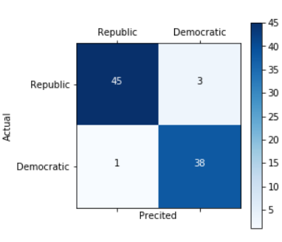
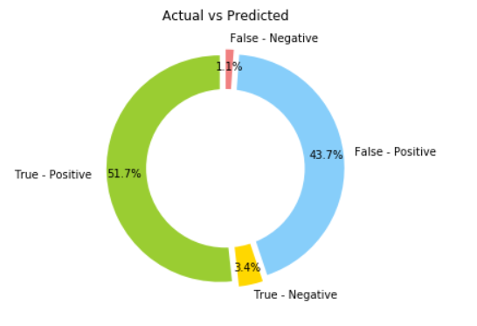
OUTPUT
ACCURACY
CONFUSION MATRIX
After a series of tests and dividing the test and training dataset randomly the average accuracy of the model implemented is above 90%. The Confusion matrix representing all the information has been plotted for all the cross validations.
Since the problem is about classifying whether a person is democratic or republican the precision and recall are not great measures to validate the model. For each validation set F-Score , Precision , Recall and Accuracy have been calculated.

