Slide 1

Fire Detection System using ML Algorithms
Delhi Technological University,
Department of Computer Science
Project Presentation
Submitted to : Nipun Bansal, Assistant Professor
TEAM MEMBERS:
Hitesh Mehta (23/CS/180), Harshit Kushwaha (23/CS/169) and Harshit Aggarwal (23/CS/167)

Slide 2
Contents
Introduction
Requirements of Projects
Literature Survey
Comparative Analysis of Existing Works
Proposed Approach
Project Design and Flow-chart
Implementation
Results
Conclusion and Future Plan
References

Slide 3
Introduction
Fire in the forest can occur naturally or by humans. Naturally, fire takes place due to extreme drought, hot weather, lightning or combustion of dry leaves and scabs. Human activities like throwing cigarettes, especially in forest areas or using borne fire also lead to fires.
So, fires which take place due to humans, are identified earlier than naturally occurring fires. There are various factors involved when a region catches fire. The hot and dry weather works as catalysts for fire. Since when there is fire in any region then the temperature of the region will become high due to fire. So increase in temperature is one of the factors which can help in fire detection events.
But we cannot just depend on temperature to detect fire as the temperature of a region also may increase due to sunlight. So we can also check the concentration of CO, CO₂ gases in that region to detect the fire. But CO, CO₂ gases can also be generated when someone uses the cigarette in that region so it may give false alarm, i.e., false fire event detection.
To increase the accuracy in predicting fire events, we will use various ML algorithms to check if there is fire or not. We will also train the machine and test by providing custom input whether there is fire or not. We will also calculate the accuracy, recall, and precision of these ML Algorithms. Hence we can save our environment ,animals and livelihood from the adverse results of forest fires.

Slide 4
Requirements of Project
HARDWARE:
Processor Above: 1.5GHz
Hardware Disk: 80GB
RAM: 2GB
SOFTWARE:
OS: Windows 7,8, 10
Language: Python
IDE: Colab (by Google)

Slide 5
Literature Survey
CNN has been proposed for the detecting the fire occurrence in different systems. The projected model uses advanced countenance transform and order calculations through deep education and the convolutional affecting animate nerve organs arrangements (CNN) which will boost the dwellings smoke alarm performance and eradicate annoyance alarm sketches.
The CNN based network has been proposed in a paper, proposes use of transfer learning that is based on deep CNN approach to detect fire. It includes the use of MobileNet and pre-trained deep CNN architecture namely VGG, for development of fire detection system. These deep CNN models are trained on imbalanced datasets to impersonate optimal situations.

Slide 6
Comparative Analysis of Existing Works
S.No. | TITLE | AUTHOR | YEAR | DESCRIPTION | LIMITATION
1. 2. | A New Approach for Event Detection using k -means Clustering and Neural Networks Use of AI Techniques for Residential Fire Detection. | M. O. Oladimeji, M. G. Smiee and S. D. Mieee M Bahrepour, N. Meratnia & P.J.M Havinga | 2015 Conference Paper AIAI 2009 (Journal) | We study the event detection problem using convolutional neural networks (CNNs) that overcome the two fundamental limitations of the traditional feature-based approaches the complicated feature engineering for rich feature sets. Early residential fire detection is important for prompt extinguishing and reducing damages and life losses. To detect fire, one or a combination of data-sets algorithms and sensors needed. | Error propagation from the preceding stages which generate these features. Complicated feature engineering for rich feature sets.

Slide 7
Proposed Approach
Forest Fire Modelling Indices Dataset is taken from UCI Machine Learning repository, description of dataset is described as below. We have taken the following indices into the consideration:
FFMC (Fine Fuel Moisture Code)
DMC (Duff Moisture Code)
DC (Drought Code)
ISI (Initial Spread Index)
Rain
RH (Relative Humidity)
Wind
Area

Slide 8
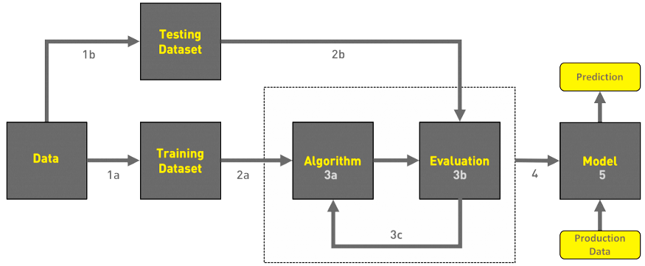
Project Design/Model
Gathering data
Data pre-processing
Researching the model that will be best for the type of data
Training and testing the model
Evaluation
Workflow of Project

Slide 9
Implementation Analysis
Algorithms
Accuracy
Logistic Regression
Support Vector Machine
Random Forest
Precision
Recall
Training & Testing

Slide 10
Results
For this purpose “Forest-fires.csv” dataset from UCI machine learning repository was taken and machine learning algorithms were applied to find accuracy of detection. The dataset “Forest-fires.csv” contains 517 instances and 13 attributes.
Algorithm Used | Accuracy (%)
Logistic Regression | 55.8011
Support Vector Machine | 61.5384
Random Forest | 57.0512

Slide 11
Conclusion
In the case of forest fire detection ML algorithms remove the difficulty faced in traditional methods like man standing on a tower and monitoring the environment.
All the data in the dataset has to be aggregated to reach the result so it is done by using tree based and cluster based methods.
With the use of machine learning techniques, the problem of faulty nodes is minimized. With the use of regression algorithm network lifetime is enhanced and with the use of decision tree algorithm network lifetime is enhanced as well as accuracy. SVM and neural network give better results.

Slide 12
Future Plan
We will be finding a method based on machine learning which will be
Accurate in prediction
Fault Tolerant
Robust
And then finding its space and time complexity and will try to optimize it.

Slide 13
References
[1] Ngonidzashe; Nnamdi I. Nwulu; Saheed Lekan Gbadamosi "Machine Learning Applications for Fire Detection in a Residential Building", 2019 IEEE 6th International Conference on Engineering Technologies and Applied Sciences (ICETAS), DOI: 10.1109/ICETAS48360.2019.9117318.
[2] Mohit Dua; Mandeep Kumar; Gopal Singh Charan; Parre Sagar Ravi, "An Improved Approach for Fire Detection using Deep Learning Models”, 2020 International Conference on Industry 4.0 Technology (I4Tech), DOI:10.1109/I4Tech48345.2020.9102697.
[3] Joao Alves, Christophe Soares, Jose M. Torres "Automatic Forest Fire Detection Based on a Machine Learning and Image Analysis Pipeline", 2019 Dynamic Programming for Impulse Feedback and Fast Controls (pp.240-251), DOI:10.1007/978-3-030-16184-2_24.
[4] A. NAMOZOV, Y.I. CHO. "An Efficient Deep Learning Algorithm for Fire and Smoke Detection with Limited Data", Advances in Electrical and Computer Engineering, Volume 18, Number 4, 2018.

Slide 14
Thank You !

