Slide 1

ProjectReport
on
Learning Management System
(CSE IV Semester Mini Project)
2021-2022
Submitted to: Submitted by:
Mr. Chandradeep Bhatt Hitesh Kandpal
University Roll. No.: 2018380
ClassRoll.No./Section: 23/A
DEPARTMENT OF COMPUTER SCIENCE AND ENGINEERING
GRAPHIC ERA HILL UNIVERSITY, DEHRADUN

Slide 2

About Project
E-Learning fulfils the thirst of knowledge and offers online content that can be delivered for the learner at anywhere, anytime and any age through a wide range of E- learning solution while compared with traditional learning system. It also provides the rapid access to specific knowledge and information. With the rapid growth of voluminous information sources and the time constraint the learning methodology has changed. Learners obtain knowledge through E-learning management systems rather than manually teaching and learning.
A key feature of an LMS is the ability to create different types of users. In our PAHADI VIDHYA LMS project we have Administrators, Teacher, and Student, who all have differing levels of access to content and performing operations on the site.

Slide 3
Steps
Create a database using SQL and alter update it according to the modules.
Import the database in XAMPP server.
3. Using php create a backend for all pages of your websites i.e login.php ,dashboard.php.
Connect all pages with HTML ,CSS, for the front end.
5. Using JS make the browser site dynamic and interactive.
6. Using mysqli connect php files with database.
7. Encrypt the default password in database and manage the different column of database according to your need.
8. Store your project folder in htdocs and run on chrome using local host (XAMPP).

Slide 4
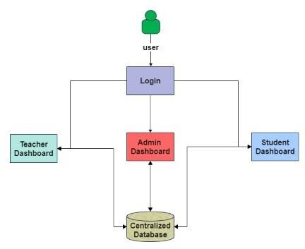
SYSTEM DESIGN

Slide 5
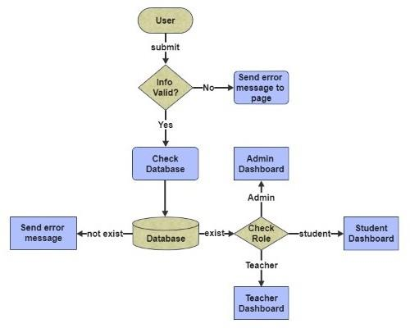
USER LOGIN

Slide 6
ROLES OF DIFFERENT USERS
Sno. | Admin | Teacher | Student
1. | Manage Teacher | Manage Course Material | Access Course Material
2. | Manage Student | Manage classes | Access classes
3. | Manage Department | Monitor course attendance | Monitor Course Progress
4. | Manage Courses | Manage Assignments | Submit Assignment
5. | Monitor Attendance

Slide 7
References/Bibliography
www.w3schools.com
YouTube tutorials
https://getbootstrap.com/docs/5.0/getting-started/introduction/
https://www.php.net/manual/en/
https://www.javascript.com/learn/
https://www.w3schools.com/mySQl/default.asp

