Slide 1
Acquaintance with Your Water Resources
Ministry Category : Software
Problem Statement : Know your Backyard and Front Yard Problem Code : MWR3
Team Leader Name : Vishu Tyagi College Code :1-480325701

Slide 2

OUR IDEA
Water is the most important resource available to a human being. To have clean water and knowledge about the available resources is the right of every human being living on Earth. India faces a big challenge to provide clean and safe water supply to many areas.

Slide 3
Our Purpose
Our main purpose is to bridge the gap between the people living in that area and the resources provided by the Government nearby.
Today, the main problem that the society faces is either lack of available resources or not having the awareness and proper knowledge about the available resources.
In our app, we intend to provide the solution to this problem using the data available about the nearest source of water provided by the Government. We will present the required information in a representable and understandable manner.
Notes:
Ye jyada bacho wali nahi lag rhi k kisi 4th class k bache ko presentation de rahe ho?

Slide 4
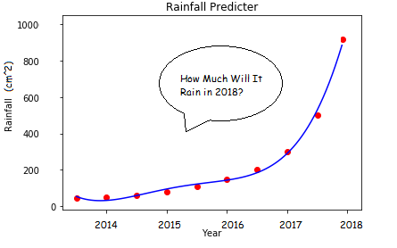
The app will provide information about the level of groundwater and the annual rainfall received by the area on average in a year. With the help of machine learning model and the forecast by the weather departments, we can predict how much of rainfall will subsequent years receive. This will also help in preventing overuse of groundwater and take measures to face harsh climatic conditions by appropriate use of rainwater.
The app will also provide data about both, the amount and timings, of water supplied by the Government. By this information, a person can know about the quality, timing and various other aspects of the supplied water in their area, which are mostly ignored or not listed.

Slide 5
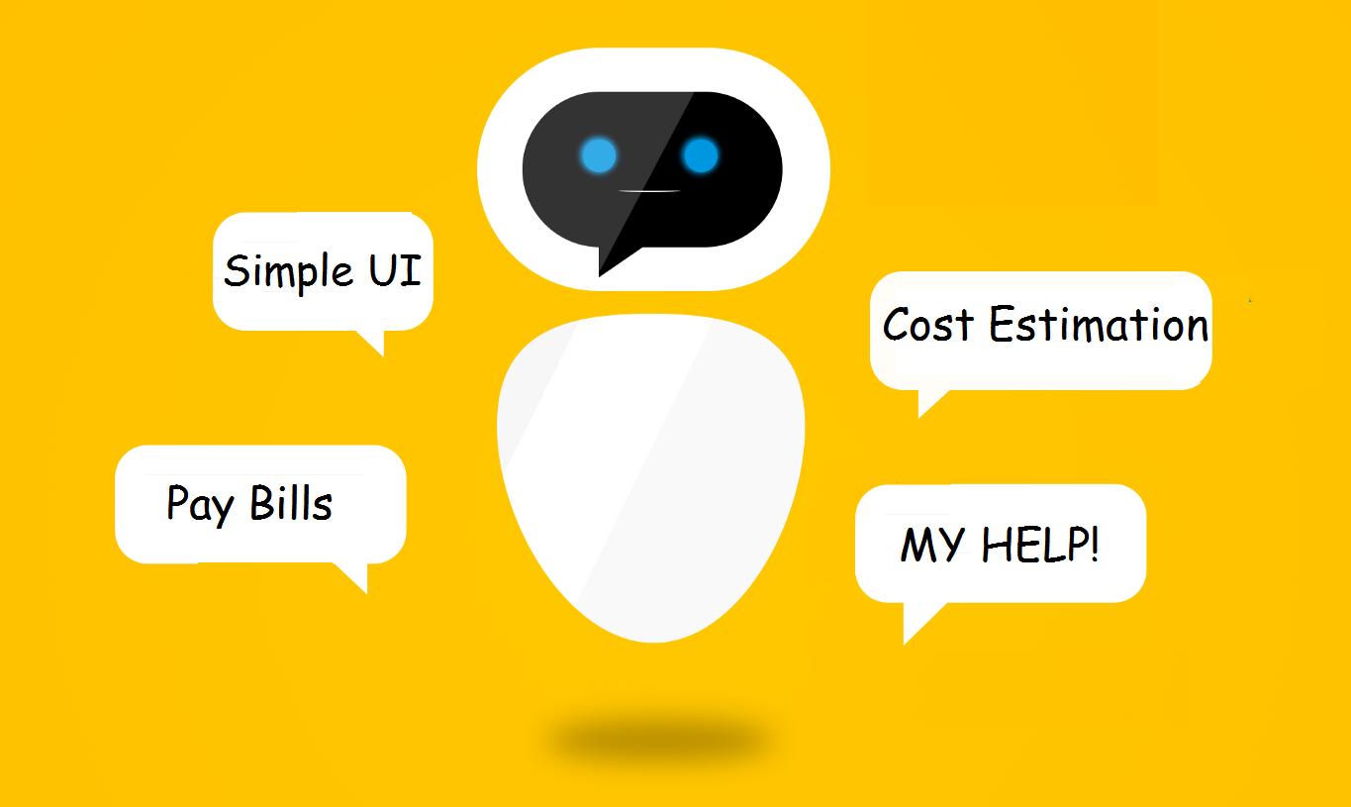
Making the app user-friendly is most important, so the UI of the app should be simple. The app will display the nearest available resource on a map and the user can click on the resource to see the data available.
Details about the estimated cost of connecting the resource to your backyard or farmyard to the concerned authority and help them in providing tenders to a suitable contractor.
Online bills to minimize the paperwork as the data will be stored online and also an online payment option for the users to make it easy to pay their dues and also avoid queues for bill payment.
An AI-based CHATBOT will be present as an assistant, which can solve basic queries or provide the information about the concerned authority.
Notes:
Abe chat bot ki daal de image, maps k baare m dekh chuke na hum
M abhi laptop band karke let rha hu kuch bhi problem ho bata diyo whatsapp p
https://securecdn.pymnts.com/wp-content/uploads/2017/04/wells-fargo-chatbot-e1492550741143-450x270.jpg

Slide 6
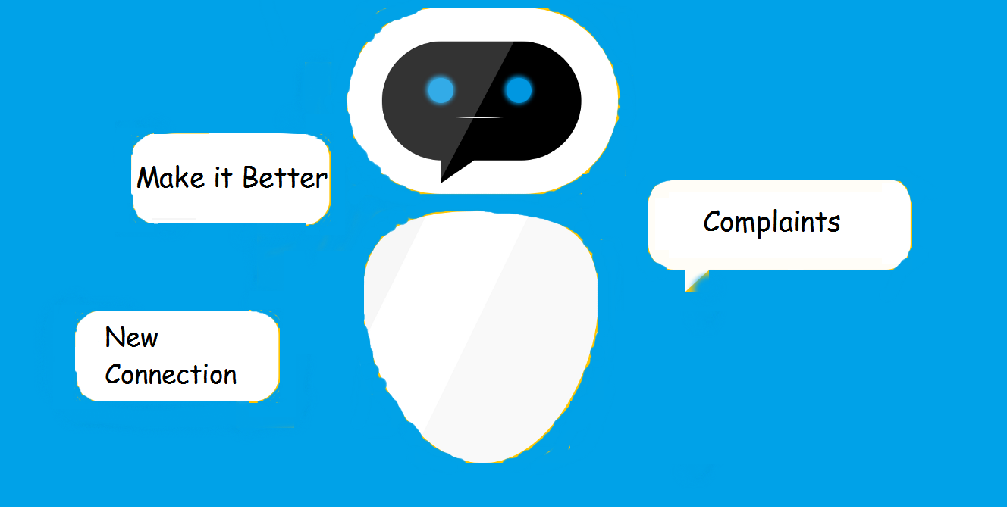
The app will provide users with the right to update the data in the app if they feel the data is invalid. This will make the app more reliable and the data more accurate.
The users can also file a complaint using this app and if the complaint is not dealt with properly, they can request for action from concerned authority.
The user can also request a new connection or pipeline in their locality or farmyard.

Slide 7
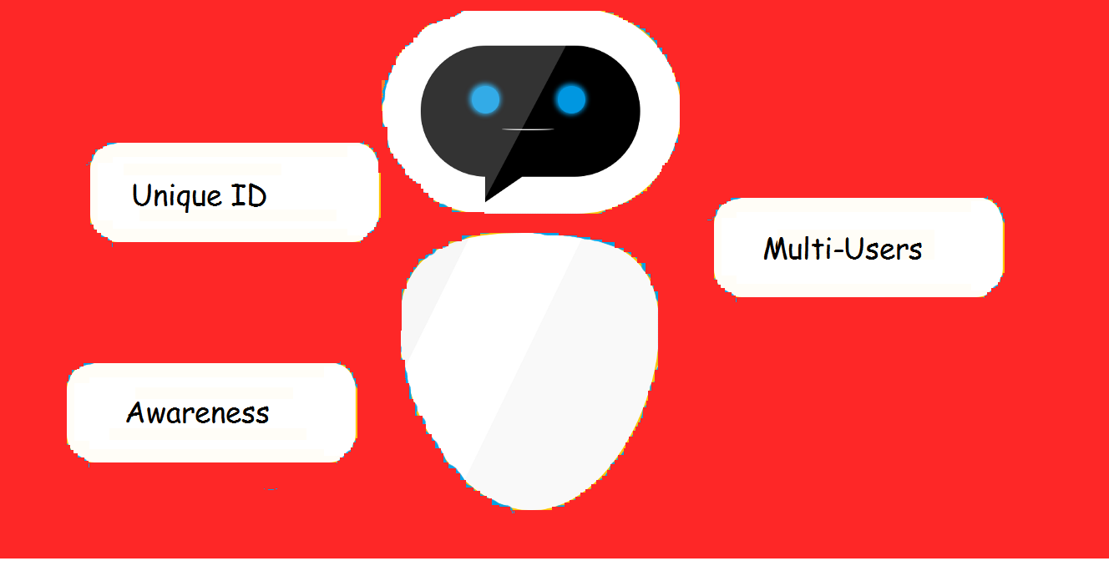
A user can login using their mobile number or Aadhar card number and a separate UI will be provided for the authority where they can update the information about the daily supply timings and also answer the queries posted by the consumers.
The app will also have some awareness advertisement to encourage the user to use more renewable resources than to exploit the ground water. It will also have an inbuilt AI to recommend the user a certain resource based on the data available in that area.
At last there will separate database for both the user and the authority and all the previous activities will be stored in the database.
Notes:
Pdf bhi karna hai isko

Slide 8
CASE
Our case helps a user to resolve their water related problems of their farmyard and backyard in simple yet elegant manner. The app covers a broad range of users i.e framers, domestic, constructors and government
Some of the common problems are like :
Is groundwater usable or is there any water supply facility provided by government.
Payment of bills
Request for new connection
Cost of water supply
Layout of water network in their area.
Rainfall prediction
These are the basic problems faced yet not are resolved.
So we here provide a simple platform to resolve the case.

Slide 9
Technology stack:
PHP
Python
MYSQL
Unity
Android Studio
Anaconda
Tensorflow

Slide 10
Dependencies
Network of Underground supplied water
Data of previous year of rainfall
Government data for the groundwater level in an area
Data regarding the available water resources in various areas
Maps provided for a region
Details about the most common water resource in use

Slide 11
Show Stopper
AI:
This app is developed with the intent to ease the use of common but helpful resources and to provide the information but such resources to the common people. But the major problem still remains the fact that there is no such platform which can provide such details and suggest some proper solution to common. To solve this problem, we propose an AI, which based on the data of that area will decide which is the most used resources and which is the best one. Taking the example, if an area, people prefer to use groundwater and they receive sufficient rainfall every area, then exploiting groundwater is not the best choice but using rainwater harvesting system is one of the best solution. The AI will give information like groundwater is overexploited but using rainwater harvesting is better alternative, also the AI will display more and more advertisement against the conventional use of groundwater followed in that area.
CHATBOT:
A chatbot will help lower the load on the authority offices as they will provide basic details and solution to some of the basic problems in the App itself. This will help both the authority and the users as the people will have to visit the offices less often and will get details in the App.
ONLINE BILLING AND PAYMENT:
To pay the bill, long queues are a common site outside the bill payment booths and not having a single platform for bill payment is also a major problem for the common masses. The App will provide a single platform, for both billing and bill payment, based on the connection details. It will be easier for the people to look into the details, explained far more in the online mode as compared to the offline mode and get more details from the chatbot.

