Slide 1
Optimized ResNet Benchmark Suite
Hitesh Bhatia

Slide 2
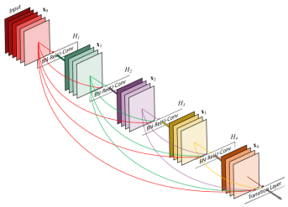
ResNet Architecture
50 Layer Architecture.
executeFirstLayerCUDA x 1
poolingAverageCUDA x 1
executepoolingCuda x 1
execute3DconvolutionCuda_split x 10
execute3DconvolutionCuda x 42
execute3Dconvolutiongroup2Cuda x 0
executeBnNormLayerCUDA x 42
executeBnNormLayerCUDA_split x 11
executeScaleLayerCUDA x 42
executeScaleLayerCUDA_split x 11
executeEltWiseLayerCUDA x 13
executeEltWiseLayerCUDA_split x 3
executeReLULayerCUDA x 39
executeReLULayerCUDA_split x 10
executeFCLayerCUDA x 1

Slide 3
executeFirstLayerCUDA
3
3
*
7
=
112
224
7
224
x 64
112
x 64
Layer1_Neurons_GPU
224 x 224 x 3
64 Kernels or Filters
Layer2_Neurons_GPU
64 x 112 x 112
Floor[ (n + 2p - f)/s + 1]
n = 112 Input Dimension
p = 2 Padding
f = 3 Filter Dimension
s = 2 Stride
Layer1_Weights_GPU
64 x 7 x 7 x 3

Slide 4
executeFirstLayerCUDA
3
3
*
7
=
112
224
7
224
x 64
112
x 64
Layer1_Neurons_GPU
224 x 224 x 3
64 Kernels or Filters
Layer2_Neurons_GPU
64 x 112 x 112
Floor[ (n + 2p - f)/s + 1]
n = 112 Input Dimension
p = 2 Padding
f = 3 Filter Dimension
s = 2 Stride
Layer1_Weights_GPU
64 x 7 x 7 x 3

Slide 5
executeFirstLayerCUDA
3
3
*
7
=
112
224
7
224
x 64
112
x 64
Layer1_Neurons_GPU
224 x 224 x 3
64 Kernels or Filters
Layer2_Neurons_GPU
64 x 112 x 112
Layer1_Weights_GPU
64 x 7 x 7 x 3

Slide 6
executeFirstLayerCUDA
3
3
*
7
=
112
224
7
224
x 64
112
x 64
Layer1_Neurons_GPU
224 x 224 x 3
64 Kernels or Filters
Layer2_Neurons_GPU
64 x 112 x 112
Layer1_Weights_GPU
64 x 7 x 7 x 3

Slide 7
executeFirstLayerCUDA
3
3
*
7
=
112
224
7
224
x 64
112
x 64
Layer1_Neurons_GPU
224 x 224 x 3
64 Kernels or Filters
Layer2_Neurons_GPU
64 x 112 x 112
Layer1_Weights_GPU
64 x 7 x 7 x 3

Slide 8
executeFirstLayerCUDA
3
3
*
7
=
112
224
7
224
x 64
112
x 64
Layer1_Neurons_GPU
224 x 224 x 3
64 Kernels or Filters
Layer2_Neurons_GPU
64 x 112 x 112
Layer1_Weights_GPU
64 x 7 x 7 x 3

Slide 9
executeFirstLayerCUDA
3
3
*
7
=
112
224
7
224
x 64
112
x 64
Layer1_Neurons_GPU
224 x 224 x 3
64 Kernels or Filters
Layer2_Neurons_GPU
64 x 112 x 112
Layer1_Weights_GPU
64 x 7 x 7 x 3

Slide 10
executeFirstLayerCUDA
3
3
*
7
=
112
224
7
224
x 64
112
x 64
Layer1_Neurons_GPU
224 x 224 x 3
64 Kernels or Filters
Layer2_Neurons_GPU
64 x 112 x 112
Can I put this filter in the Shared Memory?
Layer1_Weights_GPU
64 x 7 x 7 x 3

Slide 11
When Can we use Shared Memory?
When the same data is accessed multiple times.
Here in order to calculate 1 output Matrix of size 112 x 112, same kernel is used multiple times.
Thus we can use shared memory to store the kernel (Layer1_Weights_GPU) of size 7 x 7 x 3.
Can we store Layer1_Weights_GPU in shared Memory? = YES..!!
Can we store Layer1_Neurons_GPU in Shared Memory? = NO..!!
A large number of elements are accessed multiple times from the Layer1_Neurons_GPU.
But Size of Shared Memory is 48KB (C000) < 224 x 224 x 3 x sizeof(float).

Slide 12
Code Snippet
__shared__ float shared_Layer1_Weights_GPU[7*7*3];
int tid = threadIdx.x * blockDim.x + threadIdx.y;
if(tid<7*7*3)
{
shared_Layer1_Weights_GPU[tid] = Layer1_Weights_GPU[output*7*7*3 + tid];
}
for(int i = 0; i < loopr; i++)
{
for(int j = 0; j < loopc; j++)
{
product += ((Layer1_Neurons_GPU[i*col_width*3 + j*3 + stride + colstride] * shared_Layer1_Weights_GPU[i*7 + j + kernel*x_pad + y_pad])
+ (Layer1_Neurons_GPU [i*col_width*3 + j*3 + 1 + stride + colstride] * shared_Layer1_Weights_GPU [i*7 + 7*7 + j + kernel*x_pad + y_pad])
+ (Layer1_Neurons_GPU [i*col_width*3 + j*3 + 2 + stride + colstride] * shared_Layer1_Weights_GPU [i*7 + 7*7*2 + j + kernel*x_pad + y_pad]));
}
}
Shared Memory for each filter.
Each element is now accessed from shared Memory instead of Global Memory.

Slide 13
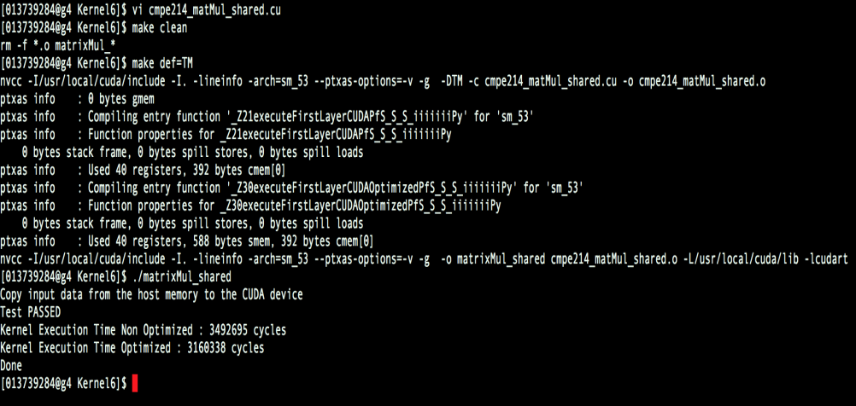
Result after using shared memory for Filter.
9.51 % Improvement

Slide 14
executepoolingCuda
Selects the maximum element
1 | 7 | 0 | 9 | 8 | 7 | 6
6 | 9 | 0 | 6 | 5 | 3 | 2
1 | 6 | 7 | 8 | 0 | 9 | 3
4 | 5 | 6 | 7 | 2 | 1 | 3
4 | 5 | 6 | 7 | 0 | 7 | 4
5 | 6 | 0 | 9 | 0 | 8 | 1
2 | 5 | 6 | 8 | 0 | 3 | 1
9
The intuition is to reserve a feature by emphasizing it.

Slide 15
executepoolingCuda
1 | 7 | 0 | 9 | 8 | 7 | 6
6 | 9 | 0 | 6 | 5 | 3 | 2
1 | 6 | 7 | 8 | 0 | 9 | 3
4 | 5 | 6 | 7 | 2 | 1 | 3
4 | 5 | 6 | 7 | 0 | 7 | 4
5 | 6 | 0 | 9 | 0 | 8 | 1
2 | 5 | 6 | 8 | 0 | 3 | 1
9 | 9

Slide 16
executepoolingCuda
1 | 7 | 0 | 9 | 8 | 7 | 6
6 | 9 | 0 | 6 | 5 | 3 | 2
1 | 6 | 7 | 8 | 0 | 9 | 3
4 | 5 | 6 | 7 | 2 | 1 | 3
4 | 5 | 6 | 7 | 0 | 7 | 4
5 | 6 | 0 | 9 | 0 | 8 | 1
2 | 5 | 6 | 8 | 0 | 3 | 1
9 | 9 | 9

Slide 17
executepoolingCuda
1 | 7 | 0 | 9 | 8 | 7 | 6
6 | 9 | 0 | 6 | 5 | 3 | 2
1 | 6 | 7 | 8 | 0 | 9 | 3
4 | 5 | 6 | 7 | 2 | 1 | 3
4 | 5 | 6 | 7 | 0 | 7 | 4
5 | 6 | 0 | 9 | 0 | 8 | 1
2 | 5 | 6 | 8 | 0 | 3 | 1
9 | 9 | 9 | 9

Slide 18
executepoolingCuda
1 | 7 | 0 | 9 | 8 | 7 | 6
6 | 9 | 0 | 6 | 5 | 3 | 2
1 | 6 | 7 | 8 | 0 | 9 | 3
4 | 5 | 6 | 7 | 2 | 1 | 3
4 | 5 | 6 | 7 | 0 | 7 | 4
5 | 6 | 0 | 9 | 0 | 8 | 1
2 | 5 | 6 | 8 | 0 | 3 | 1
9 | 9 | 9 | 9 | 9

Slide 19
executepoolingCuda
How should we optimize this layer?
1 | 7 | 0 | 9 | 8 | 7 | 6
6 | 9 | 0 | 6 | 5 | 3 | 2
1 | 6 | 7 | 8 | 0 | 9 | 3
4 | 5 | 6 | 7 | 2 | 1 | 3
4 | 5 | 6 | 7 | 0 | 7 | 4
5 | 6 | 0 | 9 | 0 | 8 | 1
2 | 5 | 6 | 8 | 0 | 3 | 1
9 | 9 | 9 | 9 | 9
9 | 9 | 8 | 9 | 9
7 | 8 | 8 | 9 | 9
6 | 9 | 9 | 9 | 8
6 | 9 | 9 | 9 | 8
Layer2_Pool_GPU
64 x 56 x 56
Floor[ (n + 2p - f)/s + 1]
n = 112 Input Dimension
p = 2 Padding
f = 3 Filter Dimension
s = 2 Stride
Layer2_Neurons_GPU
64 x 112 x 112

Slide 20
This layer is launched with 64 Thread Blocks each having 32 x 32 Threads
dim3 numBlocks(64,1,1);
dim3 numThreads(32,32);
Out of 32 Threads we use just 14 threads each from x and y dimension to calculate the final output.
Remaining Threads are not utilized at all.
Total threads not used are 1024 – (14x14) = 828.
Thus we launch this kernel with dim3 numBlocks(64,1,1);
dim3 numThreads(14,14);
Each Thread block is now launched with 196 Threads instead of 1024 Threads.

Slide 21
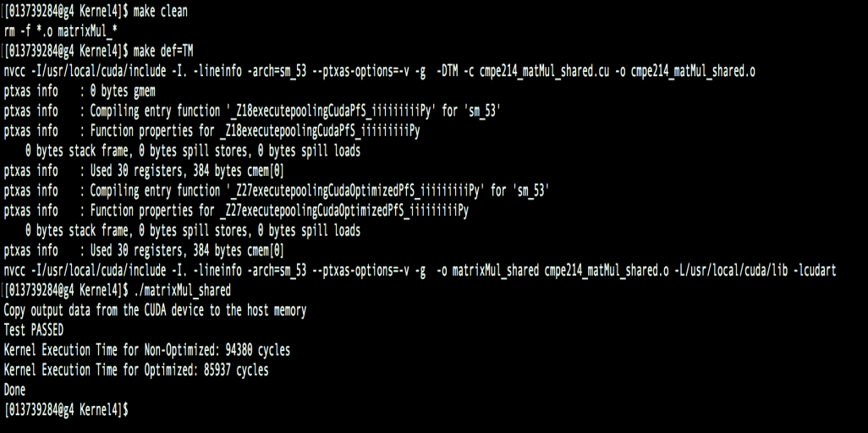
Results
8.94 % Improvement

Slide 22
poolingAverageCUDA
7 x 7
Each element in the output is the average of the 7x7 elements from the input.
Average
1
2048 x 7 x 7
2048
Layer2_pool_GPU 2048
Layer2_Neurons_GPU 2048 x 7 x 7

Slide 23
poolingAverageCUDA
7 x 7
Average
1
2048
2048 x 7 x 7
Layer2_pool_GPU
Layer2_Neurons_GPU

Slide 24
poolingAverageCUDA
How shall I optimize this layer?
Can I use shared memory to optimize it?
2048 x 7 x 7
2048
1
Average
Layer2_pool_GPU
7 x 7
Each time unique elements are accessed from the input.
Layer2_Neurons_GPU

Slide 25
Every time loopc and loopr iterates 7 x 7 times to calculate the average.
for(int i = 0; i < loopr; i++)
{
for(int j = 0; j < loopc; j++)
{
sum += Layer2_Neurons_GPU[(output*in_fr*in_fc) + i*in_fc + j + stride + colstride] ;
}
}
Layer2_pool_GPU[output] = (sum/(loopc*loopr));
Can we unroll this loop as we know the number of iterations?
YES

Slide 26
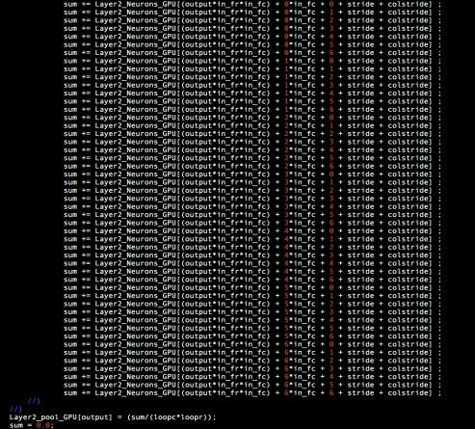
Code Snippet

Slide 27
Can we optimize it Further?
The given kernel is launched with 2048 thread blocks having 1 thread each.
dim3 numBlocks_avg(2048,1,1);
dim3 numThreads_avg(1,1);
Which means 2048 warps are launched with 1 thread each.
Can we launch it with 64 Thread Blocks having 32 threads each?
YES
Provide enough warps to hide the stalling effects.
Redistribution of work between Threads and Thread Blocks.
-”Program Optimization space pruning for a multithreaded GPU”.

Slide 28
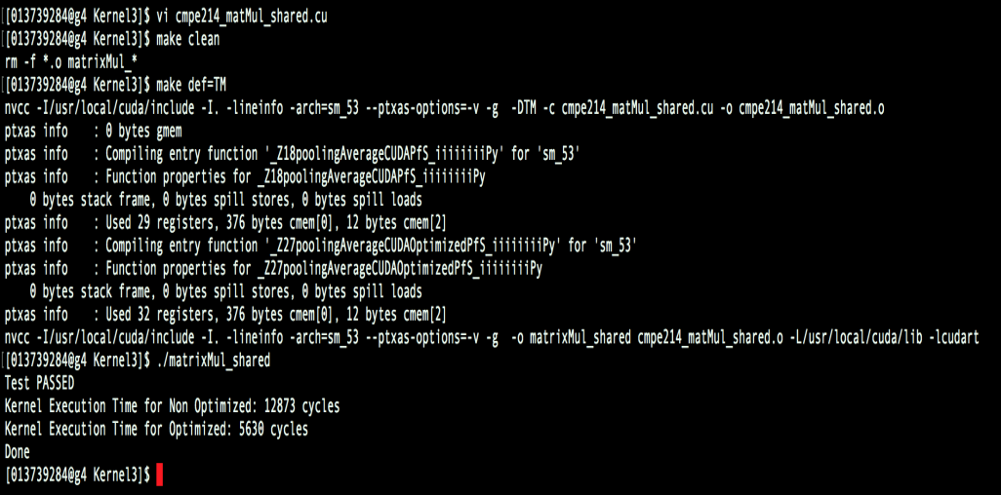
Result after Unrolling the loop
56.26 % Improvement

Slide 29
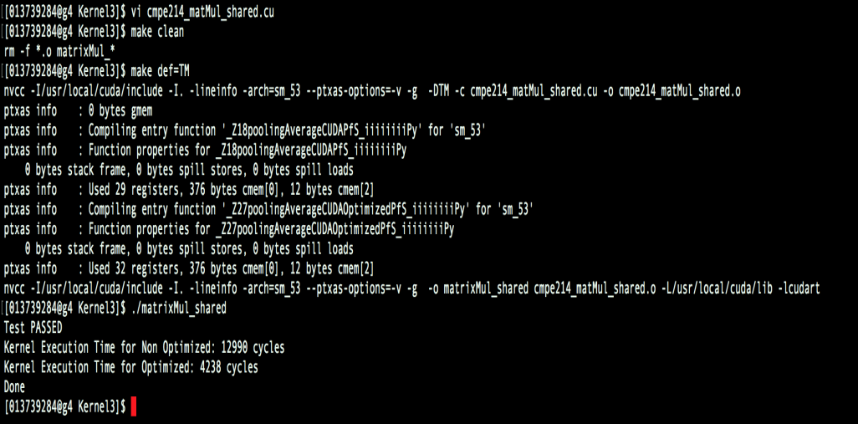
Result after using 64 Thread Blocks with 32 Threads
66.47 % Improvement

Slide 30
executeFCLayerCUDA
2048
1
2048
1000
Layer_OutNeurons_GPU
1000
Layer_InNeurons_GPU
2048
Layer_Weightss_GPU
2048 x 1000

Slide 31
executeFCLayerCUDA
2048
1
2048
1000
Layer_OutNeurons_GPU
1000
Layer_InNeurons_GPU
2048
Layer_Weightss_GPU
2048 x 1000

Slide 32
executeFCLayerCUDA
2048
1000
1
2048
Layer_OutNeurons_GPU
1000
Layer_InNeurons_GPU
2048
Layer_Weightss_GPU
2048 x 1000

Slide 33
executeFCLayerCUDA
2048
1000
1
Layer_OutNeurons_GPU
1000
Layer_InNeurons_GPU
2048
2048
Layer_Weightss_GPU
2048 x 1000

Slide 34
Can we use Constant Memory to Store Layer_InNeurons_GPU?
The Data does not change throughout the Kernel Execution.
Thus we can use the Constant Memory to store Layer_InNeurons_GPU.

Slide 35
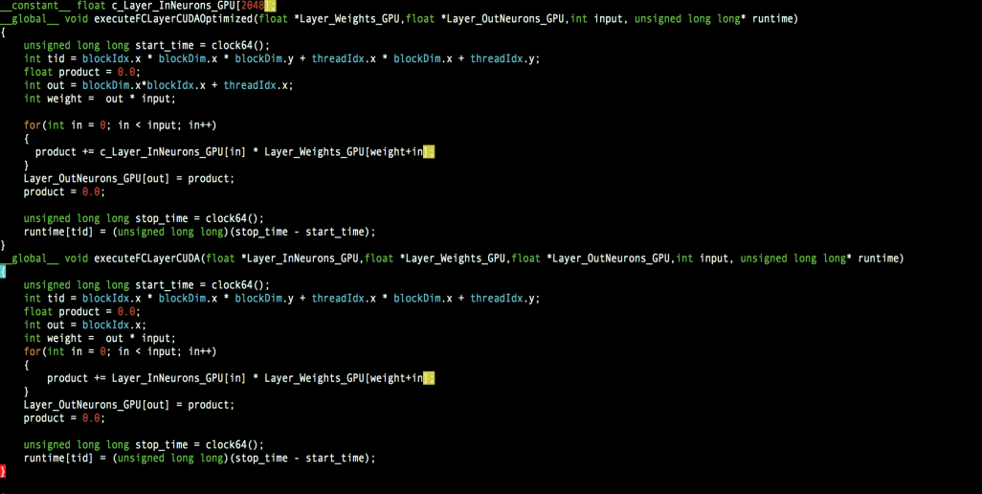
Code Snippet

Slide 36
Can we optimize it further?
The given Kernel is launched with 1000 Thread blocks having 1 Thread in each Thread block.
After distributing the work between the Thread Block and Threads e.g. Launching 10 Thread Blocks with 100 Threads each, we get performance improvements.

Slide 37
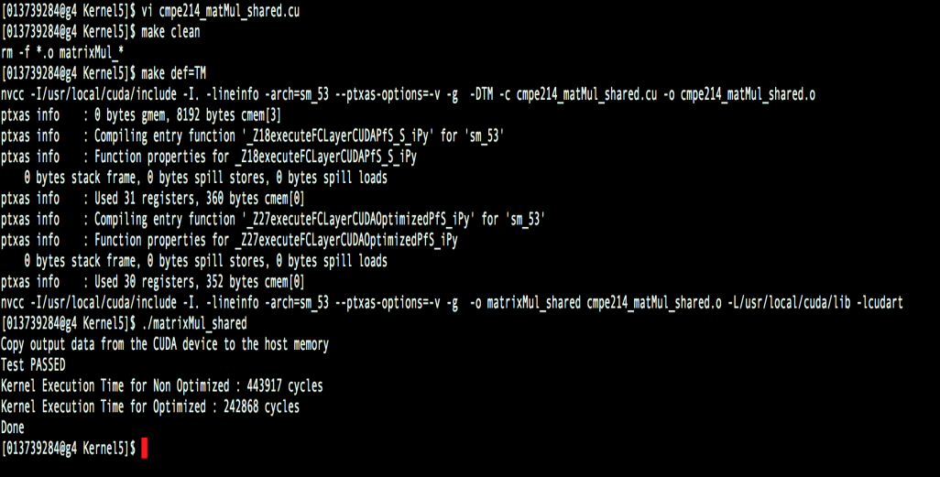
Result after using constant Memory
45.28 % Improvement

Slide 38
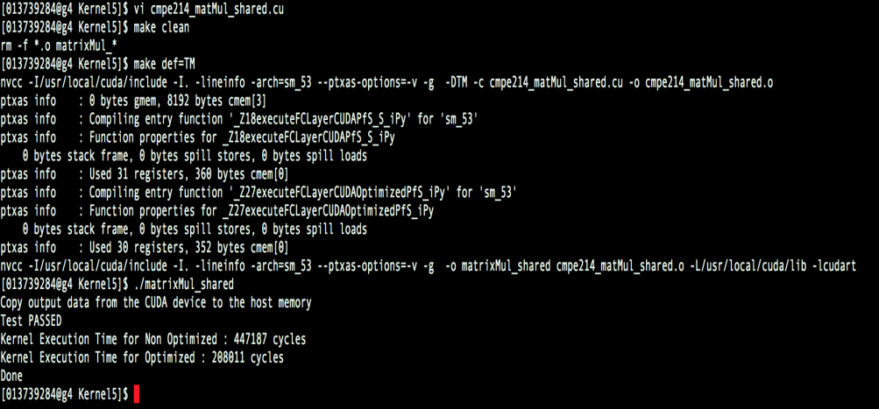
Result after using different values of Thread Blocks and Threads.
53.48 % Improvement

Slide 39
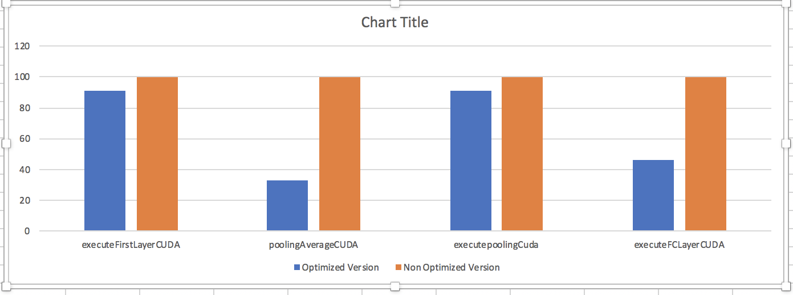
Performance Measure for Each layer
This Graph has been normalized.

Slide 40
File Structure
The original ResNet benchmark suite took more than 3 days to run. Thus I verified all the kernels by modifying Lab3 file.
Each File contains.
__global__ void executepoolingCudaOptimized() { }
__global__ void executepoolingCuda() { }
main()
{
host_input = rand()/(float)RAND_MAX;
host_output1 = output from the Kernel executepoolingCudaOptimized;
host_output2 = output from the Kernel executepoolingCuda;
Compared host_output1 == host_output2.
Used clock64() and start/stop timers to check the measurements.
}
Optimized Kernel Version
Original Kernel Version
Initialized the input with random values using rand method()

Slide 41
References
[1] S. Ryoo, C. I. Rodrigues, S. S. Baghsorkhi, S. S. Stone, D. B. Kirk, and W.-m. W. Hwu. Optimization principles and application performance evaluation of a multithreaded gpu using cuda. In Proceedings of the 13th ACM SIGPLAN Symposium on Principles and practice of parallel programming, PPoPP ’08, pages 73–82, New York, NY, USA, 2008. ACM.
[2] S. Ryoo, C. I. Rodrigues, S. S. Stone, S. S. Baghsorkhi, S.-Z. Ueng, J. A. Stratton, and W.-m. W. Hwu. Program optimization space pruning for a multithreaded gpu. In Proceedings of the 6th annual IEEE/ACM international symposium on Code generation and optimization, CGO ’08, pages 195–204, New York, NY, USA, 2008. ACM.
[3] Y. Li, J. Dongarra, and S. Tomov. A note on auto-tuning gemm for gpus. In Proceedings of the 9th International Conference on Computational Science: Part I, ICCS ’09, pages 884–892, Berlin, Heidelberg, 2009. Springer-Verlag.
[4] Guangming Tan, Linchuan Li, Sean Treichler, Everett Phillips, Yungang Bao, and Ninghui Sun. Fast implementation of DGEMM on Fermi GPU. In Supercomputing 2011, SC ’11, pages 35:1–35:11, New York, NY, USA, 2011. ACM.

Slide 42
Thank You. Any Questions?

