Slide 1
HITESH JOSHI Sri Eshwar College of Engineering Kinathukadavu , Coimbatore 641202
CODE APLHA
A PRESENTATION UPON PHISHING AWARENESS TRAINING

Slide 2
Phishing: How to Spot and Stop Online Scams

Slide 3

Introduction
Phishing is a type of cyber attack where attackers attempt to deceive individuals into providing sensitive information such as usernames, passwords, credit card numbers, or other personal details.

Slide 4
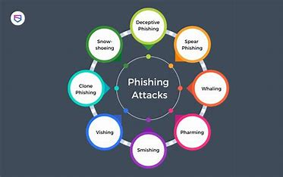
Types of Phishing
Phishing takes several forms, including email phishing, where fraudulent emails mimic reputable sources; spear phishing, which targets specific individuals or organizations with personalized messages; smishing, using deceptive SMS messages; and vishing, involving phone calls from attackers posing as trusted entities.

Slide 5

Common Red Flags
Look out for misspelled URLs, urgent requests for personal information, and generic greetings in emails.
These are common indicators of
phishing attempts. Being aware of these red ﬂags can help you avoid falling victim to scams.

Slide 6

Preventive Measures
To prevent phishing, be cautious of unsolicited messages and verify the source before clicking links or downloading attachments. Use strong, unique passwords and enable two-factor authentication. Keep software and antivirus programs updated, and educate yourself and others about common phishing tactics.

Slide 7

Reporting Phishing Attempts
Report any phishing attempts to the appropriate authorities and the affected organization. By reporting these incidents, you contribute to the prevention of future scams and protect others from falling victim to similar frauds.

