Slide 1

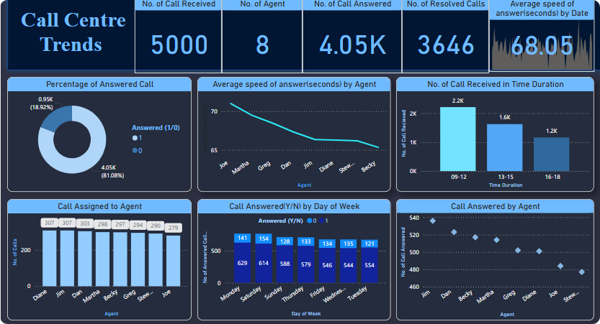
Call Centre Trends Analysis
A comprehensive look at call centre performance.
Created by Hitesh Jangid.

Slide 2





Project Workflow Overview
Data Collection
Gathering data from various call centre systems.
Data Processing
Cleaning and transforming collected data.
Dashboard Creation
Developing interactive dashboards.
Analysis and Reporting
Analysing data to identify key trends.

Slide 3
Problem 1: High Call Abandonment
The Challenge
The Solution
The Result
Many customers were dropping calls due to long wait times.
Analysed peak hours and adjusted staffing levels.
Reduced call abandonment rate by 15%.

Slide 4




Problem 2: Inefficient Agent Performance
The Challenge
The Solution
Agents were spending too much time on routine tasks.
Implemented automated workflows and scripts.
The Result
Increased agent efficiency by 20%.

Slide 5



Problem 3: Lack of Customer Insight
1
Actionable insights
2
Customer feedback
3
Data collection
Improve services based on customer interactions.

Slide 6
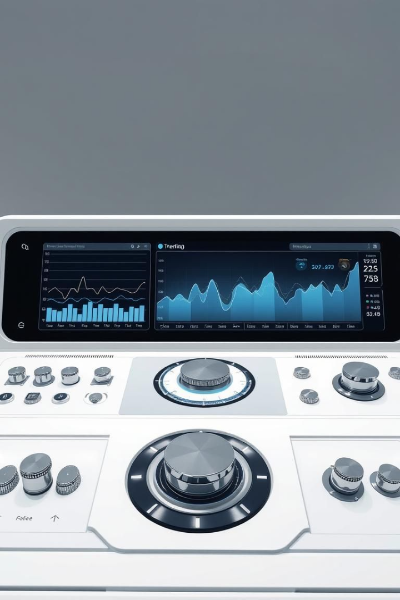



Key Features of the Analysis
Real-time Monitoring
Trend Identification
Predictive Analytics
Live dashboards to track key metrics.
Spot emerging trends in call centre data.
Forecast future call volumes and patterns.

Slide 7

Benefits of the Project
Improved Efficiency
Cost Reduction
Streamlined call centre operations.
Reduced operational expenses.
Better Customer Satisfaction
Enhanced customer experience.

Slide 8
Thank You

