Slide 1

A training period presentation
Enterprise Network Management System
-By JATIN PATNI
HITESH JAISINGHANI
KISAN CHAURASIYA
(IT – FINAL YEAR)
-Submitted to
Ms. Neha Janu

Slide 2
Contents
Networking
Some Networking Terminologies
OSI model
Routing
Technology Used
VLSM
Project TOPOLOGY Screenshots
Conclusion

Slide 3
NETWORKING
Network communication between two or more than two network devices by using any transmission media.
REQUIREMENTS OF NETWORKING
Minimum two computers with NIC.
Transmission media
Networking operating system.

Slide 4
Some Networking Terminologies
PC : A computer is capable of running various networking related commands.
Switch : A networking device that is used to connect devices . It works on Layer 2 of OSI model layer.
Router : A networking device that forwards data packets along networks. Routers are located at gateways, the places where two or more networks connect. It works on Layer 3 of OSI model Layer.
Console PC : A PC that is used to access the console of Router and Switch.
ISP : internet Service Provider (e.g. IDEA, VODAFONE)
Connecting Wires : Various connecting wires are used to connect. (Straight Cable, Cross Cable, Serial Links, etc)

Slide 5
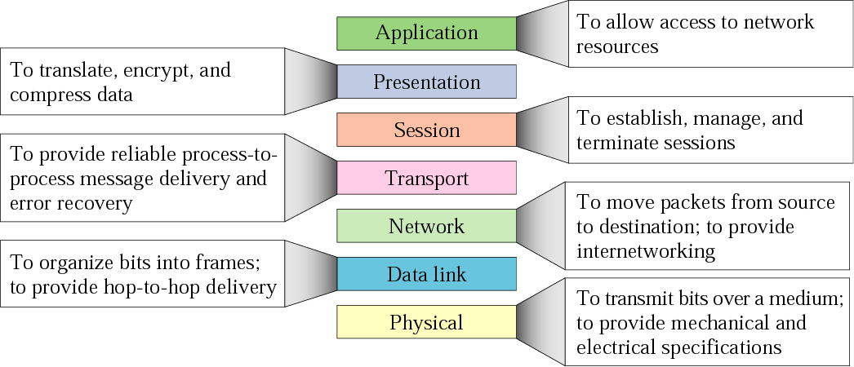
The OSI MODEL
Open system interconnection

Slide 6
ROUTING
The routing is used for taking a packet from one device and sending it through the network to another devices of different network.
Types of Routing :-
Default Routing
Static Routing
Dynamic Routing (RIP v1, RIP v2, EIGRP, OSPF)

Slide 7
Technology used
OSPF Routing Protocol
VLAN’s
InterVlan Routing
IP Phones
SMTP
DHCP Server

Slide 8
VLSM
VLSM is Variable Length Subnet Mask.
It is a process of dividing an IP space into the subnets of different sizes without wasting IP addresses.
When we perform subnetting, all subnets have the same number of hosts, this is known as FLSM ( Fixed length subnet mask) but in VLSM we futher Subnet the Subnetted IP network.

Slide 9
PROJECT TOPOLOGY

Slide 10
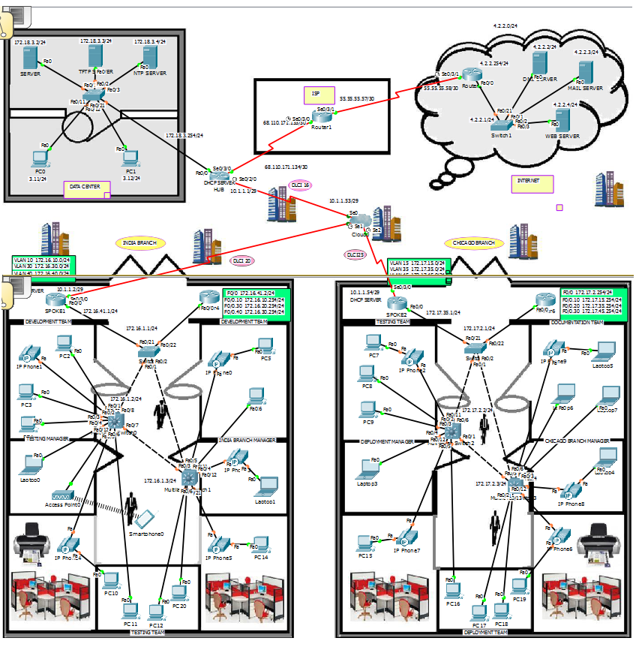

Slide 11
BRANCH INDIA & CHICAGO

Slide 12
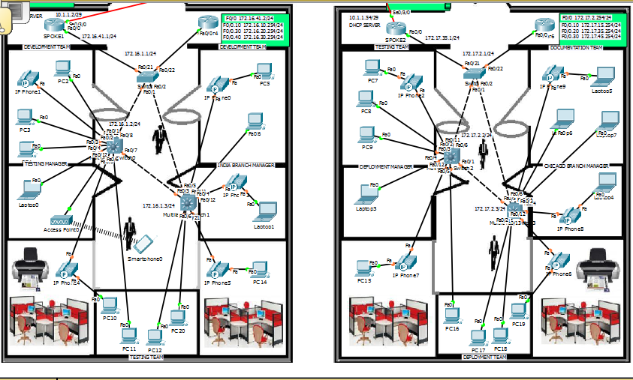

Slide 13
Configurations on various devices

Slide 14
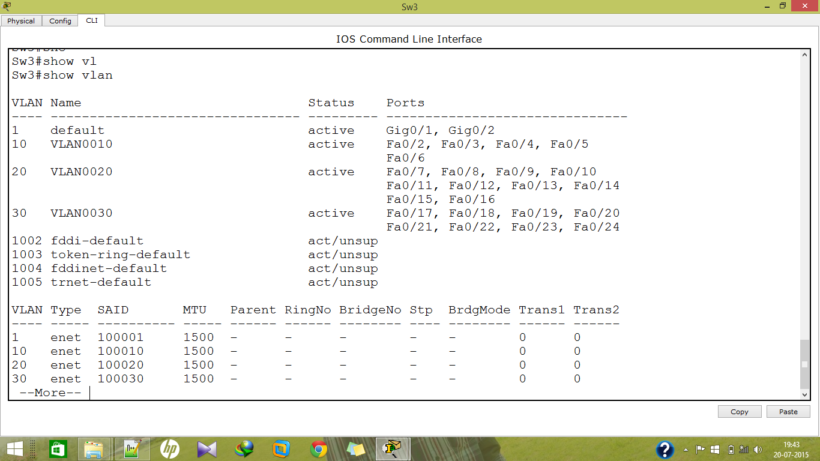
VLANs ARE CREATED ON THIS SWITCH

Slide 15
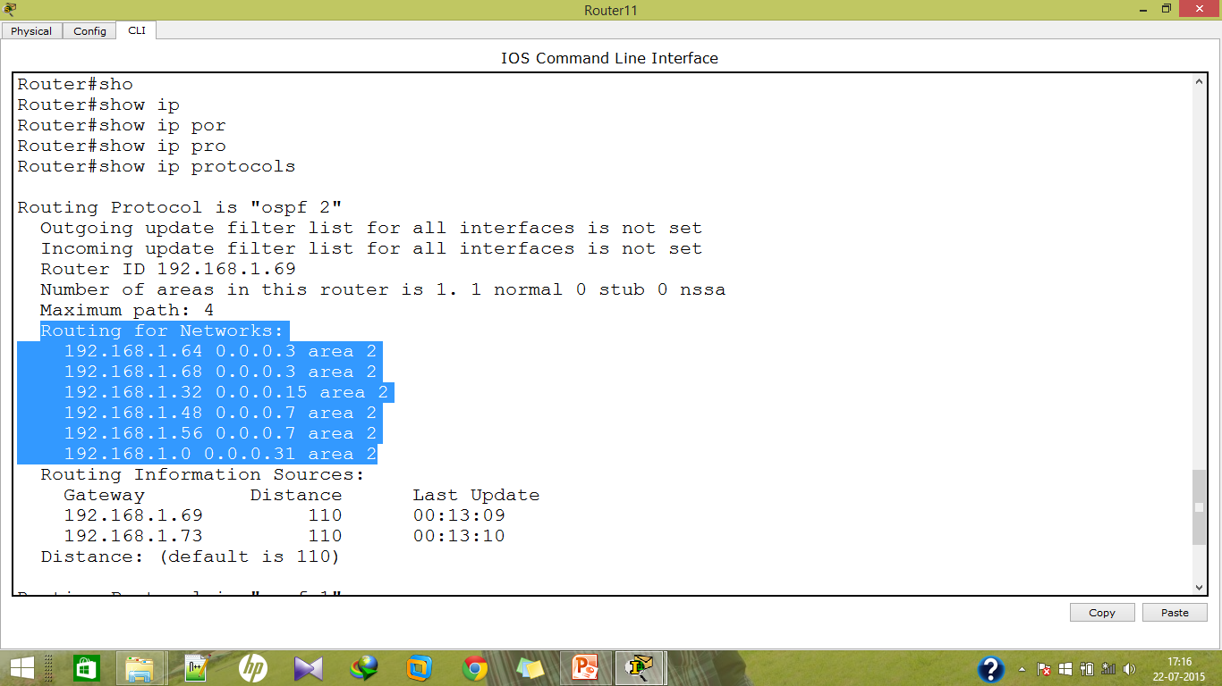
Routing protocol used is OSPF

Slide 16
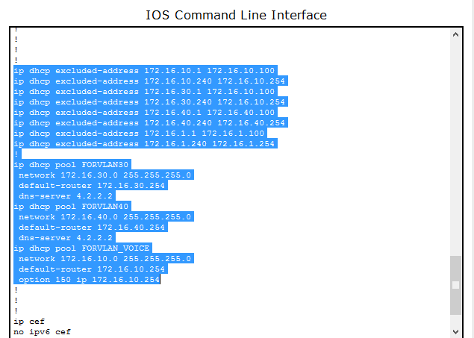
DHCP Config

Slide 17
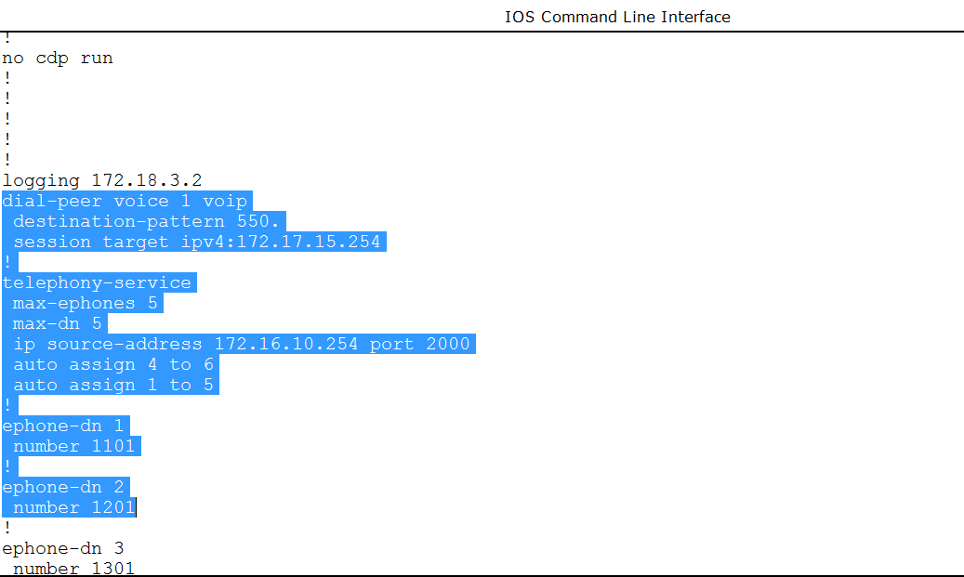
Commands used to configure IP Phone

Slide 18
Data Center

Slide 19
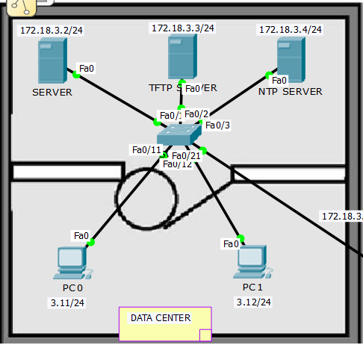

Slide 20
Configurations on various devices

Slide 21
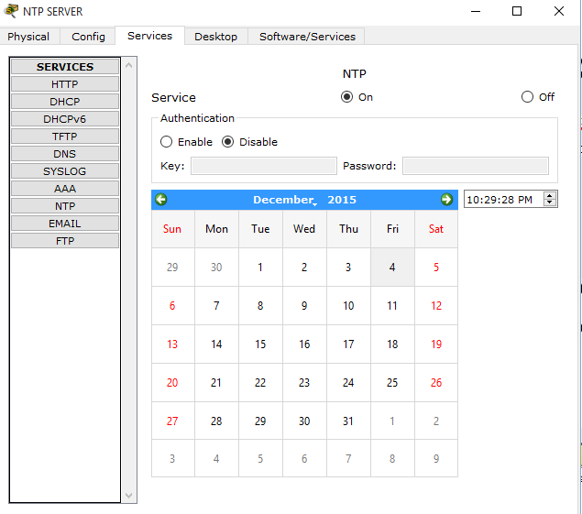
NTP Server

Slide 22
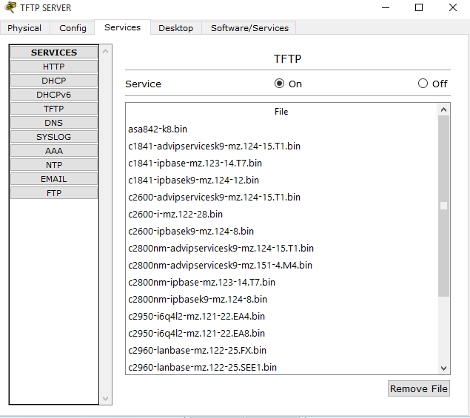
Trivial File transfer protocol

Slide 23
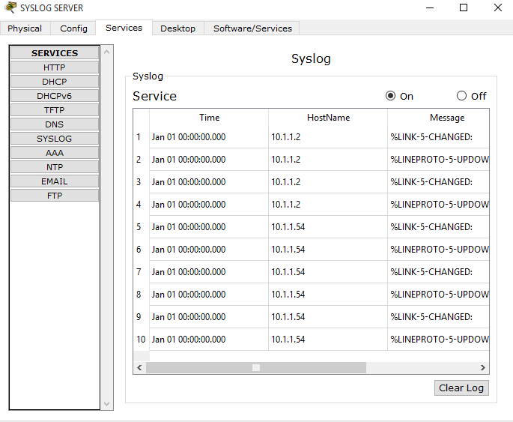
Syslog Server

Slide 24
Conclusion
Cisco Routers and Switches are best in the World, so this Enterprise Network Design works best in such type of scenario.
The Network Design is completely practical.
All the configurations are based on latest series of CISCO devices.

Slide 25
THANK YOU Any Queries..??

