Slide 1

SWAMI KESHVANAND INSTITUTE OF TECHNOLOGY,
MANAGEMENT & GRAMOTHAN
Supply Chain Management
Submitted By:-
Manoj Tyagi
Mayank Sharma
Submitted To:-
Mrs. Neha Janu

Slide 2
ABSTRACT
All facilities, functions, activities, associated with flow and transformation of goods and services from raw materials to customer, as well as the associated information flows.
An integrated group of processes to “source,” “make,” and “deliver” products.

Slide 3
Supply Chain Management (SCM)
Managing flow of information through supply chain in order to attain the level of synchronization that will make it more responsive to customer needs while lowering costs.
Keys to effective SCM :-
Information
Communication
Cooperation
Trust

Slide 4
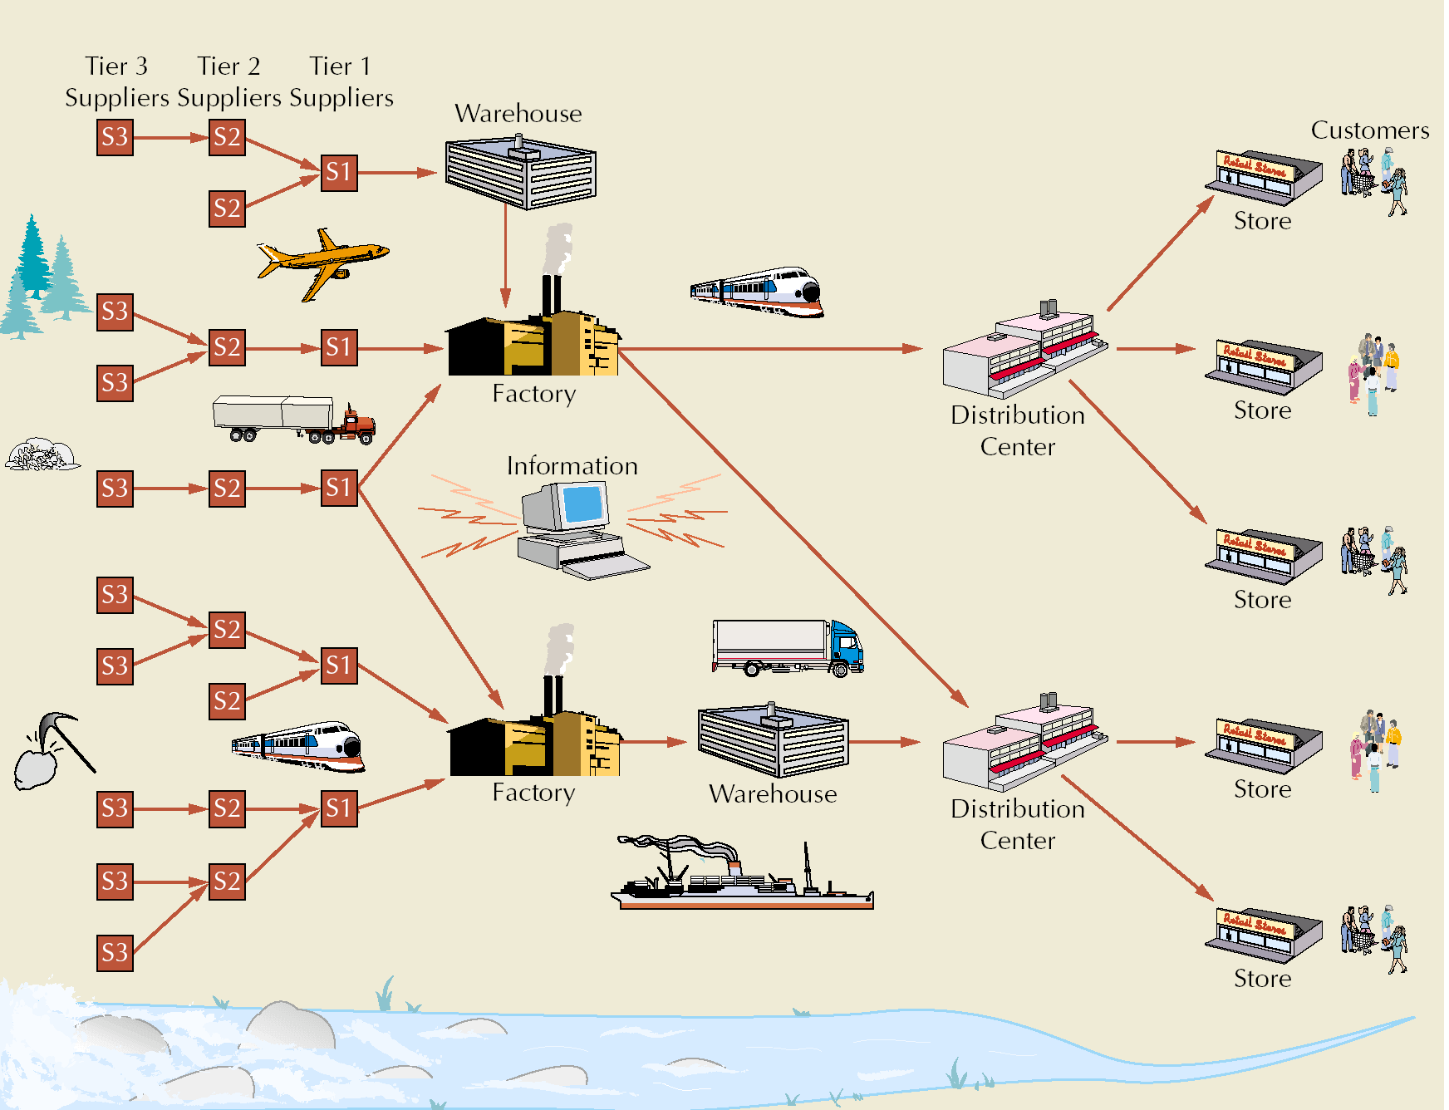

Slide 5
Supply Chain Uncertainty
One goal in SCM:
respond to uncertainty in customer demand without creating costly excess inventory
Negative effects of uncertainty
lateness
incomplete orders
Inventory
insurance against supply chain uncertainty
Factors that contribute to uncertainty
long variable lead times
late deliveries
incomplete shipments
product changes batch ordering
price fluctuations and discounts
inaccurate demand forecasting
inflated orders

Slide 6
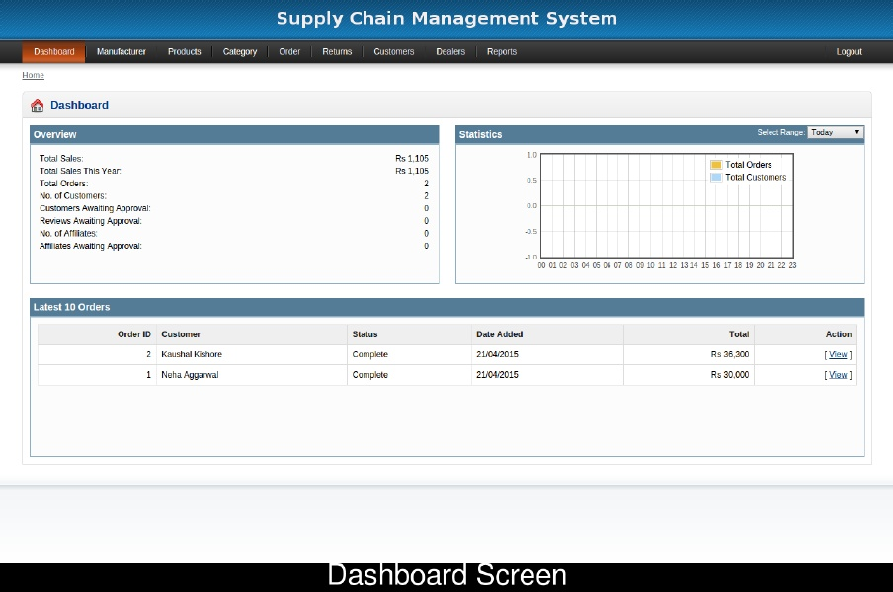
Dashboard

Slide 7
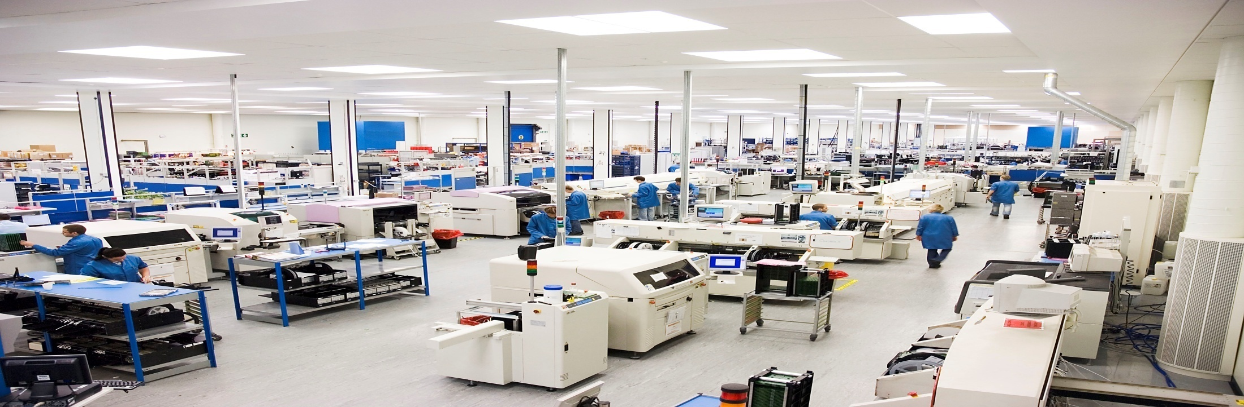
Who is Manufacturer?
Entity that makes goods through a process involving raw materials, components., assemblies usually on large scale with different operations divided among different workers. Commonly used interchangeably with producer.

Slide 8
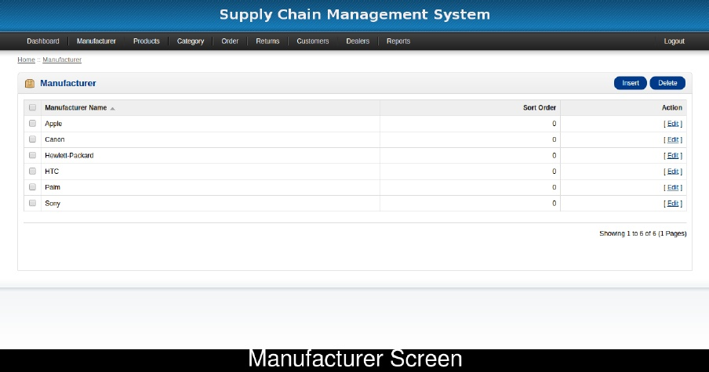
Manufacturer

Slide 9
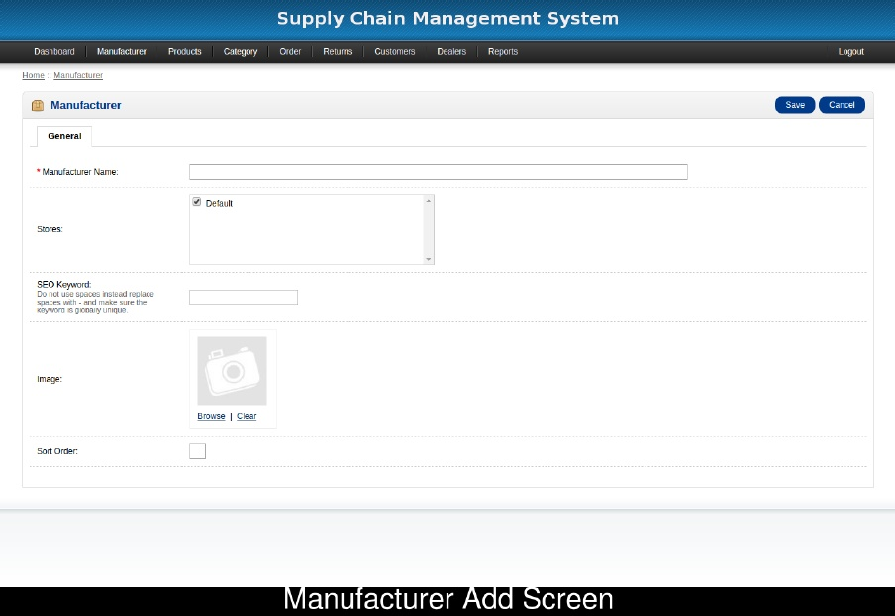
Insert a new Manufacturer

Slide 10
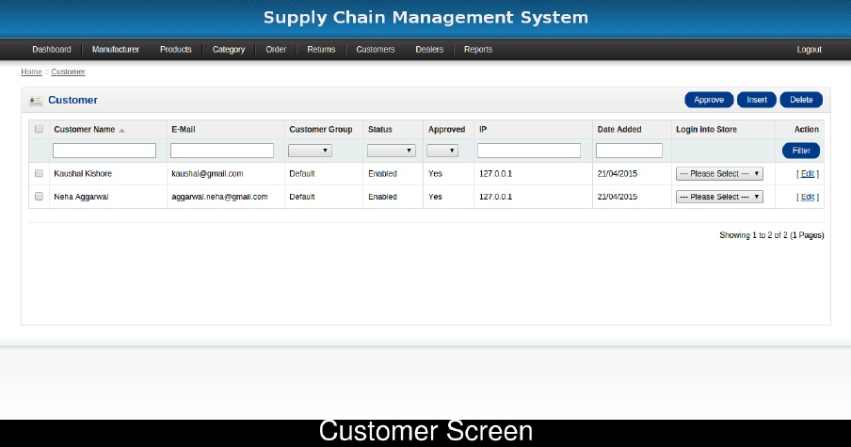
List of Customers

Slide 11
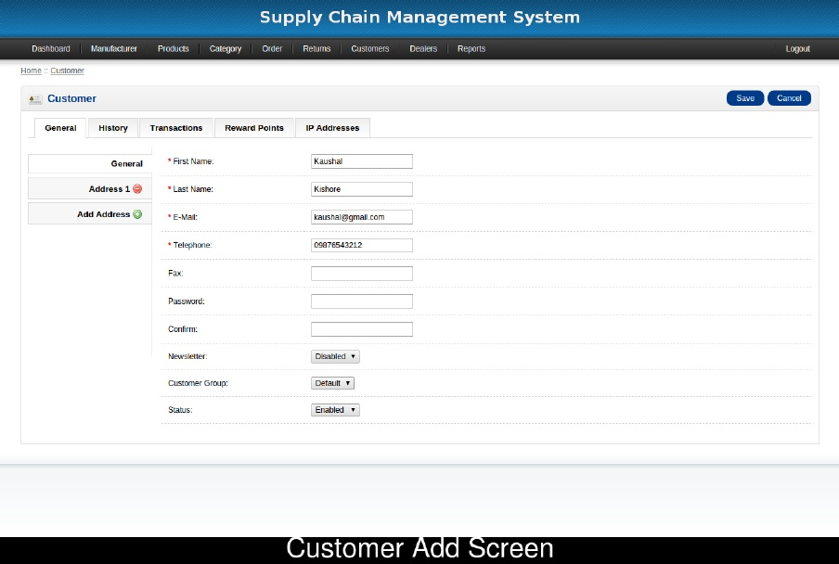
Options for Customers

Slide 12
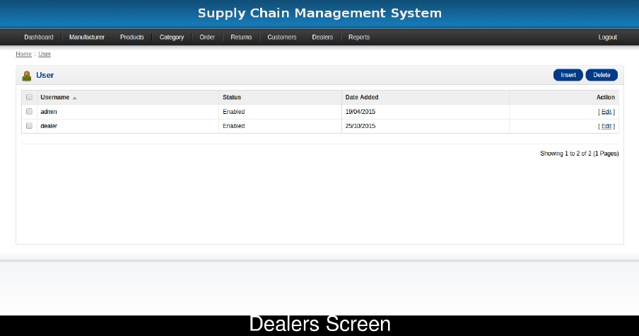
List of Dealers

Slide 13
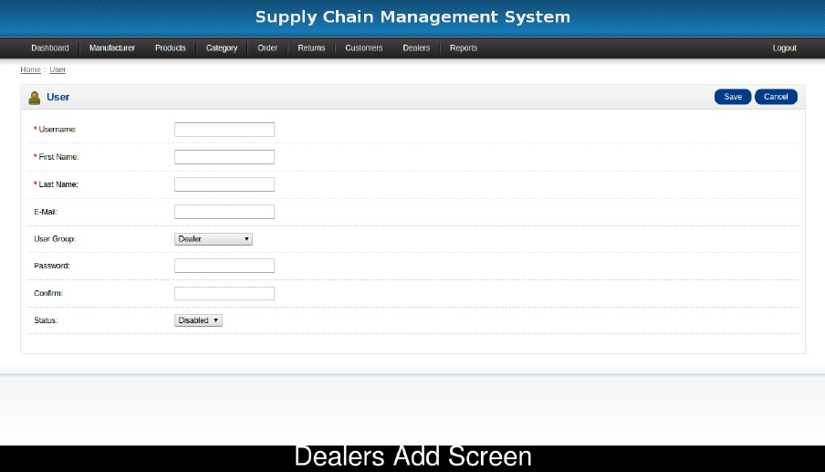
New Dealers

Slide 14
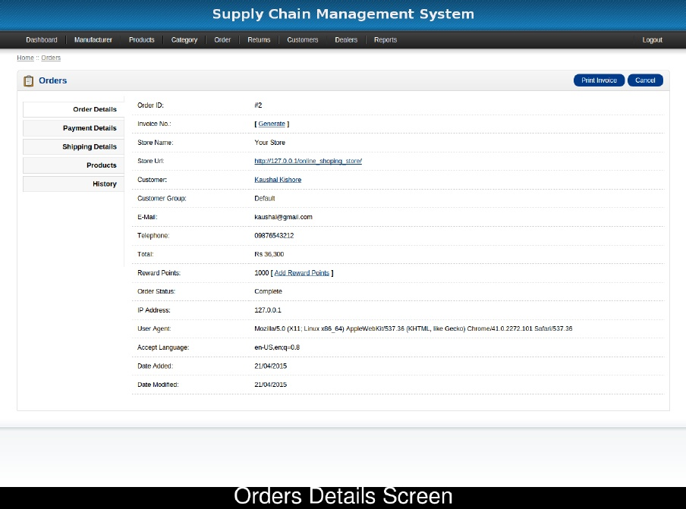

Slide 15
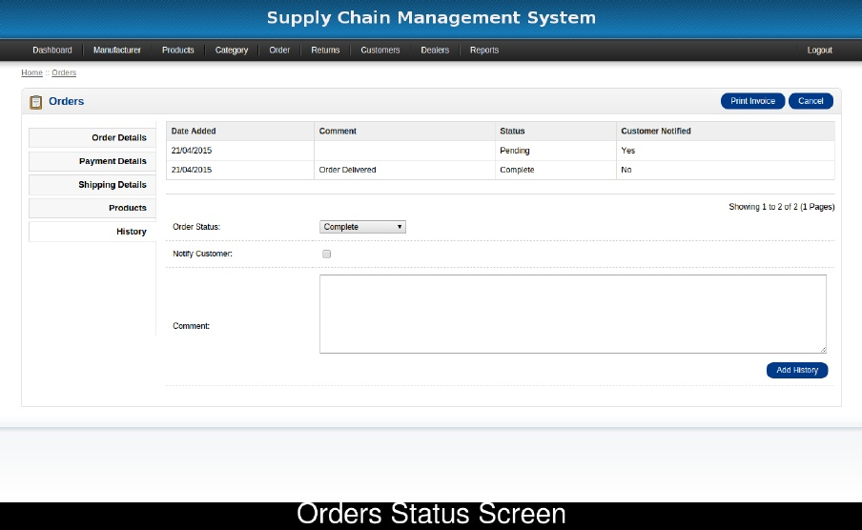

Slide 16
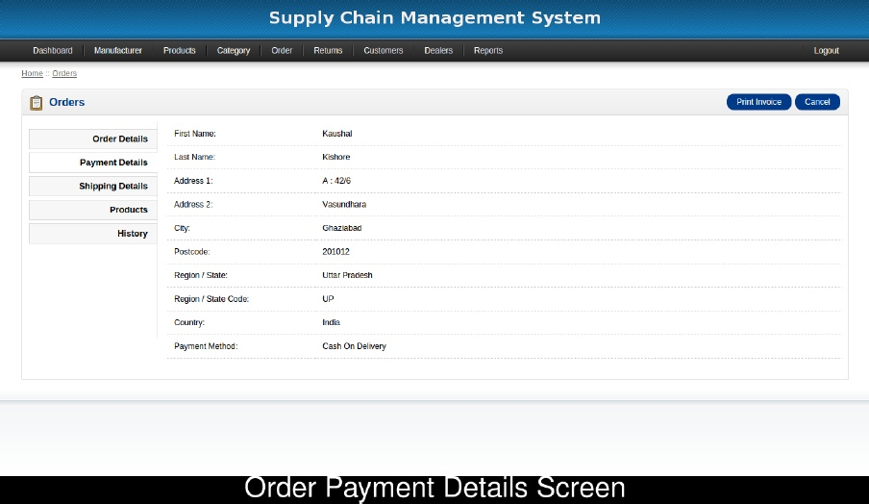

Slide 17
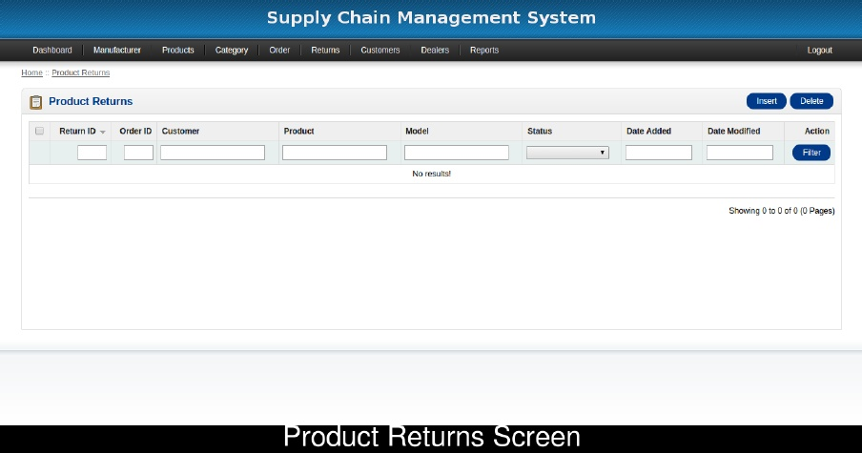
Return Requested Record

Slide 18
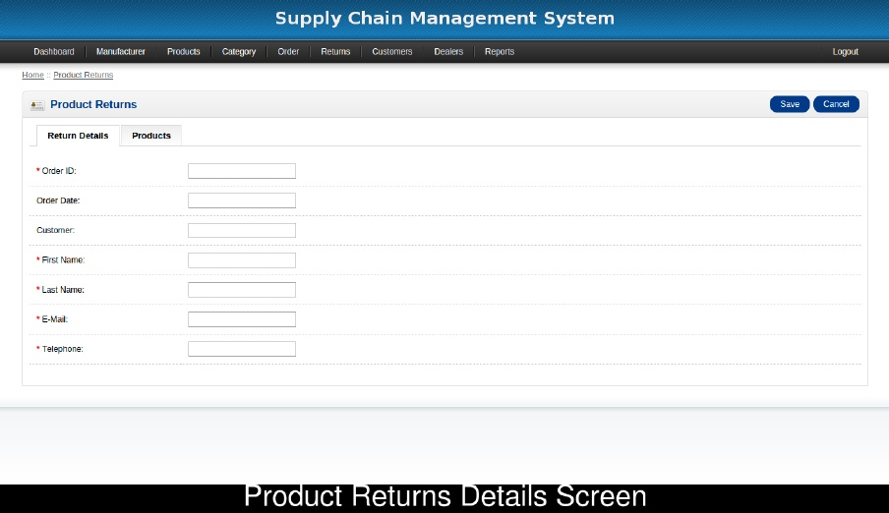
Product Return Details

Slide 19
Thank You

