Slide 1



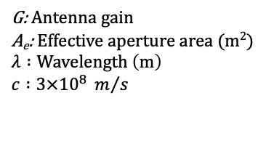

Propagation at mmWave and THz (1/3)
At higher frequencies (mmWave and above), the antennas (for a given physical size) are highly directional and have higher gains when compared to the antenna at sub-6 GHz (1).
Equation (3) demonstrates that when directional antennas are used at both the transmitter and receiver, higher frequency links have less loss than lower frequencies [1, 2].
$G=\frac{A_{e}4π}{λ^{2}} , λ=\frac{c}{fc} G=k_{1}{fc}^{2} (1)$
where, $k_{1}=\frac{A_{e}4π}{c^{2}}$
$P_{r}\left(d\right) = \frac{P_{t}G_{t}G_{r}}{{\left(\frac{4πd}{λ}\right)}^{2}}$ (2) ${ P}_{r}\left(d\right)=\frac{P_{t}A_{et}A_{er}{fc}^{2}}{d^{2}c^{2}}$ ${ P}_{r}\left(d\right)=k_{2}\frac{{fc}^{2}}{d^{2}}$ (3)
where, $k_{2}=\frac{P_{t}A_{et}A_{er}}{c^{2}}$
G: Antenna gain
A_{e}: Effective aperture area (m²)
$$λ :Wavelength \left(m\right)$$
$$c :3×{10}^{8}{ m}/s$$
$P_{r}$ : Received power (mW)
$P_{t}$ : Transmitted power(mW) $A_{er}:Effective aperture area of$
$$RX antenna (m2)$$
$A_{et }$: Effective aperture area of
TX antenna (m²)
$G_{t}$ : Gain of the TX antenna
$G_{r}$: Gain of the RX antenna
f_{c} : Center Frequency
for a fixed A_{e}
$$Using \left(1\right) in (2)$$
$$d>d_{0}\left(1m\right)$$
[1] S. Sun, G. R. MacCartney, M. K. Samimi and T. S. Rappaport, “Synthesizing Omnidirectional Antenna Patterns, Received Power and Path Loss from Directional Antennas for 5G Millimeter-Wave Communications,” 2015 IEEE Global Communications Conference (GLOBECOM), Dec. 2015, pp. 1-7. https://ieeexplore.ieee.org/abstract/document/7417335
[2] T. S. Rappaport et al., "Wireless Communications and Applications Above 100 GHz: Opportunities and Challenges for 6G and Beyond," in IEEE Access, vol. 7, pp. 78729-78757, June 2019. https://ieeexplore.ieee.org/abstract/document/8732419

Slide 2
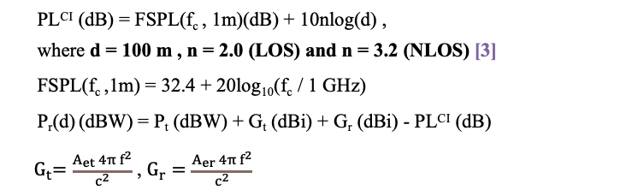
Propagation at mmWave and THz (2/3)
Example : Continuous Wave (CW) signal , P_{t} $=1 mW$ (-30 dBW), Antenna efficiency = 0.6 , A_{et} (0.5 m x 1 m) = 0.5 m², A_{er} (0.022 m x 0.022 m) = 0.0005 m².
Table 1. Received power at a fixed distance (100 m) for a CW signal for different frequencies (f_{c}) in Urban Microcell (UMi) LOS, UMi NLOS
f_{c} (GHz) | Gain TX (dBi) | Gain RX (dBi) | FSPL(f_{c},1m) (dB) | Line of sight (LOS) Omnidirectional Antenna Directional Antenna P_{r} (d) (dBW) P_{r} (d) (dBW) | Non line of sight (NLOS) Omnidirectional Antenna Directional Antenna P_{r} (d) (dBW) P_{r} (d) (dBW)
3 GHz | 25.8 | -4.2 | 42.0 | -110.0 -90.5 | -134.0 -114.5
10 GHz | 36.2 | 6.2 | 52.4 | -120.4 -80.0 | -144.0 -104.0
30 GHz | 45.8 | 15.8 | 62.0 | -130.0 -70.5 | -154.0 -94.5
100 GHz | 56.2 | 26.2 | 72.4 | -140.4 -60.0 | -164.4 -84.0
300 GHz | 65.8 | 35.8 | 82.0 | -150.0 -50.5 | -174.0. -74.5
“The received power increases as we increase the carrier frequency when directional antennas are used at both TX and RX [1, 2].”
Antenna Efficiency is defined as ratio of power radiated by the antenna to the power supplied to the antenna.
PL^{CI} (dB) = FSPL(f_{c} , 1m)(dB) + 10nlog(d) ,
where d = 100 m , n = 2.0 (LOS) and n = 3.2 (NLOS) [3]
FSPL(f_{c} ,1m) = 32.4 + 20log₁₀(f_{c} / 1 GHz)
P_{r}(d) (dBW) = P_{t} (dBW) + G_{t} (dBi) + G_{r} (dBi) - PL^{CI} (dB)
${ G}_{t}=\frac{A_{et} 4π f^{2}}{c^{2}}$ , $G_{r}=\frac{A_{er} 4π{ f}^{2}}{c^{2}}$
[1] T. S. Rappaport et al., "Wireless Communications and Applications Above 100 GHz: Opportunities and Challenges for 6G and Beyond," in IEEE Access, vol. 7, pp. 78729-78757, June 2019. https://ieeexplore.ieee.org/abstract/document/8732419
[2] Y. Xing and T. S. Rappaport, “Propagation Measurement System and Approach at 140 GHz-Moving to 6G and Above 100 GHz,” 2018 IEEE Global Communications Conference (GLOBECOM), Dec .2018, pp. 1-6. https://ieeexplore.ieee.org/abstract/document/8647921
[3] Y. Xing and T. S. Rappaport, "Millimeter Wave and Terahertz Urban Microcell Propagation Measurements and Models," in IEEE Communications Letters, doi: 10.1109/LCOMM.2021.3117900. https://ieeexplore.ieee.org/document/9558848/

Slide 3
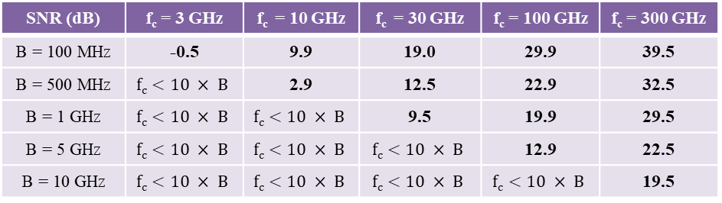
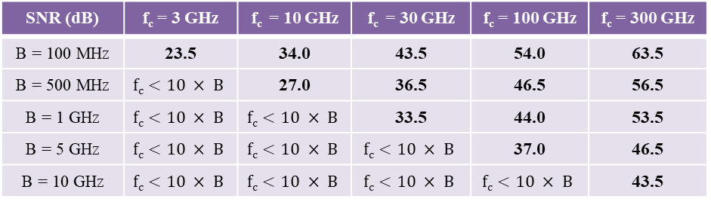
Propagation at mmWave and THz (3/3)
Table 1. SNR calculations (in dB) at different frequencies (f_{c}) and bandwidths (B) in LOS (n = 2.0).
A_{et} (0.5 m x 1 m) = 0.5 m²,
A_{er} (0.022 m x 0.022 m) = 0.0005 m²,
Noise Figure (NF) = 10 dB,
Pt = 1 mW (-30 dBW),
Antenna Efficiency = 0.6,
distance (d) = 100 m,
n = 2.0 (LOS), n = 3.2 (NLOS)
SNR (dB) | f_{c} = 3 GHz | f_{c} = 10 GHz | f_{c} = 30 GHz | f_{c} = 100 GHz | f_{c} = 300 GHz
B = 100 MHz | 23.5 | 34.0 | 43.5 | 54.0 | 63.5
B = 500 MHz | $$fc<10 × B$$ | 27.0 | 36.5 | 46.5 | 56.5
B = 1 GHz | $$fc<10 × B$$ | $$fc<10 × B$$ | 33.5 | 44.0 | 53.5
B = 5 GHz | $$fc<10 × B$$ | $$fc<10 × B$$ | $$fc<10 × B$$ | 37.0 | 46.5
B = 10 GHz | $$fc<10 × B$$ | $$fc<10 × B$$ | $$fc<10 × B$$ | $$fc<10 × B$$ | 43.5
SNR (dB) = P_{r} (d) – 10log(KTB) - NF
Table 2. SNR calculations (in dB) at different frequencies (f_{c}) and bandwidths (B) in NLOS (n = 3.2).
SNR (dB) | f_{c} = 3 GHz | f_{c} = 10 GHz | f_{c} = 30 GHz | f_{c} = 100 GHz | f_{c} = 300 GHz
B = 100 MHz | -0.5 | 9.9 | 19.0 | 29.9 | 39.5
B = 500 MHz | $$fc<10 × B$$ | 2.9 | 12.5 | 22.9 | 32.5
B = 1 GHz | $$fc<10 × B$$ | $$fc<10 × B$$ | 9.5 | 19.9 | 29.5
B = 5 GHz | $$fc<10 × B$$ | $$fc<10 × B$$ | $$fc<10 × B$$ | 12.9 | 22.5
B = 10 GHz | $$fc<10 × B$$ | $$fc<10 × B$$ | $$fc<10 × B$$ | $$fc<10 × B$$ | 19.5
“For a given bandwidth, the SNR increases as we go higher up in frequency.”
[1] T. S. Rappaport et al., "Wireless Communications and Applications Above 100 GHz: Opportunities and Challenges for 6G and Beyond,“ in IEEE Access, vol. 7, pp. 78729-78757, June 2019.
https://ieeexplore.ieee.org/abstract/document/8732419
[2] Y. Xing and T. S. Rappaport, "Millimeter Wave and Terahertz Urban Microcell Propagation Measurements and Models," in IEEE Communications Letters, doi: 10.1109/LCOMM.2021.3117900. https://ieeexplore.ieee.org/document/9558848/

Slide 4
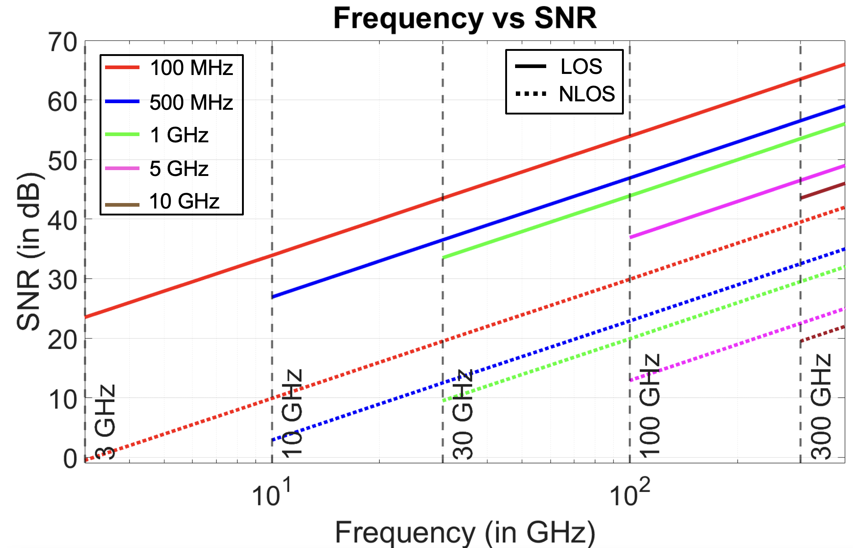
SNR (dB) calculations at different carrier frequencies (f_{c}) for a given Bandwidth in LOS/NLOS
Distance (d) = 100 m.
A_{et} (0.5 m x 1 m) = 0.5 m²,
A_{er} (0.022 m x 0.022 m) = 0.0005 m²,
Noise Figure (NF) = 10 dB,
Pt = 1 mW (-30 dBW),
Antenna Efficiency = 0.6,
n = 2.0 (LOS), n = 3.2 (NLOS)
Figure 1. Plot of SNR calculations (in dB) at different frequencies (f_{c}) and bandwidths in LOS/NLOS.
[1] T. S. Rappaport et al., "Wireless Communications and Applications Above 100 GHz: Opportunities and Challenges for 6G and Beyond," in IEEE Access, vol. 7, pp. 78729-78757, June 2019. https://ieeexplore.ieee.org/abstract/document/8732419

Slide 5
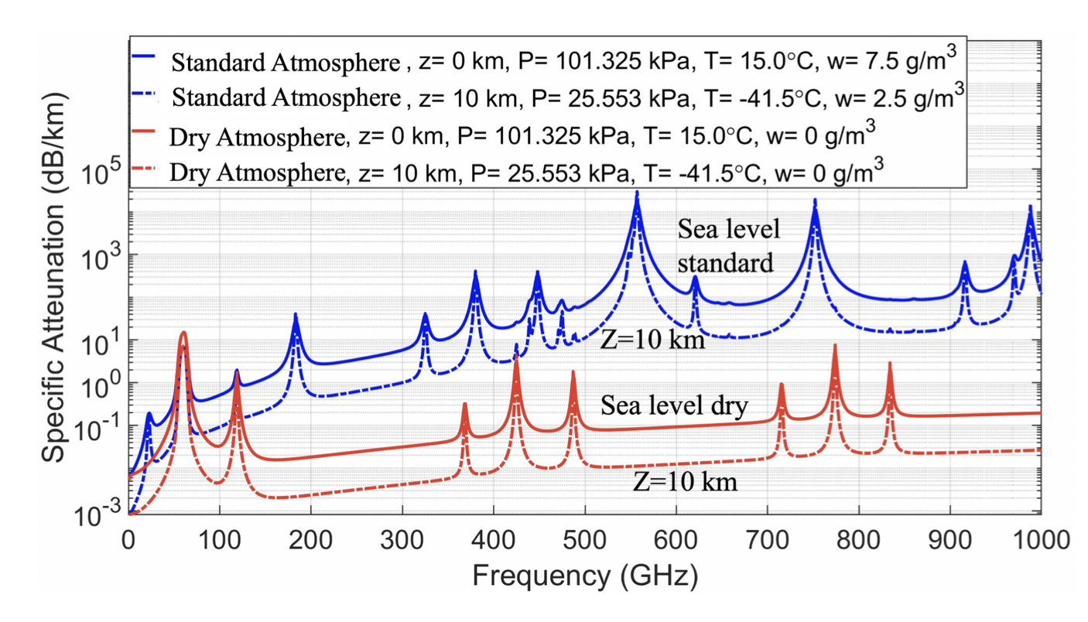
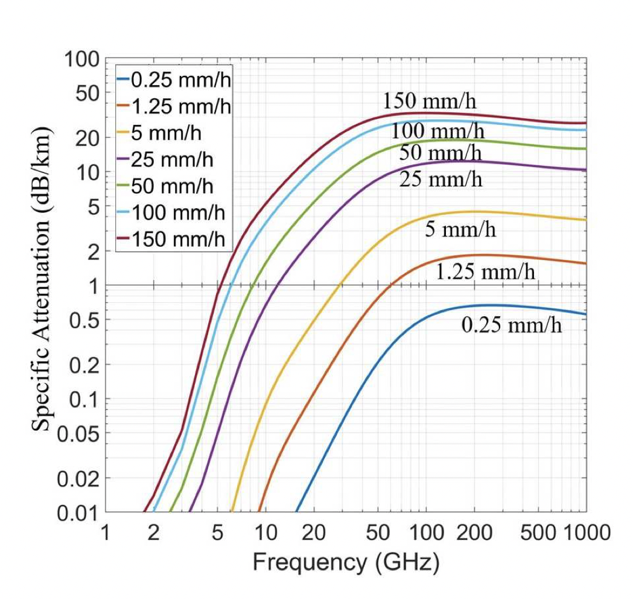
6G Challenges and Opportunities [1/2]
Frequency bands of 183 GHz, 325 GHz, 380 GHz, 450 GHz, 550 GHz, and 760 GHz suffer much greater attenuation due to the atmospheric absorption, which is in addition to the natural Friis free space loss – Use for “whisper radio” [1] (Figure 1).
mmWave bands suffer less than 10 dB/km of additional loss than caused by free space propagation in air up to 300 GHz [2, 3] (Figure 1).
Spectrum between 500 and 900 GHz suffers 100 to 200 dB/km atmospheric attenuation, which is only 10 to 20 dB over a 100 m distance (the typical radius of a small cell) [2, 3] (Figure 1).
Rain drops, snow, and hail caused substantial attenuation at frequencies above 10 GHz, however, “Rain attenuation flattens out from 50 GHz to 500 GHz” (Figure 2).
[1] T. S. Rappaport, J. N. Murdock and F. Gutierrez, “State of the Art in 60-GHz Integrated Circuits and Systems for Wireless Communications,” in Proceedings of the IEEE, vol. 99, no. 8, pp. 1390-1436, Aug. 2011. https://ieeexplore.ieee.org/abstract/document/5958173
[2] T. S. Rappaport et al., "Wireless Communications and Applications Above 100 GHz: Opportunities and Challenges for 6G and Beyond," in IEEE Access, vol. 7, pp. 78729-78757, June 2019. https://ieeexplore.ieee.org/abstract/document/8732419
[3] Y. Xing and T. S. Rappaport, "Terahertz Wireless Communications: Co-Sharing for Terrestrial and Satellite Systems Above 100 GHz," in IEEE Communications Letters, vol. 25, no. 10, pp. 3156-3160, Oct. 2021, https://ieeexplore.ieee.org/document/9450810
Figure 1. Attenuation vs Carrier Frequency [3].
Figure 2. Rain Attenuation vs Carrier Frequency [3].

Slide 6
6G Challenges and Opportunities [2/2]
Distance (d) = 100 m , A_{et} (0.5 m x 1 m) = 0.5 m², A_{er} (0.022 m x 0.022 m) = 0.0005 m², Noise Figure (NF) = 10 dB, P_{t} = 1 mW (-30 dBW), Antenna efficiency = 0.6, n = 2.0 (LOS) , n = 3.2 (NLOS) , Rain rate = 50 mm/hr (heavy rain) and Standard atmospheric attenuation (sea level).
P_{r}(d) (dBW) = P_{t} (dBW) + G_{t} (dBi) + G_{r} (dBi) - PL^{CI} (dB) – Rain attenuation (dB) – Atmospheric attenuation (dB)
Table 1. Received power at a fixed distance (100 m) for a CW signal for different frequencies (f_{c}) in Urban Microcell (UMi) LOS and UMi NLOS with Rain attenuation (dB/100m) and standard atmospheric attenuation (sea level) [1,2,3]
f_{c} (GHz) | Gain TX (dBi) | Gain RX (dBi) | FSPL(f_{c},1m) (dB) | Rain Attenuation (dB / 100m) | Standard Atmospheric attenuation (dB / 100m)
3 GHz | 25.8 | -4.2 | 42.0 | 0.0 dB | 0.0 dB
10 GHz | 36.2 | 6.2 | 52.4 | 0.1 dB | 0.0 dB
30 GHz | 45.8 | 15.8 | 62.0 | 0.9 dB | 0.0 dB
100 GHz | 56.2 | 26.2 | 72.4 | 2.0 dB | 0.1 dB
300 GHz | 65.8 | 35.8 | 82.0 | 2.0 dB | 0.6 dB
(LOS) P_{r} (d) (dBW)
-90.5
-80.1
-71.4
-62.1
-53.1
(NLOS) P_{r} (d) (dBW)
-114.5
-104.1
-95.4
-86.1
-77.1
[1] T. S. Rappaport, J. N. Murdock and F. Gutierrez, “State of the Art in 60-GHz Integrated Circuits and Systems for Wireless Communications,” in Proceedings of the IEEE, vol. 99, no. 8, pp. 1390-1436, Aug. 2011. https://ieeexplore.ieee.org/abstract/document/5958173
[2] T. S. Rappaport et al., "Wireless Communications and Applications Above 100 GHz: Opportunities and Challenges for 6G and Beyond," in IEEE Access, vol. 7, pp. 78729-78757, June 2019. https://ieeexplore.ieee.org/abstract/document/8732419
[3] Y. Xing and T. S. Rappaport, "Terahertz Wireless Communications: Co-Sharing for Terrestrial and Satellite Systems Above 100 GHz," in IEEE Communications Letters, vol. 25, no. 10, pp. 3156-3160, Oct. 2021, https://ieeexplore.ieee.org/document/9450810

