Slide 1

Stream Processing
Dilip Rao Krishna Murthy
Hitesh Sudhir Chandra Bavsar

Slide 2
TOPICS
Recap
Kafka Brokers
Advance Topics
Log Cleaning Policies
Scaling Kafka
Request Processing
Leader Broker Election
Consumer Group Rebalancing

Slide 3
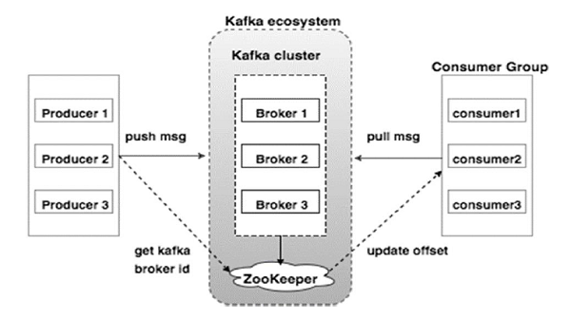
Recap and additional data on kafka
Replication factor= the number of copies of a topic in a Kafka cluster.
A broker can have n number of replicas however there is a tradeoff between the availibiliy and replication time.
Idempotent producer
Available in kafka version>0.11
Idempotent producer ensures exactly once message delivery per partition.
It guarantees a stable and safe pipeline.

Slide 4
Some Information on Kafka brokers
This leader maintains an insync replica set (ISR) consisting of all the replicas which are fully caught up with the leader
All reads and writes go through the leader. The leader writes messages to a writeahead log (WAL)
The leader also maintains a high-water mark (HW) which is the last committed message in the WAL
Each broker may have zero or more partitions per topic.
Each broker may have zero or more partitions per topic. Assume, if there are N partitions in a topic and N number of brokers, each broker will have one partition.
If N partitions in a topic and more than N brokers (n + m). Then the first N broker will have one partition and the next M broker will not have any partition for that particular topic
Assume if there are N partitions in a topic and less than N brokers (n-m), each broker will have one or more partition sharing among them. This scenario is not recommended due to unequal load distri-bution among the broker.

Slide 5
Advance Topics in Kafka
Cleanup Policies
Log Compaction
Leader Broker Election
Consumer Rebancing

Slide 6
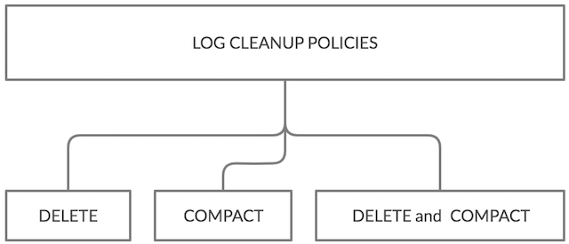
Cleaning Policies
It is important to restrict log segment to continue grow in size
Concept of making data expire is called as Cleanup
Segment :Partition is further divided into key value pairs called Segments.Those are stored in brokers.
Its divided in three types
Delete
Compact
Delete and Compact

Slide 7
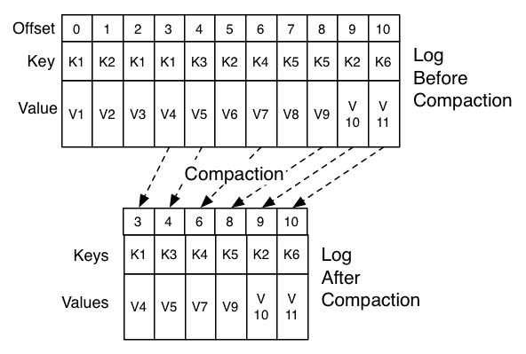
Delete Policy and compact policy
Delete policy
This is default cleanup policy.
This will discard old segments when their retention time or size limit has been reached.
Compact policy
It enables Log Compaction on the topic
This way the log is guaranteed to have
at least the last state for each key

Slide 8
Delete and compact policy
Both the policy turned on together.
In this process the log is compacted,but the cleanup process also follows the retention time or size limit settings.
Capacity planning is simpler than when you only have compaction set for a topic

Slide 9
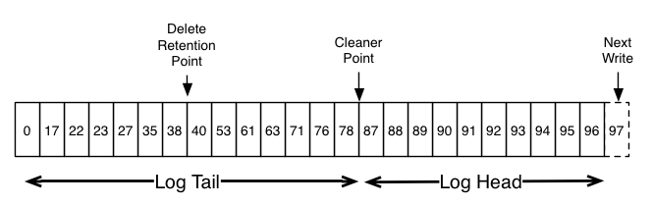
Log compaction process
It chooses the log that has the highest ratio of log head to log tail.
It creates a succinct summary of the last offset for each key in the head of the log.
It recopies the log from beginning to end removing keys which have a later occurrence in the log.
New, clean segments are swapped into the log immediately so the additional disk space required is just one additional log segment (not a fully copy of the log).
The summary of the log head is essentially just a spacecompact hash table. It uses exactly 24 bytes per entry.

Slide 10
Scaling Kafka
Suppose you have an application that needs to read messages from a Kafka topic, and write the results to another data store. In this case your application will create a consumer object, subscribe to the appropriate topic, and start receiving messages, and writing the results.
If you are limited to a single consumer reading and processing the data, your application may fall farther and farther behind, unable to keep up with the rate of incoming messages
Obviously there is a need to scale consumption from topics. Just like multiple producers can write to the same topic, we need to allow multiple consumers to read from the same topic, splitting the data between them

Slide 11
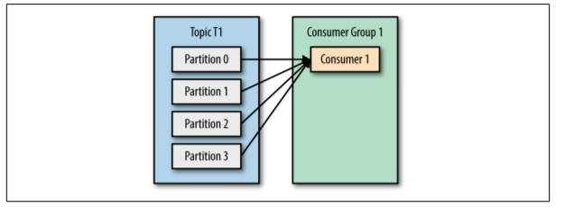
Kafka consumers are typically part of a consumer group. When multiple consumers are subscribed to a topic and belong to the same consumer group, each consumer in the group will receive messages from a different subset of the partitions in the topic
Let’s take topic T1 with four partitions. Now suppose we created a new consumer, C1, which is the only consumer in group G1, and use it to subscribe to topic T1. Con‐ sumer C1 will get all messages from all four t1 partitions.

Slide 12
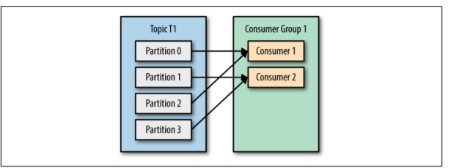
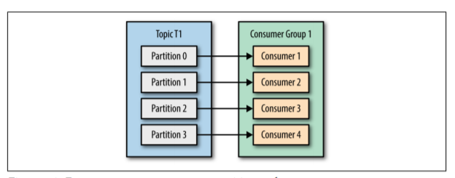
If we add another consumer, C2, to group G1, each consumer will only get messages from two partitions. Perhaps messages from partition 0 and 2 go to C1 and messages from partitions 1 and 3 go to consumer C2.
If G1 has four consumers, then each will read messages from a single partition

Slide 13
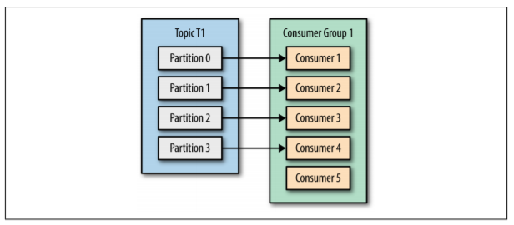
If we add more consumers to a single group with a single topic than we have parti tions, some of the consumers will be idle and get no messages at all.
The main way we scale data consumption from a Kafka topic is by adding more consumers to a consumer group.
It is common for Kafka consumers to do high-latency operations such as write to a database or a time-consuming computation on the data.
In these cases, a single consumer can’t possibly keep up with the rate data flows into a topic, and adding more consumers that share the load by having each consumer own just a subset of the partitions and messages is our main method of scaling.

Slide 14
Request processing
Most of what a Kafka broker does is process requests sent.
Kafka has a binary protocol (over TCP) that specifies the format of the requests and how brokers respond to them— both when the request is processed successfully or when the broker encounters errors while processing the request.
Clients always initiate connections and send requests, and the broker processes the requests and responds to them. All requests sent to the broker from a specific client will be processed in the order in which they were received—this guarantee is what allows Kafka to behave as a message queue and provide ordering guarantees on the messages it stores.

Slide 15
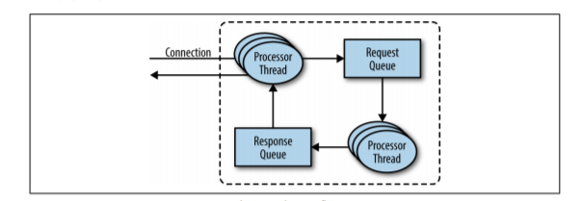
For each port the broker listens on, the broker runs an acceptor thread that creates a connection and hands it over to a processor thread for handling.
The number of processor threads (also called network threads) is configurable.
The network threads are responsible for taking requests from client connections, placing them in a request queue, and picking up responses from a response queue and sending them back to clients
Once requests are placed on the request queue, IO threads are responsible for picking them up and processing them. The most common types of requests are:
Produce Request
Fetch Request

Slide 16
Both produce requests and fetch requests have to be sent to the leader replica of a partition.
If a broker receives a produce request for a specific partition and the leader for this partition is on a different broker, the client that sent the produce request will get an error response of “Not a Leader for Partition.”
The same error will occur if a fetch request for a specific partition arrives at a broker that does not have the leader for that partition.
Kafka’s clients are responsible for sending produce and fetch requests to the broker that contains the leader for the relevant partition for the request
How do the clients know where to send the requests?
Kafka clients use another request type called a metadata request, which includes a list of topics the client is interested in. The server response specifies which partitions exist in the topics, the replicas for each partition, and which replica is the leader. Metadata requests can be sent to any broker because all brokers have a metadata cache that contains this information.

Slide 17
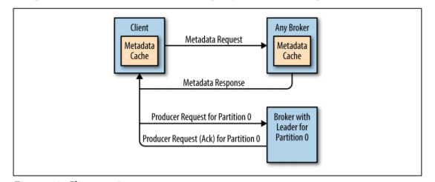
Clients typically cache this information and use it to direct produce and fetch requests to the correct broker for each partition.
They also need to occasionally refresh this information by sending another metadata request so they know if the topic metadata changed—for example, if a new broker was added or some replicas were moved to a new broker

Slide 18
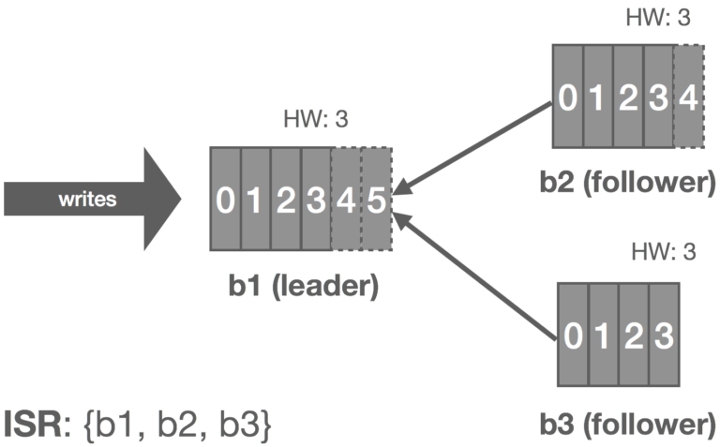
Leader Broker Election
Every time a broker process starts, it registers itself with its id in Zookeper by creating an ephemeral node
There are two cases that can happen
Leader broker dies
Unclean Leader election

Slide 19
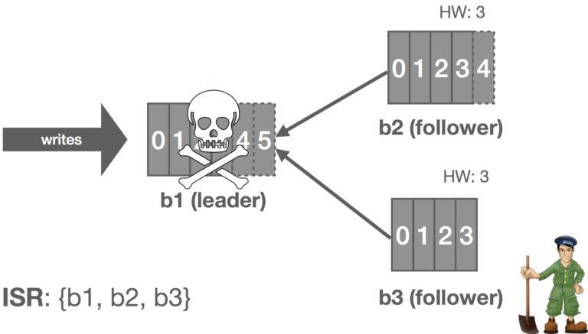
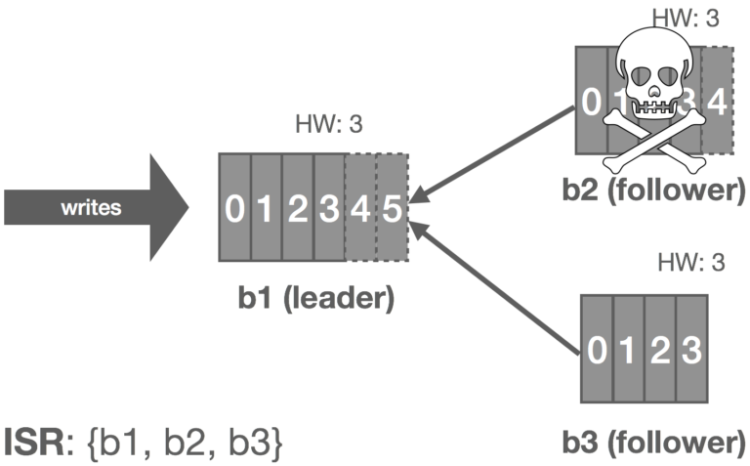
Leader broker/ follower dies
Kafka Broker elect by Controller
Controller is the Broker who registers first in Zookeeper's path /Controller/id
When a broker crash down, the leader partition (or leader replica) in this broker will be switched by Controller and Controller will choose one replica in ISR be the partition leader
The brokers create a Zookeeper watch on the controller node, so they get notified on changes to this node.
Kafka uses Zookeeper’s ephemeral node feature to elect a controller and to notify the controller when nodes join and leave the cluster

Slide 20
Unclean leader Election
If your all of In Sync Replica (ISR) die there are two option you can do
Wait for ISR to come back online
Enable unclean.leader.election=true
Enable unclean leader election to allow an out-of-sync replica to become the leader and preserve the availability of the partition.
Messages that were not synced to the new leader are lost
With unclean leader election disabled, if a broker containing the leader replica for a partition becomes unavailable, and no in-sync replica exists to replace it, the partition becomes unavailable until the leader replica or another in-sync replica is back online.

Slide 21
Consumer Group Rebalancing
Consumer Group Rebalance is a two step protocol
Collect membership, subscriptions and additional metadata for every consumer in the group.
Decide on a new partition assignment and propagate it to every consumer in the group.

Slide 22
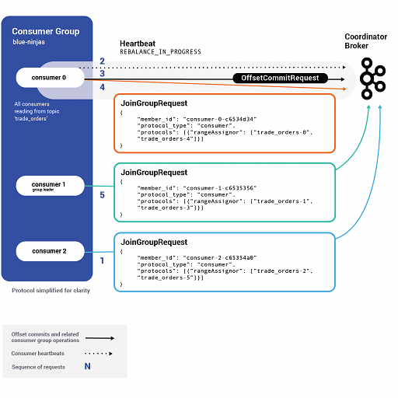
Step 1: Sending the JOincrowd Request
Consumer group coordinator : The consumer group coordinator is the group leader is an arbitrary consumer client application that is part of the group.
It is the first consumer to join the group.
Apart from being a normal consumer, it also makes the decision about which consumer should ingest from which partition.
It also manages the membership rebalance
In the first step every consumer does its part to join the group by sending a JoinGroup request to the group coordinator broker

Slide 23
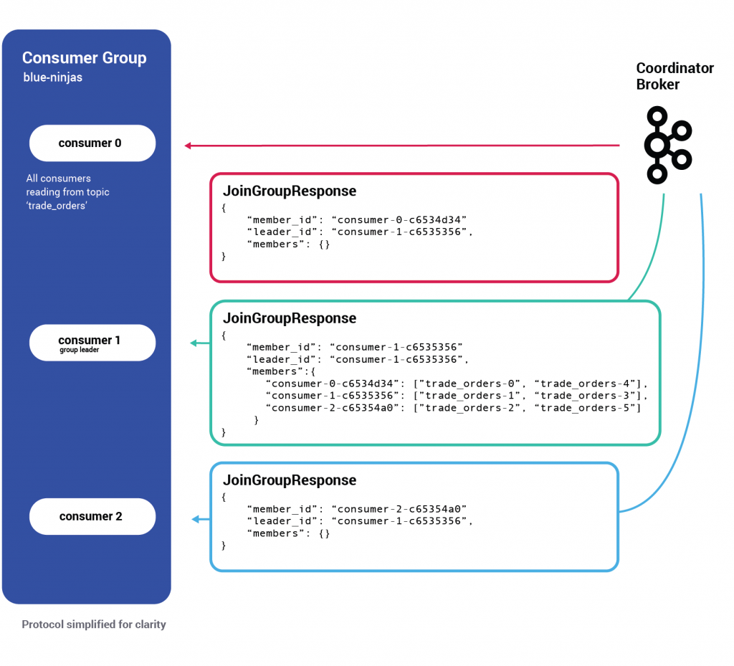
Step 1 continued
This request holds information like the topics the consumer is interested in, its member ID and custom-defined metadata.
After receiving the first request the max.poll.interval.ms is set. Its the time period till which the cosumers can join the consumer group.
During this time frame, a consumer’s heartbeats receive a REBALANCE_IN_PROGRESS error, informing the consumer to take action in committing its offsets and rejoining the group.
This window lasts until max.poll.interval.ms expires or all known members of the group have rejoined.
Once the time frames is completed the coordinator sends a JoinGroupResponce to all consumer

Slide 24
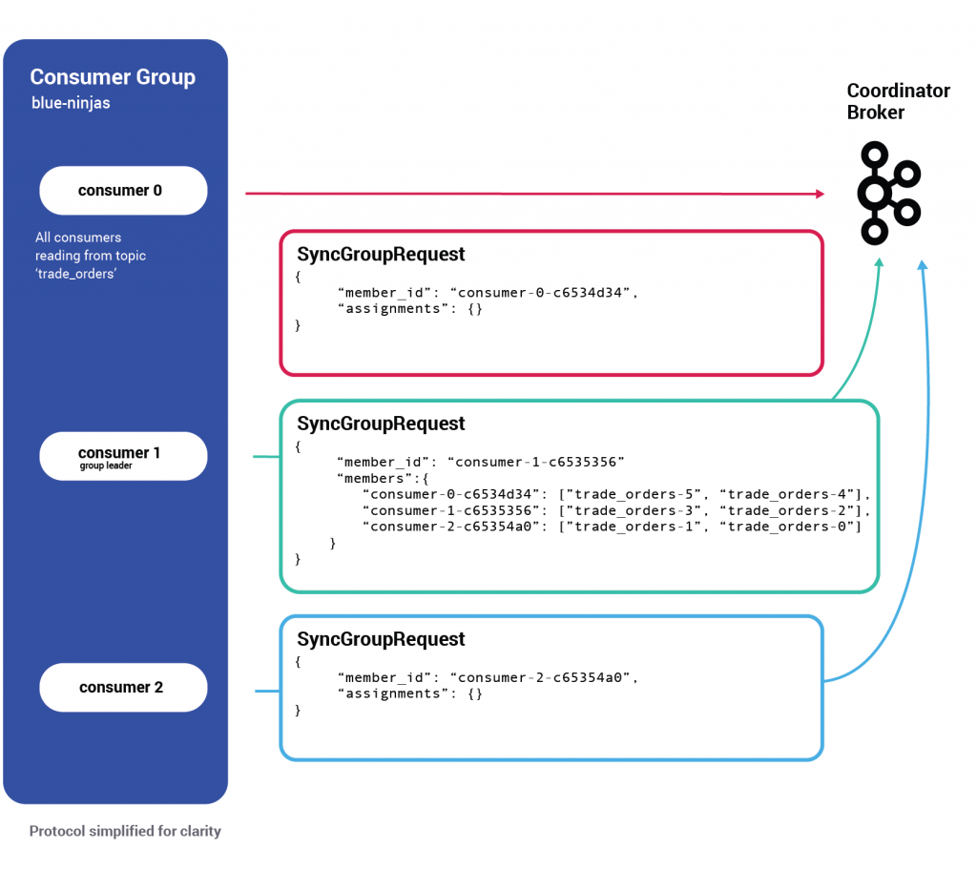
Step 2 :Sending a Syncgroup Request
Every consumer now sends a second (mostly empty) request of type SyncGroup.
Once the group coordinator broker receives the SyncGroup request from the group leader, it adds the newest state to disk (a different type of key/value record in __consumer_offsets).
And starts propagating the new assignments by responding to each consumer with its newly assigned partitions

Slide 25
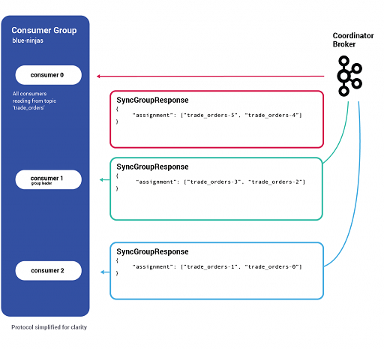
Step 2 continued
When the consumer receives a response to SyncGroup, it starts consuming from the partitions to which it was assigned.
Here the rebalance is complete

Slide 26


Slide 27

Any Questions ?

