Slide 1





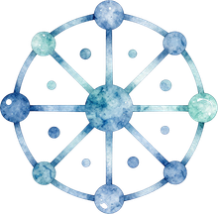
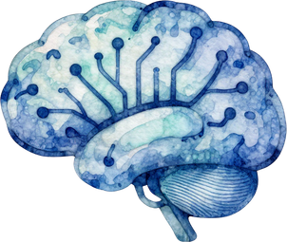
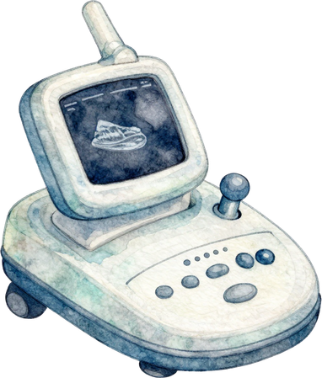

MAHARAJA INSTITUTE OF TECHNOLOGY,
MYSORE
Diffusion-Based Unsupervised Anomaly Detection in Fetal Brain Ultrasound
MULTI-TIMESTEP SCORING AND AUTOMATED QUALITY ASSURANCE FOR MORE ROBUST ANOMALY MAPS
SUBMITTED BY :
HITESH C V [4MH24IS034]
BHUVAN C [4MH24IS008]

Slide 2
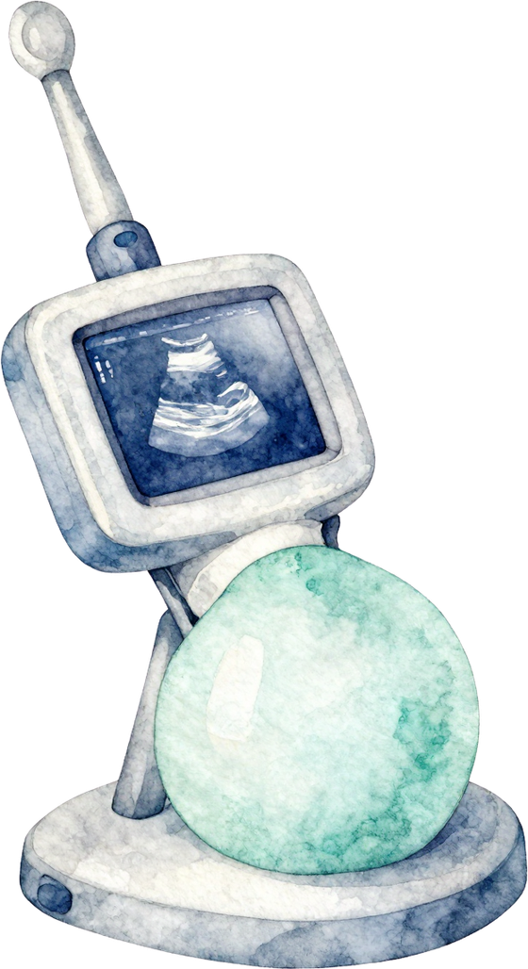
Introduction
Ultrasound (US) is the standard tool for parental care because it is safe, real-time, and low-cost.
The mid-pregnancy scan (about 22 weeks) is key for finding fetal brain anomalies.
Unsupervised anomaly detection (UAD) trains only on healthy scans and flags anything that deviates from normal anatomy
Image quality suffers from acoustic shadows, speckle noise, and motion blur.
Denoising diffusion models (DDPMs) generate a "pseudo-healthy" version of a scan. The difference from the original gives an anomaly heatmap.

Slide 3
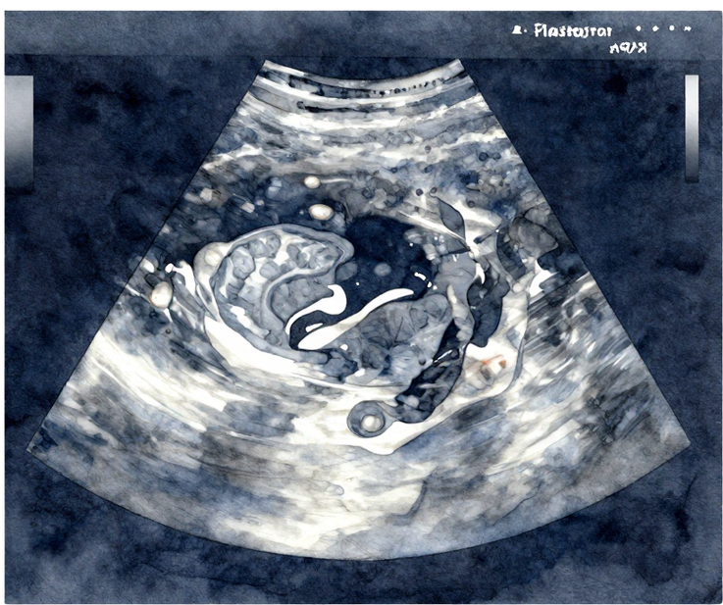
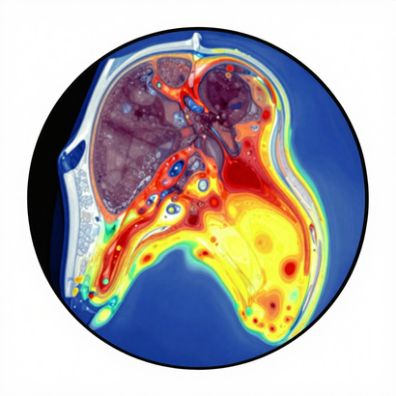

Problem Statement
The current diffusion-based pipeline shows a "noise paradox":
  Low noise: good reconstruction, but pathology is also reconstructed, so it is missed.
  High noise: pathology is removed, but healthy regions are altered, causing false positives.
Supervised classifiers cannot recognise anomaly types they never saw.
Goal: build a more reliable UAD pipeline that reduces false positives and manual curation, and evaluate it rigorously.

Slide 4
Motivation
Early detection of brain anomalies supports timely clinical decisions and counselling.
A label-free method can generalise to rare and unseen malformations.
Diffusion models succeeded in brain MRI, but fetal brain US is largely unexplored.

Slide 5
Existing Systems
Category
Examples
Approach
Supervised fetal brain US
Xie et al. (2020)
CNN classifies images as normal or abnormal
Supervised fetal MRI
FOAC-NET (Lo et al., 2022)
CNN detects organ anomalies
Unsupervised fetal heart US
Chotzoglou et al. (2021)
Learns normal appearance to detect HLHS
Autoencoder / GAN UAD
(brain MRI)
VAE, F-AnoGAN, GANomaly
Reconstruct healthy anatomy, flag differences
Diffusion UAD
(brain MRI)
Wolleb et al., Behrendt et al.
Noise and denoise to find anomalies
General diffusion UAD
AnoDDPM, AutoDDPM
Gaussian/Simplex noise; conditional “mask, stitch, resample”
Baseline for this work
Mykula et al. (2024)
SonoNet plane filter, head segmentation, AnoDDPM/AutoDDPM on fetal brain US (best AUPRC 79.8%, AUROC 66.6%)

Slide 6
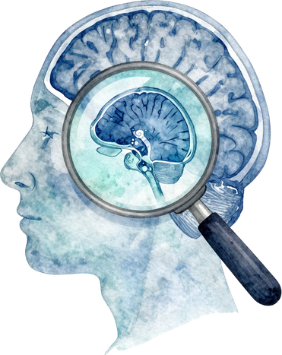

Advantages
Limitations
  Trains on healthy data only, so no pathological labels are needed.
  Can generalise to unseen anomaly types.
  DDPMs offer better mode coverage and sample quality than VAEs and GANs.
  Semi-automatic preprocessing (age filter, SonoNet, segmentation) reduces data variability.
  Anomaly maps localise findings and are visually interpretable.
  Noise paradox : a trade-off between reconstruction quality and detection.
  Simplex noise produces visible artefacts on US images.
  Manual expert verification is still required.
  Works on static 2D slices only; no video or temporal information.
  Small evaluation set (18 pathological and 12 healthy images), so results are statistically uncertain.
  Single-centre data; generalisation across scanners is untested.
  Pixel-space diffusion is computationally heavy.

Slide 7
Thank You

