Slide 1

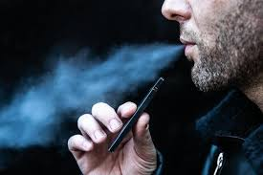
ANALYSIS OF SMOKERS & E-CIGARETTE USERS
OBJECTIVE –
To analyze the BRFSS’17 survey data based on demographic variables; prevalence and differences.
VS
Made by-
Hitesh Gohil

Slide 2
TO BE ANSWERED FROM THE ANALYSIS
1. Is there a correlation between:
i.)INCOME & COMBUSTIBLE/E-CIGARETTE USE & differs in GENDER?
ii.)EDUCATION & COMBUSTIBLE/E-CIGARETTE USE & differs in GENDER?
iii.)AGE & COMBUSTIBLE/E-CIGARETTE USE & differs in GENDER?
2. What EMPLOYMENT STATUS uses more; COMBUSTIBLE/E-CIGARETTE & how does it differ by GENDER?
3. What HOME STATUS uses more ;COMBUSTIBLE/E-CIGARETTE & how does it differ by GENDER?
4. What RACE uses more ;COMBUSTIBL/E-CIGARETTE & how does it differ by GENDER?
5. What MARITAL STATUS uses more ;COMBUSTIBLE/E-CIGARETTE & how does it differ by GENDER?

Slide 3
STATISTICS
1. Approx. 2 out of 5 participants smokes combustible cigarette(41.24%)
2. Approx. 1 out of 7 participants uses e-cigarette(14.84%)
3. Participants who never smoked but used e-cigarette; 5.72%.
4. Participants who has QUIT smoking and are actively using e-cigarette; 7.22%.
*From the given population data

Slide 4
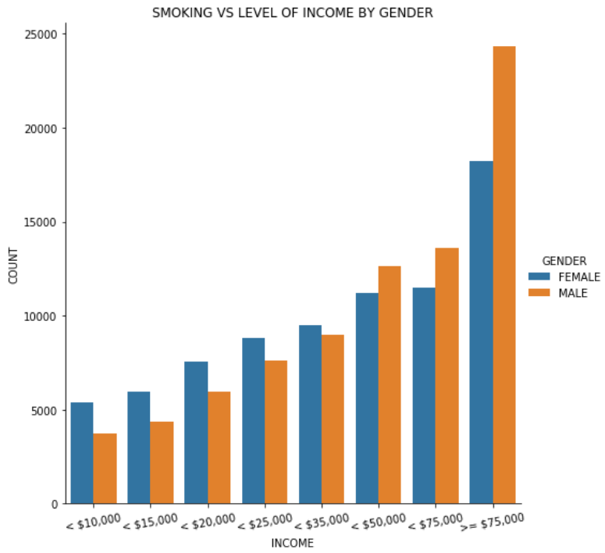
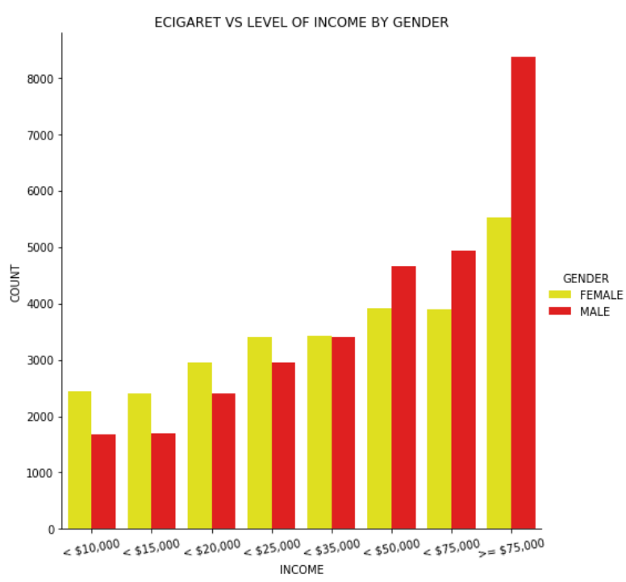
1.i.) We see that if the Income increases both the users of combustible & e-cigarette increases; both in male and female.

Slide 5
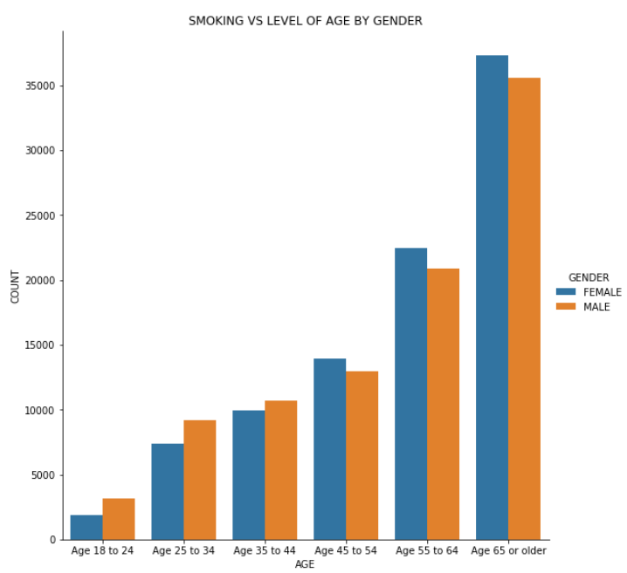
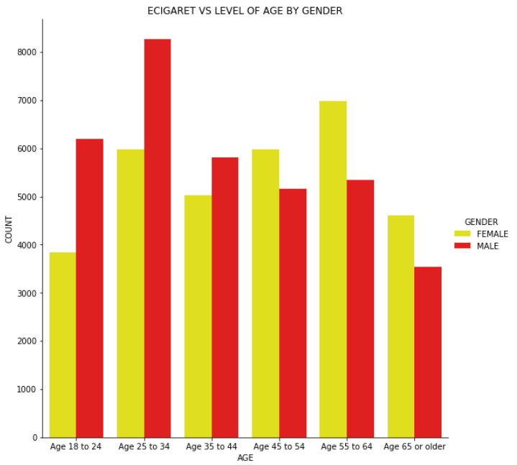
1.iii.) As the Age of the population increases the use of combustible cigarette increases.
As the Age of male increases they tend to use lesser e-cigarette where as in female it’s almost an increasing trend.

Slide 6
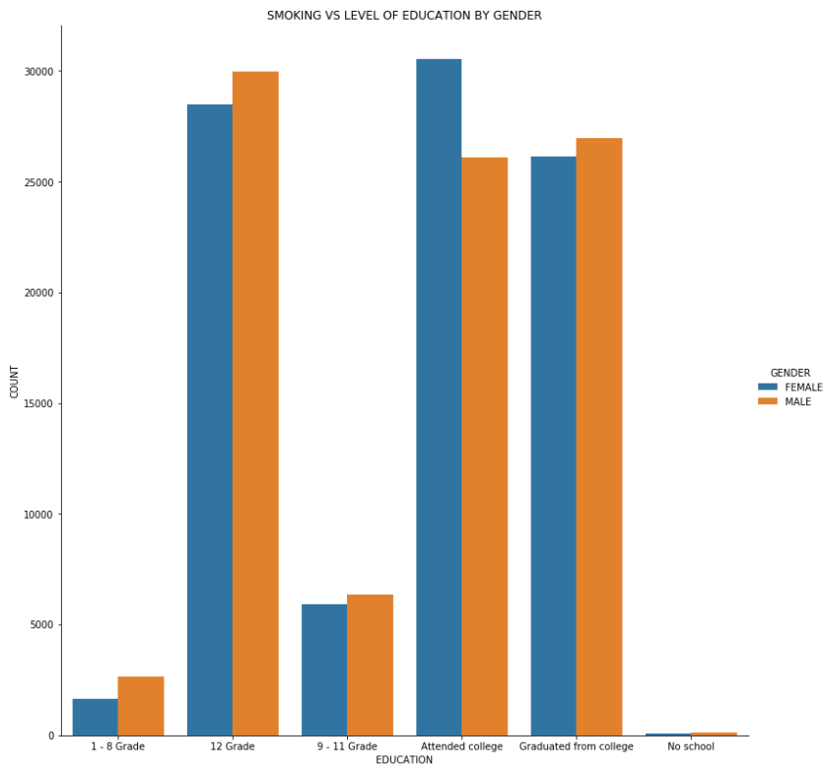
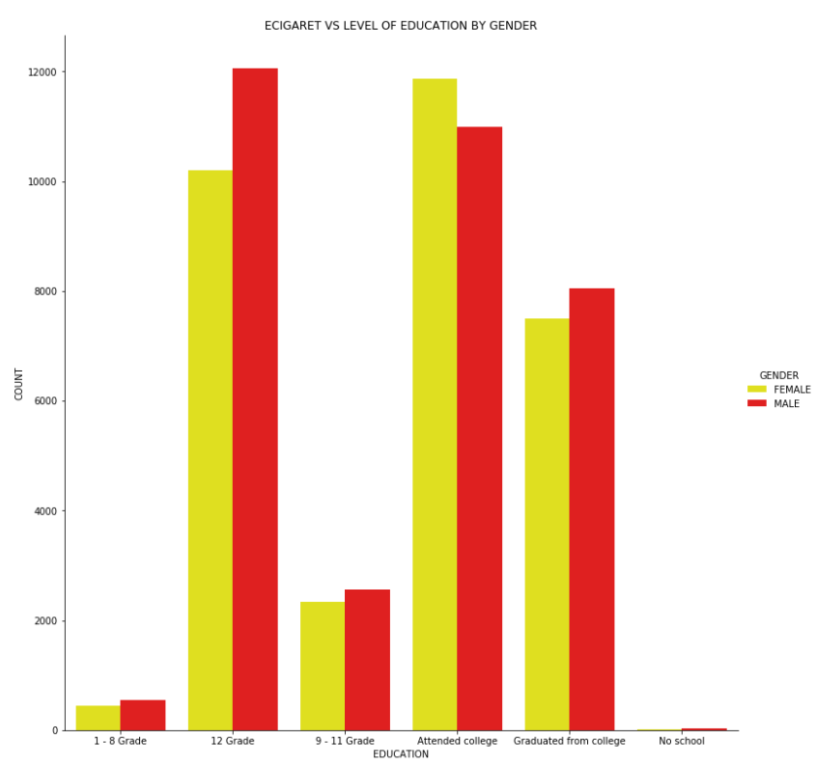
1.ii.) Before analysis we think that more the Educated people lesser they the users of combustible & e-cigarette but from the graph we see the consumption is almost equal in the higher educated participants; both in male and female.

Slide 7
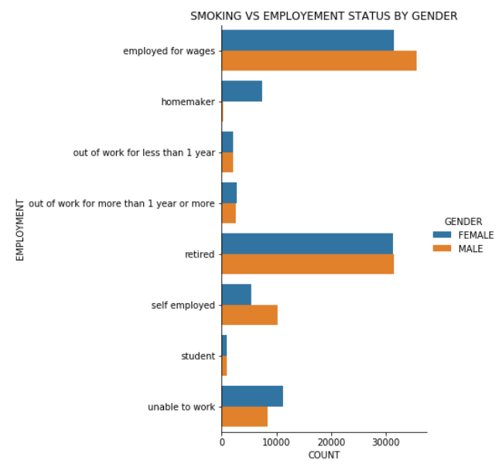
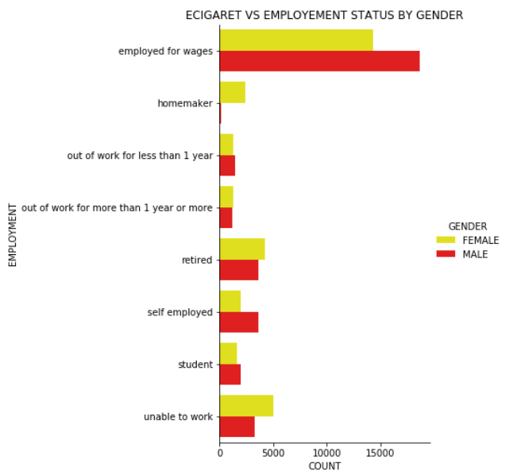
2.) Participants of Retired population uses more combustible cigarette as compared to e-cigarette.

Slide 8
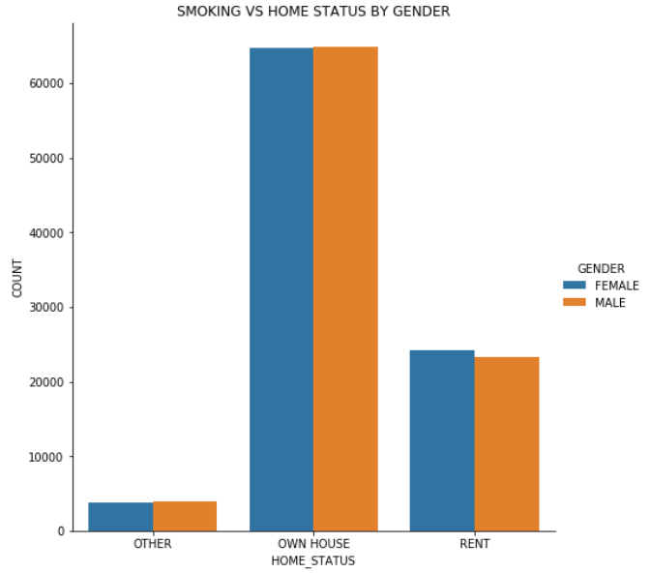
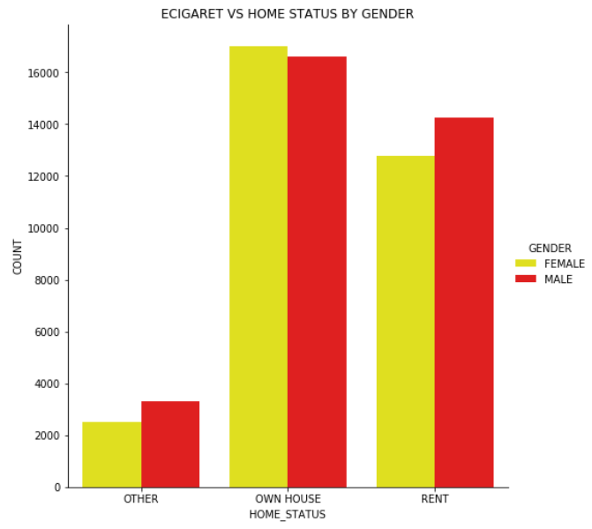
3.) Population who lives in a Rented house uses e-cigarette the most as compared to combustible smoking.

Slide 9
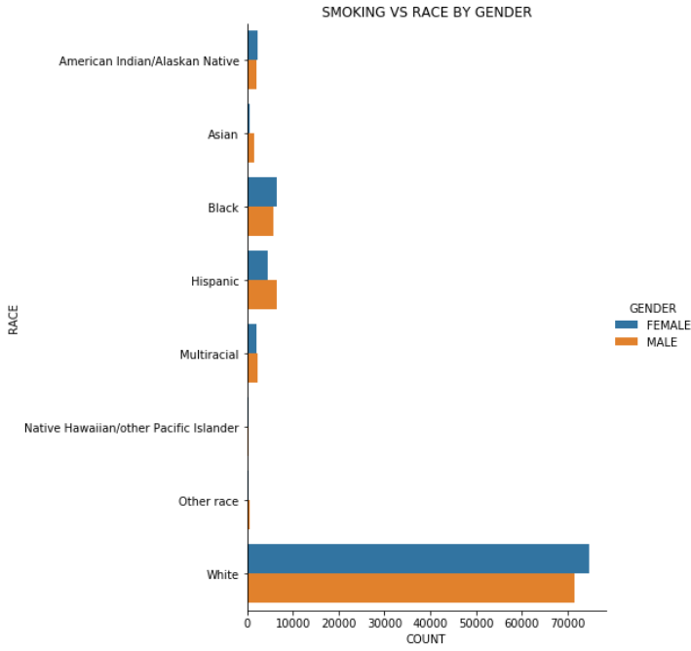
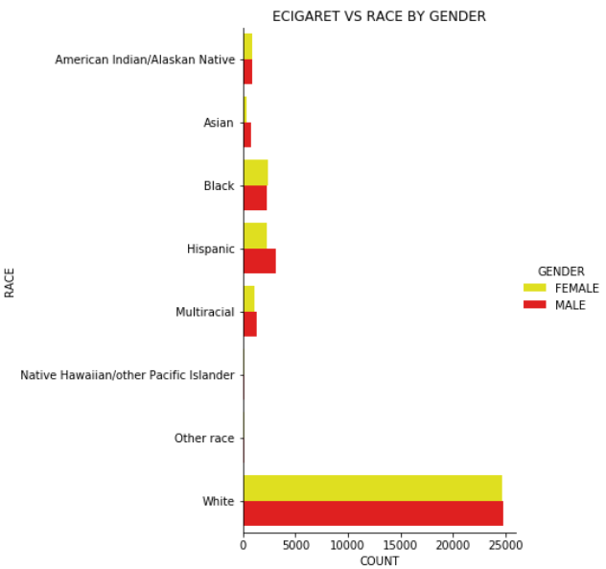
4.) White people uses both the combustible & e-cigarette the most as compared to other Races in the States.

Slide 10
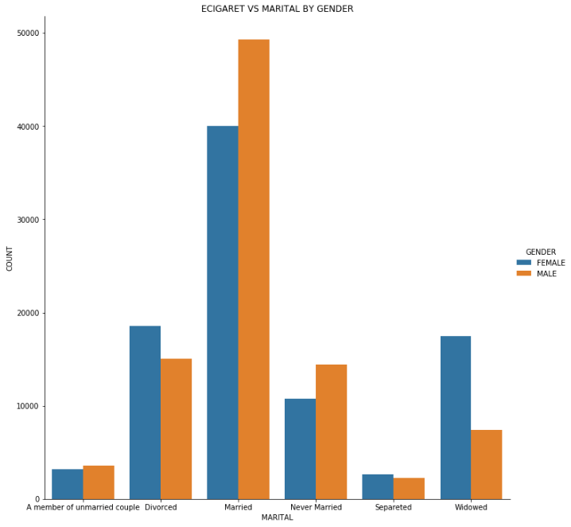
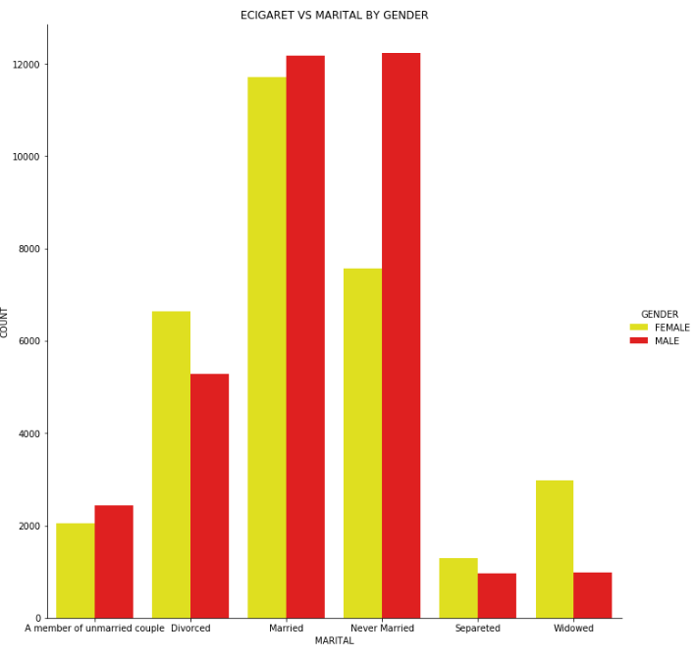
5.) Population with Marital status of unmarried uses more e-cigarette than combustible smoking.

Slide 11
SUMMARY
Adult e-cigarette users-
14.84% population are e-cigarette users.
Higher the income level, high number of users.
Population who have completed 12th grade or higher level uses more e-cigarette
Males who are between 18 to 34 years of age are higher e-cigarette users whereas in females number of users increases till 65 years of age.
E-cigarette users are more who are employed for wages.
White population are the major users among other races.
Married & Unmarried population are the major users among other marital status.

Slide 12
THANK YOU

