Slide 1
Integrated Capstone Project
Checkpoint 1
BatchG Group 2

Slide 2
Group Members
Miska Gowri Sankar
Bansal Lakshi
Satish Kanagala Naga
Gulati Hitesh
Singh Harsh

Slide 3
Problem Statement
The XYZ automobile company in India wants to enter the business of selling used cars. They would like to analyse the business challenges before the venture
XYZ company want to understand the factors affecting the pricing of cars in the market, since those may be very different from the new car market. Essentially, the company wants to know:
Which variables are significant in predicting the price of a used car?
How well those variables describe the price of a car
Based on various market surveys, the consulting firm has gathered a large dataset of different types of used cars across the market.

Slide 4
Approach
All the entity files shared by XYZ company were modified to create entity relationship model and identified relationships between the files based on the data shared and transferred the same data to load it to corresponding tables in Oracle database and answered the challenges using sql queries.
Similar way all the entities of XYZ company has been converted to python understandable data frames and performed data analytics by comparing multiple factors with each other and helped XYZ company in predicting the price of a used car

Slide 5
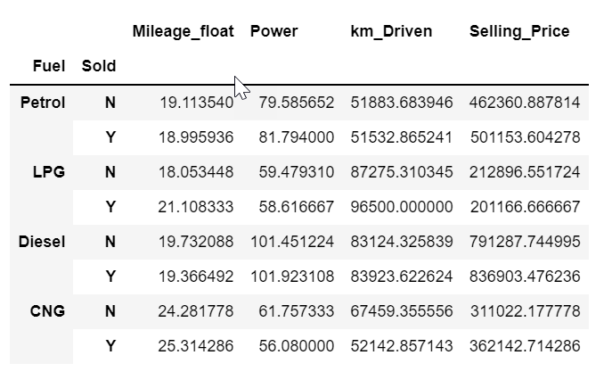
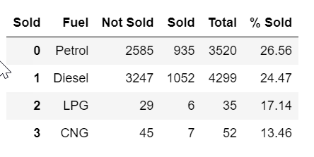
Data Manipulation using Python
Q. How the sold cars depend on the Fuel,
Mileage and Power?
Checklist:
Selling Price vs (Km driven, Power, and Mileage) of different fuel cars
Percentage of Sold Cars for different Fuel cars
Conclusion:
Selling Price of Cars are more for those with high power and more for Diesel cars.
Petrol Cars sold more than any other fuel cars

Slide 6
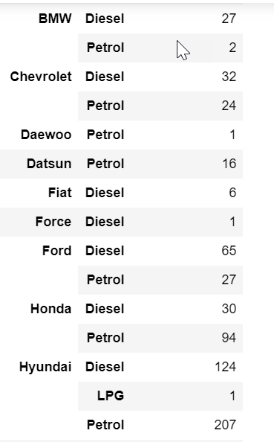
Data Manipulation using Python Contd..
Q. How Fuel is related to Brand?
Checklist:
Total Sold cars vs Fuel Type of cars
Conclusion:
Almost for all the brands Diesel cars sold more when compared with other fuel cars such as Petrol, LPG and CNG
Petrol cars sold more for Hyundai and Skoda brands

Slide 7
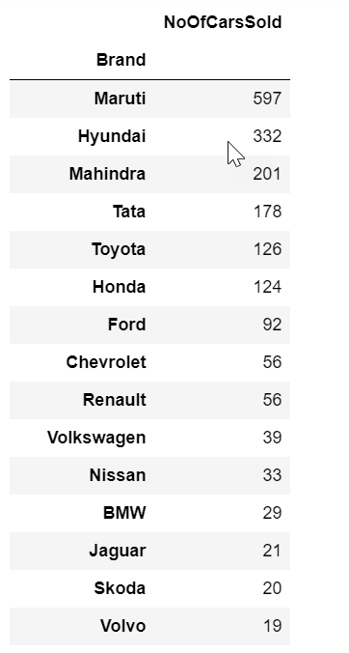
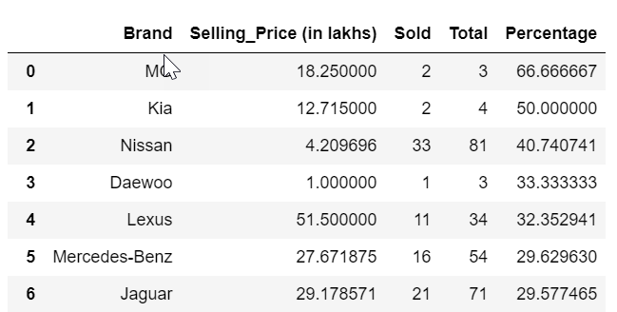
Data Manipulation using Python Contd..
Q. Which Brands are selling the most?
Checklist:
Total Sold cars for different brands irrespective of fuel, Mileage ,power and other parameters of the car
Total no of cars available vs Total cars sold
Conclusion:
Maruti cars are sold more followed by
Hyundai, Mahindra, Tata and Toyota
Percentage of cars sold is more for MG brand w.r.t the cars available

Slide 8
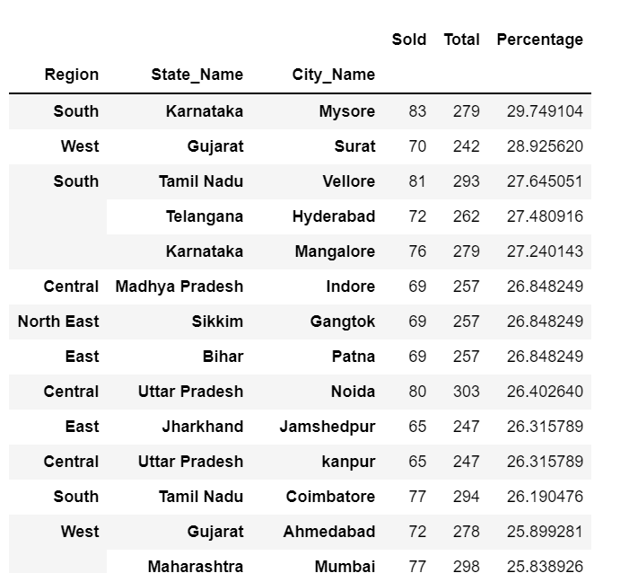
Data Manipulation using Python Contd..
Q. Are their any specific locations selling the most?
Checklist:
Total Sold cars for different brands irrespective of fuel, Mileage ,power and other parameters of the car in different areas
Conclusion:
Total number of cars sold id more in Mysore of Karnataka State of south region followed by Surat, Vellore ,Hyderabad and Mangalore

Slide 9
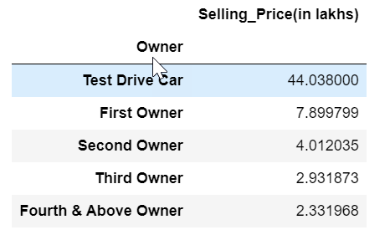
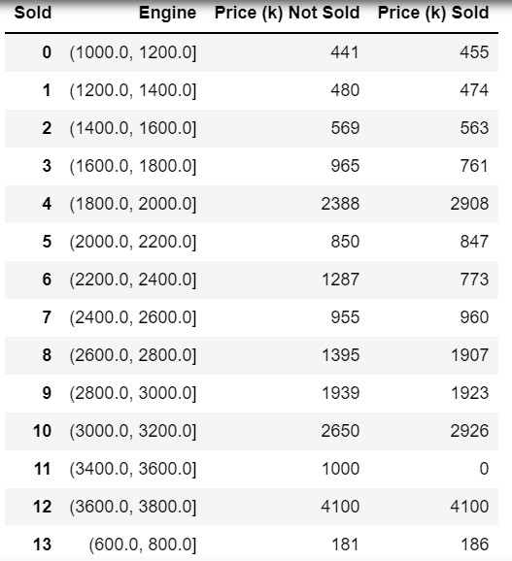
Data Manipulation using Python Contd..
Q. Which factors which might help in Selling Prices ?
Checklist:
Owner vs selling price
Engine range vs selling price
Conclusion:
Customers are interested in buying Test drive cars
Higher the engine more is the price but given the data mid level engines are also doing good

Slide 10
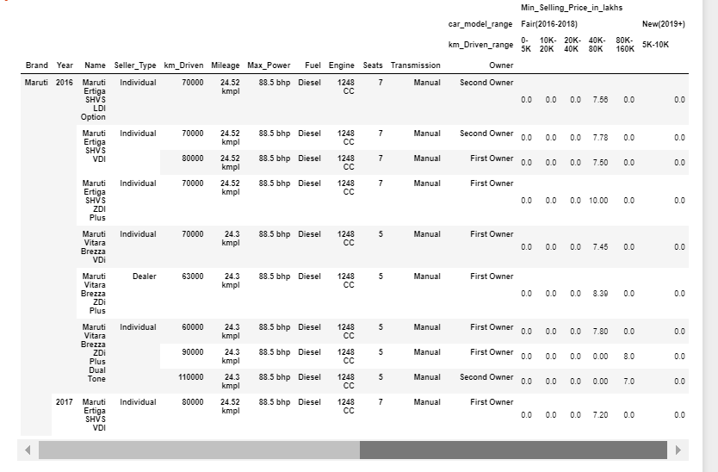
Data Manipulation using Python Contd..
Q. Given a set of input checklist from user designed the minimum selling price for different brands and other parameters of car
Checklist:
User provided some parameters such as
Brand :Maruti, Fuel: Petrol, approximate
mileage:25
Conclusion:
Company can come up with minimum selling price based on user inputs w.r.t km driven range and model of the car(year)

Slide 11
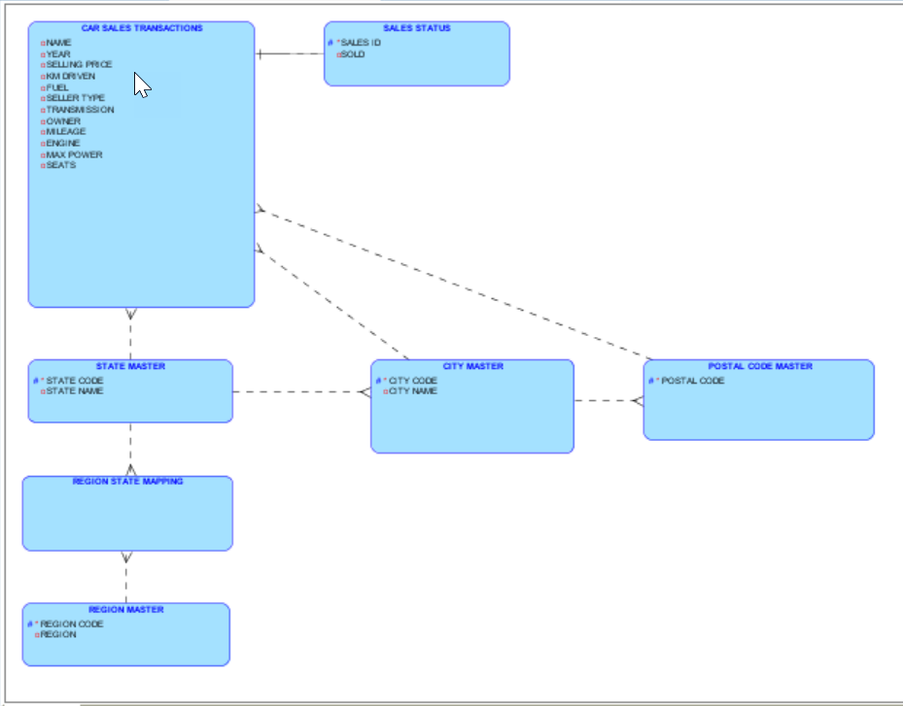
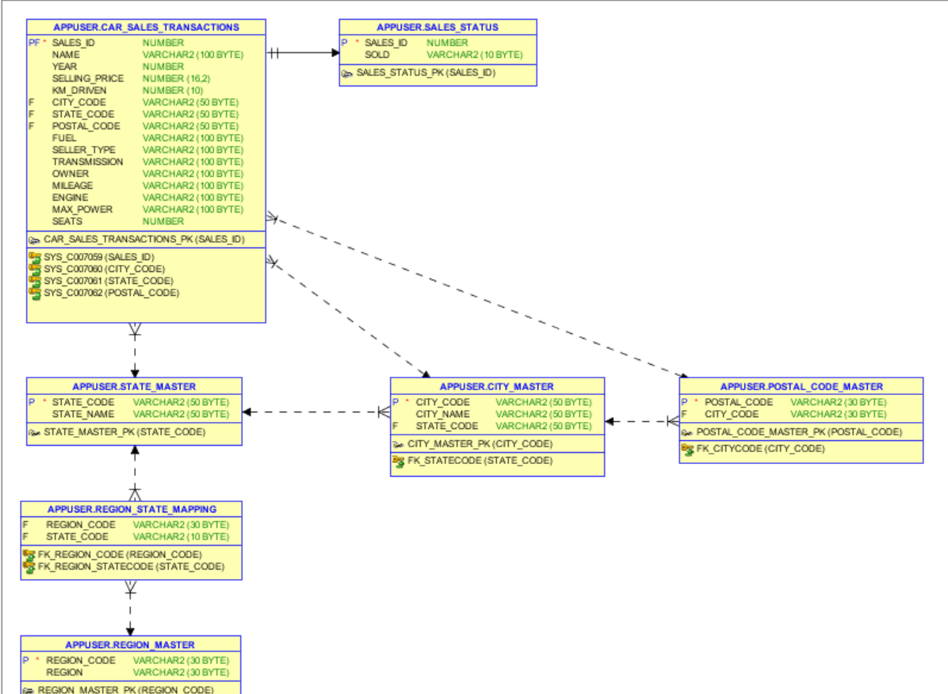
SQL Oracle..
Entity Relationship Model

Slide 12
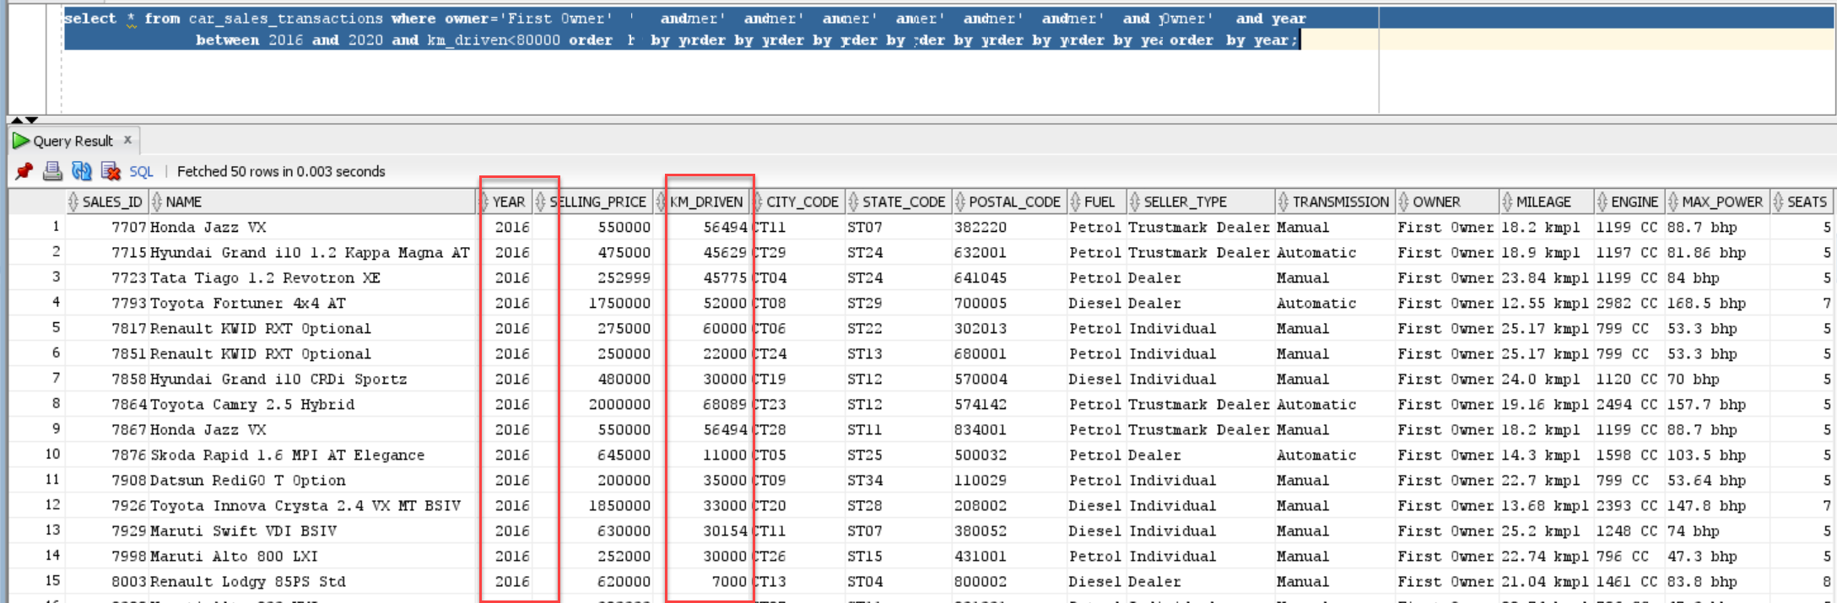
SQL Oracle..
Queries
Generate Info of the cars which is of the type first owner and the year of car purchase is between 2016-2020 and the number of kms driven is less than 80,000

Slide 13
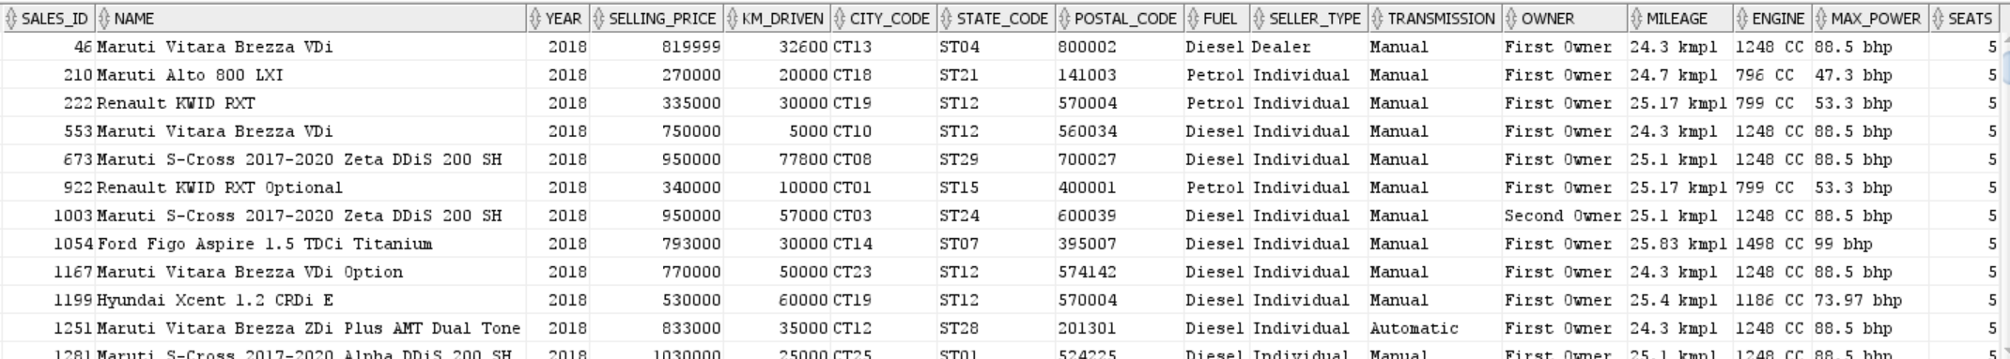
SQL Oracle..
Queries
Generate Info of all the cars whose average mileage is around 25 kmpl and year of car purchase is between 2018-2020 which has minimum seating of 4-5 and fuel type is diesel.(Considering around with boundaries 24 to 26)

Slide 14
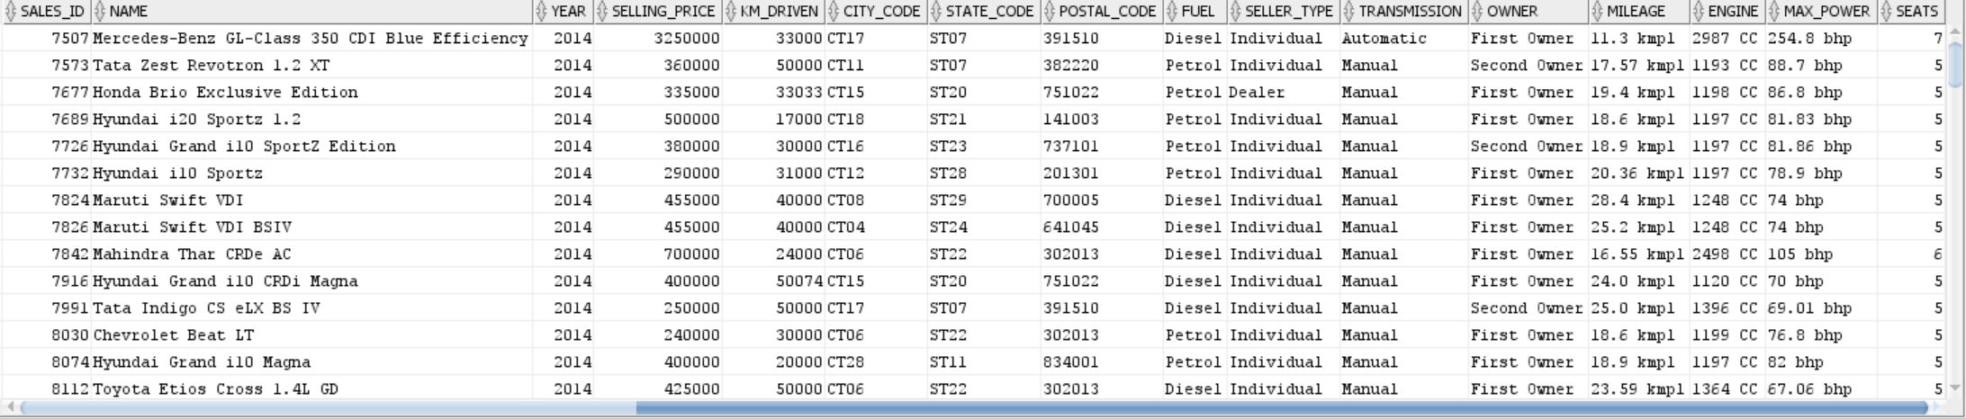
SQL Oracle..
Queries
Generate Info of all the cars which are not sold, and seller-type is individual or dealer and also which has been used for less than 60000 kms and year of car purchase is 2014-2020

Slide 15
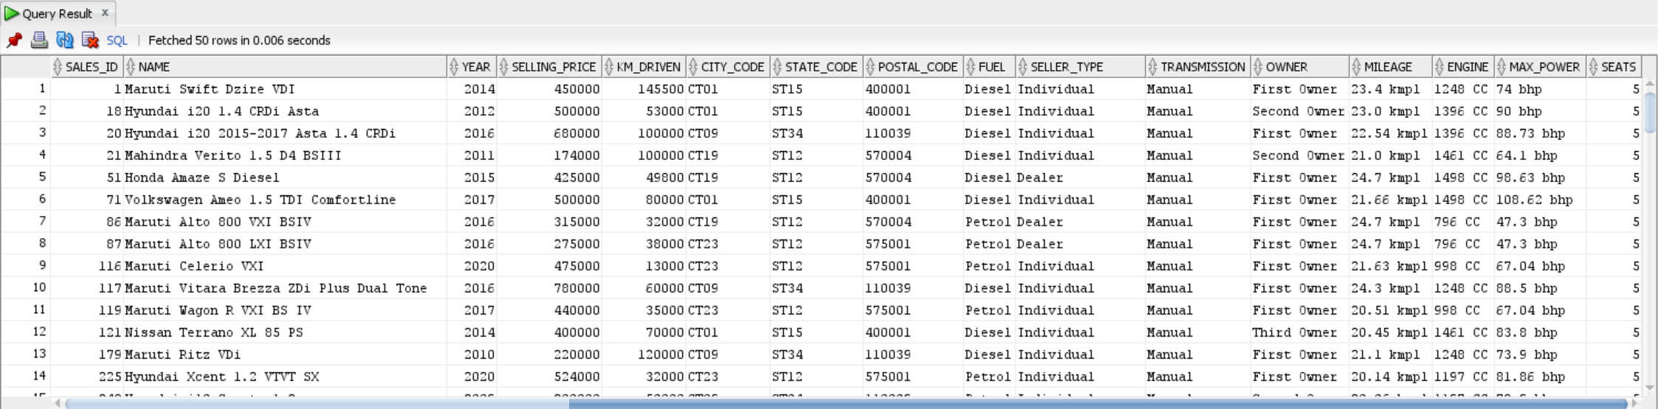
SQL Oracle..
Queries
Generate Info of all the cars which are manual and automatic whose mileage ranges between 20-25kmpl approximately and also which is within these cities(Washington, New York City,Chicago,Los Angeles), city names modified to 'Mumbai','Delhi','Mysore','Mangalore’ cities based on the available data

Slide 16
SQL Oracle..
Queries
Generate Info of all the cars which belong to honda category could be either first owner and second owner and also fuel type is petrol and average mileage should be 25kmpl and which are not sold and seating arrangement should be minimum 4
No Rows Selected with the above criteria

Slide 17
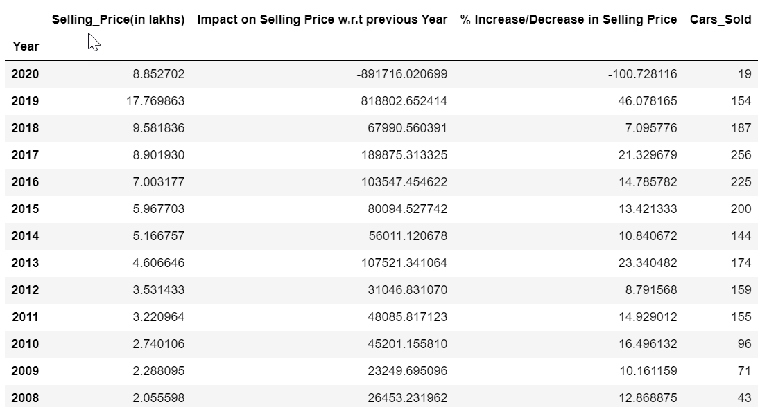
Statistical Analysis using Python
Q. How Selling Price of Cars are related with time (Year)
Checklist:
Cpm
Conclusion:
Based on the data provided there is significant decrease in selling price in year 2020

Slide 18
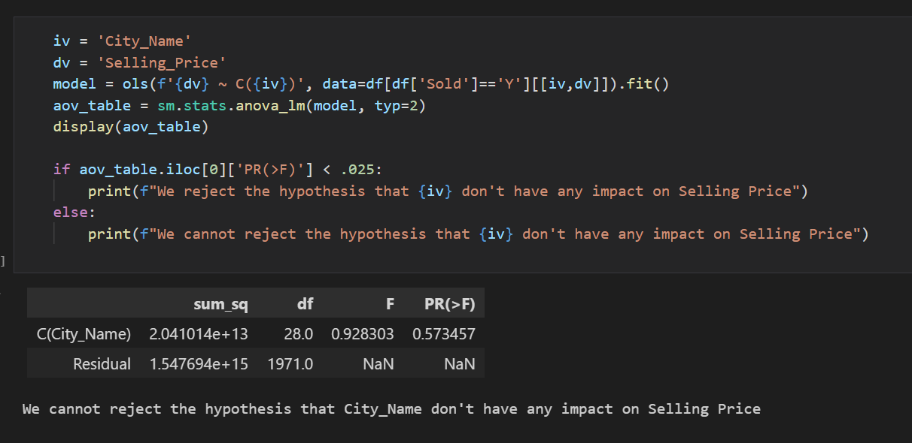
Statistical Analysis using Python Contd..
Q. How Selling Price of Cars are related with time different variables
Checklist:
Anova testing
Test the impact of different independent variables (IV) on dependent variables (DV) – ‘Selling Price’
Conclusion:
City_Name – p value > 2.5%; Don’t have impact
Fuel – p value < 2.5%; Have Impact
Transmission – p value < 2.5%; Have Impact
Owner - p value < 2.5%; Have Impact
Year - p value < 2.5%; Have Impact

Slide 19
Contribution

