Slide 1
Indexed Universal Life as a
Cash Accumulation & Wealth Transfer Vehicle
Notes:
Welcome and thank you for joining me in a discussion on how and why indexed universal life contracts, when funded properly, can be tremendous cash accumulation and wealth transfer vehicles.

Slide 2
Tax Laws
TEFRA
DEFRA
TAMRA
Notes:
To understand how IUL can be such a powerful financial tool, we need to start first with how this product is taxed. In the life insurance world, there are three tax acts that are critical to understanding the power of IUL product. Once you understand this information, you will know more about life insurance products than almost all insurance agents and financial planners.

Slide 3
TEFRA
Tax Equity & Fiscal Responsibility Act of 1982
Place premium limits on flexible premium products
Notes:
It’s interesting that prior to 1980, there was very little guidance in the tax code about exactly what was a life insurance contract. The Tax Equity & Fiscal Responsibility Act of 1982 was the first time that guidance was given on this issue. While it was very generally, this act, known as TEFRA, actually placed limits on flexible premium products.

Slide 4
DEFRA
Deficit Reduction Act of 1984
Enacted IRC Section 7702
Notes:
A few years later, the Deficit Reduction Act of 1984, known as DEFRA, was passed. In this law, the real underpinnings of the structure of life insurance contracts were created. Specifically, there was a new internal revenue code section created known as 7702. We’ll spend some time talking about this.

Slide 5
IRC Section 7702
For a contract to be defined as life insurance, it must meet at least one of two actuarial tests:
  Cash Value Accumulation Test (CVAT)
  Guideline Premium & Cash Value Corridor Test (GPT)
Notes:
IRC Section 7702 defines how a contract must be built so that it is taxed as a life insurance contract. The law basically states that a life insurance policy meet one of two actuarial tests.

Slide 6
Cash Value Accumulation Test
The cash surrender value of a contract must not at any time exceed the net single premium that is required to fund future benefits
The net single premium is determined by using (1) an annual effective interest rate of 4% or the interest rate(s) guaranteed in the contract, whichever is greater; (2) the mortality charges specified in the contract or if not specified, the charges used in figuring the statutory reserves for the contract; and (3) any other charges specified in the contract.
Notes:
Simply walk through this slide.

Slide 7
Guideline Premium Test
Two requirements
  Guideline Premium Test
  Cash Value Corridor Test
Both tests must be met
Notes:
The second test is known as the GPT or the Guideline Premium Test and the Cash Value Corridor Test.

Slide 8
Guideline Premium Test
A policy will meet these requirements if the sum of the premiums does not exceed the greater of the:
  Guideline Single Premium or
  Cumulative sum of the Guideline Level Premiums
Notes:
Read over slide.

Slide 9
Cash Value Corridor Test
Requires a “corridor” between the account value and insurance benefit
Expresses insurance benefit as a percentage of the account value
The “corridor” is 250% for ages under 41 and then it decreases every year until it reaches 100% at age 95.
Notes:
Read over slide.

Slide 10
General Observations
CVAT – death benefit oriented contracts
GPT – cash accumulation oriented contracts
Notes:
In summarizing the two tests and their practicle applications, the CVAT test is most appropriately used in a pure wealth transfer scenario. By this, I mean when a client is looking to maximize the death benefit in a contract and is not concerned as much with the cash value, you should look at the CVAT design.
When you want a contract that accumulates cash, use the GPT test. As the corridor in the GPT contract gets smaller over time, the net amount at risk gets smaller as well. Because there is a smaller net amount at risk vs. the CVAT design, there is less “drag” of the cost of insurance expense and thus, this design is more efficient from a cash accumulation perspective.

Slide 11
Violations of DEFRA
Penalties
Growth in cash value is taxable as earned
Insurance death benefit remains income tax free
*Most insurance companies will not allow a contract to violate the definition
of life insurance.
Notes:
Technically, if a contract violates the actuarial tests as defined by DEFRA, the growth in the cash values is taxed every year as it is earned. Obviously, this is a bad thing…even if the insurance death benefit is still received income tax free by the beneficiary in most cases. The reality though is that most insurance companies will not allow a policyowner to fund a contract to a point where it violates DEFRA.

Slide 12
TAMRA
Technical & Miscellaneous Revenue Act of 1988
IRC Section 7702A
Modified Endowment Contracts
7-Pay Test
Notes:
Even with the restrictions of DEFRA, in the 80’s, with the high interest rates available and the incredible tax advantages associated with life insurance contracts, hundreds of millions of dollars were flowing out of banks and into insurance contracts.
Many believe that, at the request of the banking industry at the time whose leaders were working to stem the disintermediation of funds flowing from CDs to insurance contracts, The Technical & Miscellaneous Revenue Act of 1988 was passed. This act, affectionately known as TEFRA, created Modified Endowment Contracts and new ways of taxing life insurance contracts.
In effect, if too much money is placed in a life insurance contract over too short a period of time, a contract becomes a MEC.

Slide 13
Violations of TAMRA
Penalties
Last in, first out (LIFO) tax treatment of distributions
Any access of gain the contract is subject to ordinary income taxes, even when the access is in the form of a loan
If access occurs before the contract owner is 59 1/2 , there is an additional 10% tax penalty on the amount of gain recognized
Insurance death benefit remains income tax free
Notes:
When policies become MECs, several things happen to the taxation of these contracts.

Slide 14
Types of Contracts under Tax Law
Contracts meeting the definition of life insurance
Those that meet the definition of life insurance but that are Modified Endowment Contracts
Those that fail the definition of life insurance
Notes:
The history of TEFRA, DEFRA, and TAMRA leave us with three types of contracts under the code.

Slide 15
Key IRC Sections
Tax Law | Meaning
IRC Section 101(a)(1) | Life insurance death benefit is received federal income tax free
IRC Section 7702 | Definition of life insurance
IRC Section 7702(a) | Defines “Modified Endowment Contracts”
IRC Section 72 | Cash value grows tax deferred Loans taken from a non-MEC’d policy are not considered distributions and are thus not generally subject to income tax
Notes:
These four sections of the Internal Revenue Code are the key to understanding why a properly funded life insurance contract receives such favorable income tax treatment. For instance:
The insurance benefit is received by most beneficiaries income tax free. Beneficiaries of CDs or IRAs don’t have this benefit.
Section 72 says that cash values grow tax deferred. With the long term power of values growing on money that would otherwise go to the government every year in the form of taxes, this is a huge benefit.
As long as the contract doesn’t violate IRC Section 7702(a) and become a MEC, cash values can be accessed in a first in first out manner. By doing this, the policyowner can pull their basis out of the contract first, before touching gain. It’s a huge advantage over other financial vehicles. Furthermore, cash values can be reached without penalty prior to age 59 ½. An IRA does not allow this. And, with policy loans, policyowners can borrow their gains out of the contract in the form of zero net cost loans. As loans aren’t taxable under current tax law, this leverage makes life insurance contracts one of the most tax advantaged vehicles available.

Slide 16
Master Elite - $500,000
Male, Preferred N/T
Age | 7-Pay | GSP | GLP
40 | $19,565 | $85,008 | $7,012
45 | $23,289 | $105,302 | $8,819
50 | $27,598 | $133,081 | $11,310
55 | $32,690 | $162,471 | $14,397
60 | $38,510 | $198,116 | $18,684
65 | $45,187 | $237,269 | $24,494
Notes:
Let’s look at a real life example of some of the numbers you will see when designing a life insurance contract for cash accumulation and wealth transfer situations.
You can see the 7-pay numbers from TAMRA, and the GSP and GLP numbers from DEFRA. Let’s look closer at some of the ratios you’ll see in these numbers.

Slide 17
Master Elite - $500,000
Male, Preferred N/T
Age | GSP | GLP | Ratio
40 | $85,008 | $7,012 | 12.02
45 | $105,302 | $8,819 | 11.94
50 | $133,081 | $11,310 | 11.77
55 | $162,471 | $14,397 | 11.28
60 | $198,116 | $18,684 | 10.60
65 | $237,269 | $24,494 | 9.69
Notes:
What you’ll see is that, on average, the GSP is about 10 – 12 times the value of the GLP. Now, when you know one number, you can assume a rough estimate of the other.

Slide 18
Master Elite - $500,000
Male, Preferred N/T
Age | 7-Pay | GSP | Ratio
40 | $19,565 | $85,008 | 23.02%
45 | $23,289 | $105,302 | 22.12%
50 | $27,598 | $133,081 | 20.74%
55 | $32,690 | $162,471 | 20.12%
60 | $38,510 | $198,116 | 19.44%
65 | $45,187 | $237,269 | 19.04%
Notes:
On the other hand, you also see that the 7-pay/TAMRA premium is about 20% of the GSP. Knowing these ratios will you in setting up rules of thumb around explaining the funding of these contracts for maximum tax efficiency.

Slide 19
Master Elite - $500,000
Male, Preferred N/T
Age | 7-Pay | GSP | GLP
45 | $23,289 | $105,302 | $8,819
What is the maximum amount of premium that can be placed in the contract by the end of year 3 and the contract still have all the tax advantages of life insurance?
What about the end of year 5?
And the end of year 15?
Notes:
Self explanatory.

Slide 20
Master Elite - $500,000
Male, Preferred N/T
Age | 7-Pay | GSP | GLP
45 | $23,289 | $105,302 | $8,819
Year 3: $23,289 x 3 = $69,867 (the cumulative 7-pay premium is smaller than the GSP)
Year 5: GSP = $105,302 (GSP is smaller than the cumulative 7-Pay premium at the 5th year)
Year 15: $8,819 x 15 = $132,285 (cumulative GLP)
Notes:
Self explanatory.

Slide 21
Funding for Wealth
Accumulation & Distribution
Life insurance is unique in that it is the only financial tool that leverages up money at an individual’s death.
Important to put as much money into the contract as legally allowed and as fast as possible to minimize the net amount at risk. This tactic has the effect of minimizing COI charges.
Important not to violate the GSP, GLP, or the 7-Pay limits
Notes:
Read slide.

Slide 22
Practically, this means that contracts can
be “max-funded” to the GSP level without
violating TAMRA’s 7-pay test in five
years. In the 11th year or beyond, the
GLP may be paid into the contract
as well.
Notes:
Read slide.

Slide 23
Case Scenario
Male – Age 45
$500,000 Master Elite IUL, Preferred N/T
Premiums
  $23,289, years 1 – 4
  $12,144, year 5
  $8,819, years 13 – 20
Variable loans
  $50,000 per year, years 26 – 40
Notes:
Let’s look at a live case. I’ve already run the numbers, so let me walk you through how to present this to a client.

Slide 24
IUL Hypothetical-Historical
Crediting Rates
Company | Old Mutual
Product | Master Series
Cap Rate | 15%
Guarantee Rate | 0%
1950’s | 9.65%
1960’s | 7.47%
1970’s | 6.93%
1980’s | 10.52%
1990’s | 10.15%
2000’s | 5.51%
Average | 8.33%
Source – AMZ competitive analysis completed effective 12/2008.
Notes:
Before I take you too far though, let’s talk about illustrations, max illustrated rates and historical numbers.
At Old Mutual, our current maximum illustrated rate is 8.81%. We came to that number by looking at the growth in values had money been invested in the contract 25 years ago at our current 15% cap in all years and then solving for the internal rate of return.
While that’s a good idea, this chart does a similar evaluation, but it looks at the returns for each decade since the 50’s. As you can see, some decades of yielded returns in the high 5’s and others have yielded returns in the mid-10% range. Over the entire 50 years though, the average return was 8.33%. As a result, that’s the illustrated rate we are using in this evaluation.

Slide 25
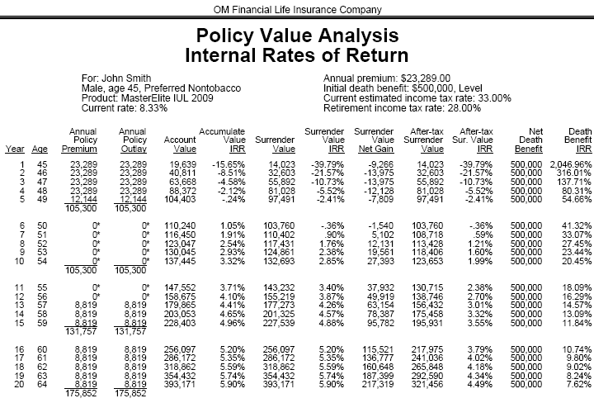
* These projections are based on current assumptions and are not guaranteed.
Notes:
What you see here is the output of the case when using Old Mutual’s Tapestry illustration software. It’s much more attractive than the core software and it should be used when you want to present a more prefessional case design scenario to a client.
What I want you to pay attention to is the current crediting rate of 8.33% vs. the IRR in the contract in the 7th year. The IRR is 0.90%. That’s ugly….and how do you explain it?

Slide 26
  Assets should be viewed relative to needs at a given point in time. Retirement assets should be viewed over the long-term, not the short term.
Notes:
Simply put….read slide.

Slide 27
* These projections are based on current assumptions and are not guaranteed.
Notes:
But still, while we all acknowledge that my previous comment is right on point, we still have a big difference between 8.33% and 0.90%!

Slide 28
Analogy
  Think of your over-funded life insurance contract as you would a commercial building
  Due to funding limitations (GSP, GLP, 7-Pay), you can lease-out your 5-story building one year at a time (1st floor – year one, 2nd floor – year two, etc.). It will take you five years before your building is fully leased…or your contract is fully funded)
  In the early years, there isn’t enough money in the contract to cover all the expenses (not enough people paying rent to cover costs)
  Over time, when the contract is fully funded (when the building is fully leased), the product is in a much better position to perform well
  * The term “fully funded” means that the contract has as much premium in it as the law will allow without violating the definition of life insurance and without making the contract a MEC. It is not meant to imply that the contract is guaranteed to endow at any age.
Notes:
When max funding a life insurance contract, I often explain the short term results of the contract by drawing an analogy to how a client’s cash-flow would work if they had purchased a commercial building.
Read the slide.

Slide 29
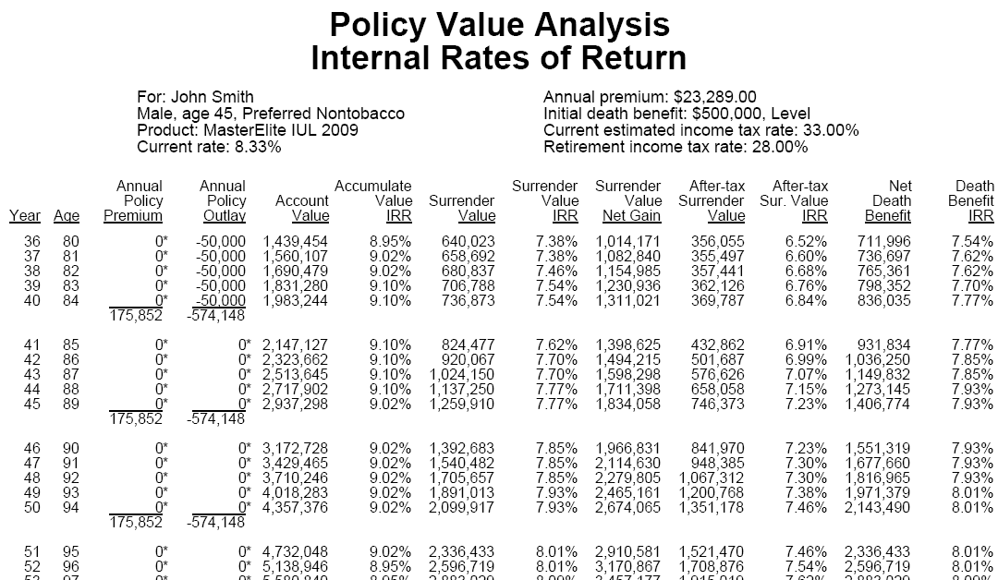
Tapestry Illustrations
* These projections are based on current assumptions and are not guaranteed.
Notes:
Now, let’s look at how the contract performs…over a long period of time…as it was designed to. Here, we see that the 40 year IRR is 7.54%.

Slide 30
Evaluation
Crediting rate – 8.33%
IRR on the cash surrender value at the end of 35th year – 7.54%
Internal costs – 0.79% (8.33% - 7.54%)
Notes:
Think about the power of this number. We assumed the gross rate of return was 8.33%. As the net rate of return shown is 7.54%, that means that the internal expenses over that period of time have only cost the policy owner 79 basis points!

Slide 31
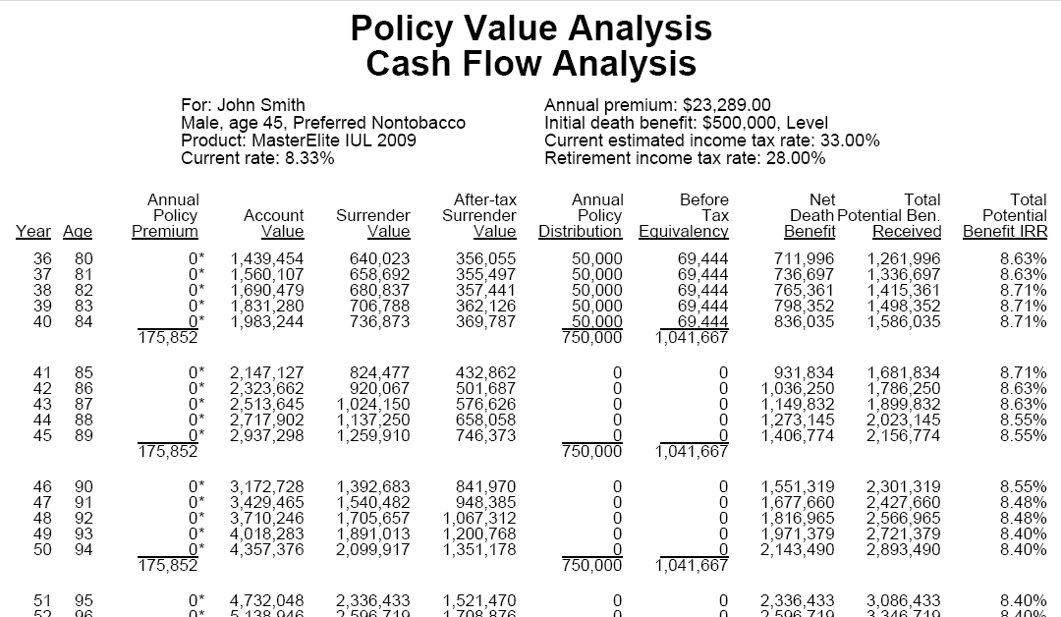
Notes:
As we go out even longer, to the insureds age 90, when I am assuming the insured passes away, you can see the total tax-quivalent yield IRR is 8.55% The tax benefits of the life contract make the overall performance HIGHER than the 8.33% we started with!

Slide 32
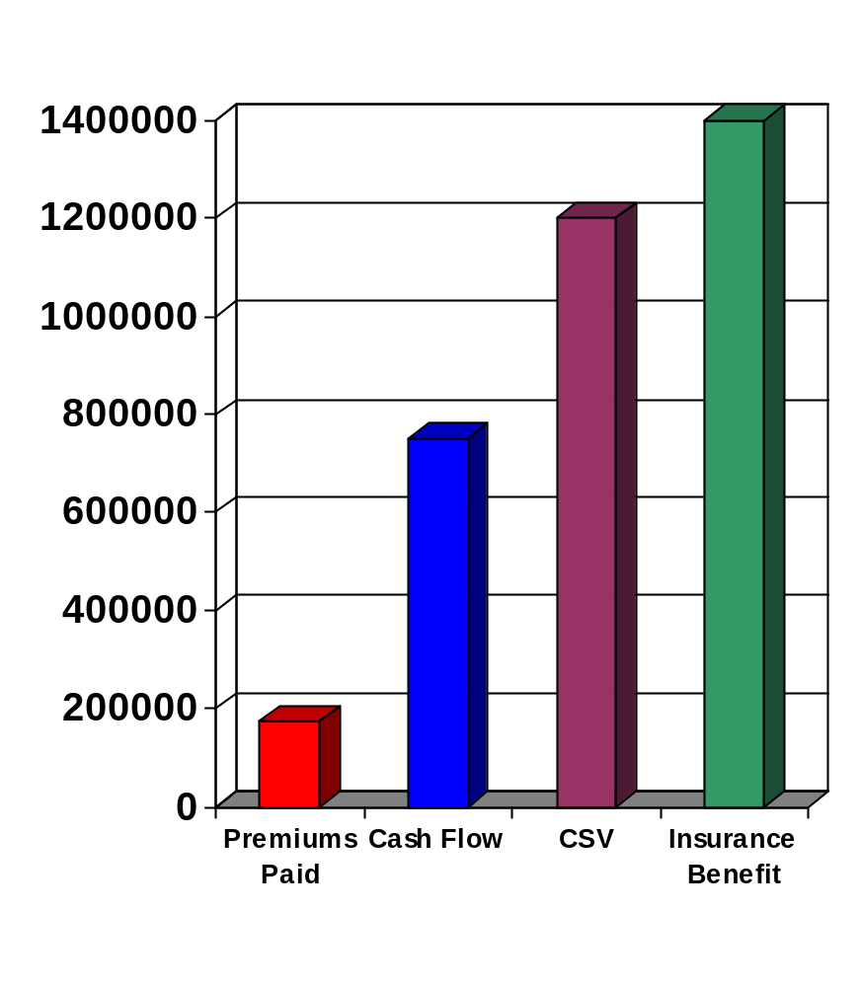
Case Results at Age 90
Notes:
Think about these results:
$170,000 in premiums paid
$700,000 in retirement income over 20 years in retirement
at age 90, there’s still $1.2 million in cash value remaining, and
assuming the client dies at age 90, his heirs receive $1.4 million of life insurance tax free. What a legacy!

Slide 33
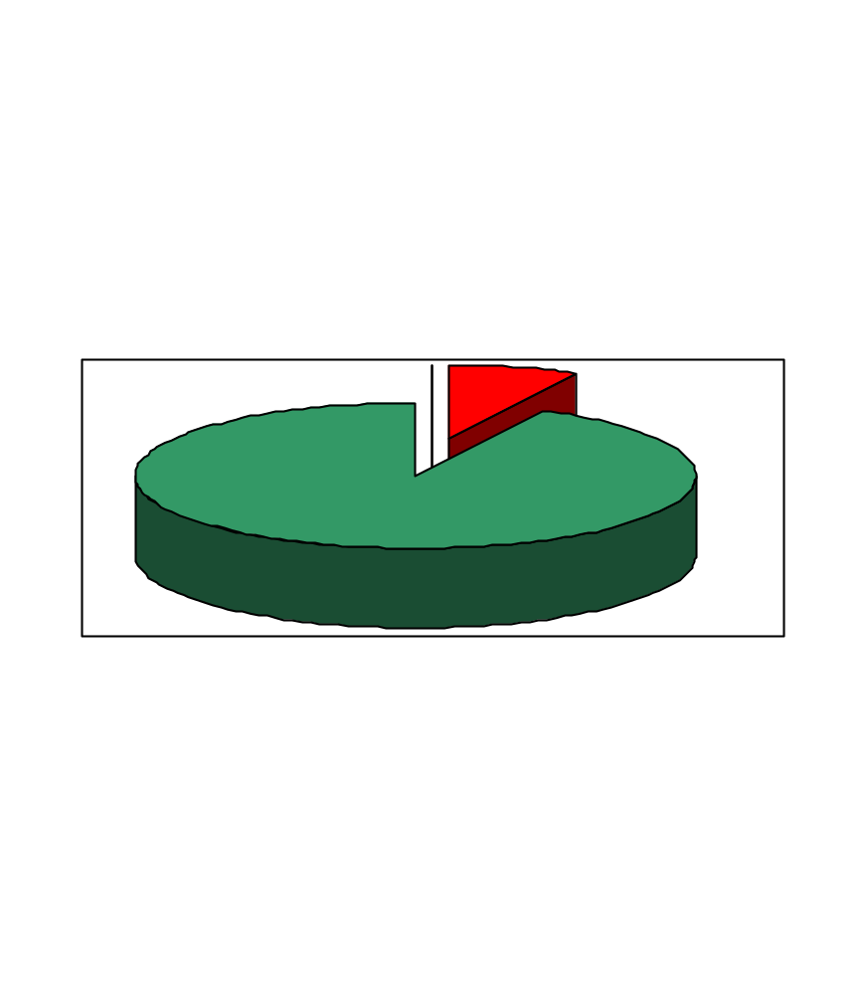
Death Age 90
$176,000 in Premiums
$2,150,000 in Benefits
- $750,000 in retirement cash flow
- $1,400,000 in life insurance proceeds to heirs
Notes:
Here’s another way of looking at the same story!

Slide 34
Comparisons
Features | Indexed Universal Life | Variable Universal Life | Equity Mutual Fund | Certificate of Deposit
Insurance benefit | Yes | Yes | No | No
FIFO tax treatment of distributions | Yes | Yes | No | No
Tax deferred growth | Yes | Yes | Possible – due to delay in recognizing capital gains | No
Gains not subject to loss | Yes – ignoring surrender charges | No | No | Yes
Tax advantaged access to gains | Yes | Yes | No | No
Notes:
IUL has many advantages over other financial vehicles when it comes to:
taxes
management of risk and return
leaving legacies

Slide 35
Summary
Highly funded contracts may have low, long-term expenses associated with them
Life contracts have positive tax benefits
  Insurance benefit is income tax free
  Cash values grow tax deferred
  FIFO treatment on distributions
  Loans are not considered income for income tax purposes
People need the advice and counsel that we provide
Notes:
Read slide.

