Slide 1
Retirement Planning & the Role of Life Insurance

Slide 2
3-Legged Stool
Government programs
Employer benefits
Personal savings
Problem: Budget deficit
Problem: PBGC deficit
Problem: Savings deficit

Slide 3
Size of the Federal Deficit
$8,700,000,000,000
Size of the Gross Domestic Product
$13,500,000,000,000
Deficit to GDP Ratio
64%

Slide 4

History of Federal Deficit
1789
1835
1861
1913
1917
1750
1800
1850
1900
1929
1939
1960
1980
1992
1950
2000
1789
1st day of the
US Federal Government
$75 million in debt
40%
GDP
1835
Federal debt is now ZERO
$0
DEBT
1861
US Federal Government
on the brink of bankruptcy
$1 billion in debt
27%
GDP
1913
Woodrow Wilson
Federal reserve System
Modern Income Tax
7%
GDP
1917
World War I
1917-1919
GDP -7% within a decade
32%
GDP
1929
The Great Depression
1929-1939
The New Deal Era
44%
GDP
1939
World War II
1939-1945
Americans brought saving bonds
*US Debt over $200 billion
122%
GDP
1960
Vietnam War Era
1960-1970
Medicare and Medicaid
47%
GDP
1980
Reagan Era
1980-1988
40%
GDP
1992
Economic Recession
“Tax cuts are too expensive”
$4 trillion in debt
57%
GDP

Slide 5
2008 Federal Expenditures
Budget | Program
$610 billion | Social Security
$330 billion | Medicare
$204 billion | Medicaid
$607 billion | Military
$936 billion | Everything Else
$244 billion | Interest on Debt
$2.9 TRILLION | EXPENSES

Slide 6
2008 Federal Income
Budget | Program
$1.22 trillion | Personal Income Taxes
$910 billion | Payroll (FICA) Taxes
$345 billion | Corporate Income taxes
$46 billion | Other revenue
$2.5 TRILLION | INCOME

Slide 7
2008 Budget
$2.9 Trillion In Expenses
+ $2.5 Trillion In Income
$400 Billion ANNUAL DEFICIT
Current Federal Deficit
$11,000,000,000,000

Slide 8
Budgets & Social Security
Last 40 years, 5 budget surplus years
Social Security has been running a surplus for years and those surplus have offset further budget deficits
When taking those into account, we’ve had 1 year in the last 40 with a budget surplus

Slide 9
Present Value of Liabilities
Amount | Item
$11 trillion | Current liabilities
$7 trillion | Social Security
$26 trillion | Medicare (A & B)
$8 trillion | Medicare (D)
$1 trillion | Miscellaneous
$53 trillion | Total

Slide 10
History – 20 Years Ago
Bush vs. Dukakis
Berlin Wall had not yet fallen
Gorbechev & perishroika
USSR was no longer “scary”
There was no internet
The DOW was around 2,000
Orel Hershiser – MVP
Mike Tyson knocked out Michael Spinks

Slide 11
The Future - 2030
Three Programs:
  Medicare
  Medicaid
  Social Security
Account for 75% of forecasted federal revenue.
The other 25% is debt service.

Slide 12
Farewell
US Military
Homeland Security
Education
Veterans benefits
National parks
Food stamps
NASA
Roads and bridges

Slide 13
1945 – Financing Deficits
Public Debt:
$235B

Slide 14
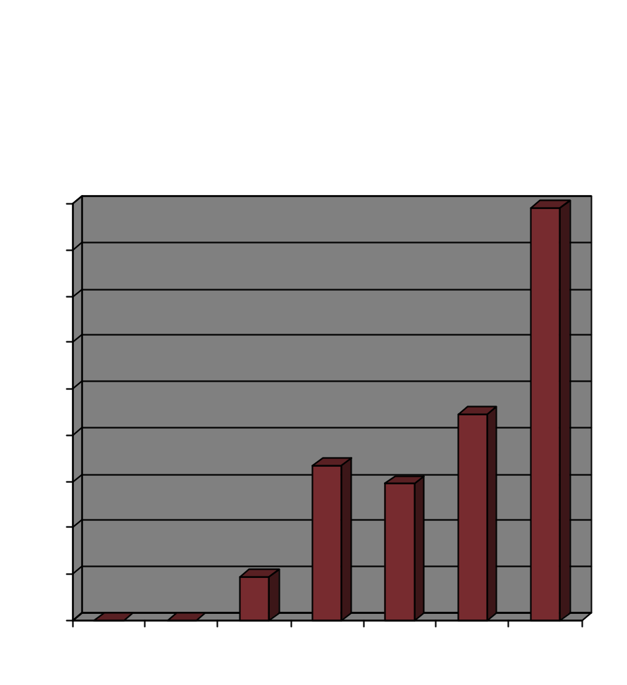
Foreign Debt
Top Foreign
Holders of Debt
Japan
China
Oil exporting countries

Slide 15
Potential Fixes
Two Options:
  Raise taxes
  Reduce benefits offered by the government

Slide 16
Income Statistics
Federal
Income Tax
Marginal Rate | Income | Plus | Total Tax @ Highest Income | Effective Rate
10% | $0 - $16,050 | $0 | $1,605 | 10%
15% | $16,050 - $65,100 | $1,605 | $8,962.50 | 13.77%
25% | $65,100 - $131,450 | $8,962.50 | $22,550 | 17.15%
28% | $131,450 - $200,300 | $22,550 | $44,828 | 22.38%
33% | $200,300 – $357,700 | $44,828 | $96,700 | 27.05%
35% | $357,700 | $96,700 | $321,505* | 32.15%*
* Assumes the AGI is $1,000,000
Income
Distribution
Year | House - holds | $25k - $34.9k | $35k - $49.9k | $50k - $74.9k | $75k - $99.9k | $100k+ | Median | Mean
2006 | 116,011 | 11.5% | 14.6% | 18.2% | 11.3% | 19.1% | $48,201 | $66,570
2000 | 108,209 | 10.9% | 15.1% | 18.6% | 12.3% | 18.3% | $49,163 | $66,895
1990 | 94,312 | 12.0% | 16.2% | 19.9% | 11.3% | 13.0% | $44,778 | $55,934
1980 | 82,368 | 12.6% | 17.0% | 21.2% | 10.3% | 8.6% | $41,258 | $49,070
1970 | 64,788 | 12.9% | 20.6% | 21.1% | 8.7% | 5.9% | $39,604 | $45,361
1967 | 60,813 | 15.1% | 21.2% | 20.1% | 6.5% | 4.7% | $36,847 | $41,212
U.S. Census Bureau
Income, Poverty, and Health Insurance Coverage in the United States: 2006
Household
Income Distribution
Bottom 10% | Bottom 20% | Bottom 25% | Middle 33% | Middle 20% | Top 25% | Top 20% | Top 5% | Top 1.5% | Top 1%
$0 - $10,500 | $0 - $18,500 | $0 - $22,500 | $30,000 - $62,500 | $35,000 - $55,000 | $77,500 and up | $92,000 and up | $167,000 and up | $250,000 and up | $350,000 and up
US Census Bureau, 2006;
income statistics for the year 2005

Slide 17
Taxes
Are taxes the answer?
20.5% is the average effective rate today
42% is what the average effective rate would have to be
I’m sure someone is thinking about it!

Slide 18
Point of Interest
1931 – Highest marginal tax was 25%
1932 – Highest marginal tax was 63%
1936 – Highest marginal tax was 79%
1941 – Highest marginal tax was 81%
1942 – Highest marginal tax was 88%
1944 – Highest marginal tax was 94%

Slide 19
Budgets & Social Security
$2,200,000,000,000 placed in fund
Money used to fund other social programs
Funding through taxes goes negative in 2017
Trust goes “broke” in 2042
Medicare & Medicaid make things MUCH WORSE!

Slide 20
Social Security & Medicare
Key Agencies:
  Government Accountability Office (GAO)
  Congressional Budget Office
  Office of Management and Budget (OMB)
  U.S. Treasury Department
Theme
  Between 2030 and 2040, mandatory spending on Social Security, Medicare, Medicaid, and the national debt will exceed tax revenue
  “unsustainable” and “trainwreck”

Slide 21
“Normal” Retirement Age
Year of Birth | Normal Retirement Age | Age 62 Benefit as a % of PIA
1940 | 65 and 6 months | 77.5%
1941 | 65 and 8 months | 76.7%
1942 | 65 and 10 months | 75.8%
1943 – 1954 | 66 | 75%
1955 | 66 and 2 months | 74.2%
1956 | 66 and 4 months | 73.3%
1957 | 66 and 6 months | 72.5%
1958 | 66 and 8 months | 71.7%
1959 | 66 and 10 months | 70.8%
1960 & after | 67 | 70.0%

Slide 22
In 2009, what is the maximum benefit payable at normal retirement age?
$2,323/per month

Slide 23
The Simple Truth
This will be corrected
Federal benefits will be reduced
Taxes will increase

Slide 24
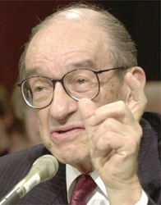
Without savings, there is no future.
- Alan Greenspan
Too many people follow the bad example of their federal government. They are spending more money than they make.
- David Walker, Ex-Comptroller of the Currency

Slide 25
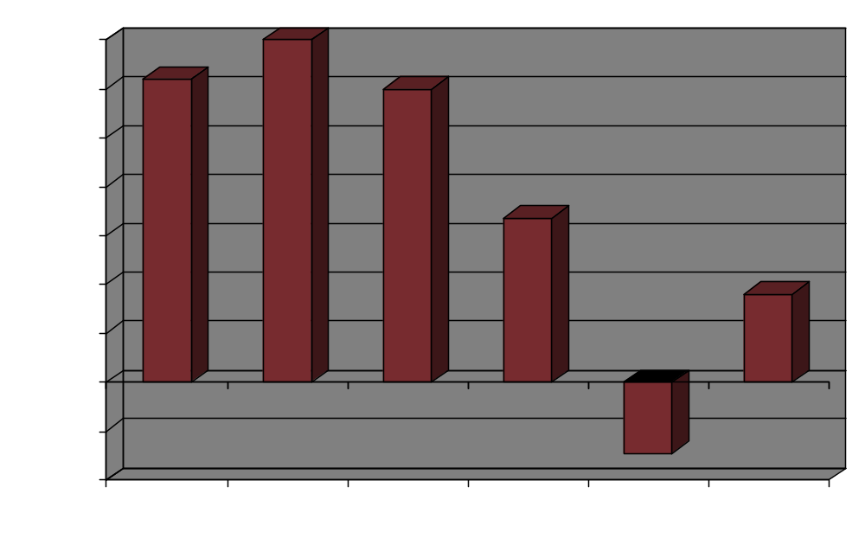
Historical Savings Rates

Slide 26
Profiles in Retirement
Social Security
  Represents 40% of the income of those 65+
    52% of married couples and 72% of unmarried persons receive 50% of their income from Social Security
    20% of married couples and 41% of unmarried couples receive 90% of their income from Social Security
General
  52% of the workforce has no private pension coverage
  31% of the workforce has no savings set aside specifically for retirement

Slide 27
Pension Plans
Since 1978, the number of defined benefit plans have declined from 128,041 to only 26,000 today
21% of workers in the private sector have defined-benefit pension
Since 1978, the number of defined-contribution plans has more than doubled from 314,592 to 840,301. They cover 42 million workers
1 in 4 workers has NOT signed up to participate in their 401(k) plan
Nearly 50% of America workers don’t contribute enough to their 401(k) plan to get the full employer match
Employee Benefit Research Institute

Slide 28
Pension Benefit Guaranty Corporation
Created by ERISA in 1974
  Studebaker Company
    Bankruptcy
    11,000 workers affected
    85% reduction in benefit
Insures defined benefit pension
  Protects 44 million workers in 30,000 pension plans
  Insures up to $4,312.50/month
  US Airways and Bethlehem Steel

Slide 29
PBGC Financials
$68.4 Billion In Assets
+ $82.5 Billion In Liabilities
($14.1) Billion NET WORTH

Slide 30
Defined Contribution Plans
401(k) plans are… or were… popular
With recent market declines, individuals have lost a decade of gains
Many companies have stopped funding their profit sharing plans

Slide 31
Planning for the Future
Not the government
Not the employer pension
It’s you
(the three legged stool (government, pensions, personal savings… with two legs gone)

Slide 32
Retirement Risks
3 – 7 years before retirement
3 – 7 years after retirement
Age 65
$1,699,248
Age 60
$1,096,589
Age 58
$ 913,339
Beginning at age 35, $15,000 per year contributed into a 401(k) at an 8% RoR, accumulates to $1,699,248 at age 65.
Value at 58 is $913,399
46% of the value at retirement accrues in the last 7 years. That’s $785,849 of which only $105,000 is attributable to additional contributions.
Value at 60 is $1,096,589
35% of the value at retirement accumulates in the last 5 years. That’s $602,659, of which only $75,000 came from additional contributions.

Slide 33
The Role of Life Insurance
A retirement plan is simply a dream
unless you are there to fund it…
except when you have life insurance
Is it a good way to save for retirement?

Slide 34
Tax Laws
TEFRA
  Tax Equity & Fiscal Responsibility Act of 1982
  Place premium limits on flexible premium products
DEFRA
  Deficit Reduction Act of 1984
  Enacted IRC Section 7702
TAMRA
  Technical & Miscellaneous Revenue Act of 1988
  IRC Section 7702A
  Modified Endowment Contracts
  7-Pay Test
Notes:
To understand how IUL can be such a powerful financial tool, we need to start first with how this product is taxed. In the life insurance world, there are three tax acts that are critical to understanding the power of IUL product. Once you understand this information, you will know more about life insurance products than almost all insurance agents and financial planners.

Slide 35
IRC Section 7702
For a contract to be defined as life insurance, it must meet at least one of two actuarial tests:
  Cash Value Accumulation Test (CVAT)
  Guideline Premium & Cash Value Corridor Test (GPT)
Notes:
IRC Section 7702 defines how a contract must be built so that it is taxed as a life insurance contract. The law basically states that a life insurance policy meet one of two actuarial tests.

Slide 36
Cash Value Accumulation Test
CVAT – death benefit oriented contracts
The cash surrender value of a contract must not at any time exceed the net single premium that is required to fund future benefits
The net single premium is determined by using (1) an annual effective interest rate of 4% or the interest rate(s) guaranteed in the contract, whichever is greater; (2) the mortality charges specified in the contract or if not specified, the charges used in figuring the statutory reserves for the contract; and (3) any other charges specified in the contract.
Notes:
Simply walk through this slide.

Slide 37
Guideline Premium Test
GPT – cash accumulation oriented contracts
Two requirements
  Guideline Premium Test
  Cash Value Corridor Test
Both tests must be met
Notes:
The second test is known as the GPT or the Guideline Premium Test and the Cash Value Corridor Test.

Slide 38
Guideline Premium Test
A policy will meet these requirements if the sum of the premiums does not exceed the greater of the:
  Guideline Single Premium or
  Cumulative sum of the Guideline Level Premiums
Notes:
Read over slide.

Slide 39
Cash Value Corridor Test
Requires a “corridor” between the account value and insurance benefit
Expresses insurance benefit as a percentage of the account value
The “corridor” is 250% for ages under 41 and then it decreases every year until it reaches 100% at age 95.
Notes:
Read over slide.

Slide 40
Violations of DEFRA
Penalties
Growth in cash value is taxable as earned
Insurance death benefit remains income tax free
*Most insurance companies will not allow a contract to violate the definition of life insurance.
Notes:
Technically, if a contract violates the actuarial tests as defined by DEFRA, the growth in the cash values is taxed every year as it is earned. Obviously, this is a bad thing…even if the insurance death benefit is still received income tax free by the beneficiary in most cases. The reality though is that most insurance companies will not allow a policyowner to fund a contract to a point where it violates DEFRA.

Slide 41
Violations of TAMRA
Penalties
Last in, first out (LIFO) tax treatment of distributions
Any access of gain the contract is subject to ordinary income taxes, even when the access is in the form of a loan
If access occurs before the contract owner is 59 1/2 ,
there is an additional 10% tax penalty on the amount of
gain recognized
Insurance death benefit remains income tax free
Notes:
When policies become MECs, several things happen to the taxation of these contracts.

Slide 42
Types of Contracts under Tax Law
Contracts meeting the definition of life insurance
Those that meet the definition of life insurance but that are Modified Endowment Contracts
Those that fail the definition of life insurance
Notes:
The history of TEFRA, DEFRA, and TAMRA leave us with three types of contracts under the code.

Slide 43
Key IRC Sections
Tax Law | Meaning
IRC Section 101(a)(1) | Life insurance death benefit is received federal income tax free
IRC Section 7702 | Definition of life insurance
IRC Section 7702(a) | Defines “Modified Endowment Contracts”
IRC Section 72 | Cash value grows tax deferred Loans taken from a non-MEC’d policy are not considered distributions and are thus not generally subject to income tax
Notes:
These four sections of the Internal Revenue Code are the key to understanding why a properly funded life insurance contract receives such favorable income tax treatment. For instance:
The insurance benefit is received by most beneficiaries income tax free. Beneficiaries of CDs or IRAs don’t have this benefit.
Section 72 says that cash values grow tax deferred. With the long term power of values growing on money that would otherwise go to the government every year in the form of taxes, this is a huge benefit.
As long as the contract doesn’t violate IRC Section 7702(a) and become a MEC, cash values can be accessed in a first in first out manner. By doing this, the policyowner can pull their basis out of the contract first, before touching gain. It’s a huge advantage over other financial vehicles. Furthermore, cash values can be reached without penalty prior to age 59 ½. An IRA does not allow this. And, with policy loans, policyowners can borrow their gains out of the contract in the form of zero net cost loans. As loans aren’t taxable under current tax law, this leverage makes life insurance contracts one of the most tax advantaged vehicles available.

Slide 44
Master Elite - $500,000
Male, Preferred N/T
Age | 7-Pay | GSP | GLP
40 | $19,565 | $85,008 | $7,012
45 | $23,289 | $105,302 | $8,819
50 | $27,598 | $133,081 | $11,310
55 | $32,690 | $162,471 | $14,397
60 | $38,510 | $198,116 | $18,684
65 | $45,187 | $237,269 | $24,494
Age | GSP | GLP | Ratio
40 | $85,008 | $7,012 | 12.02%
45 | $105,302 | $8,819 | 11.94%
50 | $133,081 | $11,310 | 11.77%
55 | $162,471 | $14,397 | 11.28%
60 | $198,116 | $18,684 | 10.60%
65 | $237,269 | $24,494 | 9.69%
Age | 7-Pay | GSP | Ratio
40 | $19,565 | $85,008 | 23.02%
45 | $23,289 | $105,302 | 22.12%
50 | $27,598 | $133,081 | 20.74%
55 | $32,690 | $162,471 | 20.12%
60 | $38,510 | $198,116 | 19.44%
65 | $45,187 | $237,269 | 19.04%
Notes:
Let’s look at a real life example of some of the numbers you will see when designing a life insurance contract for cash accumulation and wealth transfer situations.
You can see the 7-pay numbers from TAMRA, and the GSP and GLP numbers from DEFRA. Let’s look closer at some of the ratios you’ll see in these numbers.

Slide 45
Master Elite - $500,000
Male, Preferred N/T
Age | 7-Pay | GSP | GLP
45 | $23,289 | $105,302 | $8,819
What is the maximum amount of premium that can be placed in the contract by the end of year 3 and the contract still have all the tax advantages of life insurance?
What about the end of year 5?
And the end of year 15?
Year 3: $23,289 x 3 = $69,867
(the cumulative 7-pay premium is smaller than the GSP)
Year 5: GSP = $105,302
(GSP is smaller than the cumulative 7-Pay premium at the 5th year)
Year 15: $8,819 x 15 = $132,285 (cumulative GLP)
Notes:
Self explanatory.

Slide 46
Funding for Wealth
Accumulation & Distribution
Life insurance is unique in that it is the only financial tool that leverages up money at an individual’s death.
To be at its most efficient, place as much money into the contract as legally allowed and as fast as possible to minimize the net amount at risk. This tactic has the effect of minimizing COI charges.
Important not to violate the GSP, GLP, or the 7-Pay limits
Notes:
Read slide.

Slide 47
Practically, this means that contracts can
be “max-funded” to the GSP level without violating TAMRA’s 7-pay test in five years.
In the 11th year or beyond, the GLP may be paid into the contract as well.
Notes:
Read slide.

Slide 48
Case Scenario
Male – Age 45
$500,000 Master Elite IUL, Preferred N/T
Premiums
  $23,289, years 1 – 4
  $12,144, year 5
  $8,819, years 13 – 20
Variable loans
  $50,000 per year, years 26 – 40
Notes:
Let’s look at a live case. I’ve already run the numbers, so let me walk you through how to present this to a client.

Slide 49
IUL Hypothetical-Historical
Crediting Rates
Company | Old Mutual
Product | Master Series
Cap Rate | 15%
Guarantee Rate | 0%
1950’s | 9.65%
1960’s | 7.47%
1970’s | 6.93%
1980’s | 10.52%
1990’s | 10.15%
2000’s | 5.51%
Average | 8.33%
Source – AMZ competitive analysis completed effective 12/2008.
Notes:
Before I take you too far though, let’s talk about illustrations, max illustrated rates and historical numbers.
At Old Mutual, our current maximum illustrated rate is 8.81%. We came to that number by looking at the growth in values had money been invested in the contract 25 years ago at our current 15% cap in all years and then solving for the internal rate of return.
While that’s a good idea, this chart does a similar evaluation, but it looks at the returns for each decade since the 50’s. As you can see, some decades of yielded returns in the high 5’s and others have yielded returns in the mid-10% range. Over the entire 50 years though, the average return was 8.33%. As a result, that’s the illustrated rate we are using in this evaluation.

Slide 50
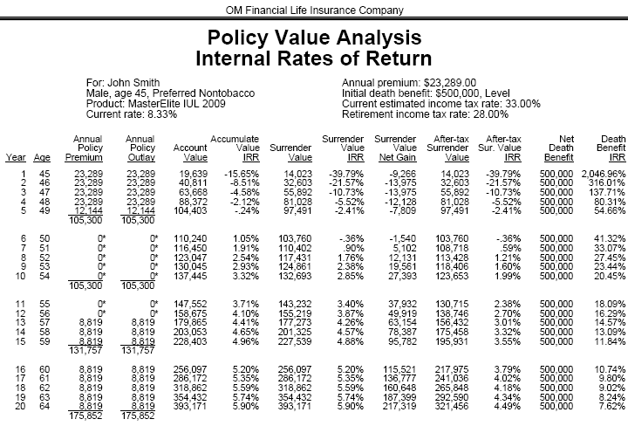
* These projections are based on current assumptions and are not guaranteed.
Notes:
What you see here is the output of the case when using Old Mutual’s Tapestry illustration software. It’s much more attractive than the core software and it should be used when you want to present a more prefessional case design scenario to a client.
What I want you to pay attention to is the current crediting rate of 8.33% vs. the IRR in the contract in the 7th year. The IRR is 0.90%. That’s ugly….and how do you explain it?

Slide 51
  Assets should be viewed relative
  to needs at a given point in time.
  Retirement assets should be viewed over the long-term, not the short term.
Notes:
Simply put….read slide.

Slide 52
* These projections are based on current assumptions and are not guaranteed.
Notes:
But still, while we all acknowledge that my previous comment is right on point, we still have a big difference between 8.33% and 0.90%!

Slide 53
Analogy
  Think of your over-funded life insurance contract as you would a commercial building
  Due to funding limitations (GSP, GLP, 7-Pay), you can lease-out your 5-story building one year at a time (1st floor – year one, 2nd floor – year two, etc.). It will take you five years before your building is fully leased…or your contract is fully funded)
  In the early years, there isn’t enough money in the contract to cover all the expenses (not enough people paying rent to cover costs)
  Over time, when the contract is fully funded (when the building is fully leased), the product is in a much better position to perform well
  * The term “fully funded” means that the contract has as much premium in it as the law will allow without violating the definition of life insurance and without making the contract a MEC. It is not meant to imply that the contract is guaranteed to endow at any age.
Notes:
When max funding a life insurance contract, I often explain the short term results of the contract by drawing an analogy to how a client’s cash-flow would work if they had purchased a commercial building.
Read the slide.

Slide 54
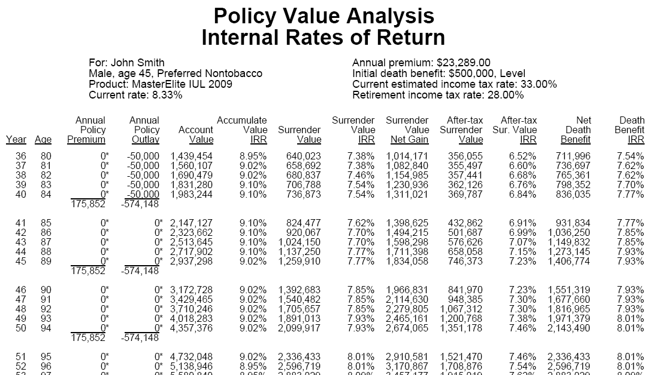
Tapestry Illustrations
* These projections are based on current assumptions and are not guaranteed.
Notes:
Now, let’s look at how the contract performs…over a long period of time…as it was designed to. Here, we see that the 40 year IRR is 7.54%.

Slide 55
Evaluation
Crediting rate – 8.33%
IRR on the cash surrender value at the end of 35th year – 7.54%
Internal costs – 0.79% (8.33% - 7.54%)
Notes:
Think about the power of this number. We assumed the gross rate of return was 8.33%. As the net rate of return shown is 7.54%, that means that the internal expenses over that period of time have only cost the policy owner 79 basis points!

Slide 56
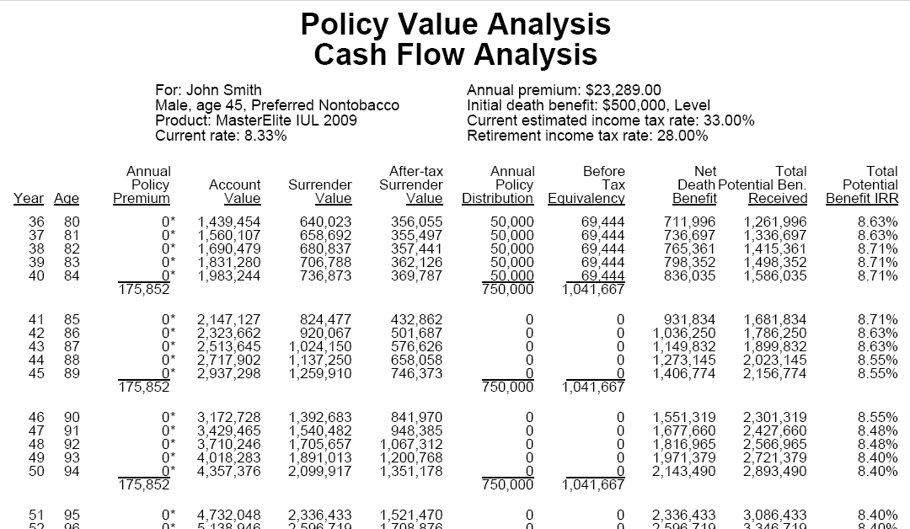
Notes:
As we go out even longer, to the insureds age 90, when I am assuming the insured passes away, you can see the total tax-quivalent yield IRR is 8.55% The tax benefits of the life contract make the overall performance HIGHER than the 8.33% we started with!

Slide 57
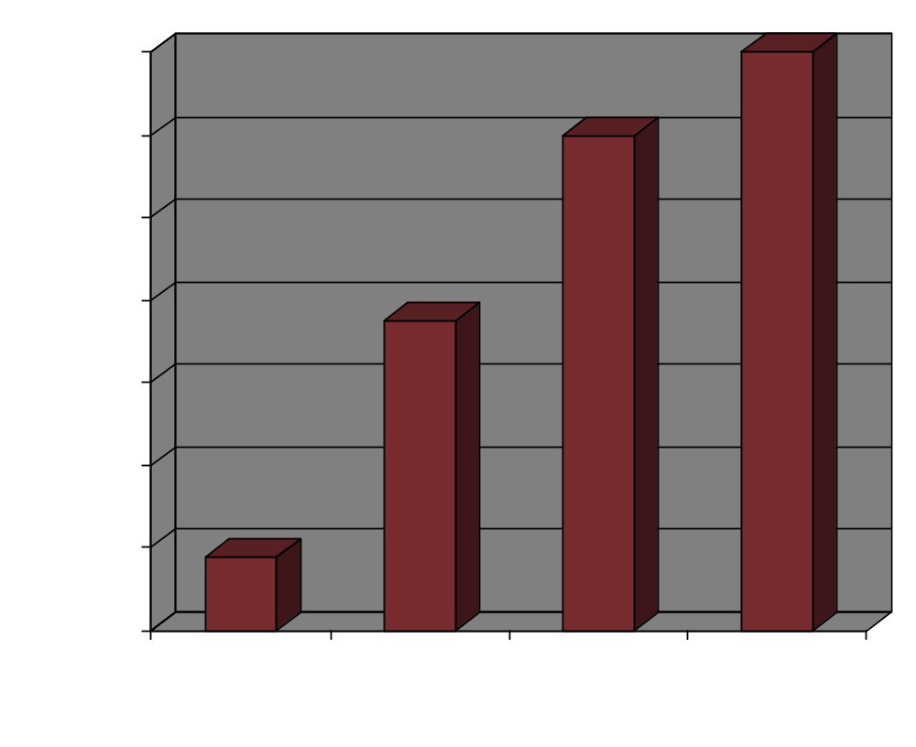
Case Results at Age 90
Notes:
Think about these results:
$170,000 in premiums paid
$700,000 in retirement income over 20 years in retirement
at age 90, there’s still $1.2 million in cash value remaining, and
assuming the client dies at age 90, his heirs receive $1.4 million of life insurance tax free. What a legacy!

Slide 58
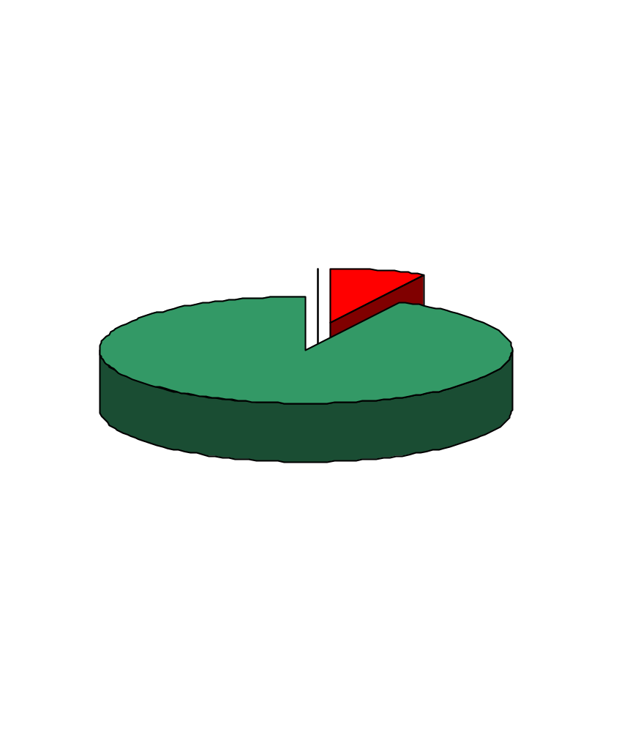
Death Age 90
$176,000 in Premiums
$2,150,000 in Benefits
- $750,000 in retirement cash flow
- $1,400,000 in life insurance proceeds to heirs
Notes:
Here’s another way of looking at the same story!

Slide 59
Comparisons
Features | Indexed Universal Life | Variable Universal Life | Equity Mutual Fund | Certificate of Deposit
Insurance benefit | Yes | Yes | No | No
FIFO tax treatment of distributions | Yes | Yes | No | No
Tax deferred growth | Yes | Yes | Possible – due to delay in recognizing capital gains | No
Gains not subject to loss | Yes – ignoring surrender charges | No | No | Yes
Tax advantaged access to gains | Yes | Yes | No | No
Notes:
IUL has many advantages over other financial vehicles when it comes to:
taxes
management of risk and return
leaving legacies

Slide 60
Summary
Having life insurance to guarantee funds for survivors in retirement is a good idea
Life contracts have positive tax benefits
  Insurance benefit is income tax free
  Cash values grow tax deferred
  FIFO treatment on distributions
  Loans are not considered income for income tax purposes
People need the advice and counsel that we provide
Notes:
Read slide.

