Slide 1
Retirement Planning & the Role of Insurance
Bruce Wing, CLU, ChFC
Old Mutual Financial Network

Slide 2
Sources of Retirement Income
Government benefits
Employer pensions
Personal Savings

Slide 3
Key Numbers
$853 billion
$1.38 trillion
$2.718 billion
$59 trillion
1 - http://www.federalreserve.gov/paymentsystems/coin/
2 - http://blogs.abcnews.com/politicalpunch/2009/09/federal-deficit-hits-record-high-of-138-trillion-in-august.htm
4 - http://www.usatoday.com/news/washington/2007-05-28-federal-budget_N.htm

Slide 4
Factoids
US government spends $1.35 for every $1 it collects in revenue
Debt grows $41 million an hour, $690,000 a minute, $11,500 per second
http://www.usdebtclock.org/

Slide 5
Social Security & Medicare
Key Agencies:
  Government Accountability Office (GAO)
  Congressional Budget Office
  Office of Management and Budget (OMB)
  U.S. Treasury Department
Theme
  Between 2030 and 2040, mandatory spending on Social Security, Medicare, Medicaid, and the national debt will exceed tax revenue
  “unsustainable” and “trainwreck”

Slide 6
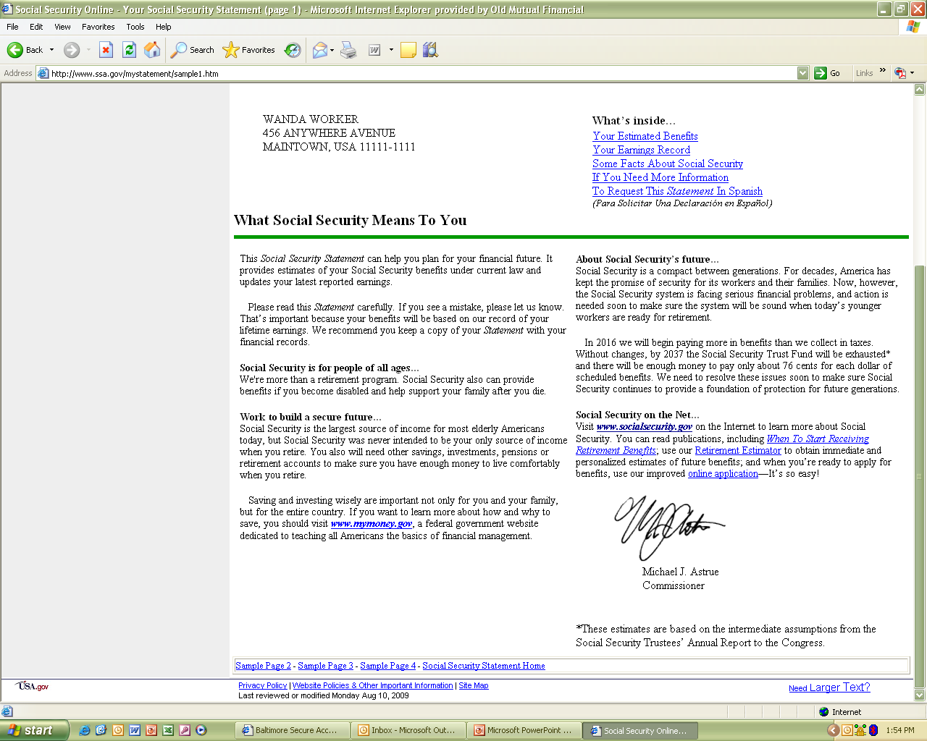

Slide 7
Challenges to Success
Behavior
Rate of return & risk
Taxation

Slide 8
Behavior

Slide 9
Test
Average weight of an adult blue whale, in pounds?
When was the Mona Lisa painted?
How many independent countries were there at YE 2006?
What is the air distance, in miles, between Paris and Sydney?
How many bones are in the human body?
How many combatants were killed in WWI?
How many books were in the Library of Congress at YE 2006?
How long is the Amazon River?
How fast does the earth spin at the equator?
How many transistors are in the Pentium III processor?

Slide 10
Answers
Blue whale - 250,000 pounds
Mona Lisa - 1513
Independent countries - 192
Paris to Sydney - 10,543 miles
Bones - 206
WWI - 8.3 million
Library books - 19 million
Amazon - 4,000 miles
Earth spin - 1,044 mph
Transistors - 9.5 million

Slide 11
Quantitative Analysis of Investor Behavior
Created by DALBAR
Period – January 1, 1989 to December 31, 2008
Investment returns vs. investor returns
QAIB - 2009

Slide 12
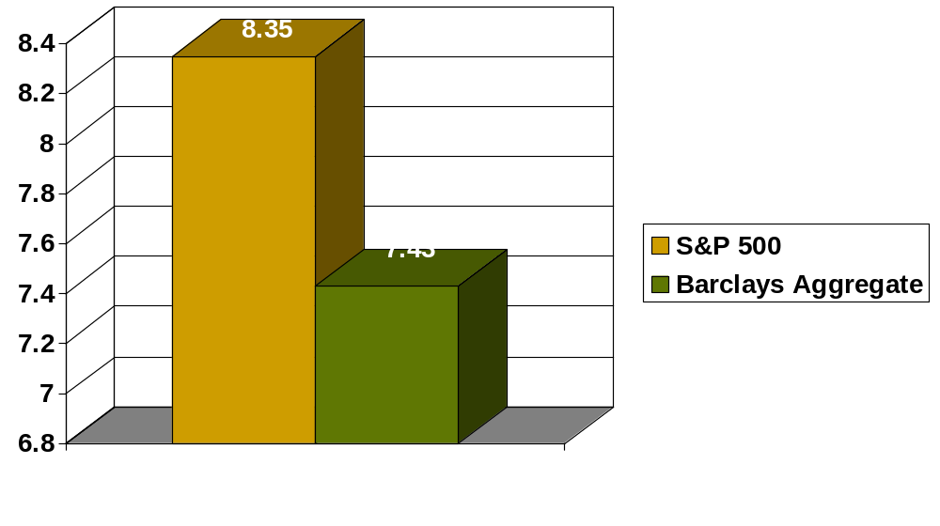
Investment Returns

Slide 13
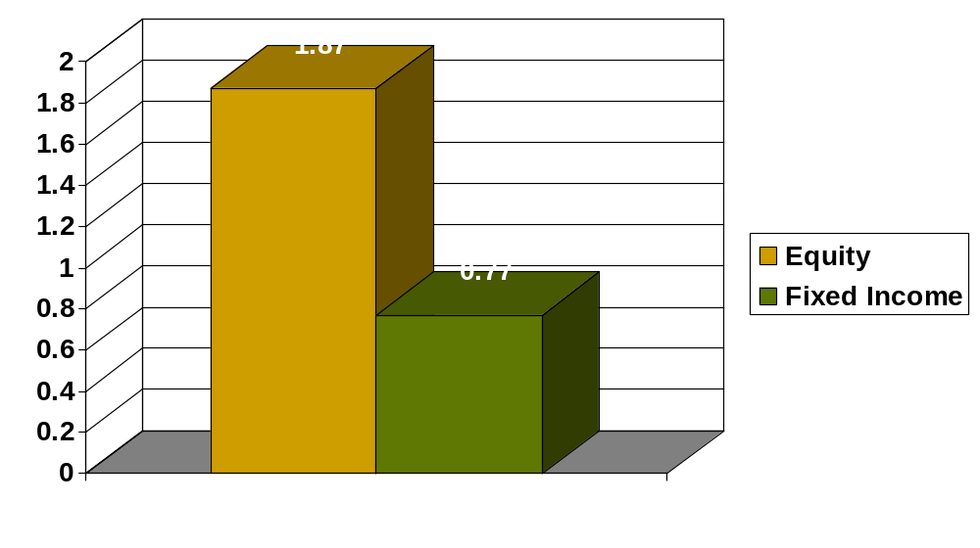
Investor Returns

Slide 14
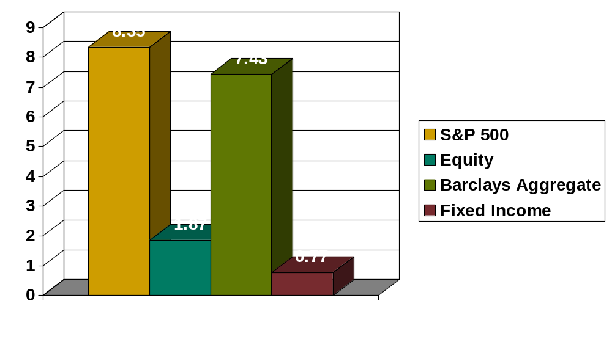
Investment vs. Investor Returns

Slide 15
Rate of Return
& Risk

Slide 16
Retirement Risks
3 – 7 years before retirement
3 – 7 years after retirement
Age 65
$1,699,248
Age 60
$1,096,589
Age 58
$ 913,339
Beginning at age 35, $15,000 per year contributed into a 401(k) at an 8% RoR, accumulates to $1,699,248 at age 65.
Value at 58 is $913,399
46% of the value at retirement accrues in the last 7 years. That’s $785,849 of which only $105,000 is attributable to additional contributions.
Value at 60 is $1,096,589
35% of the value at retirement accumulates in the last 5 years. That’s $602,659, of which only $75,000 came from additional contributions.

Slide 17
Impact of Taxes

Slide 18
Factoids
1946 – National GDP:National Debt = 122%
2009 – National GDP:National Debt = 240%

Slide 19
Income Statistics
Federal
Income Tax
Marginal Rate | Income | Plus | Total Tax @ Highest Income | Effective Rate
10% | $0 - $16,050 | $0 | $1,605 | 10%
15% | $16,050 - $65,100 | $1,605 | $8,962.50 | 13.77%
25% | $65,100 - $131,450 | $8,962.50 | $22,550 | 17.15%
28% | $131,450 - $200,300 | $22,550 | $44,828 | 22.38%
33% | $200,300 – $357,700 | $44,828 | $96,700 | 27.05%
35% | $357,700 | $96,700 | $321,505* | 32.15%*
* Assumes the AGI is $1,000,000

Slide 20
Tax Demographics - 2007
Percentages ranked on AGI | AGI Thresholds on Percentiles | Percentage of Federal Income Tax Paid
Top 1% | $410,096 | 40.42%
Top 5% | $160,041 | 60.63%
Top 10% | $113,018 | 71.22%
Top 25% | $66,532 | 86.59%
Top 50% | $32,879 | 97.11%
Bottom 50% | <$32,879 | 2.89%
National Tax Payers Union
http://www.ntu.org/main/page.php?PageID=6

Slide 21
See the Math
Receivers of benefits
Taxpayers

Slide 22
Point of Interest
1931 – Highest marginal tax was 25%
1932 – Highest marginal tax was 63%
1936 – Highest marginal tax was 79%
1941 – Highest marginal tax was 81%
1942 – Highest marginal tax was 88%
1944 – Highest marginal tax was 94%

Slide 23
Taxation on Savings
Rate of Return | Tax Rate | After Tax | Tax Equivalent Yield
8% | 25% | 6.0% | 10.66%
8% | 35% | 5.2% | 12.30%
8% | 45% | 4.4% | 14.54%
8% | 55% | 3.6% | 17.77%

Slide 24
Financial Solution
Manages behavior
Manages risk and return
Manages tax liability

Slide 25
The Role of Life Insurance

Slide 26
Tax Advantages
& Funding

Slide 27

Key IRC Sections
Tax Law | Meaning
IRC Section 101(a)(1) | Life insurance death benefit is received federal income tax free
IRC Section 7702 | Definition of life insurance
IRC Section 7702(a) | Defines “Modified Endowment Contracts”
IRC Section 72 | Cash value grows tax deferred Loans taken from a non-MEC’d policy are not considered distributions and are thus not generally subject to income tax
Notes:
These four sections of the Internal Revenue Code are the key to understanding why a properly funded life insurance contract receives such favorable income tax treatment. For instance:
The insurance benefit is received by most beneficiaries income tax free. Beneficiaries of CDs or IRAs don’t have this benefit.
Section 72 says that cash values grow tax deferred. With the long term power of values growing on money that would otherwise go to the government every year in the form of taxes, this is a huge benefit.
As long as the contract doesn’t violate IRC Section 7702(a) and become a MEC, cash values can be accessed in a first in first out manner. By doing this, the policyowner can pull their basis out of the contract first, before touching gain. It’s a huge advantage over other financial vehicles. Furthermore, cash values can be reached without penalty prior to age 59 ½. An IRA does not allow this. And, with policy loans, policyowners can borrow their gains out of the contract in the form of zero net cost loans. As loans aren’t taxable under current tax law, this leverage makes life insurance contracts one of the most tax advantaged vehicles available.

Slide 28

Fixed Indexed Universal Life
Cash Contributions
Compound Interest
Maximum Premiums
Minimum Death Benefit
Yr. 5
$
Yr. 4
$
$
Yr. 3
Yr. 2
$
Mortality &
Expense
Charges
Yr. 1
$
TEFRA 1982
DEFRA 1984
TAMRA 1988
Dictates the minimum death benefit required based upon the insured’s age and sex to
accommodate the desired premium.
Grandfathering provision

Slide 29
Fixed Indexed Universal Life
Maximum Premiums
Cash Contributions
Compound Interest
Year 5
$
Yr. 4
$
$
Yr. 3
Mortality &
Expense
Charges
Yr. 2
$
Yr. 1
$
Minimum Death Benefit

Slide 30
Return & Risk via Indexing

Slide 31
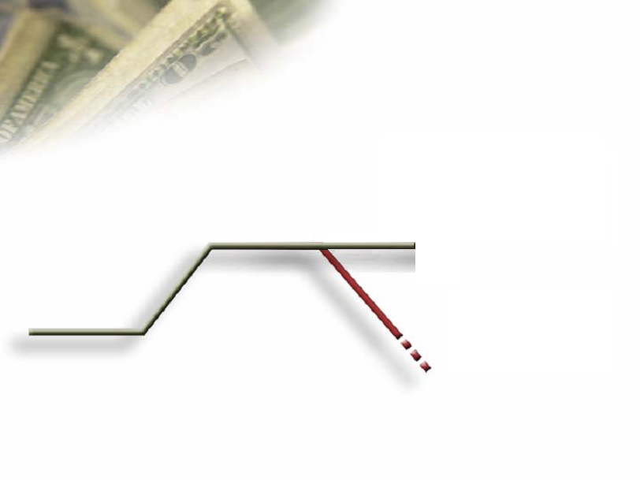


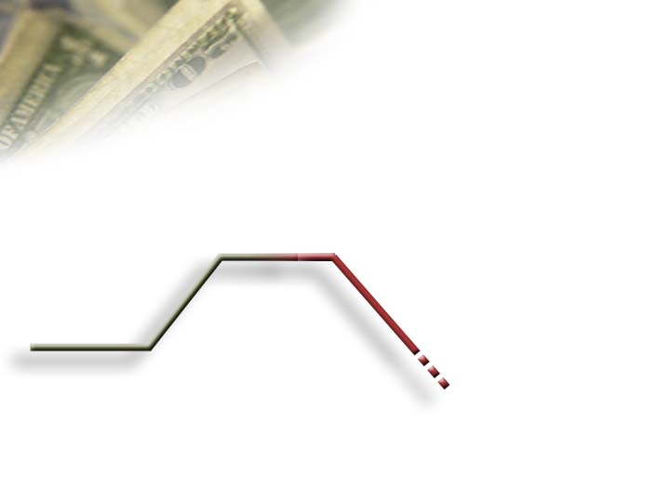

The Powerful Advantage of Annual Lock in and Reset of the S&P Index
$115,655
5%
$110,000
11%
10%
Gains
Become
Principal
$103,950
$100,000
-10%
5%
$99,000
That is a $11,705 difference because of the annual lock in and reset.

Slide 32
Fixed Indexed Scenario
Linked S&P 500 Index
$163,281
$152,599
1600
1500
1400
1300
1200
1000
800
600
400
$148,154
$129,960
$109,509
$120,000
1474
$114,000
$114,000 $114,000
1336
1320
$108,000
1248
$102,345
$100,000
1229
$100,000
1212
$99,364
1148
$93,960
1112
$91,159
970
880
$72,349
771
96 97 98 99 00 01 02 03 04 05 06
* This is a hypothetical illustration and assumes a 14% cap. S&P 500 from October 1, 1996 to October 1, 2006

Slide 33
Fixed Indexed Scenario
Linked S&P 500 Index
$ 202,893
1600
1500
1400
1300
1200
1000
800
600
400
$192,024
1469
$189,619
$184,096
1320
$172,821
1336
$168,896
$160,898
1248
$150,353
$160,000
1229
1212
$145,974
1148
150,354
$148,154
1112
$145,874
$126,000
$129,960
880
970
$114,000
$115,773
$100,000
771
96 97 98 99 00 01 02 03 04 05 06
* This is a hypothetical illustration and assumes a 14% cap. S&P 500 from October 1, 1996 to October 1, 2006

Slide 34
Managing Behavior

Slide 35
Behavior
Fear of loss
Greed of gain
Forced savings

Slide 36
Case Scenario
Male – Age 45
$500,000 Master Elite IUL, Preferred N/T
Premiums
  $23,289, years 1 – 4
  $12,144, year 5
  $8,819, years 13 – 20
Variable loans
  $50,000 per year, years 26 – 40
Notes:
Let’s look at a live case. I’ve already run the numbers, so let me walk you through how to present this to a client.

Slide 37
IUL Hypothetical-Historical
Crediting Rates
Company | Old Mutual
Product | Master Series
Cap Rate | 15%
Guarantee Rate | 0%
1950’s | 9.65%
1960’s | 7.47%
1970’s | 6.93%
1980’s | 10.52%
1990’s | 10.15%
2000’s | 5.51%
Average | 8.33%
Source – AMZ competitive analysis completed effective 12/2008.
Notes:
Before I take you too far though, let’s talk about illustrations, max illustrated rates and historical numbers.
At Old Mutual, our current maximum illustrated rate is 8.81%. We came to that number by looking at the growth in values had money been invested in the contract 25 years ago at our current 15% cap in all years and then solving for the internal rate of return.
While that’s a good idea, this chart does a similar evaluation, but it looks at the returns for each decade since the 50’s. As you can see, some decades of yielded returns in the high 5’s and others have yielded returns in the mid-10% range. Over the entire 50 years though, the average return was 8.33%. As a result, that’s the illustrated rate we are using in this evaluation.

Slide 38
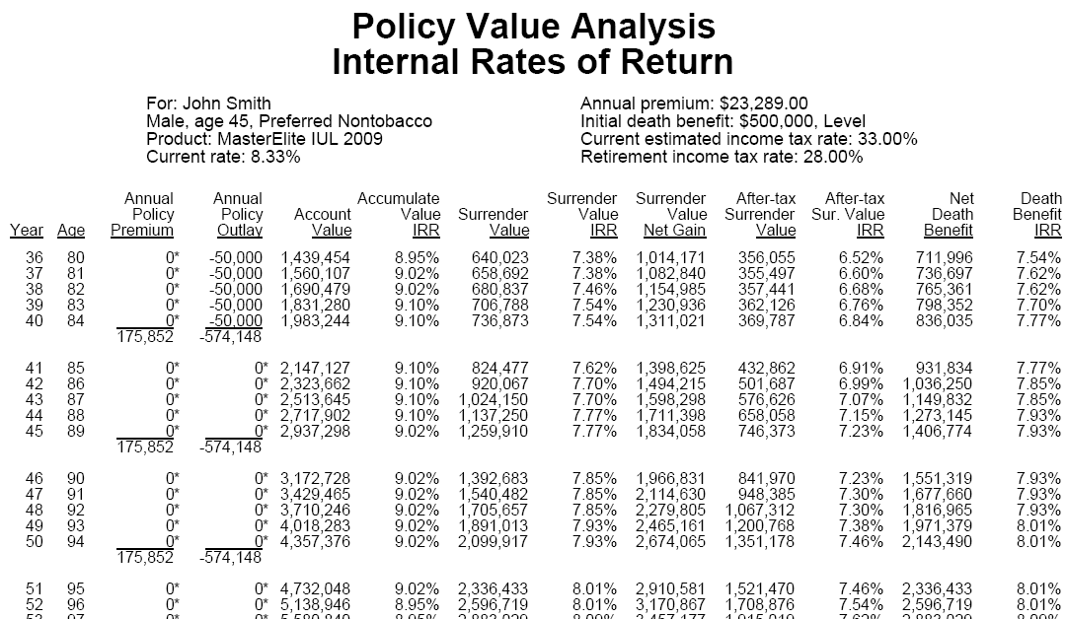
Tapestry Illustrations
* These projections are based on current assumptions and are not guaranteed.
Notes:
Now, let’s look at how the contract performs…over a long period of time…as it was designed to. Here, we see that the 40 year IRR is 7.54%.

Slide 39
Evaluation
Crediting rate – 8.33%
IRR on the cash surrender value at the end of 35th year – 7.54%
Internal costs – 0.79% (8.33% - 7.54%)
Notes:
Think about the power of this number. We assumed the gross rate of return was 8.33%. As the net rate of return shown is 7.54%, that means that the internal expenses over that period of time have only cost the policy owner 79 basis points!

Slide 40
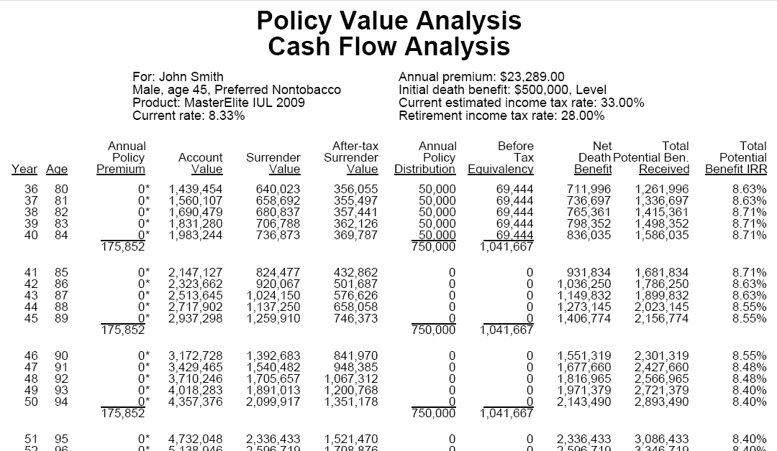
Notes:
As we go out even longer, to the insureds age 90, when I am assuming the insured passes away, you can see the total tax-quivalent yield IRR is 8.55% The tax benefits of the life contract make the overall performance HIGHER than the 8.33% we started with!

Slide 41
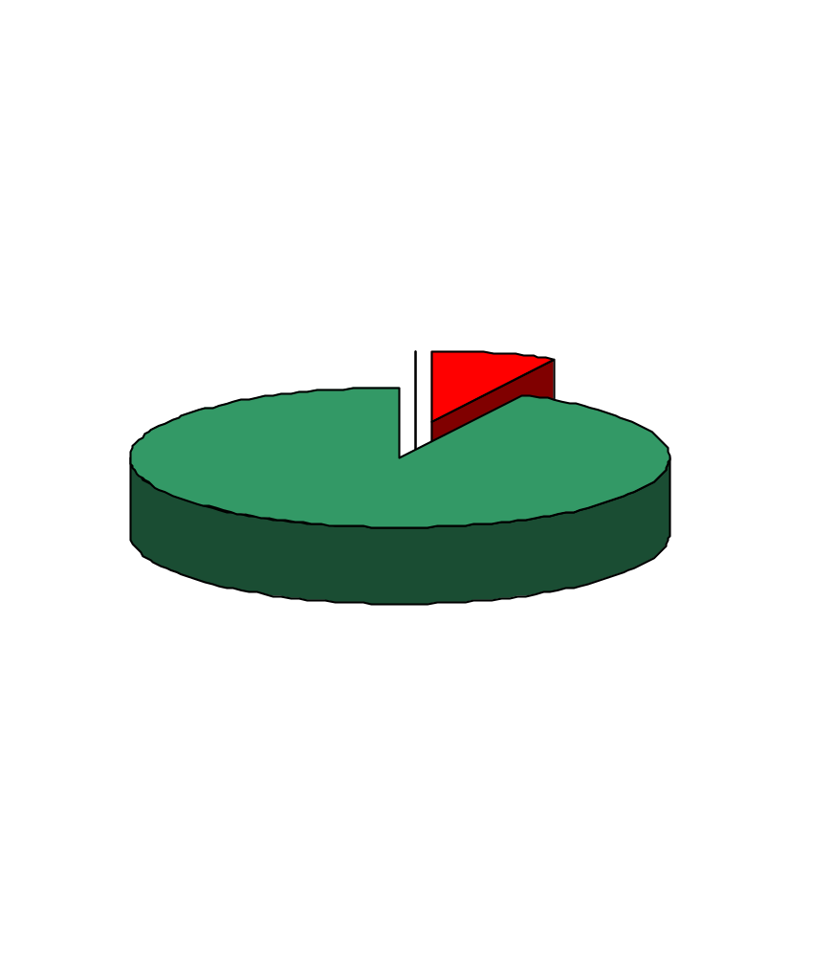
Death Age 90
$176,000 in Premiums
$2,150,000 in Benefits
- $750,000 in retirement cash flow
- $1,400,000 in life insurance proceeds to heirs
Notes:
Here’s another way of looking at the same story!

Slide 42
Summary
Three-legged stool
Ideal savings vehicle
Fixed indexed universal life
Notes:
Read slide.

