Slide 1
C# Properties
- By Nimesh Kumar Dagur

Slide 2


Slide 3
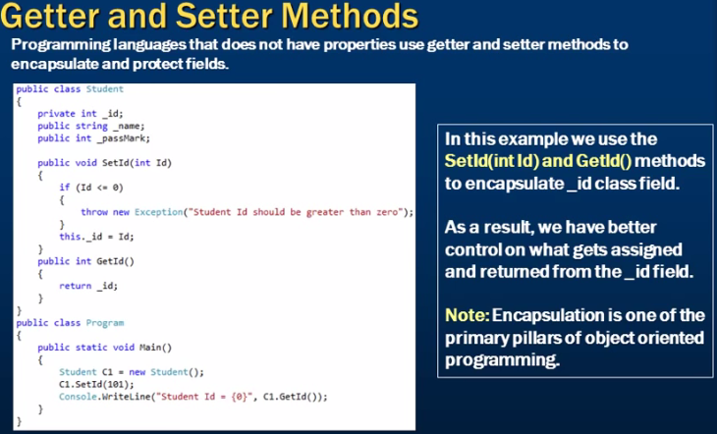

Slide 4
Property
In addition to method you can also use properties to allow the code to access the variables of the class outside the class.
Using properties you can allow the code outside the class to retrieve and set the values of the variable of the class.
In c# you can implements the properties by using the get and set accessors.
The get set accessor or modifier mostly used for storing and retrieving value from the private field.
The get accessor must return a value of property type where set accessor returns void.
The set accessor uses an implicit parameter called value.
In simple word, the get method used for retrieving value from private field whereas set method used for storing value in private variables.

Slide 5
Property
You can create a property by specifying a name and then writing the get and set accesors to implement the property.
The get accessor is used to retrieve the value of the variable represented by a property and the set accessor is used to assign a new value to that variable.

Slide 6
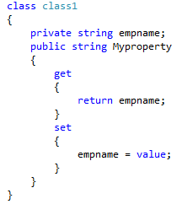
Property: Example

Slide 7
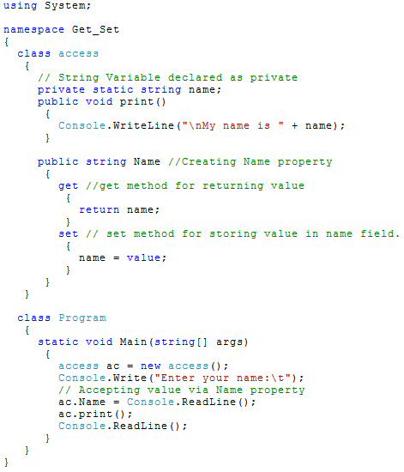

Slide 8
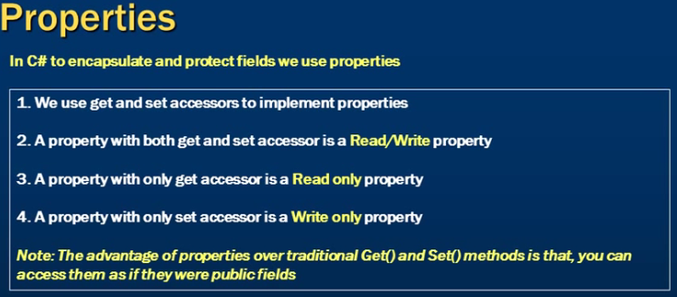

Slide 9


Slide 10
