Slide 1
Online Payment Of Electricity Bill

Slide 2
Introduction
This project centres on an electricity bill payment application that enhances user experience through three main features. Users start by logging in or registering with their electricity board details. After logging in, the application auto-fills their information, enabling easy verification. The payment process then offers various options like Credit Card, Debit Card, UPI, or Cash On Delivery, and confirms successful transactions with a clear message.

Slide 3
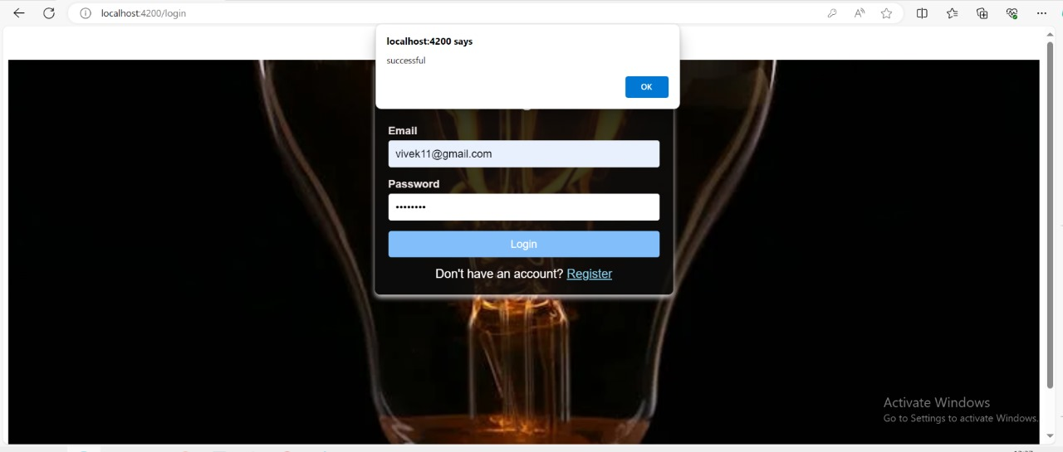
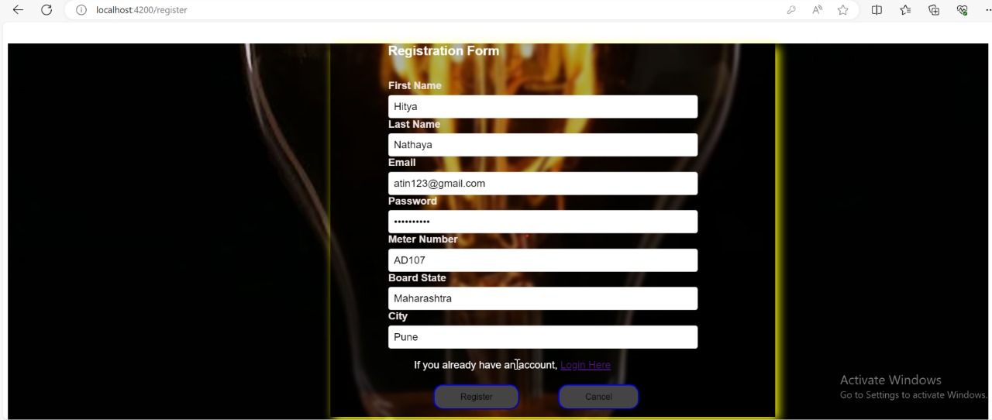
Register and Login
Login
Register

Slide 4
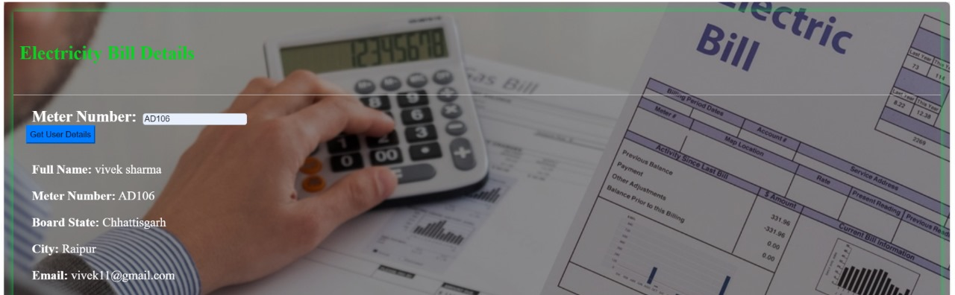
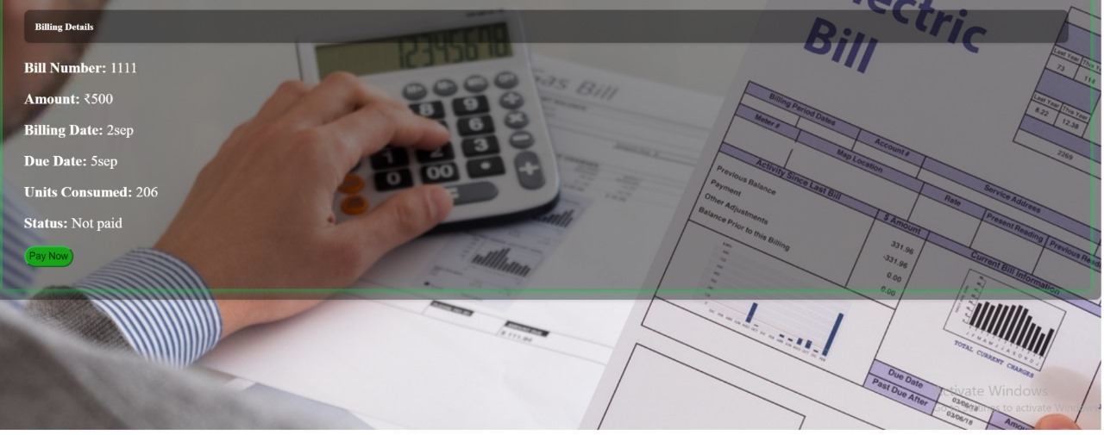
Electricity Bill Details

Slide 5
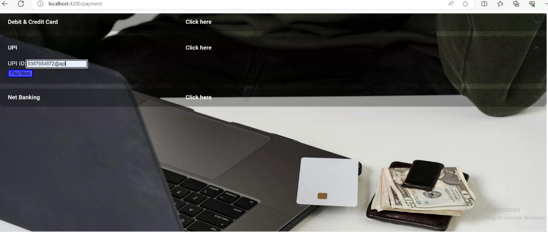
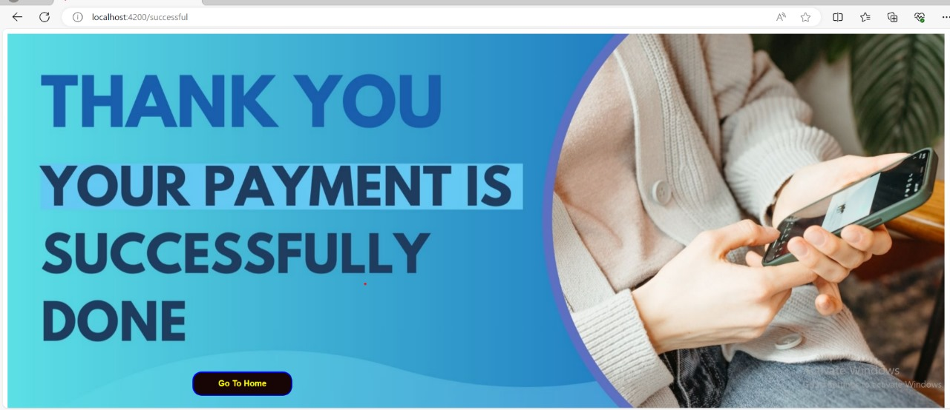
Payment

Slide 6

Team Members
Hitesh Nathya
Apurva Shinde
Dulla Likhitha Devi
Atin Garg
Anusha Pamarthi
Jyotsna Mali

Slide 7
Thank you

