Slide 1
JSON
https://www.youtube.com/watch?v=NJwRQgsu1Q8

Slide 2
Contents
JavaScript: Introduction to Scripting languages, Introduction to JavaScript (JS), JS Variables and Constants, JS Variable Scopes, JS Data Types, JS Functions, JS Array, JS Object, JS Events.
Advanced JavaScript: JSON - JSON Create, Key-Value Pair, JSON Access, JSON Array, JS Arrow Functions, JS Callback Functions, JS Promises, JS Async-Await Functions, JS Error Handling.
AJAX: Why AJAX, Call HTTP Methods Using AJAX, Data Sending, Data Receiving, AJAX Error Handling.
JQUERY :Why JQuery, How to Use, DOM Manipulation with JQuery, Dynamic Content Change with JQuery, UI Design Using JQuery. TI

Slide 3
JSON
JSON stands for JavaScript Object Notation
JSON is a text format for storing and transporting data
JSON is "self-describing" and easy to understand

Slide 4
JSON Example
This example is a JSON string:
'{"name":"John", "age":30, "car":null}'
It defines an object with 3 properties:
name
age
car
If you parse the JSON string with a JavaScript program, you can access the data as an object:
let personName = obj.name; let personAge = obj.age;

Slide 5
JSON Example
JSON stands for JavaScript Object Notation
JSON is a lightweight data-interchange format
JSON is plain text written in JavaScript object notation
JSON is used to send data between computers
JSON is language independent *

Slide 6
Why Use JSON?
The JSON format is syntactically similar to the code for creating JavaScript objects.
Because of this, a JavaScript program can easily convert JSON data into JavaScript objects.
Since the format is text only, JSON data can easily be sent between computers,
and used by any programming language.
JavaScript has a built-in function for converting JSON strings into JavaScript objects:
JSON.parse()
JavaScript also has a built-in function for converting an object into a JSON string:
JSON.stringify()

Slide 7
Storing Data
When storing data, the data has to be a certain format, and regardless of where you choose to store it, text is always one of the legal formats.
JSON makes it possible to store JavaScript objects as text

Slide 8
JSON Syntax Rules
The JSON syntax is a subset of the JavaScript syntax.
JSON syntax is derived from JavaScript object notation syntax:
Data is in name/value pairs
Data is separated by commas
Curly braces hold objects
Square brackets hold arrays

Slide 9
JSON Data - A Name and a Value
JSON data is written as name/value pairs (a key/value pairs).
A name/value pair consists of a field name (in double quotes), followed by a colon, followed by a value:
Example
"name":"John"
JSON names require double quotes.

Slide 10
JSON - Evaluates to JavaScript Objects
The JSON format is almost identical to JavaScript objects.
In JSON, keys must be strings, written with double quotes:
{"name":"John"}
In JavaScript, keys can be strings, numbers, or identifier names:
{name:"John"}

Slide 11
JSON Values
In JSON, values must be one of the following data types:
a string
a number
an object
an array
a boolean
null
In JavaScript values can be all of the above, plus any other valid JavaScript expression, including:
a function
a date
undefined

Slide 12
JSON Values
In JSON, string values must be written with double quotes:
JSON
{"name":"John"}
In JavaScript, you can write string values with double or single quotes:
JavaScript
{name:'John'}

Slide 13
JavaScript Objects
With JavaScript you can create an object and assign data to it, like this:
Example
person = {name:"John", age:31, city:"New York"};
You can access a JavaScript object like this:
Example
// returns John person.name;

Slide 14
JavaScript Objects
<!DOCTYPE html>
<html>
<body>
<h2>Access a JavaScript object</h2>
<p id="demo"></p>
<script>
const myObj = {name:"John", age:30, city:"New York"};
document.getElementById("demo").innerHTML = myObj.name;
</script>
</body>
</html>

Slide 15
JavaScript Objects
It can also be accessed like this:
Example
// returns John person["name"];
<!DOCTYPE html>
<html>
<body>
<h2>Access a JavaScript object</h2>
<p id="demo"></p>
<script>
const myObj = {name:"John", age:30, city:"New York"};
document.getElementById("demo").innerHTML = myObj["name"];
</script>
</body>
</html>

Slide 16
JSON Data Types
In JSON, values must be one of the following data types:
a string
a number
an object (JSON object)
an array
a boolean
null
JSON values cannot be one of the following data types:
a function
a date
undefined

Slide 17
JSON Data Types
JSON Strings
Strings in JSON must be written in double quotes.
Example
{"name":"John"}
JSON Numbers
Numbers in JSON must be an integer or a floating point.
Example
{"age":30}
JSON Objects
Values in JSON can be objects.
Example
{ "employee":{"name":"John", "age":30, "city":"New York"} }

Slide 18
JSON Data Types
JSON Arrays
Values in JSON can be arrays.
Example
{ "employees":["John", "Anna", "Peter"] }
JSON Booleans
Values in JSON can be true/false.
Example
{"sale":true}
JSON null
Values in JSON can be null.

Slide 19
JSON.parse()
Use the JavaScript function JSON.parse() to convert text into a JavaScript object.
When receiving data from a web server, the data is always a string.
Parse the data with JSON.parse(), and the data becomes a JavaScript object.
Example - Parsing JSON
Text received from a web server:
'{"name":"John", "age":30, "city":"New York"}’
const obj = JSON.parse('{"name":"John", "age":30, "city":"New York"}');

Slide 20
JSON.parse()
Use the JavaScript object in your page:
<!DOCTYPE html>
<html>
<body>
<h2>Creating an Object from a JSON String</h2>
<p id="demo"></p>
<script>
const txt = '{"name":"John", "age":30, "city":"New York"}'
const obj = JSON.parse(txt);
document.getElementById("demo").innerHTML = obj.name + ", " + obj.age;
</script>
</body>
</html>

Slide 21
Array as JSON
When using the JSON.parse() on a JSON derived from an array, the method will return a JavaScript array, instead of a JavaScript object.
<!DOCTYPE html>
<html>
<body>
<h2>Parsing a JSON Array.</h2>
<p>Data written as an JSON array will be parsed into a JavaScript array.</p>
<p id="demo"></p>
<script>
const text = '[ "Ford", "BMW", "Audi", "Fiat" ]';
const myArr = JSON.parse(text);
document.getElementById("demo").innerHTML = myArr[0];
</script>
</body>
</html>

Slide 22
Exceptions
Parsing Dates.
Date objects are not allowed in JSON.
If you need to include a date, write it as a string.
You can convert it back into a date object later:

Slide 23
Exceptions eg
Example
Convert a string into a date:
<!DOCTYPE html>
<html>
<body>
<h2>Convert a string into a date object.</h2>
<p id="demo"></p>
<script>
const text = '{"name":"John", "birth":"1986-12-14", "city":"New York"}';
const obj = JSON.parse(text);
obj.birth = new Date(obj.birth);
document.getElementById("demo").innerHTML = obj.name + ", " + obj.birth;
</script>
</body>
</html>

Slide 24
Parsing Functions
Functions are not allowed in JSON.
If you need to include a function, write it as a string.
You can convert it back into a function later:

Slide 25
Parsing Functions
Example
Convert a string into a function:
<!DOCTYPE html>
<html>
<body>
<h2>Convert a string into a function.</h2>
<p id="demo"></p>
<script>
const text = '{"name":"John", "age":"function() {return 30;}", "city":"New York"}';
const obj = JSON.parse(text);
obj.age = eval("(" + obj.age + ")");
document.getElementById("demo").innerHTML = obj.name + ", " + obj.age();
</script>
</body>
</html>

Slide 26
JSON.stringify() ❮ Pre
A common use of JSON is to exchange data to/from a web server.
When sending data to a web server, the data has to be a string.
Convert a JavaScript object into a string with JSON.stringify().

Slide 27
JSON.stringify() ❮ Pre
Stringify a JavaScript Object
const obj = {name: "John", age: 30, city: "New York"};
Use the JavaScript function JSON.stringify() to convert it into a string.
const myJSON = JSON.stringify(obj);
The result will be a string following the JSON notation.
myJSON is now a string, and ready to be sent to a server:

Slide 28
JSON.stringify() eg ❮ Pre
<!DOCTYPE html>
<html>
<body>
<h2>Create a JSON string from a JavaScript object.</h2>
<p id="demo"></p>
<script>
const obj = {name: "John", age: 30, city: "New York"};
const myJSON = JSON.stringify(obj);
document.getElementById("demo").innerHTML = myJSON;
</script>
</body>
</html>

Slide 29
Stringify a JavaScript Array eg ❮ Pre
It is also possible to stringify JavaScript arrays:
Array in JavaScript:
const arr = ["John", "Peter", "Sally", "Jane"];
Use the JavaScript function JSON.stringify() to convert it into a string.
const myJSON = JSON.stringify(arr);

Slide 30
Exceptions: date eg ❮ Pre
Stringify Dates
In JSON, date objects are not allowed.
The JSON.stringify() function will convert any dates into strings.
You can convert the string back into a date object at the receiver.

Slide 31
Exceptions: function eg_func_strconv eg_func ❮ Pre
In JSON, functions are not allowed as object values.
The JSON.stringify() function will remove any functions from a JavaScript object, both the key and the value:
Example
const obj = {name: "John", age: function () {return 30;}, city: "New York"}; const myJSON = JSON.stringify(obj);
This can be omitted if you convert your functions into strings before running the JSON.stringify() function.
If you send functions using JSON, the functions will lose their scope, and the receiver would have to use eval() to convert them back into functions.

Slide 32
JSON Object Literals EG ❮ Previou ❮ Pre
<!DOCTYPE html>
<html>
<body>
<h2>Looping Object Properties</h2>
<p id="demo"></p>
<script>
const myJSON = '{"name":"John", "age":30, "car":null}';
const myObj = JSON.parse(myJSON);
let text = "";
for (const x in myObj) {
text += x + ", ";
}
document.getElementById("demo").innerHTML = text;
</script>
</body>
</html>

Slide 33
JSON Object Literals EG ❮ Previou ❮ Pre
In a for-in loop, use the bracket notation to access the property values:
<!DOCTYPE html>
<html>
<body>
<h2>Looping JavaScript Object Values</h2>
<p id="demo"></p>
<script>
const myJSON = '{"name":"John", "age":30, "car":null}';
const myObj = JSON.parse(myJSON);
let text = "";
for (const x in myObj) {
text += myObj[x] + ", ";
}
document.getElementById("demo").innerHTML = text;
</script>
</body>
</html>

Slide 34
JSON Array Literals ❮ Previou ❮ Pre
'["Ford", "BMW", "Fiat"]’ JSON String
["Ford", "BMW", "Fiat"] JSON array literal
In JSON, array values must be of type string, number, object, array, boolean or null.
In JavaScript, array values can be all of the above, plus any other valid JavaScript expression, including functions, dates, and undefined.

Slide 35
JSON Array Literals ❮ Previou ❮ Pre
JavaScript Arrays
You can create a JavaScript array from a literal:
<!DOCTYPE html>
<html>
<body>
<h2>Creating an Array from a Literal</h2>
<p id="demo"></p>
<script>
const myArray = ["Ford", "BMW", "Fiat"];
document.getElementById("demo").innerHTML = myArray;
</script>
</body>
</html>

Slide 36
JSON Array Literals ❮ Previou ❮ Pre
<!DOCTYPE html>
<html>
<body>
<h2>Creating an Array from JSON</h2>
<p id="demo"></p>
<script>
const myJSON = '["Ford", "BMW", "Fiat"]';
const myArray = JSON.parse(myJSON);
document.getElementById("demo").innerHTML = myArray;
</script>
</body>
</html>

Slide 37
Accessing Array Values ❮ Previou ❮ Pre
<!DOCTYPE html>
<html>
<body>
<h1>Access an Array by Index</h1>
<p id="demo"></p>
<script>
const myJSON = '["Ford", "BMW", "Fiat"]';
const myArray = JSON.parse(myJSON);
document.getElementById("demo").innerHTML = myArray[0];
</script>
</body>
</html>

Slide 38
Arrays in Objects ❮ Previou ❮ Pre
Objects can contain arrays:
{ "name":"John", "age":30, "cars":["Ford", "BMW", "Fiat"] }
You access array values by index:

Slide 39
Arrays in Objects ❮ Previou ❮ Pre
<!DOCTYPE html>
<html>
<body>
<h2>Access Array Values</h2>
<p id="demo"></p>
<script>
const myJSON = '{"name":"John", "age":30, "cars":["Ford", "BMW", "Fiat"]}';
const myObj = JSON.parse(myJSON);
document.getElementById("demo").innerHTML = myObj.cars[0];
</script>
</body>
</html>

Slide 40
JavaScript Before Arrow Function ❮ Previou ❮ Pre
Arrow functions were introduced in ES6(ECMAScript revision to JS).
Arrow functions allow us to write shorter function syntax:
Before Arrow:
hello = function() {
return "Hello World!";
}
With Arrow Function:
hello = () => { return "Hello World!"; }

Slide 41
JavaScript Before Arrow Function ❮ Previou ❮ Pre
It gets shorter!
If the function has only one statement, and the statement returns a value,
Remove the brackets and the return keyword:
Arrow Functions Return Value by Default:
hello = () => "Hello World!";

Slide 42
JavaScript Arrow Function with Parameters eg ❮ Previou ❮ Pre
<!DOCTYPE html>
<p id="demo"></p>
<script>
let myFunction = (a, b) => a * b;
document.getElementById("demo").innerHTML = myFunction(4, 5);
</script>
</body>
</html>

Slide 43
JavaScript Arrow Function with Parameters eg ❮ Previou ❮ Pre
Arrow Function With Parameters:
hello = (val) => "Hello " + val;
In fact, if only one parameter, skip the parentheses as well:
Arrow Function Without Parentheses:
hello = val => "Hello " + val;

Slide 44
Contents
JavaScript: Introduction to Scripting languages, Introduction to JavaScript (JS), JS Variables and Constants, JS Variable Scopes, JS Data Types, JS Functions, JS Array, JS Object, JS Events.
Advanced JavaScript: JSON - JSON Create, Key-Value Pair, JSON Access, JSON Array, JS Arrow Functions, JS Callback Functions, https://www.youtube.com/watch?v=i2SPq-nb3NQ JS Promises, JS Async-Await Functions, JS Error Handling.
AJAX: Why AJAX, Call HTTP Methods Using AJAX, Data Sending, Data Receiving, AJAX Error Handling.
JQUERY :Why JQuery, How to Use, DOM Manipulation with JQuery, Dynamic Content Change with JQuery, UI Design Using JQuery. TI

Slide 45
Before JS Callback Function eg
function myFirst() { myDisplayer("Hello"); } function mySecond() { myDisplayer("Goodbye"); } myFirst(); mySecond();

Slide 46
Before JS Callback Function eg
<!DOCTYPE html>
<html>
<body>
<p>The result of the calculation is:</p>
<p id="demo"></p>
<script>
function myDisplayer(some) {
document.getElementById("demo").innerHTML = some;
}

Slide 47
Before JS Callback Function eg
function myCalculator(num1, num2) {
let sum = num1 + num2;
myDisplayer(sum);
}
myCalculator(5, 5);
</script>
</body>
</html>

Slide 48
JS Callback Function eg
In JavaScript, you can also pass a function as an argument to a function.
This function that is passed as an argument inside of another function is called a callback function.
“A callback function is a function passed into another function as an argument, which is then invoked inside the outer function to complete some kind of routine or action.”

Slide 49
JS Callback Function eg
<!DOCTYPE html>
<html> <body>
<h1>JavaScript Functions</h1>
<h2>Callback Functions</h2>
<p>The result of the calculation is:</p>
<p id="demo"></p>
<script>
function myDisplayer(something) {
document.getElementById("demo").innerHTML = something;
}
function myCalculator(num1, num2, myCallback) {
let sum = num1 + num2;
myCallback(sum);
}
myCalculator(5, 5, myDisplayer); </script> </body> </html>

Slide 50
JS Callback Function eg
What is output of program?
program

Slide 51
When to Use a Callback?
The benefit of using a callback function is that
callbacks really shine are in asynchronous functions, where one function has to wait for another function (like waiting for a file to load).
wait for the result of a previous function call and then execute another function call.

Slide 52
setTimeout() with Callback eg
<!DOCTYPE html>
<html> <body>
<h1>JavaScript Functions</h1>
<h2>setTimeout() with a Callback</h2>
<p>Wait 3 seconds (3000 milliseconds) for this page to change.</p>
<h1 id="demo"></h1>
<script>
setTimeout(myFunction, 3000);
function myFunction() {
document.getElementById("demo").innerHTML = “How r u?";
}
</script>
</body>
</html>

Slide 53
setInterval() with Callback eg
<!DOCTYPE html>
<html>
<body>
<h1 id="demo"></h1>
<script>
setInterval(myFunction, 1000);
function myFunction() {
let d = new Date();
document.getElementById("demo").innerHTML=
d.getHours() + ":" +
d.getMinutes() + ":" +
d.getSeconds();
}
</script>
</body> </html>

Slide 54
Callback Alternatives
With asynchronous programming, JavaScript programs can start long-running tasks, and continue running other tasks in parallel.
But asynchronous programmes are difficult to write and difficult to debug.
Because of this, most modern asynchronous JavaScript methods don't use callbacks.
Instead, in JavaScript, asynchronous programming is solved using Promises instead.

Slide 55
Callback Alternatives
Const cart={“shoes”, “Kurti”, “shirt” };
Createorder(cart, function(orderId){
makePayment(orderId);
});
makePayment callback func in createOrder API
Createorder func call and then call makePayment API .
But if createOrder never call MakePayment, or double called.
i.e giving control of our program to some other part of the code.

Slide 56
Callback Alternatives
Passing callback function
Const cart={“shoes”, “Kurti”, “shirt” };
createOrder(cart, function(orderId){
makePayment(orderId);
});
Promises
Const promise= createOrder(cart);
promise.then(function(orderId){
makePayment(orderId);
});
Createoder API will call when ever it wants ; trusting on createOrder
Attaching callback function to Promise object
When data is inside promise object it will call CallBack makePayment

Slide 57
JS Promise
A promise is a returned object to which you attach callbacks, instead of passing callbacks into a function.
Placeholder for some period of time until get value.
The Promise is an object, represents the eventual completion (or failure) of an asynchronous operation and its resulting value.
Const promise= createOrder(cart);
promise.then(function(orderId){
makePayment(orderId);
});

Slide 58
JS Promises
a Promise is an object that will produce a single value some time in the future.
If the promise is successful, it will produce a resolved value,
but if something goes wrong then it will produce a reason why the promise failed.
The possible outcomes here are similar to that of promises in real life

Slide 59

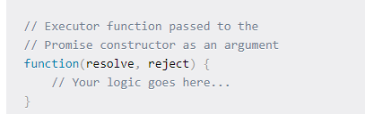
JS Promises Syntax
The constructor function takes a function as an argument.
This function is called the executor function.

Slide 60
JS Promises Syntax
The executor function takes two arguments, resolve and reject.
These are the callbacks provided by the JavaScript language.
For the promise to be effective, the executor function should call either of the callback functions, resolve or reject.
The new Promise() constructor returns a promise object.
As the executor function needs to handle async operations, the returned promise object should be capable of informing when the execution has been started, completed (resolved) or retuned with error (rejected).

Slide 61
JS Promises Syntax
A promise object has the following internal properties:
state – This property can have the following values:
pending: Initially when the executor function starts the execution.
fulfilled: When the promise is resolved.
rejected: When the promise is rejected.

Slide 62
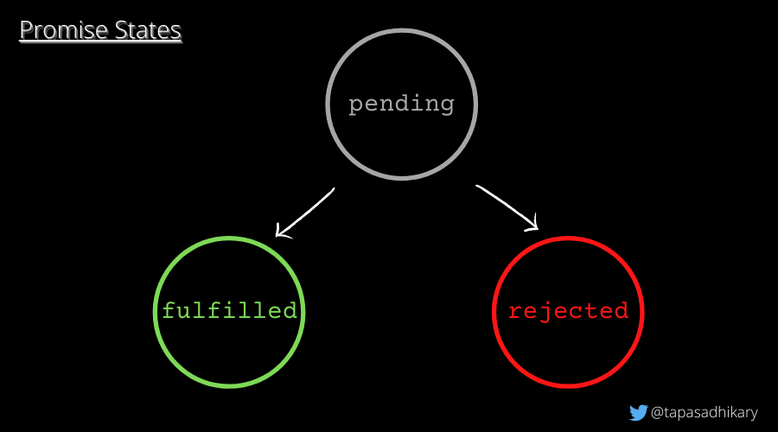
JS Promises Syntax

Slide 63
JS Promises Syntax
A promise object has the following internal properties:
2. result – This property can have the following values:
undefined: Initially when the state value is pending.
value: When resolve(value) is called.
error: When reject(error) is called.

Slide 64
JS Promises Syntax
let myPromise = new Promise(function(myResolve, myReject) { // "Producing Code" (May take some time) myResolve(); // when successful myReject(); // when error });
// "Consuming Code" (Must wait for a fulfilled Promise) myPromise.then( function(value) { /* code if successful */ }, function(error) { /* code if some error */ } );

Slide 65
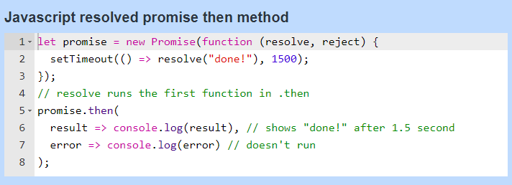
JS Promises :resolved promise reaction

Slide 66
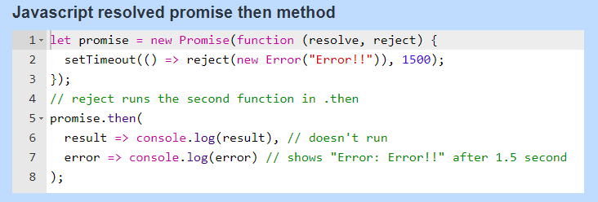
JS Promises :case of rejection

Slide 67
Async-Await
Represent Async functions
Async always returns a promise
If it return value then it will be wrapped in Promise and returns it.
Eg async function getdata(){
Return “Namaste”;
}
Const data =getdata();
Console.log(data);

Slide 68
Async-Await
async function f() {
return 1; } //return Promise.resolve(1);
f().then(alert); // 1

Slide 69
Async-Await
There’s another keyword, await, that works only inside async functions,
The syntax:
// works only inside async functions
let value = await promise;
The keyword await makes JavaScript wait until that promise settles and returns its result.

Slide 70
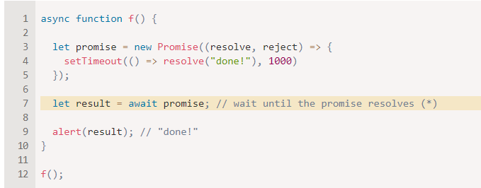
Async-Await
T
The function execution “pauses” at the line (*) and resumes when the promise settles, with result becoming its result.
So the code above shows “done!” in one second.

Slide 71
Async-Await
Async-await combo used to handle promises.
Why?
No need to use .then and .catch
Use await in async function which is promise handler function

Slide 72
JS Promises syntax
The constructor function takes a function as an argument.
This function is called the executor function.
https://www.freecodecamp.org/news/javascript-promise-tutorial-how-to-resolve-or-reject-promises-in-js/

Slide 73
How to Create a Promise in JavaScript
To create a promise,
Create an instance object using the Promise constructor function.
The Promise constructor function takes in one parameter.
That parameter is a function that defines when to resolve the new promise, and optionally when to reject it.
const promise = new Promise((resolve, reject) => {
// Condition to resolve or reject the promise
});

Slide 74
JSON vs XML
Both JSON and XML can be used to receive data from a web server.
JSON and XML examples both define an employees object, with an array of 3 employees:
JSON Example
{"employees":[ { "firstName":"John", "lastName":"Doe" }, { "firstName":"Anna", "lastName":"Smith" }, { "firstName":"Peter", "lastName":"Jones" } ]}

Slide 75
JSON vs XML
XML Example
<employees> <employee> <firstName>John</firstName> <lastName>Doe</lastName> </employee> <employee> <firstName>Anna</firstName> <lastName>Smith</lastName> </employee> <employee> <firstName>Peter</firstName> <lastName>Jones</lastName> </employee> </employees>

Slide 76
Why JSON is Better Than XML
XML is much more difficult to parse than JSON.
JSON is parsed into a ready-to-use JavaScript object.
For AJAX applications, JSON is faster and easier than XML:
Using XML
Fetch an XML document
Use the XML DOM to loop through the document
Extract values and store in variables
Using JSON
Fetch a JSON string
JSON.Parse the JSON string

