Slide 1
AJAX

Slide 2
Contents
JavaScript: Introduction to Scripting languages, Introduction to JavaScript (JS), JS Variables and Constants, JS Variable Scopes, JS Data Types, JS Functions, JS Array, JS Object, JS Events.
Advanced JavaScript: JSON - JSON Create, Key-Value Pair, JSON Access, JSON Array, JS Arrow Functions, JS Callback Functions, JS Promises, JS Async-Await Functions, JS Error Handling.
AJAX: Why AJAX, Call HTTP Methods Using AJAX, Data Sending, Data Receiving, AJAX Error Handling.
JQUERY :Why JQuery, How to Use, DOM Manipulation with JQuery, Dynamic Content Change with JQuery, UI Design Using JQuery. TI

Slide 3

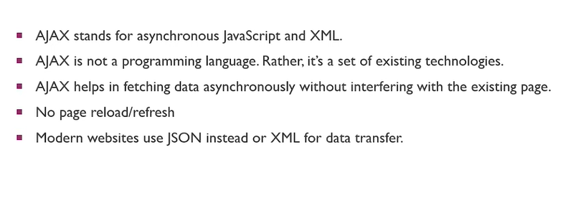
What is it??
AJAX is a technique for accessing a web page from web servers

Slide 4
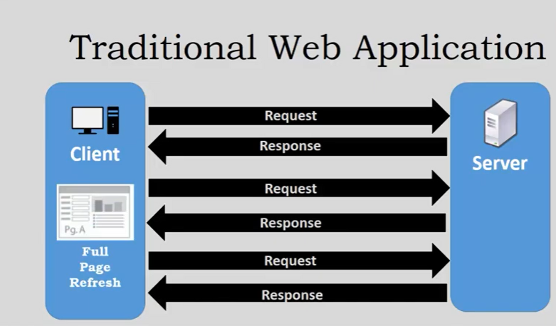
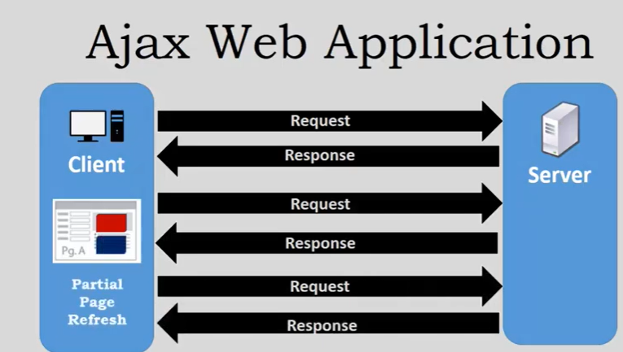

Slide 5
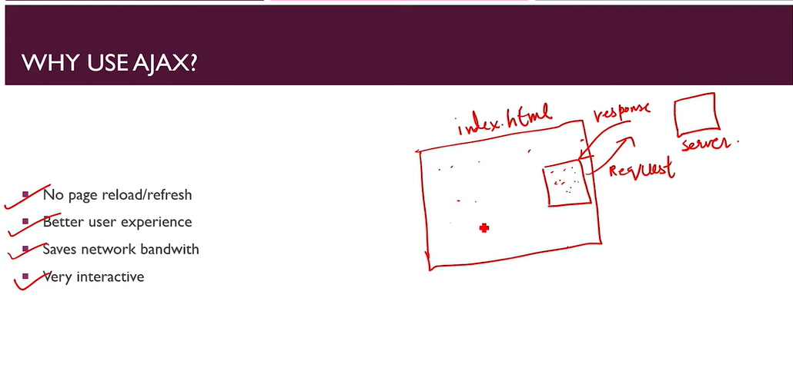

Slide 6
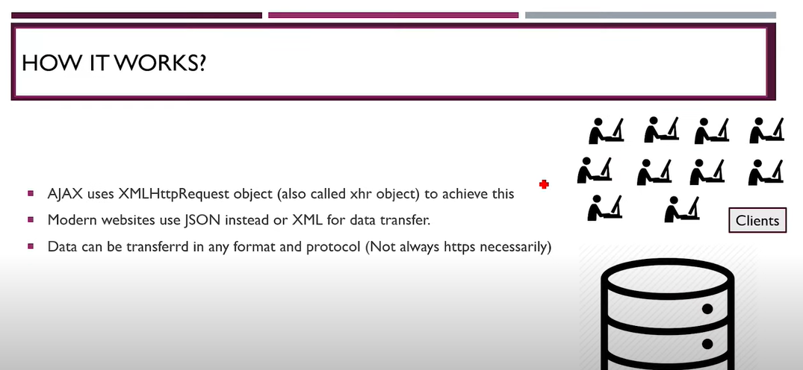
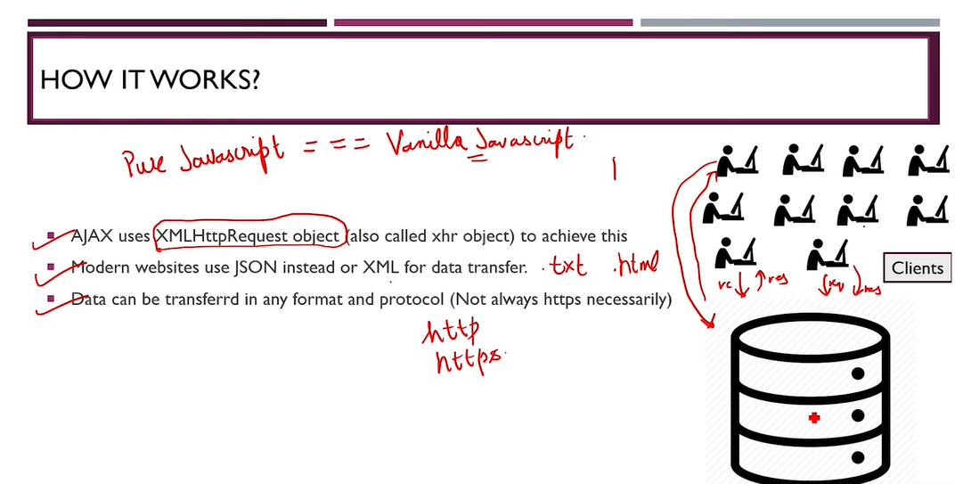


Slide 7
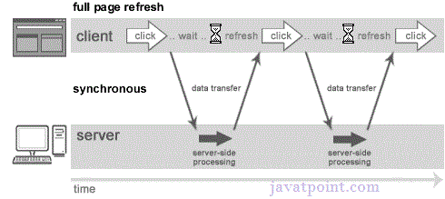
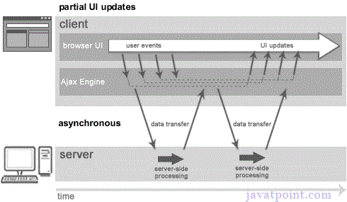
What is the difference between synchronous and asynchronous requests?
Synchronous request blocks the user until a response is retrieved whereas asynchronous doesn't block the user.
Synchronous Request Asynchronous Request

Slide 8
What is the purpose of XMLHttpRequest?
Property | Description
onReadyStateChange | It is called whenever readystate attribute changes. It must not be used with synchronous requests.
readyState | represents the state of the request. It ranges from 0 to 4.0 UNOPENED open() is not called. 1 OPENED open is called but send() is not called. 2 HEADERS_RECEIVED send() is called, and headers and status are available. 3 LOADING Downloading data; responseText holds the data. 4 DONE The operation is completed fully.
reponseText | returns response as text.
responseXML | returns response as XML
Interact with servers asynchronously.
It sends data in the background to the server.
It requests data from the server.
It receives data from the server.
It updates data without reloading the page.

Slide 9
XMLHttpRequest Properties
onreadystatechange
An event handler for an event that fires at every state change.
readyState
The readyState property defines the current state of the XMLHttpRequest object.
readyState = 0 After you have created the XMLHttpRequest object, but before you have called the open() method.
readyState = 1 After you have called the open() method, but before you have called send().

Slide 10
XMLHttpRequest Properties
readyState = 2 After you have called send().
readyState = 3 After the browser has established a communication with the server, but before the server has completed the response.
readyState = 4 After the request has been completed, and the response data has been completely received from the server.
responseText
Returns the response as a string.

Slide 11
Methods of XMLHttpRequest object
Method | Description
void open(method, URL) | opens the request specifying get or post method and url.
void open(method, URL, async) | same as above but specifies asynchronous or not.
void open(method, URL, async, username, password) | same as above but specifies username and password.
void send() | sends get request.
void send(string) | send post request.
setRequestHeader(header,value) | it adds request headers.

Slide 12
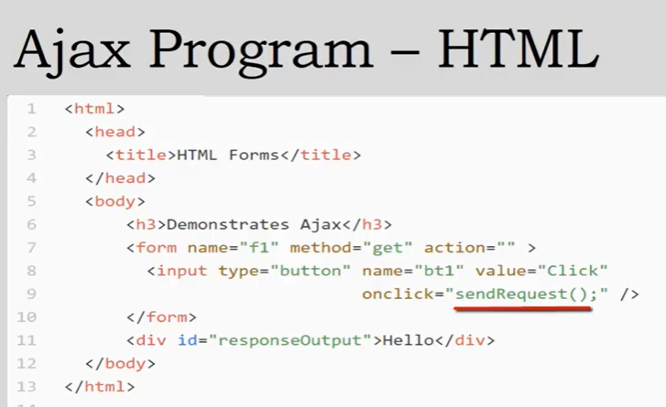
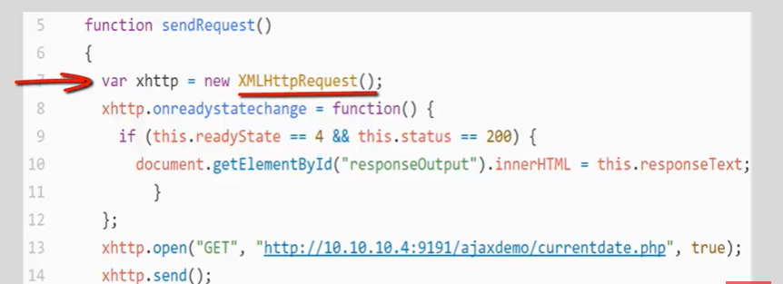

Slide 13
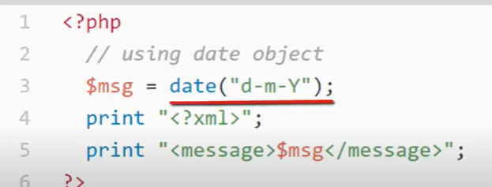

Slide 14
Status property
1xx: Information
3xx: Redirection
Message: | Description:
100 Continue | The server has received the request headers, and the client should proceed to send the request body
300 Multiple Choices | A link list. The user can select a link and go to that location. Maximum five addresses
301 Moved Permanently | The requested page has moved to a new URL
302 Found | The requested page has moved temporarily to a new URL
2xx: Successful
200 OK | The request is OK (this is the standard response for successful HTTP requests)
201 Created | The request has been fulfilled, and a new resource is created
202 Accepted | The request has been accepted for processing, but the processing has not been completed

Slide 15
Status property
5xx: Server Error
Message: | Description:
500 Internal Server Error | A generic error message, given when no more specific message is suitable
501 Not Implemented | The server either does not recognize the request method, or it lacks the ability to fulfill the request
4xx: Client Error
Message: | Description:
400 Bad Request | The request cannot be fulfilled due to bad syntax
403 Forbidden | The request was a legal request, but the server is refusing to respond to it
404 Not Found | The requested page could not be found but may be available again in the future

Slide 16
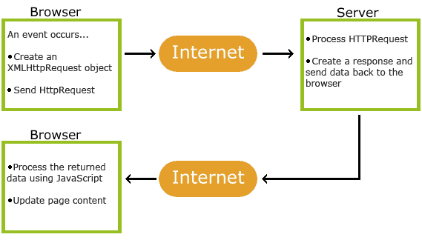

Slide 17
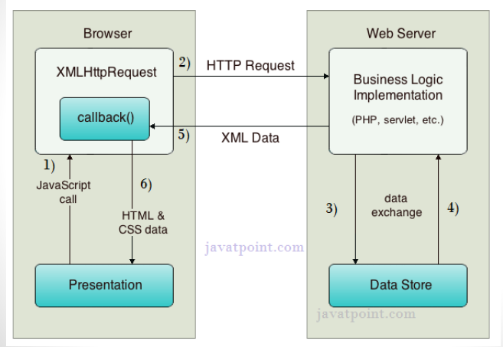
How AJAX Works

