Slide 1

1st REVIEW
Smart Library Database Engineering and Student Services Portal
A.Bhavika Pawar | 2520030616
Harini Brundavanam | 2520030384
Hitesh Reddy | 2520030420
Under the Guidance
of
Dr.Y Subbarayudu
Assitant Professor
Department of Computer Science and Engineering
KONERU LAKSHMAIAH EDUCATION FOUNDATION

Slide 2
GROUP NUMBER:1
Name of Candidate | Role
Harini Brundavanam | Frontend & Backend
A. Bhavika Pawar | PPT, ER Diagrams, SQL
Hitesh Reddy | Offline Caching, Notifications and Testing

Slide 3
ABSTRACT
The Smart Library Management System is a web-based application developed to simplify and organize the major activities involved in library management. The system provides separate functionalities for students and administrators, allowing students to search for books, view book details, borrow and reserve books, return books, track due dates, extend eligible borrowing periods, and monitor fines. Administrators can manage books, categories, students, borrowing records, reservations, fines, and library reports through a dedicated portal.
The system is developed using React, Node.js, Express.js, and MySQL, providing a structured and centralized way to manage library information. Since the frontend, backend, and database can run locally on a computer, the core functionality of the system can operate without continuous internet connectivity after the initial setup. This makes the system useful for educational institutions and local library environments where reliable internet access may not always be available.

Slide 4
INTRDOUCTION
Libraries manage a large amount of information every day, including book details, student records, borrowing and return activities, reservations, due dates, and fines. When these activities are handled manually, maintaining accurate records can become difficult as the number of books and users increases. Students may also have to depend on library staff to check book availability, borrowing status, due dates, or fine information.
The Smart Library Management System provides a centralized digital platform to address these difficulties. It brings important library operations together in a single application and provides different interfaces according to the user's role. The system aims to make library services more organized, accessible, and efficient while reducing unnecessary manual record-keeping.

Slide 5
EXISTING SYSTEM
In the existing traditional system, libraries commonly depend on manual registers, spreadsheets, or separate records to maintain information about books and students. Borrowing and returning books, checking availability, maintaining reservation records, and tracking fines may require direct involvement from library staff. As the amount of data grows, maintaining and updating these records can become time-consuming.
Students may also face difficulties in quickly accessing information about available books, current borrowings, due dates, reservations, and fines. Manual systems provide limited automation and can make it harder to maintain a complete and easily accessible history of library activities.

Slide 6
PROBLEM
Managing library operations manually can result in difficulties while maintaining accurate book and student records, tracking borrowing and return activities, managing reservations, and monitoring overdue books and fines. The increasing number of books and students makes it more challenging for library staff to maintain records efficiently and provide updated information to users.
There is therefore a need for a centralized and organized library management system that can automate common library activities and provide students and administrators with easy access to relevant information. The system should also be capable of operating locally so that essential library functions do not depend on continuous internet connectivity.

Slide 7
SOLUTION(Contribution)
The proposed Smart Library Management System provides a centralized platform for digitally managing important library activities. Students can search and explore books, view availability, borrow books, make reservations, return books, monitor due dates, extend eligible borrowing periods, and check their fines. The system also provides reminders for approaching due dates and displays borrowing history.
For administrators, the system provides tools to add, update, and delete books, manage categories, view students, monitor borrowing and reservation activities, manage fines, update due dates, and generate reports. The application uses a local MySQL database with a Node.js and Express.js backend, allowing the system's core operations to function locally without requiring continuous internet access.

Slide 8
Objectives
The primary objective of the Smart Library Management System is to provide a centralized and user-friendly platform for managing library activities efficiently. It aims to reduce manual work involved in maintaining book records, student information, borrowing details, reservations, returns, and fines.
The system also aims to improve accessibility for students by allowing them to independently view and manage their library activities. For administrators, it provides better control and visibility over library operations. Another important objective is to provide a locally deployable system that can perform essential operations without continuous internet connectivity.

Slide 9
Modules
Member Management | ER Modelling, DDL, Constraints, DML
Book & Asset Management | ER Modelling, Normalisation, DDL, Indexing, SQL Queries
Borrowing Management | Relationships, Joins, DML, Transactions, ACID
Reservation Management | Relationships, Constraints, DML, Transactions
Fine Management | DML, Aggregates, Procedures, Triggers
Search & Reports | Joins, Subqueries, CTEs, Aggregates, Window Functions, Indexing
Member History | Joins, Views, Aggregates
Admin Management | DDL, DML, Constraints, Transactions

Slide 10
SOFTWARE REQUIREMENTS
Windows 10/11 – Operating system for developing and running the project.
Visual Studio Code – Used for writing, editing, and managing the project code.
React.js – Used to develop the frontend and user interface of the web portal.
Node.js – Used to run the backend application and server-side JavaScript.
Express.js – Used to create the backend server and REST APIs.
MySQL – Used to store and manage student, book, and borrowing records.
MySQL Workbench – Used to create, manage, and visualize the MySQL database.
Postman – Used to test and verify the backend APIs.
Git & GitHub – Used for version control and collaboration among team members.
Google Chrome – Used to run, test, and debug the web application.

Slide 11
CONCLUSION AND FUTURE SCOPE
The Smart Library Management System provides a structured digital solution for managing the major activities of a library. By integrating book management, borrowing, reservations, returns, due-date tracking, fine management, and administrative reports into one platform, the system reduces dependence on manual record-keeping and makes information easier to manage.
The system provides separate student and administrator functionalities, improving the overall organization of library operations. Its React-based interface, Node.js and Express.js backend, and MySQL database provide a complete full-stack solution, while its ability to run locally makes it suitable for academic and institutional environments where continuous internet connectivity is not required.

Slide 12
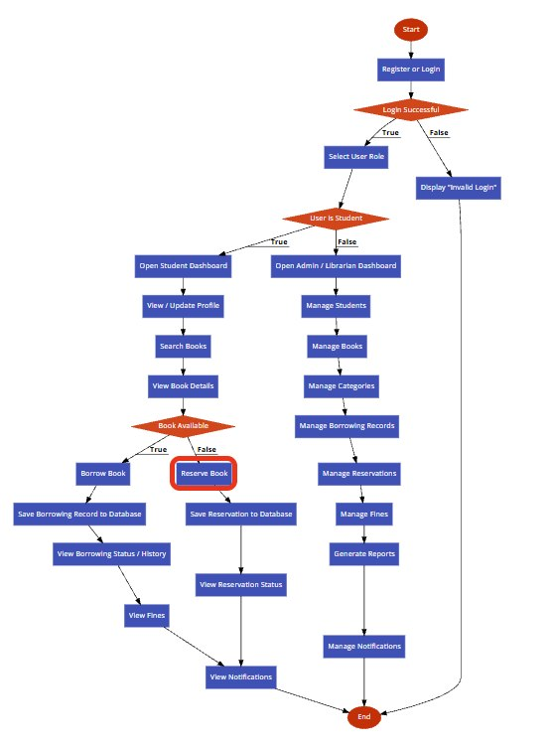

Slide 13
THANK YOU

