Slide 1
ZERO TO ONE · POCKET FM × OPENAI × LIGHTSPEED · IIM BANGALORE
Kahani
Multi-agent production studio for serialized audio entertainment.
What we built · how the agents work · Databricks-backed context & cast retrieval.
THEME
T-04 Creator Tools · T-01 / T-02
CORE
7 specialized agents in one pipeline
DEMO
Listen → simulate → human publish

Slide 2
01 WHAT WE BUILT
An end-to-end studio — from story hook to publishable episode package
Not a chat wrapper: human-gated production stages with agent orchestration.
Shipped surfaces
• Project workspace with context attachments
• Agent chat: discover, pitch, generate, approve
• LangGraph run → structured script package
• Voice + SFX mix (ElevenLabs / Sarvam)
• Companion visuals + cover art
• Web timeline editor (stems, markers, listen)
• Audience simulation (audit + personas + patches)
• Episode assembly → S3 artifact package
ENTRY
Project + prompt + attachments
GATES
Script → Audio → Visuals → Cover → Assembly
LANGUAGES
Hindi + English (library voices)
RUNTIME
Docker Compose · API · Worker · Redis
Kahani · Zero to One × Pocket FM · IIM Bangalore
02 / 09

Slide 3
02 TECH STACK
Production stack — including Databricks for vector retrieval
Same stack we run in Compose locally and wire for cloud deploy.
Application
• React 19 · TypeScript · Vite · Tailwind
• FastAPI · SQLAlchemy async · Alembic
• ARQ workers on Redis
• LangGraph + Postgres checkpointer
AI & media
• LLM: OpenAI / Anthropic (Script Writer)
• TTS: ElevenLabs + Sarvam (Hindi)
• Images: OpenAI · Gemini (fallback)
• Research: Tavily web crawl
Data & infra
• Postgres 16 · Redis 7
• Databricks AI Search (project RAG)
• Databricks Vector Search (cast catalog)
• S3 artifacts · Docker · AWS / Terraform
Databricks in the loop
AI Search indexes story attachments for grounded scripting. Vector Search retrieves cast / voice assets and shot templates — so agents don’t invent casting or visuals from thin air.
Kahani · Zero to One × Pocket FM · IIM Bangalore
03 / 09

Slide 4
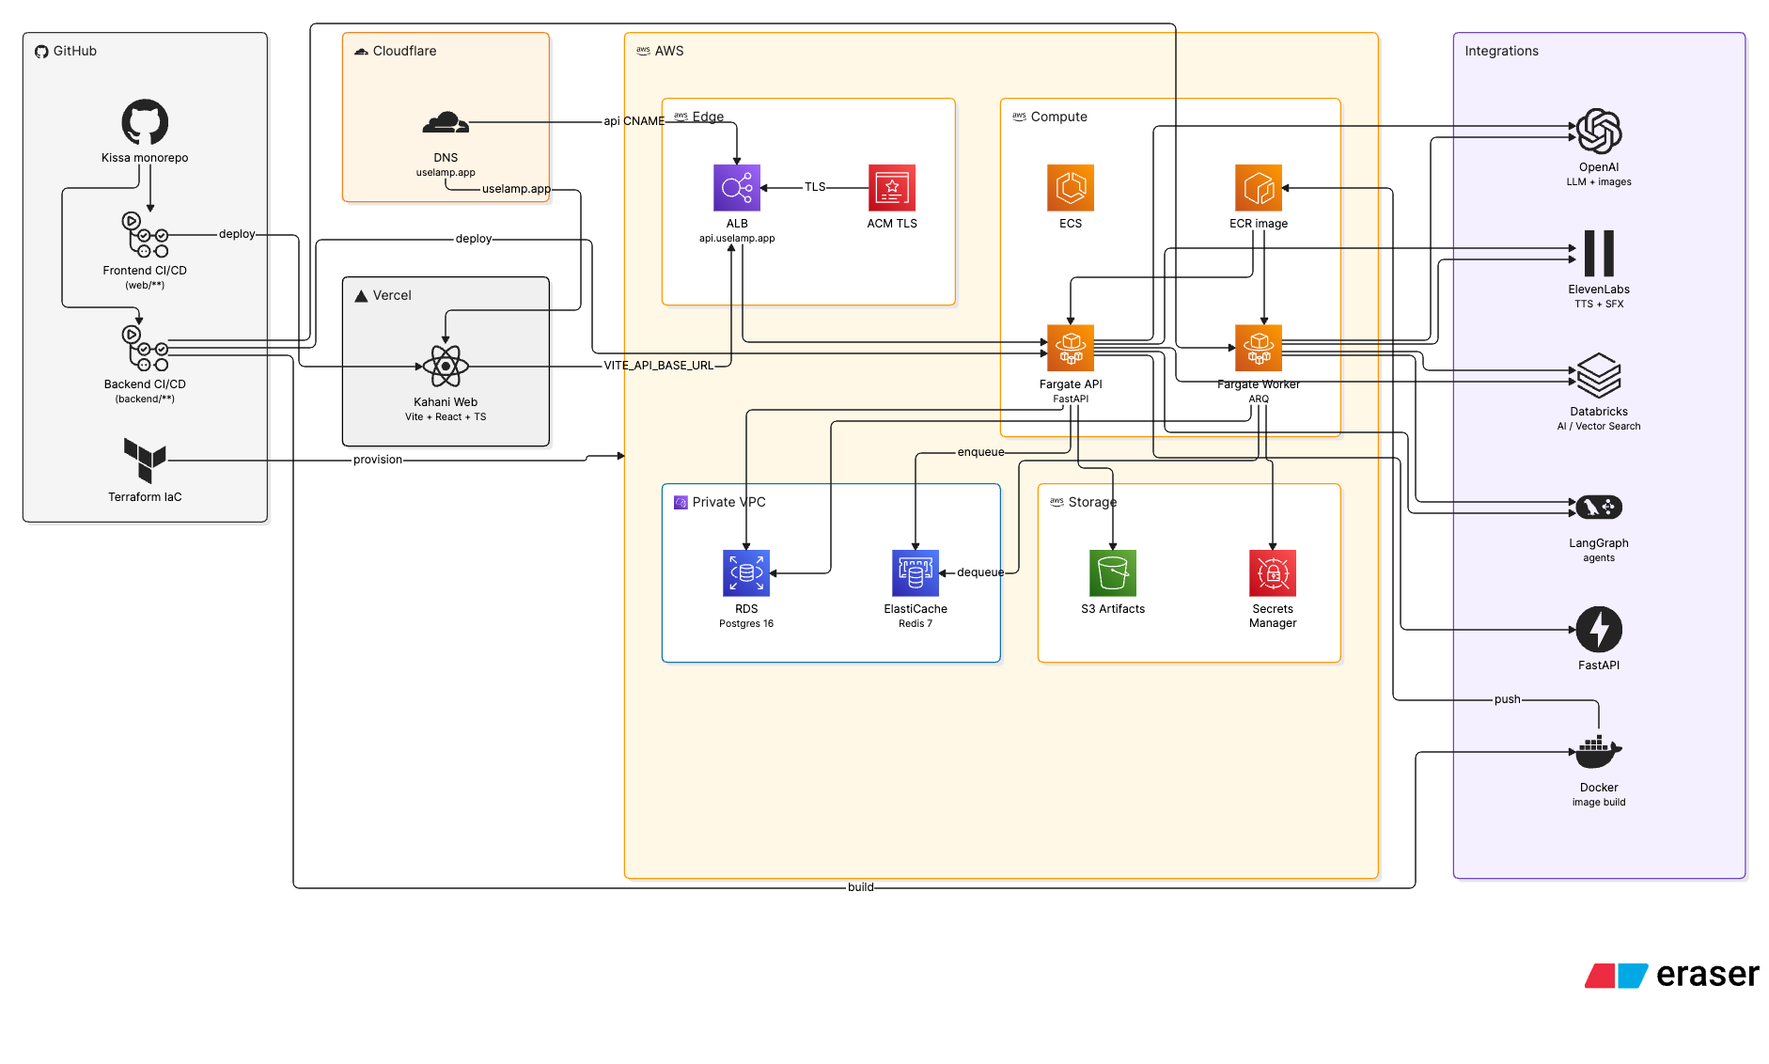
03 ARCHITECTURE
GitHub → edge → AWS → agents & media APIs
Vercel web · Cloudflare DNS · ALB/ECS Fargate · RDS · Redis · S3 · Secrets.
Kahani · Zero to One × Pocket FM · IIM Bangalore
04 / 09

Slide 5
04 PROBLEM
Serial audio wins on part-to-part retention. Production is still fragmented.
Pocket FM–class storytelling needs speed, cultural specificity, and pre-publish signal.
Idea → script is slow
Regional authenticity is the moat. Generic LLM drafts sound thin.
Episodes don’t chain
Weak cliffhangers → drop-off after part one.
Audio assembly is manual
Voice, SFX, and visuals are synced by hand across tools.
No pre-publish signal
Teams guess which cohorts will continue listening.
No closed loop
Wins on one story don’t systematically improve the next.
Tool sprawl
Briefing, writing, casting, mix, and QA live in five apps.
Kahani · Zero to One × Pocket FM · IIM Bangalore
05 / 09

Slide 6
05 HOW IT WORKS
One orchestrated pipeline — agents specialize, humans gate quality cliffs
Auto-run generation. Never auto-publish.
1
Discover
2
Research
3
Script
4
Narrate
5
Voice
6
Visuals
7
Edit
8
Simulate
GROUND
Attachments → Databricks AI Search. Cast & templates → Vector Search. Optional Tavily crawl for fresh hooks.
WRITE
Storytelling + Script Writer produce a structured multi-part package with cliffhangers and narration plan.
PRODUCE
Voice agent renders TTS + SFX. Director + Image agents build companion visuals and cover art.
ASSURE
Timeline editor for listen/edit. Audience Sim proposes patches. Human approves each gate.
Kahani · Zero to One × Pocket FM · IIM Bangalore
06 / 09

Slide 7
06 AGENTS
Seven specialized agents — one production studio
Each owns a stage; the orchestrator sequences them with human approvals.
Storytelling Agent
Shapes the series brief, plot pitches, and creative direction inside chat.
Scripting & Search Agent
Retrieves project context (Databricks) and researches hooks (Tavily + extraction).
Narrative Agent
Locks narration mode — narration-led, dialogue inserts, multi-narrator, framed.
Script Writer Agent
Writes the structured multi-part script package and screenplay.
Director Agent
Plans visual shots / lookbook — performance-aware scene direction.
Voice Agent
Casts library voices and renders TTS + SFX beds (ElevenLabs / Sarvam).
Image Agent
Generates companion stills, cover art, and visual track assets.
Kahani · Zero to One × Pocket FM · IIM Bangalore
07 / 09

Slide 8
07 AGENT HANDOFF
Who does what in sequence
Search grounds truth → writers lock story → voice & image produce → humans decide.
Storytelling
Chat director
Plot pitches, series intent, route generate / rewrite
Scripting & Search
RAG + crawl
Databricks chunks · Tavily research · SOURCE assembly
Narrative + Script Writer
Script package
Narration config + multi-part screenplay + cliffs
Voice
Audio stems
Cast match (Vector Search) · TTS · SFX mix
Director + Image
Visual track
Shot plan · lookbook · stills · cover art
Human + Audience Sim
Quality gate
Approve stages · listen in editor · apply patches
Kahani · Zero to One × Pocket FM · IIM Bangalore
08 / 09

Slide 9
THANK YOU
Kahani
Seven agents. One timeline. Human publish. Built for Pocket FM–scale serial production.
ASK
Pilot with a Pocket FM–style content pod
PROOF
Live demo: generate → listen → simulate
CONTACT
Add team names and emails here
Stack highlight
LangGraph · FastAPI · React · ElevenLabs/Sarvam · Gemini/OpenAI · Tavily · Databricks AI Search & Vector Search · S3 · Docker
Kahani · Zero to One × Pocket FM · IIM Bangalore
09 / 09

