Slide 1
Introduction to GIS

Slide 2
What is GIS?
G stands for geographic, so GIS has something to do with geography.
I stands for information, so GIS has something to do with information, namely geographic information.
S stands for system, so GIS is an integrated system of geography and information tied together.

Slide 3
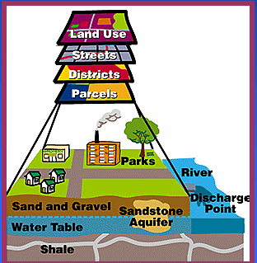
What is GIS?
•A computer system for
-collecting,
-storing,
-manipulating,
-analyzing,
-displaying, and
-querying geographically related information.

Slide 4
Definitions of GIS
GIS is a particular form of Information System applied to geographical data.
GIS is a computer based tool that analyzes, stores, manipulates and visualizes geographic information on a map.
A Geographic Information System is a system of computer software, hardware and data, and the personnel that make it possible to enter, manipulate, analyze, and present information that is tied to a location on the earth’s surface.

Slide 5
History of GIS
The first GIS was created by Dr. Roger Tomlinson and then introduced in the early 1960’s in Canada.
It was meant for collecting, storing and then analyzing the capability and potential which the land in the rural areas had.
But it had many limitations.
By the end of the 80’s, GIS became popular in other related fields too and led to the growth of GIS too.
The advent of GUI, powerful hardware and software, public digital data enhanced the range of GIS applications and bought GIS to mainstream in 1990’s.

Slide 6
GIS Applications
Natural resource-based
wildlife habitat analysis, migration routes planning
Natural Resource Management
Land Use Planning
Natural Hazard assessment
Environmental impact analysis (EIA)
Groundwater modeling and contamination tracking
Street network-based
address matching - finding locations given street addresses
vehicle routing and scheduling
location analysis, site selection
development of evacuation plans

Slide 7
Land parcel-based
Zoning, subdivision plan review
Land record management
environmental impact statements
water quality management
maintenance of ownership
Facilities management
locating underground pipes, cables
balancing loads in electrical networks
planning facility maintenance
Others
Crime analysis
Market analysis
Location based services
In car navigation system

Slide 8
Who Uses GIS?
Planning Strategies
Police and Law Enforcement Agencies
Foresters
Industry
Environmental Engineers
Real Estate Professionals
Telecommunications Professionals
Emergency Response Organizations
Local and Federal Government
Health
Transportation
Geographers
Market Developers

Slide 9
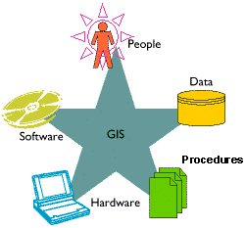
GIS components
Computer system
Hardware
Software
Geographic data
People to carry out various management and analysis tasks

Slide 10
Hardware – it is the computer on which a GIS operates
Software – it provides functions and tools needed to input and store, query, performs analysis, and displays geographic information in the form of maps or reports. All GIS software packages rely on an underlying database management system (DBMS) for storage and management of the geographic and attribute data.

Slide 11
Data - Data is one of the most important, and often most expensive, components of a GIS.
It is entered into a GIS using a technique called digitizing.
Digitizing is done by tracing the location, path or boundary of geographic features either on a computer screen using a scanned map in the background, or a paper map that is attached to a digitizing tablet.
Even data is available for free or for purchase from the data provider or from a spatial data clearinghouse.

Slide 12
GIS & GPS
GPS stands for Global Positioning System, which is a system of satellites, ground stations, and receivers that allow you to find your exact location on Earth.
A Global Positioning System (GPS) is a tool used to collect data for a GIS.

Slide 13
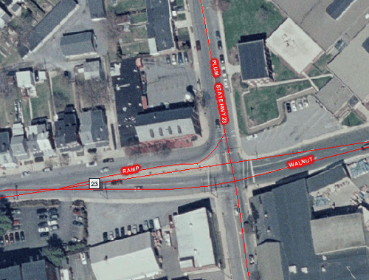
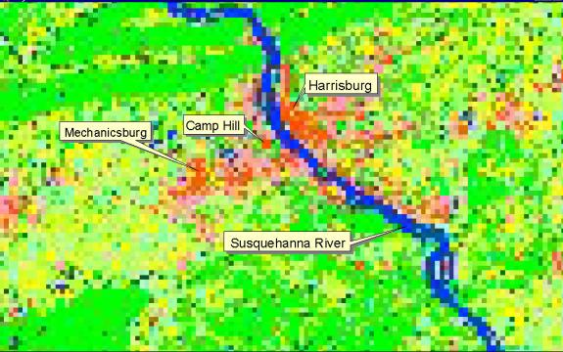
GIS Data Types
Raster Data - In a GIS, raster data is a cell-based or grid based representation of map features. Satellite images, aerial photography and scanned images are all stored in raster format.

Slide 14
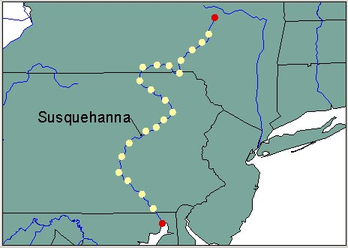
Vector Data - Vectors can be classified into three primary feature types: points, lines and polygons. Vector data is entered into a GIS by digitizing these features from a base map. All vector data is stored as an x,y coordinate, or a series of x,y coordinates.

Slide 15
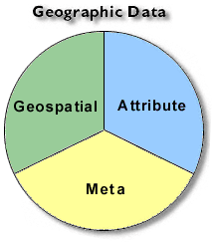
Geographic Data or Geospatial Data
It is used to indicate that data, that has geographic component to it (have locational information tied to them)
GIS data is a form of geospatial data.
Geospatial data has two components
Spatial data
Attribute data

Slide 16
Spatial data
Spatial data describes the location of spatial feature, which may be discrete or continuous.
GIS represents these spatial features on the Earth’s surface whereas map features on a plane surface.
Projection is the process that transform the Earth’s spherical surface to a plane surface.
Vector data model uses points and their co-ordinates to construct spatial features. Ideal for discrete features.
Raster data model uses grid and grid cells to represent spatial features. Ideal for continuous features.

Slide 17
Data structure
Raster data model uses a simple data structure with rows and columns.
Vector data model may be Georelational or object based, may or may not involve topology.
Georelational Data Model – uses a split system to store spatial data and attribute data.
Object Based Data Model – stores spatial and attribute data in a single system.
Topology – it expresses explicitly the spatial relationship between features. (e.g. two roads meeting at a point)

Slide 18
Attribute data
Attribute data describes the characteristics of spatial features.
For raster data each cell has a value that correspond to the attribute at that location.
For vector data, the amount of attribute data can vary.

Slide 19
Joining spatial and attribute data
In Georelational data Model the two components are linked through the feature ID’s.

Slide 20
GIS Operations
Spatial Data Input –
Data entry using existing data and creating new data
Editing removes digitizing errors
Geometric Transformation converts a newly digitized map, which has the same physical dimension as its source map, into a real world coordinate system.
Attribute data management
An attribute table is organized by row and column.
Each row represents a special feature and each column describes a characteristics
It includes adding or deleting fields and creating new fields from existing fields.

Slide 21
Data display
Maps are prepared for data visualization and presentation.
Map has a number of elements title, sub title, body, legend, north arrow, scale bar, acknowledgement and border.
Data exploration
It involves exploring the general trends in the data, taking a closer look at data subsets, and focusing on data relationship between data sets.
Data analysis
GIS packages include basic analytical tools such as buffering, overlay etc.

