Slide 1
Data in Nexus file

Slide 2
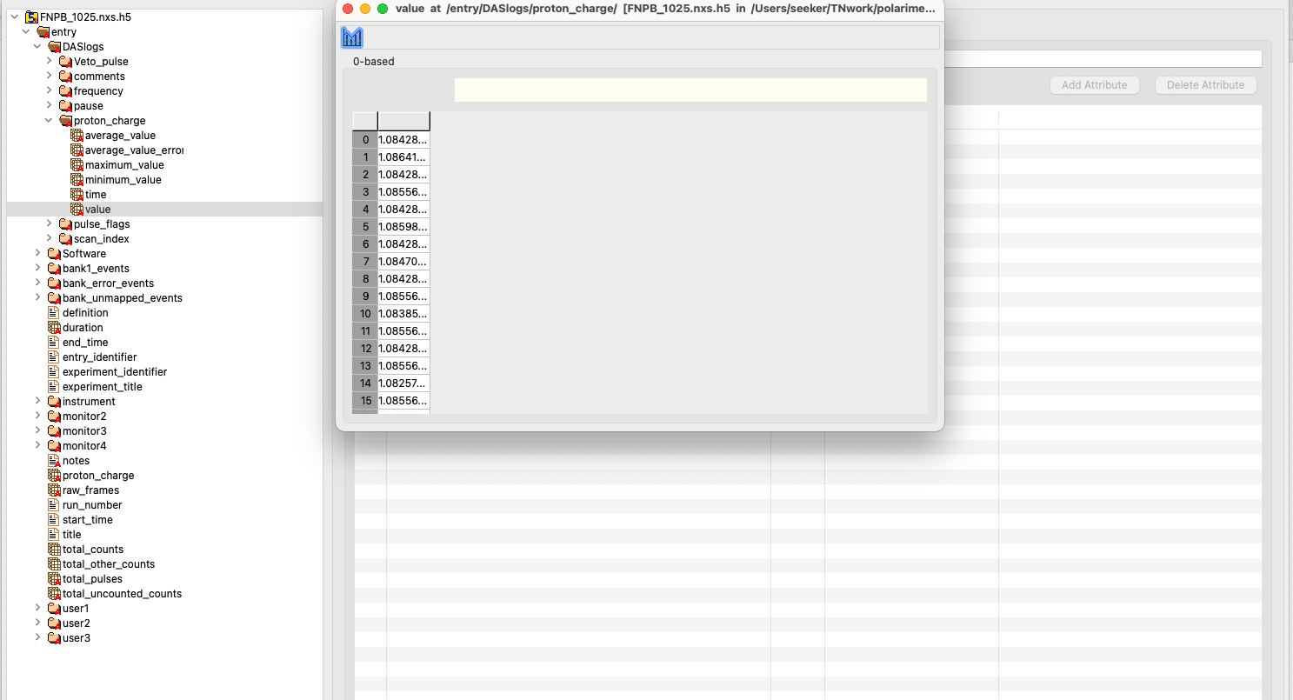
Proton charge
Proton charge for each T0
is stored here

Slide 3
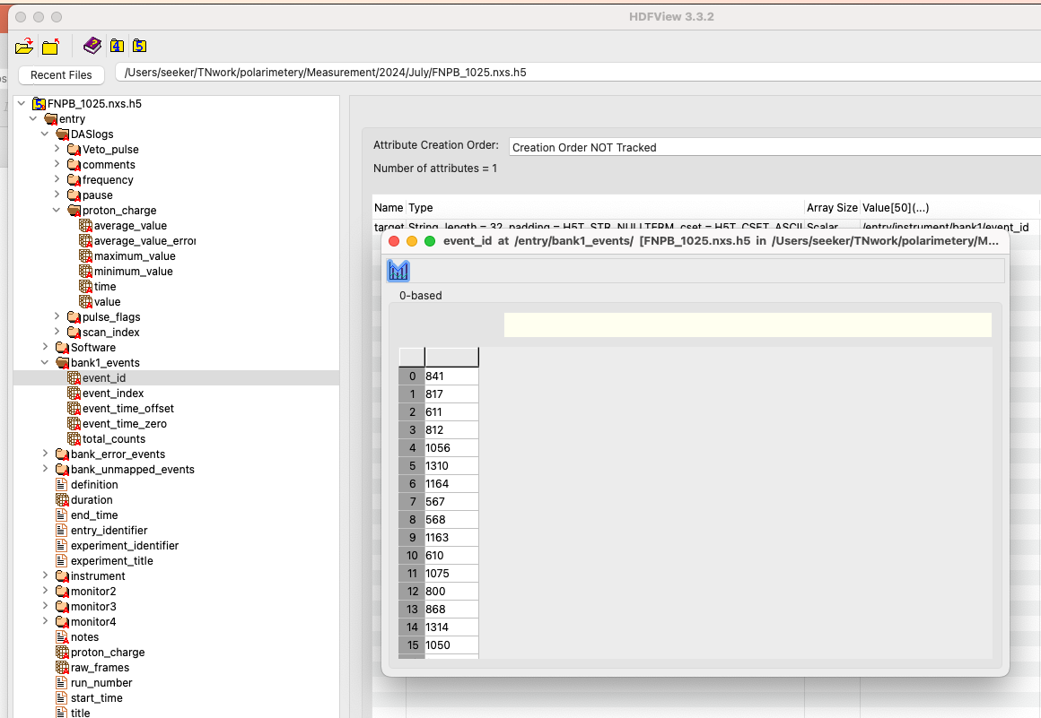
Neutron Events
Neutron events are stored in bank1_events
event_id = pixel on tube(0-255 tube 1,
256-511 taube 2,
and so on)
event_time_offset = time of neutron event from
T0 for that event
event_time_zero = list of T0 pulse times from
start of run
event_index = list of neutron event_id for which new
T0 started

Slide 4
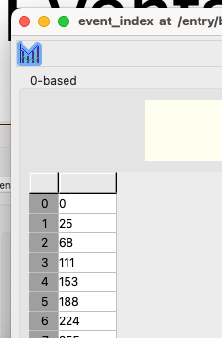
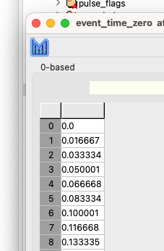
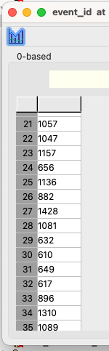
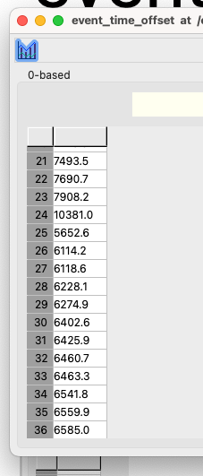
Calculation of absolute time and location
Lets calculate for 21st event in event_id list:
from event_index, we get all events till 25 belongs to the first T0:
and the time offset for that event is 7493.5 microseconds
so abs time = 0+7493.5 us
and pix hit is : 1057 that is tube 5 and 34th pixel
1057 = 256*4-1+34
Same calculation for 32nd pixel will tell:
from event_index, we get all events from 25 till 38 belongs to the second T0:
and the time offset for that event is 6460.7 microseconds
so abs time = 0.01667ms + 6460.7 us
and pix hit is : 617 that is tube 3 and 106th pixel
617 = 256*2-1+106

Slide 5
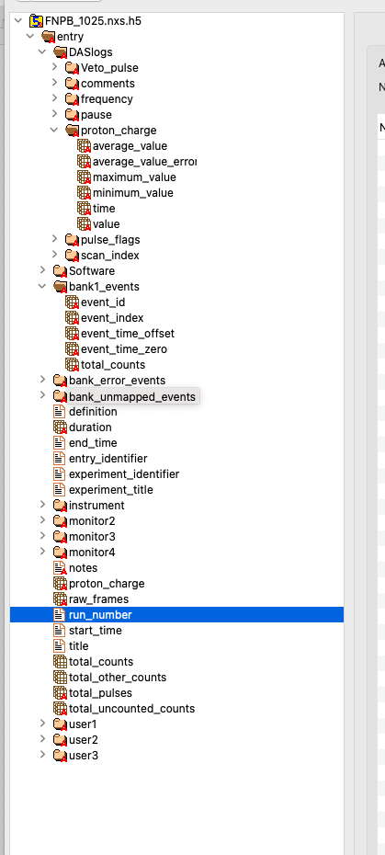
Other information
File also contains other information such as
Run Number
Duration
Start and end time
total counts
total T0
etc…

