Slide 1

BTIT603: Cyber and Network Security
Botnet
1
Lokendra Vishwakarma, Assistant Professor, SVIIT-SVVV, Indore

Slide 2
Botnets have become one of the biggest threats to security systems today. Their growing popularity among cybercriminals comes from their ability to infiltrate almost any internet-connected device, from DVR players to corporate mainframes.
Botnets are also becoming a larger part of cultural discussions around cyber security. Facebook’s fake ad controversy and the Twitter bot fiasco during the 2016 presidential election worry many politicians and citizens about the disruptive potential of botnets. Recently published studies from MIT have concluded that social media bots and automated accounts play a major role in spreading fake news.
Aside from being tools for influencing elections and mining cryptocurrencies, botnets are also dangerous to corporations and consumers because they’re used to deploy malware, initiate attacks on websites, steal personal information, and defraud advertisers.
It’s clear botnets are bad, but what are they exactly? And how can you protect your personal information and devices?
2
Lokendra Vishwakarma, Assistant Professor, SVIIT-SVVV, Indore
Notes:
2

Slide 3
What is Botnet?
To better understand what botnets are and how botnets function, consider that the name itself is a blending of the words “robot” and “network”. In a broad sense, that’s exactly what botnets are: a network of robots used to commit cyber crime.
The term botnet is derived from the words robot and network. A bot in this case is a device infected by malware, which then becomes part of a network, or net, of infected devices controlled by a single attacker or attack group. The cyber criminals controlling them are called botmasters or bot herders.
Botnets are the workhorses of the Internet. They’re connected computers performing a number of repetitive tasks to keep websites going.
3
Lokendra Vishwakarma, Assistant Professor, SVIIT-SVVV, Indore

Slide 4
What you need to be careful of are the illegal and malicious botnets. What happens is that botnets gain access to your machine through some piece of malicious coding. In some cases, your machine is directly hacked, while other times what is known as a “spider” (a program that crawls the Internet looking for holes in security to exploit) does the hacking automatically.
More often than not, what botnets are looking to do is to add your computer to their web. That usually happens through a drive-by download or fooling you into installing a Trojan horse on your computer. Once the software is downloaded, the botnet will now contact its master computer and let it know that everything is ready to go. Now your computer, phone or tablet is entirely under the control of the person who created the botnet.
4
Lokendra Vishwakarma, Assistant Professor, SVIIT-SVVV, Indore

Slide 5
Once the botnet’s owner is in control of your computer, they usually use your machine to carry out other nefarious tasks. Common tasks executed by botnets include:
Using your machine’s power to assist in distributed denial-of-service (DDoS) attacks to shut down websites.
Emailing spam out to millions of Internet users.
Generating fake Internet traffic on a third-party website for financial gain.
Replacing banner ads in your web browser specifically targeted at you.
Pop-ups ads designed to get you to pay for the removal of the botnet through a anti-spyware package.
The short answer is that a botnet is hijacking your computer to do what botnets do -- carry out mundane(boring, tedious) tasks -- faster and better.
5
Lokendra Vishwakarma, Assistant Professor, SVIIT-SVVV, Indore

Slide 6
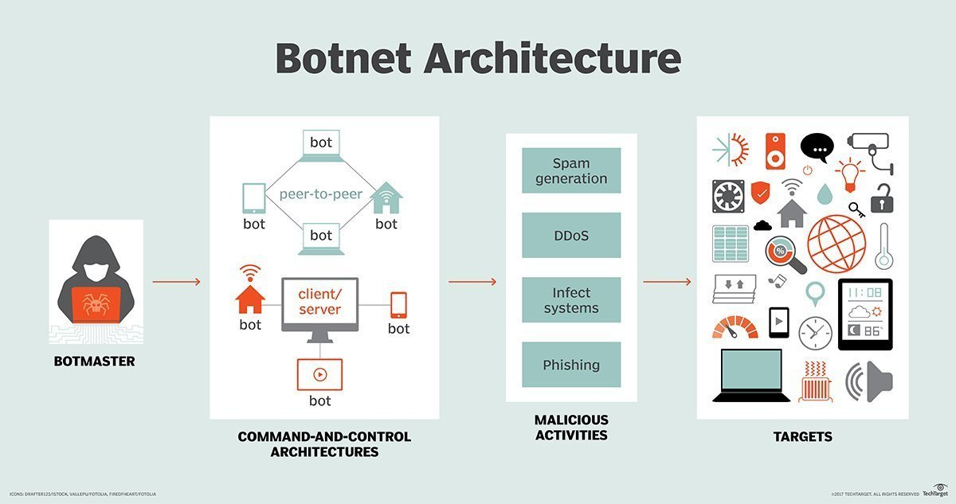
Source of image: https://searchsecurity.techtarget.com/definition/botnet
6
Lokendra Vishwakarma, Assistant Professor, SVIIT-SVVV, Indore

Slide 7
Once the desired number of devices is infected, attackers can control the bots using two different approaches. The traditional client/server approach involves setting up a command-and-control (C&C) server and sending automated commands to infected botnet clients through a communications protocol, such as internet relay chat (IRC). The bots are often programmed to remain dormant and await commands from the C&C server before initiating any malicious activities.
The other approach to controlling infected bots involves a peer-to-peer network. Instead of using C&C servers, a peer-to-peer botnet relies on a decentralized approach. Infected devices may be programmed to scan for malicious websites, or even for other devices in the same botnet. The bots can then share updated commands or the latest versions of the botnet malware.
The peer-to-peer approach is more common today, as cybercriminals and hacker groups try to avoid detection by cybersecurity vendors and law enforcement agencies, which have often used C&C communications as a way to monitor for, locate and disrupt botnet operations.
7
Lokendra Vishwakarma, Assistant Professor, SVIIT-SVVV, Indore

Slide 8
How to Protect Yourself From Botnets?
Most people who are infected with botnets aren’t even aware that their computer’s security has become compromised. However, taking simple, common-sense precautions when using the Internet can not only remove botnets that have been installed, it can also prevent them from being installed on your computer, tablet and phone in the first place.
Always update your computer’s operating system as early as possible. Hackers often utilize known flaws in operating system security to install botnets. You can even set your computer to install updates automatically.
The same is true of applications on your computer, phone and tablet. Once weakness are found and announced by software companies, hackers rush to create programs to exploit those weaknesses.
8
Lokendra Vishwakarma, Assistant Professor, SVIIT-SVVV, Indore

Slide 9
How to Protect Yourself From Botnets?
Don’t download attachments or click on links from email addresses you don’t recognize. This is one of the most common vectors for all forms of malware.
Use a firewall when browsing the Internet. This is easy to do with Mac computers, as they come with Firewall software pre-installed. If you’re using a Windows-based machine, you might need to install third-party software.
Don’t visit websites that are known distributors of malware. One of the things that a full-service Internet security suite can do is warn you when you’re visiting such sites. When in doubt, check with Norton Safe Web.
In general, hackers tend to look for low-hanging fruit. If you can mount even basic defenses, botnets and other forms of malware are going to look for easier targets
9
Lokendra Vishwakarma, Assistant Professor, SVIIT-SVVV, Indore

Slide 10
Notable botnet attacks
1. Zeus The Zeus malware, first detected in 2007, is one of the best-known and widely used malware types in the history of information security.
Zeus uses a Trojan horse program to infect vulnerable devices and systems, and variants of this malware have been used for various purposes over the years, including to spread CryptoLocker ransomware.
Initially, Zeus, or Zbot, was used to harvest banking credentials and financial information from users of infected devices. Once the data was collected, attackers used the bots to send out spam and phishing emails that spread the Zeus Trojan to more prospective victims.
In 2009, cybersecurity vendor Damballa estimated Zeus had infected 3.6 million hosts. The following year, the FBI identified a group of Eastern European cybercriminals who were suspected to be behind the Zeus malware campaign; the FBI later made more than 100 arrests in the U.S. and Europe.
The Zeus botnet was repeatedly disrupted in 2010, when two internet service providers that were hosting the C&C servers for Zeus were shut down. However, new versions of the Zeus malware were later discovered.
10
Lokendra Vishwakarma, Assistant Professor, SVIIT-SVVV, Indore

Slide 11
2. Srizbi The Srizbi botnet, which was first discovered in 2007, was, for a time, the largest botnet in the world. Srizbi, also known as the Ron Paul spam botnet, was responsible for a massive amount of email spam -- as much as 60 billion messages a day, accounting for roughly half of all email spam on the internet at the time. In 2007, the Srizbi botnet was used to send out political spam emails promoting then-U.S. Presidential candidate Ron Paul.
The botnet used a Trojan to infect users' computers, which were then used to send out spam. Experts estimated that the Srizbi botnet included approximately 450,000 infected systems.
The cybercriminals behind Srizbi used San Jose, Calif.-based hosting provider McColo for the botnet's C&C infrastructure. The botnet's activity ceased when McColo, which was discovered to be hosting other botnet and spam operations, as well, was shut down in 2008.
11
Lokendra Vishwakarma, Assistant Professor, SVIIT-SVVV, Indore

Slide 12
3. Gameover Zeus Approximately a year after the original Zeus botnet was disrupted, a new version of the Zeus malware emerged, known as Gameover Zeus.
Instead of relying on a traditional, centralized C&C operation to control bots, Gameover Zeus used a peer-to-peer network approach, which initially made the botnet harder for law enforcement and security vendors to pinpoint and disrupt. Infected bots used the domain generation algorithm (DGA) to communicate.
The Gameover Zeus botnet would generate domain names to serve as communication points for infected bots. An infected device would randomly select domains until it reached an active domain that was able to issue new commands. Security firm Bitdefender reported two versions of Gameover Zeus, one of which generated 1,000 new domains, and the other which generated 10,000 new domains each day.
In 2014, international law enforcement agencies took part in Operation Tovar to temporarily disrupt Gameover Zeus by identifying the domains used by the cybercriminals, and then redirecting bot traffic to government-controlled servers.
The FBI also offered a $3 million reward for Russian hacker Evgeniy Bogachev, who is accused of being the mastermind behind the Gameover Zeus botnet. Bogachev is still at large, and new variants of Gameover Zeus have since emerged.
12
Lokendra Vishwakarma, Assistant Professor, SVIIT-SVVV, Indore

Slide 13
4. Methbot An extensive cybercrime operation and ad fraud botnet known as Methbot was revealed in 2016 by cybersecurity services company White Ops. According to security researchers, Methbot was generating between $3 million and $5 million in fraudulent ad revenue daily last year by producing fraudulent clicks for online ads, as well as fake views of video advertisements.
Instead of infecting random devices, the Methbot campaign is run on approximately 800-1,200 dedicated servers in data centers located in both the U.S. and the Netherlands. The campaign's operational infrastructure includes 6,000 spoofed domains, and more than 850,000 dedicated IP addresses, many of which are falsely registered as belonging to legitimate U.S.-based internet service providers.
The infected servers can produce fake clicks and mouse movements, as well as forge social media account logins to appear as legitimate users to fool conventional ad fraud detection techniques. In an effort to disrupt the monetization scheme for Methbot, White Ops published a list of the spoofed domains and fraudulent IP addresses to alert advertisers and enable them to block the addresses.
13
Lokendra Vishwakarma, Assistant Professor, SVIIT-SVVV, Indore

Slide 14
5. Mirai Several powerful, record-setting distributed denial-of-service (DDoS) attacks were observed in late 2016, and they later traced to a new brand of malware known as Mirai. The DDoS traffic was produced by a variety of connected devices, such as wireless routers and CCTV cameras.
Mirai malware is designed to scan the internet for insecure connected devices, while also avoiding IP addresses belonging to major corporations, like Hewlett-Packard and government agencies, such as the U.S. Department of Defense.
Once it identifies an insecure device, the malware tries to log in with a series of common default passwords used by manufacturers. If those passwords don't work, then Mirai uses brute force attacks to guess the password. Once a device is compromised, it connects to C&C infrastructure and can divert varying amounts of traffic toward a DDoS target.
Devices that have been infected are often still able to continue functioning normally, making it difficult to detect Mirai botnet activity from a specific device. For some internet of things (IoT) devices, such as digital video recorders, the factory password is hard coded in the device's firmware, and many devices cannot update their firmware over the internet.
The Mirai source code was later released to the public, allowing anyone to use the malware to compose botnets leveraging poorly protected IoT devices.
14
Lokendra Vishwakarma, Assistant Professor, SVIIT-SVVV, Indore

Slide 15
References:
https://searchsecurity.techtarget.com/definition/botnet.
https://www.pandasecurity.com/mediacenter/security/what-is-a-botnet/
https://us.norton.com/internetsecurity-malware-what-is-a-botnet.html
https://en.wikipedia.org/wiki/Botnet
15
Lokendra Vishwakarma, Assistant Professor, SVIIT-SVVV, Indore

