Slide 1




TITLE PAGE
•Problem Statement Title -Smart Student Assistant using AI
•Theme -Artificial Intelligence
•Team ID - HITBIN34
•Team Name (Registered on Website) -Binary Bros
•Participant Names - A.Hiteshwar
S.Lokesh Varma
Sri Indu College of Engg & Tech - Cyber Club, Department of Cyber Security
Page 01

Slide 2

Smart Student Assistant using AI
Binary
Bros
AI-powered assistant to manage study schedules and remind students of deadlines.
Answers academic questions using a custom-trained knowledge base.
Adapts to individual learning patterns for personalized support.
Integrates with school platforms for real-time updates and smart planning.
Sri Indu College of Engg & Tech - Cyber Club, Department of Cyber Security
Page 02

Slide 3
TECHNICAL APPROACH
Binary
Bros
Programming Languages: Python (for backend, AI/ML), JavaScript (for frontend interactions),TypeScript
Frameworks:React (frontend), TensorFlow or PyTorch (for AI models)
Databases: SupaBase
Tools:Lovable AI
Sri Indu College of Engg & Tech - Cyber Club, Department of Cyber Security
Page 03

Slide 4
FEASIBILITY AND VIABILITY
Binary
Bros
Technically feasible using existing AI, APIs, and cloud platforms.
Challenges: data privacy, academic accuracy, and system integration.
Risk of low user engagement and trust.
Strategies: strong encryption, verified content, modular integration, and intuitive UI.
Focus on user onboarding and feedback to improve adoption.
Sri Indu College of Engg & Tech - Cyber Club, Department of Cyber Security
Page 04

Slide 5
IMPACT AND BENEFITS
Binary
Bros
Empowers students with better time management and academic support.
Reduces stress by automating reminders and simplifying study planning.
Increases academic performance through personalized assistance.
Economically beneficial by reducing the need for external tutoring.
Promotes digital literacy and smart learning habits among students.
Sri Indu College of Engg & Tech - Cyber Club, Department of Cyber Security
Page 05

Slide 6
RESEARCH AND REFERENCES
Binary
Bros
Research on AI in education:
https://www.sciencedirect.com/science/article/pii/S0360131520302199
Use of chatbots in learning environments:
https://ieeexplore.ieee.org/document/8954007
Study schedule optimization using machine learning:
https://arxiv.org/abs/2003.14391
Data privacy in AI-powered student tools:
https://www.ncbi.nlm.nih.gov/pmc/articles/PMC7949374/
Sri Indu College of Engg & Tech - Cyber Club, Department of Cyber Security
Page 06

Slide 7
Binary
Bros
FUTURE ENHANCEMENTS
Voice assistant integration for hands-free interaction.
Multilingual support to assist a diverse range of students.
AI-based performance tracking and personalized study recommendations.
Integration with wearable devices for smart reminders and focus tracking.
Gamification features to boost motivation and engagement.
Sri Indu College of Engg & Tech - Cyber Club, Department of Cyber Security
Page 07

Slide 8
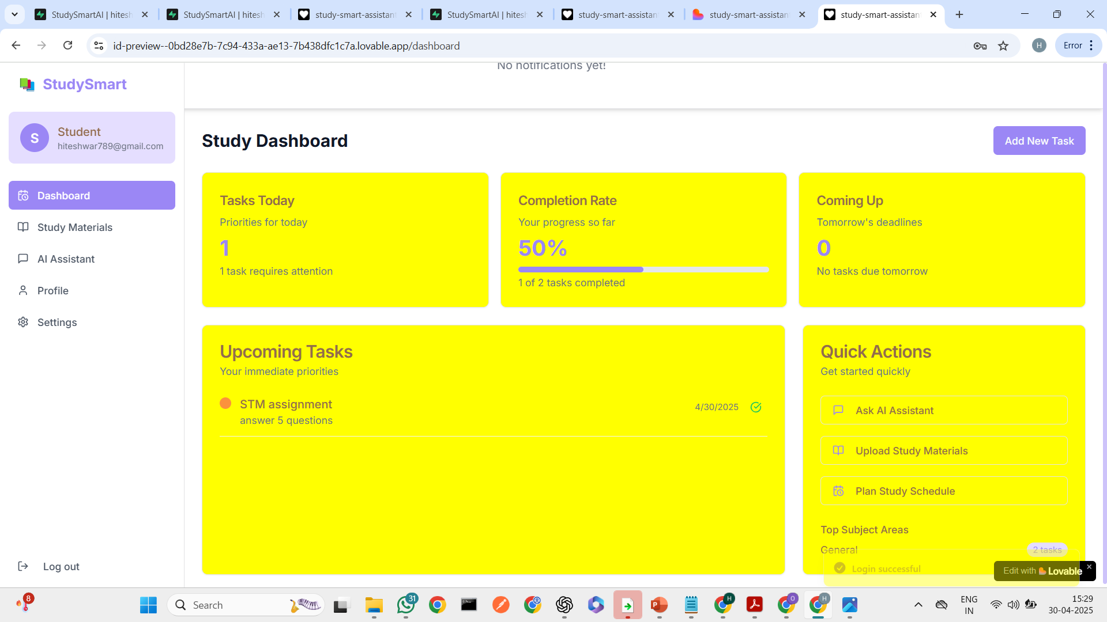
Binary
Bros
DEMO (IF APPLICABLE)
Sri Indu College of Engg & Tech - Cyber Club, Department of Cyber Security
Page 08

Slide 9
Binary
Bros
CONCLUSION & THANK YOU
In conclusion, this AI-powered student assistant helps manage study schedules, reminds of deadlines, and provides academic support by leveraging a custom-trained knowledge base. It aims to enhance learning efficiency and organization for students.
Thank you to the organizers and mentors for their guidance and support throughout this project!
Sri Indu College of Engg & Tech - Cyber Club, Department of Cyber Security
Page 09

