Slide 1
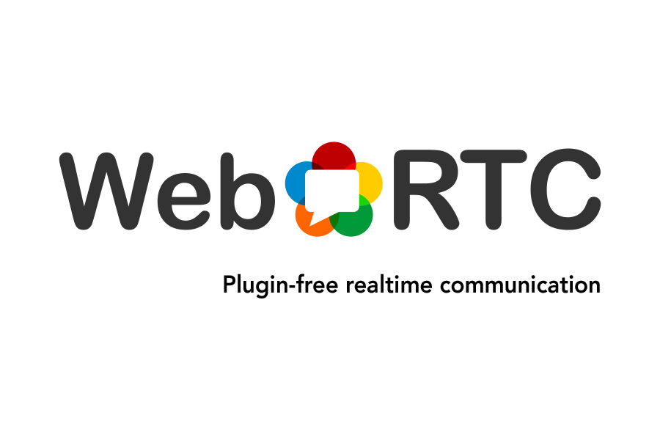

Slide 2


WebRTC : Real-Time Communication for Web
WebRTC is a technology which provides browsers and mobile
applications with Real-Time Communication capabilities with the
help of its components.
WebRTC is a collection of communication protocols and application
programming interfaces (APIs).
WebRTC is a cross-browser and cross-platform technology.
Supported browsers and platforms

Slide 3
WebRTC does a lot of things :
- Get streaming audio, video or other data.
- Get network information such as IP addresses and ports,
and exchange this with other WebRTC clients (known as peers) to enable connection,
even through NATs and firewalls.
- Coordinate signaling communication to report errors and initiate or close sessions.
- Exchange information about media and client capability, such as resolution and codecs.
- Communicate streaming audio, video or any type of arbitrary data.

Slide 4
The WebRTC APIs
WebRTC performs three main tasks –
Acquiring audio and video
Communicating audio and video
Communicating arbitrary data
which are performed by WebRTC three main APIs –
getUserMedia
RTCPeerConnection
RTCDataChannel

Slide 5
getUserMedia
capture audio and video
obtain a media stream with navigator.getUserMedia

Slide 6
RTCPeerConnection
Audio and video communication between peers
Signaling
Codec Handling
Security
Bandwidth management

Slide 7
RTCDataChannel
Bidirectional communication of arbitrary data between peers
uses RTCPeerConnection

Slide 8
Signaling
WebRTC uses RTCPeerConnection to communicate streaming data between peers,
but also needs a mechanism to coordinate communication and to send control messages,
a process known as signaling
Signaling is used to exchange three types of information :
- Session control messages: to initialize or close communication and report errors
- Network configuration: to the outside world, what's my computer's IP address and port
- Media capabilities: what codecs and resolutions can be handled by my browser
and the browser it wants to communicate with

Slide 9
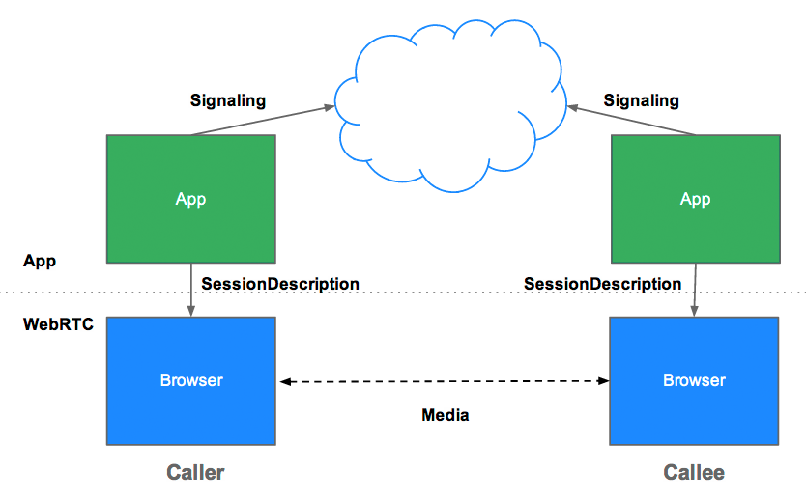
Signaling

Slide 10
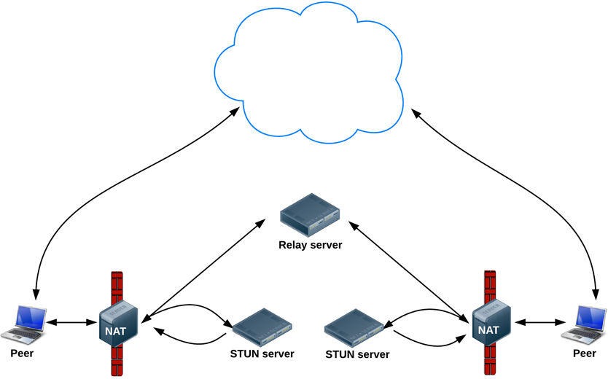
Signaling
WebRTC is designed to work peer-to-peer, so users can connect by the most direct route possible.
However, WebRTC is built to cope with real-world networking :
client applications need to traverse NAT gateways and firewalls,
and peer to peer networking needs fallbacks in case direct connection fails.
As part of this process, the WebRTC APIs use STUN servers to get the IP address of your computer,
and TURN servers to function as relay servers in case peer-to-peer communication fails.

Slide 11
STUN Servers
Session Traversal Utilities for NAT (STUN) :
simple protocol for discovering the server-reflexive address.
– Client: Where do you see me at?
– Server: I see you at 206.123.31.67:55123.
A STUN server is only used during the connection setup and once that session has been established,
media will flow directly between clients.

Slide 12
TURN Servers
If a STUN server cannot establish the connection,
TURN ( Traversal Using Relays around NAT ) comes into picture.
TURN Server allocates some of its resources to the client.
The client then uses the TURN server for the media flow.
It acts as a relay between different peers.
A TURN server provides a relayed address to the clients which is then used
by the clients for communication.
Unlike STUN, TURN remains in between the peers throughout the session.

Slide 13
ICE : Interactive Connectivity Establishment
- A framework for connecting peers
- A combination of STUN and TURN technology
- Tries to find the best path for each call
- First priority is STUN, if STUN fails, it turns to TURN

Slide 14
JavaScript Frameworks
There are many JavaScript frameworks available which implement WebRTC and
provide easy to use APIs to build WebRTC applications
simpleWebRTC ( https://simplewebrtc.com/ )
PeerJS ( http://peerjs.com/ )
easyRTC ( https://easyrtc.com/ )

Slide 15
My Apps
https://hxiicwrtc2.appspot.com ( simpleWebRTC )
https://hxiicwrtc.appspot.com ( PeerJS )

Slide 16
Thank You
- Hitesh Kumar

