Slide 1

Prediction Model for Adverse Drug Reactions Using Deep Learning Methods
Binary ADR classification on MIMIC-IV using MLP, ResNet, Attention & EmbeddingMLP, with a real-time Streamlit clinical dashboard.
MIMIC-IV · BIDMC
PyTorch Deep Learning
Optuna Hyperparameter Tuning
Streamlit Dashboard
DS5500 Data Science Capstone · Spring 2026
Elizabeth Coquillette · Hithaishi Raghavendra Reddy · Ishan Chotalia

Slide 2

Why Does ADR Prediction Matter?
Adverse drug reactions are preventable, but only if we see them coming. Late detection is the core problem: clinical trials miss rare ADR events, and post-market surveillance is slow. By the time a clinician recognizes an ADR, harm has already occurred.
~7%
$136B
Hospital Admissions
Annual US Cost
caused by ADRs globally
from ADR-related harm

Slide 3
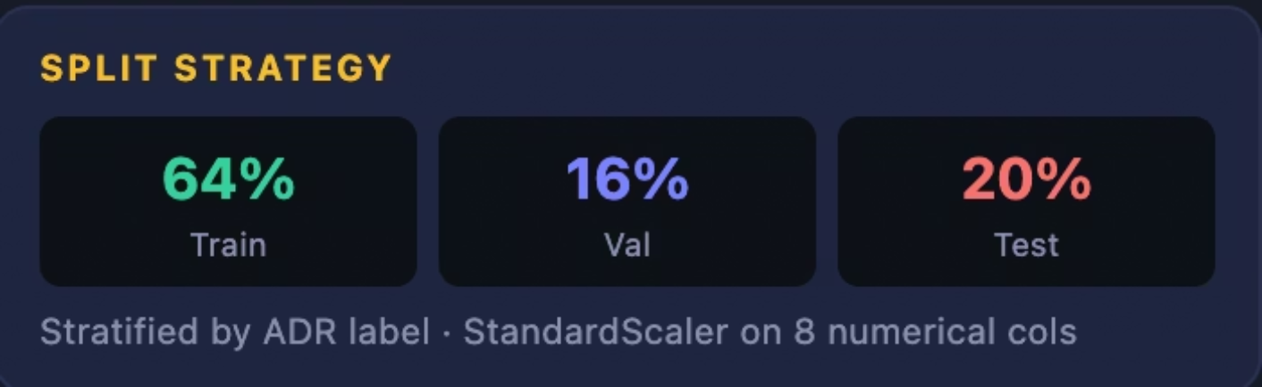
Data Foundation: MIMIC-IV
De-identified EHR data from Beth Israel Deaconess Medical Center, Boston. We built four dataset variants to study the effect of features systematically, with stratified 64/16/20% train/val/test splits and StandardScaler on 8 numerical columns.
Dataset Scale
Core Features (13)
Drug, route, dose value & unit
Patient age, sex, age group
Treatment duration (hours), log dose, drug frequency
Patient admission & prescription count
Expanded Features (+7)
50K+
76K+
Polypharmacy count, renal & liver disease flags (ICD)
Creatinine, ALT, AST lab values · Admission type
Patients
ICU Admissions
4
20
Dataset Variants
Max Features

Slide 4
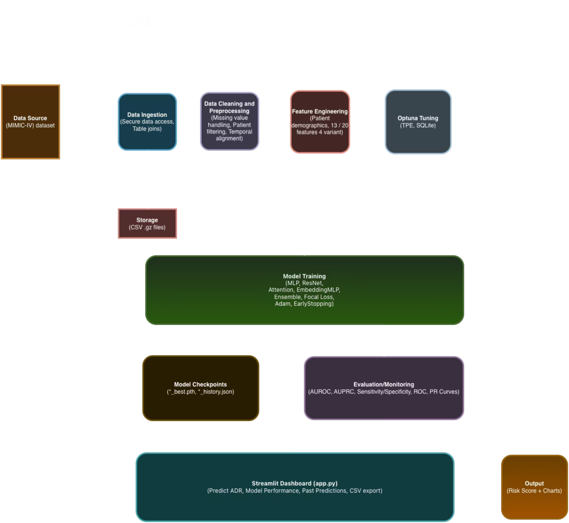
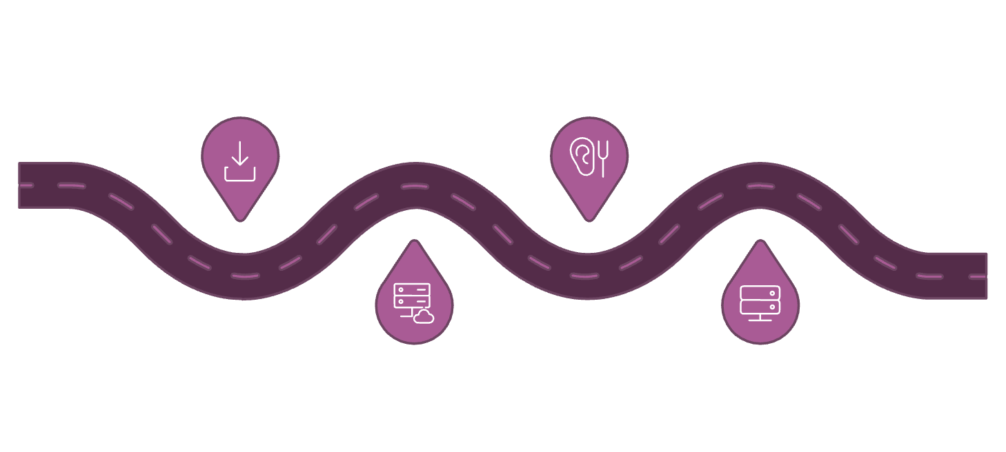

System Architecture
End-to-end flow from raw MIMIC-IV data to deployed clinical dashboard.
Ingestion
Hyperparameter Tuning
Merge 6 MIMIC-IV tables
Optuna TPE with SQLite
Preprocessing
Training & Deployment
Impute, encode, build 13/20 variants
Models, ensemble, Streamlit dashboard

Slide 5
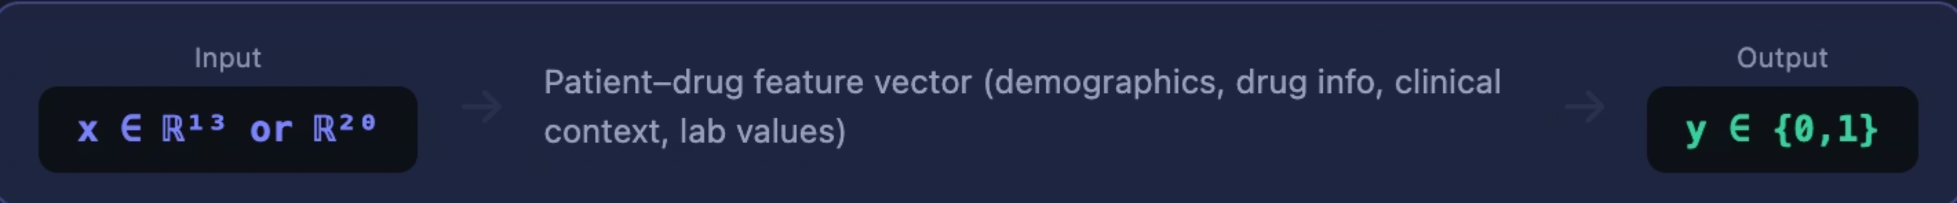
Problem Formulation
Binary classification at the prescription-event level. Each row represents one drug administered during one hospital admission. The model predicts whether that event results in an adverse drug reaction.
Loss Function
Class Imbalance
Evaluation Metrics
Focal Loss (α=0.25, γ=2.0) - down-weights easy negatives
Focuses training on hard minority ADR cases
Optional weighted BCE as alternative
ADR prevalence often <10% of rows
Stratified train/val/test splits
Decision threshold tuned at 0.3, 0.5, 0.7
AUROC - primary (threshold-free)
AUPRC - more honest under imbalance
F1, Precision, Recall, Sensitivity & Specificity

Slide 6
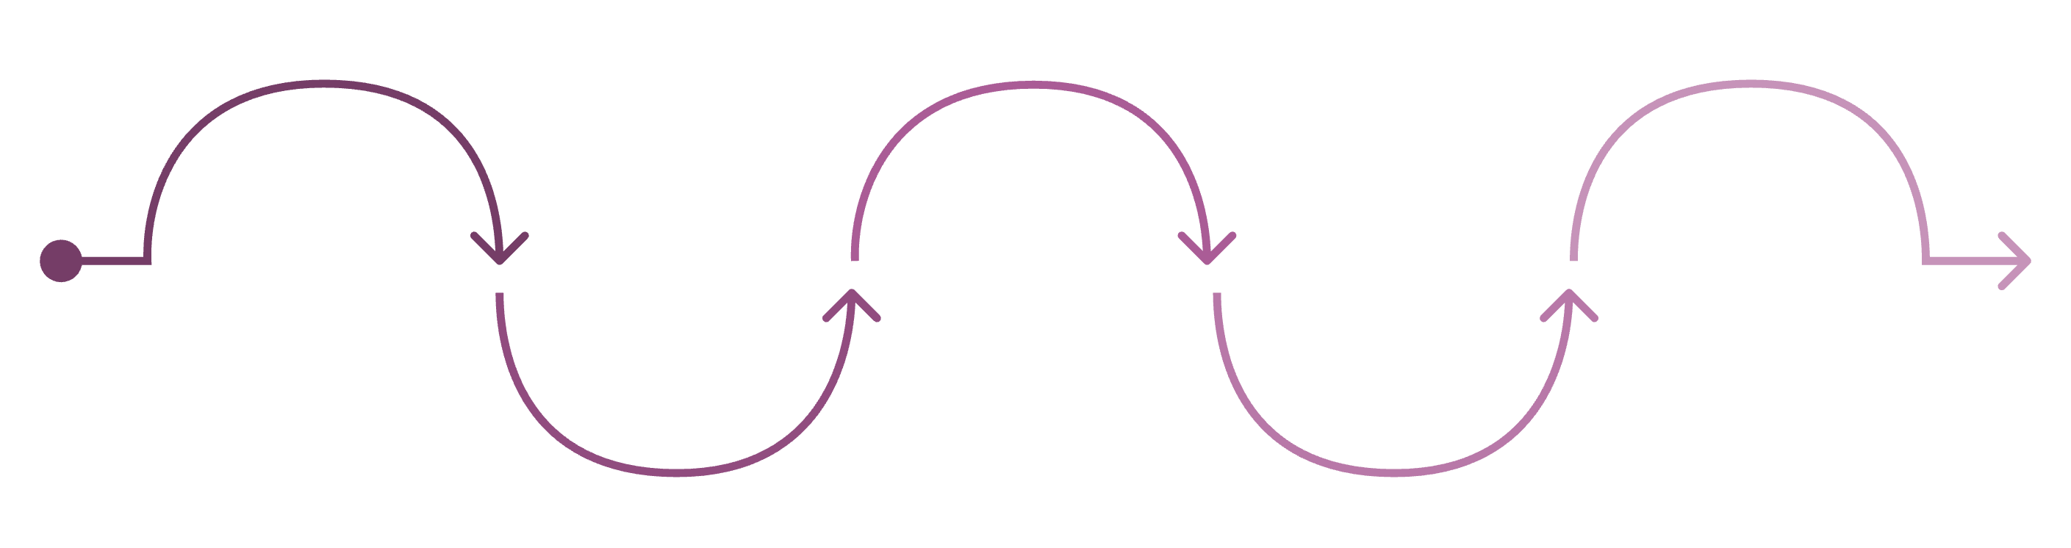
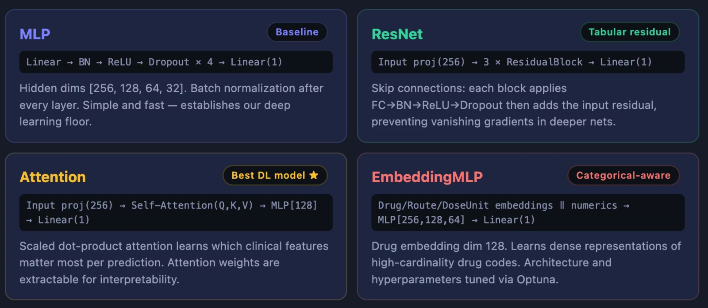
Pipeline & Four Deep Learning Architectures
Feature Prep
Training
Shared Config
Evaluation
Model Build
ReduceLROnPlateau · EarlyStopping · bs 1024
Construct shared feature matrix
Implement networks in PyTorch
Focal Loss with Adam optimizer
Monitor validation AUROC

Slide 7
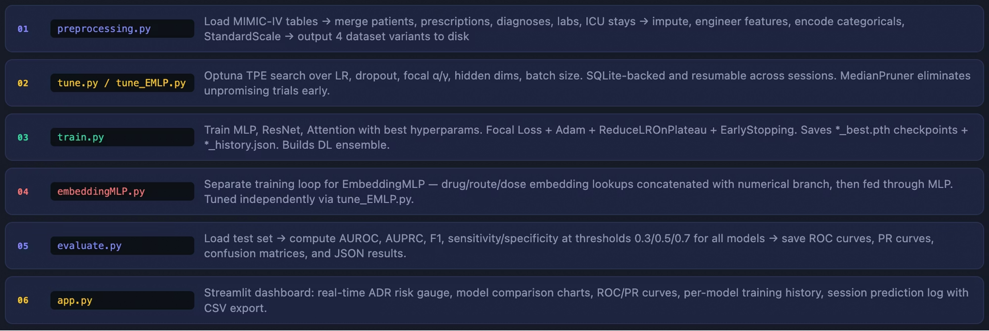
End-to-end Pipeline

Slide 8
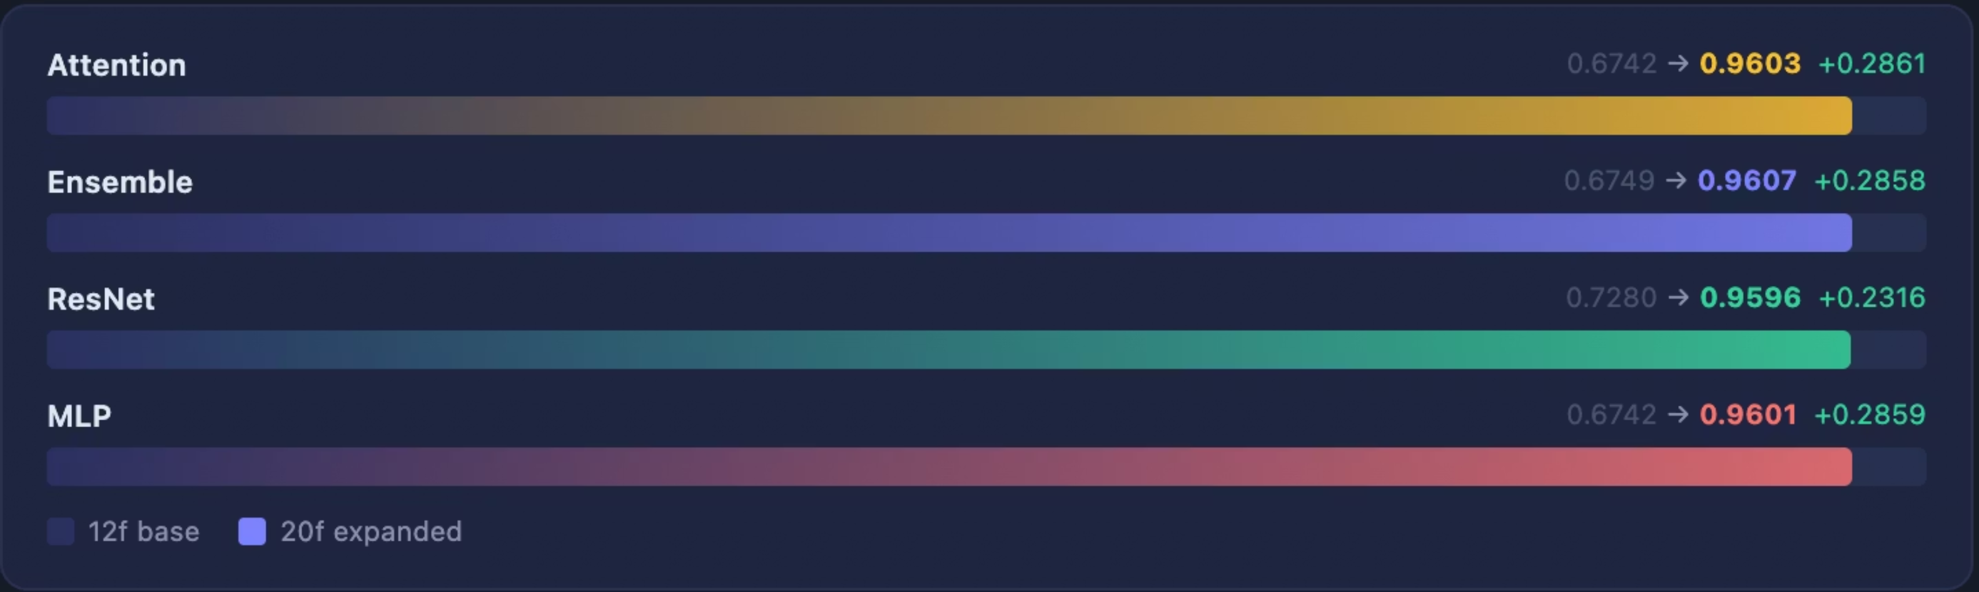
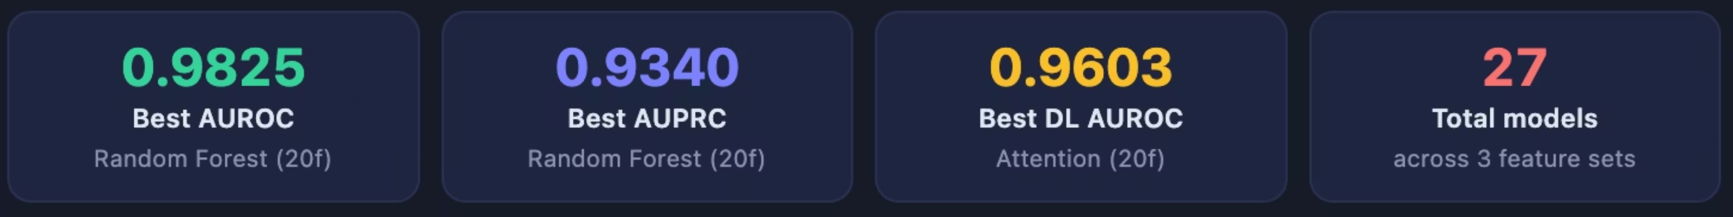
Results & Model Comparison
27 model variants evaluated across 3 feature sets and 4 architectures. The Attention model on the 20-feature expanded set is the best deep learning result; Random Forest on the same set achieves the overall best.
Feature engineering drove the biggest gains. Expanding from 12 to 20 features improved AUROC by up to +0.29 across every model, Attention improved from 0.6742 → 0.9603, MLP from 0.6742 → 0.9601. Domain knowledge in clinical feature engineering outperformed any architectural change.

Slide 9
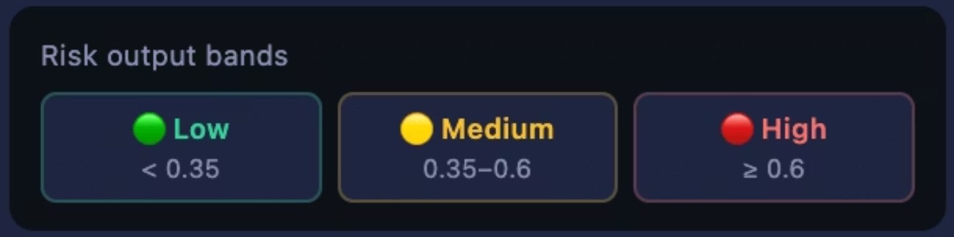
Streamlit Clinical Dashboard
Trained models wrapped in an interactive clinical decision support tool. A clinician enters patient demographics, drug, dose, route, and duration, the model returns a real-time probability score with color-coded risk bands.
Predict ADR
Model Performance Page
Low (<0.35) · Medium (0.35–0.6) · High (≥0.6)
High-risk triggers alert: consider alternative medication or dose adjustment
AUROC/AUPRC headline KPI cards
ROC & PR curves for all models
Per-model training loss & AUROC history
Past Predictions Page
Session-level prediction log, filter by drug or risk level
Risk distribution pie chart · One-click CSV export

Slide 10
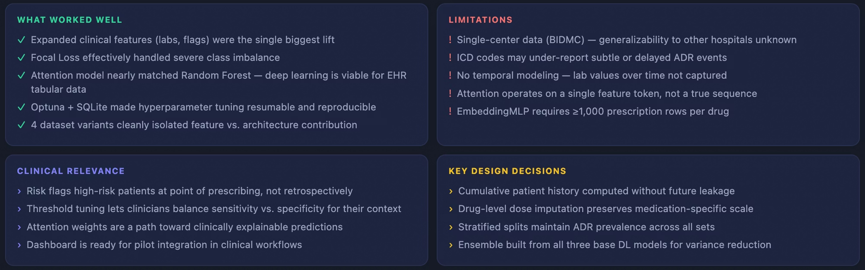
Discussion

Slide 11

Conclusion & Future Work
✓ What We Achieved
→ Future Directions
0.9825 AUROC : best overall (20-feature expanded set)
0.9603 AUROC : best DL model (Attention, 20f)
27 models across 3 feature sets & 4 architectures
Full pipeline: preprocessing → tuning → training → evaluation → dashboard
Temporal modeling : LSTM/Transformer over longitudinal lab sequences
External validation on eICU, OMOP, or UK Biobank
Drug molecular fingerprints from DrugBank/PubChem
Attention weight visualization as clinical explainability layer
Multi-label extension : predict specific ADR types simultaneously
Key Takeaway: Deep learning on real-world EHR data can reliably predict adverse drug reactions and clinical feature engineering matters as much as architecture. Our Attention model achieves near state-of-the-art performance and remains interpretable for clinical deployment.

Slide 12

Project Demo

Slide 13
Thank You!
We appreciate your time and attention to our project. We hope this presentation has demonstrated the potential of deep learning to proactively identify and mitigate adverse drug reactions, ultimately improving patient safety.
For any questions or further discussions, please reach out to our team:
Elizabeth Coquillette
Hithaishi Raghavendra Reddy
Ishan Chotalia
DS5500 Data Science Capstone · Spring 2026

