Slide 1

CS6120: Natural Language Processing
ResuMatch
Smart Resume Parser & Job Fit Analyzer

Slide 2




Team Members
Naga Pavithra Lagisetty
Hithaishi Raghavendra Reddy
Vinisha Sunkara
Sharan Giri
Member
Member
Member
Member

Slide 3

Previous Work
Automated Resume Screening
Job Role Recommendation Systems
Early systems relied on keyword-based matching, where resumes were compared to job descriptions based on exact keyword matches. While simple, these systems struggled to capture context or nuanced skills, limiting their accuracy and effectiveness, especially for complex or diverse job roles.
Early systems used rule-based approaches or simple machine learning models, relying on keyword matching and basic feature extraction. While effective for straightforward roles, they struggled with complex job descriptions. Modern systems now leverage NLP and semantic analysis to better understand context and improve job role predictions.

Slide 4

Problem Statement
How can we improve the way models interpret a candidate’s skill set beyond surface-level keyword matching?
Can models alert candidates about potential skill sets that can help them boost their current portfolios?
How can we train the model to help candidates discover potential openings that better align with their experience?
Are there ways to impart these nuanced skill understanding to model at preprocessing stage to help models learn better?

Slide 5
Data Overview
Source
Why this Dataset?
About Dataset
Format : CSV (Comma-Separated Values)
Size : 17MB
Number of Columns: 35
Number of Rows : 9544
After Preprocessing :
Number of Columns : 16
Number of Rows : 4108
Utilized a curated dataset from Kaggle called Resume Data.
Includes structured information on career objectives, skills, education, certifications, professional experiences, and other relevant details. Ideal Dataset for profiling and job matching .

Slide 6

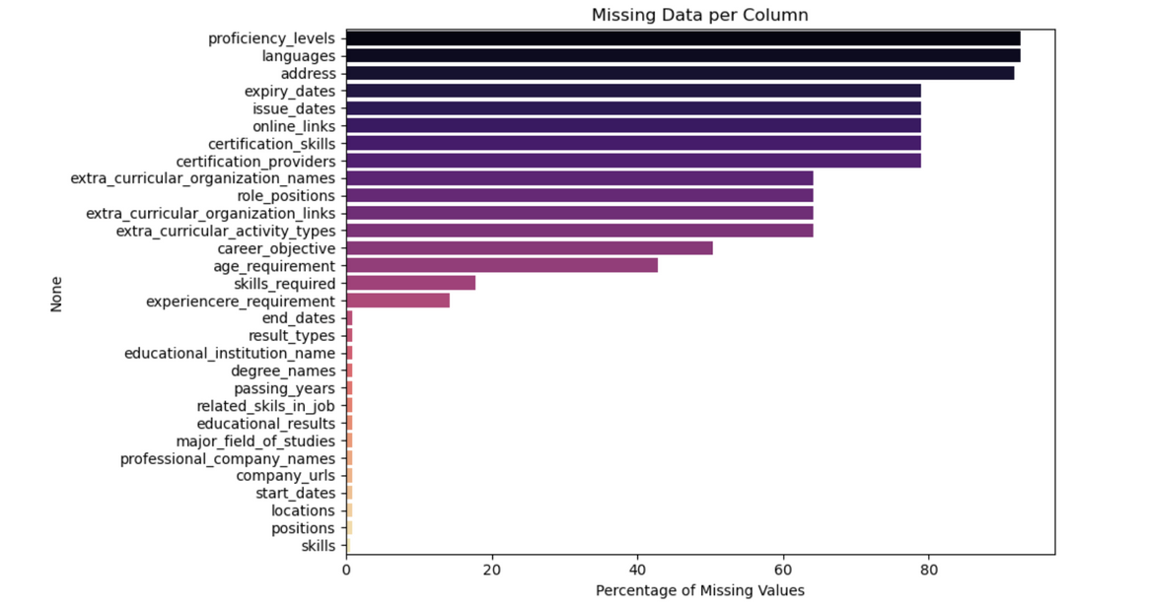
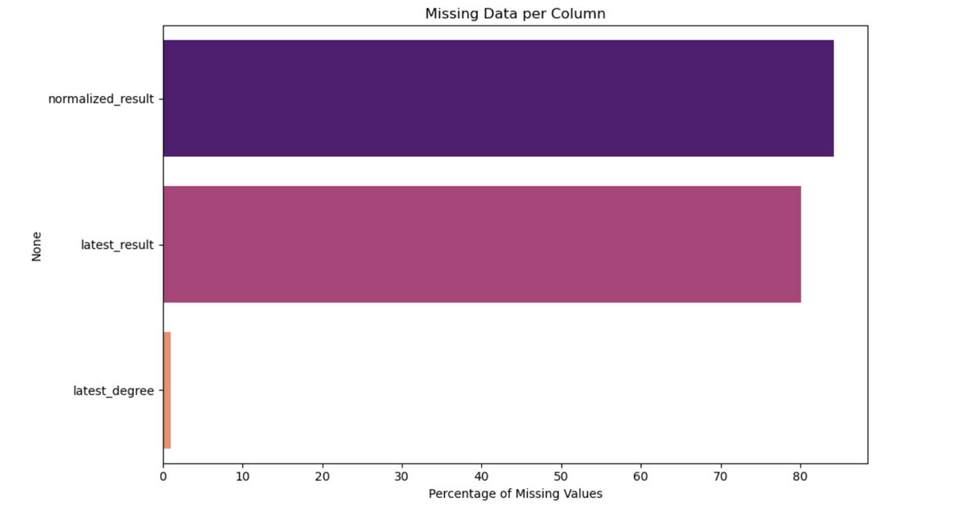

Data Analysis
Missing values from the raw data
After normalizing the dataset

Slide 7
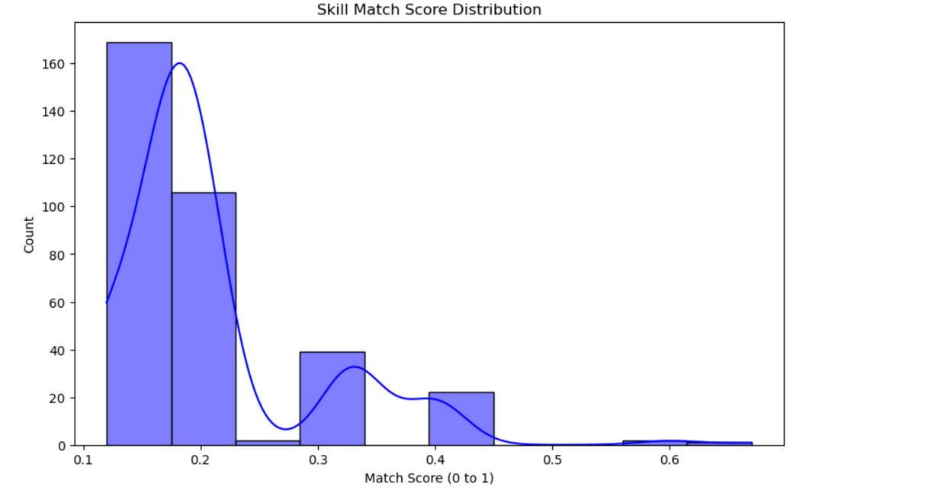
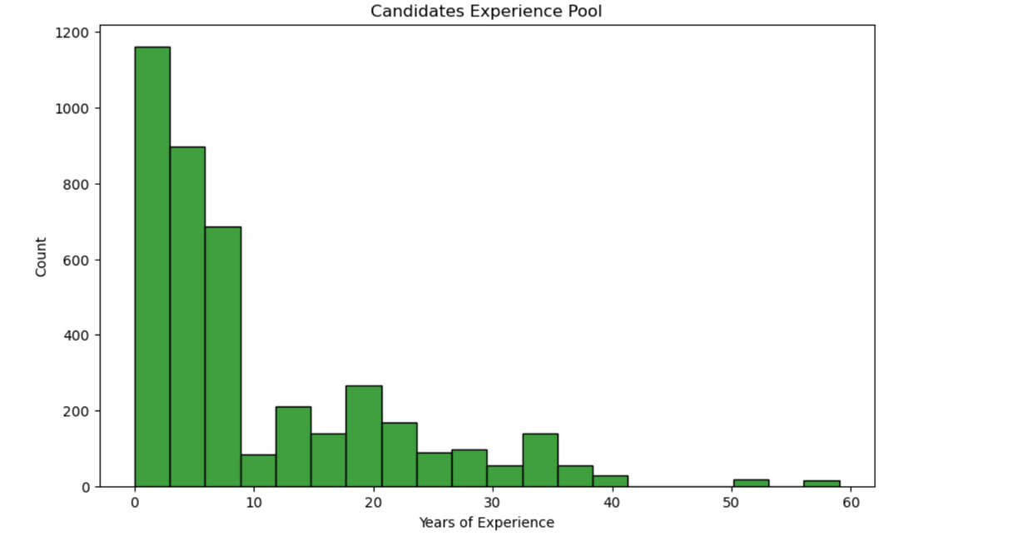
Data Analysis
Surface-level Skill Match score of the candidates in the dataset
Experience of the candidates in the dataset

Slide 8
Methodology
Multi-Label Transformation & Classification
Probability Calibration & Evaluation
Resume Parsing & TF-IDF
Uses CalibratedClassifierCV to improve the confidence and quality of probability predictions.
Implements GridSearchCV for hyperparameter tuning and K-Fold Cross-Validation to ensure robust generalization.
Extracts relevant information such as skills, job titles, education, and experience to make it usable for analysis.
Term Frequency- Inverse Document Frequency transforms resume text into numerical vectors, capturing the importance of terms relative to the entire dataset.
MultiLabelBinarizer is used to convert job titles into binary labels for multi-label classification.
A Logistic Regression (One-vs-Rest) model is trained on the TF-IDF vectors to predict multiple job roles for each resume.

Slide 9
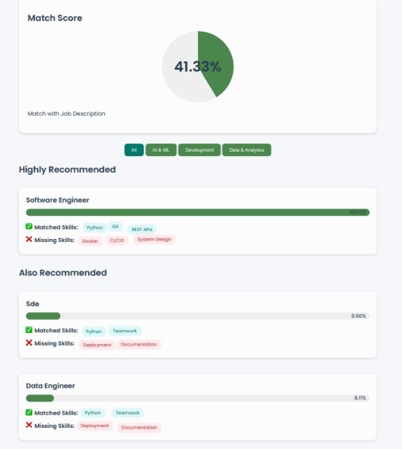
Model Training
Model Pipeline Summary:
Resume Text → Preprocessed into structured features (TF-IDF + dense embeddings + numeric data) → Job Titles binarized (MultilabelBinarizer).
Logistic Regression (One-vs-Rest classification) for multi-label prediction.
Hyperparameter Tuning:
C, max_iter, class_weight = ‘balanced’ via GridSearchCV for One-vs-Rest.
CalibratedClassifierCV - improve probability estimiates for multi label predictions
Model Generalization:
K-Fold Cross-Validation (k = 5) , ensure generalization across folds.
Class Balancing techniques used to avoid overfitting to dominant labels.

Slide 10
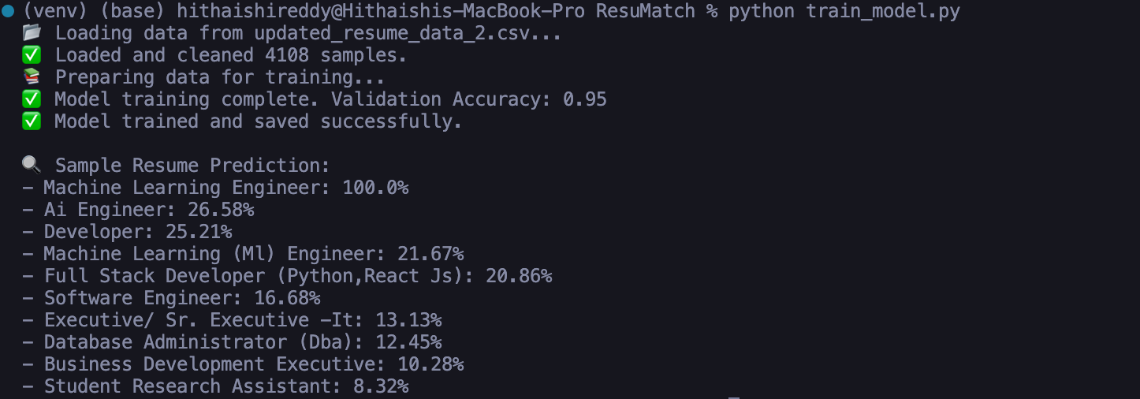
Model Evaluation
Model Type:
Logistic Regression with One-vs-Rest Classification
Why This Model?
Handles multi-label classification (one resume → multiple job roles)
Works well with high-dimensional text features (TF-IDF)
Fast, interpretable, and efficient on small-to-medium datasets

Slide 11
Model Evaluation
Model Pipeline Summary:
Resume text → TF-IDF features
Labels → MultiLabelBinarizer
Trained with:
CalibratedClassifierCV – for accurate probability scores
GridSearchCV – to find best hyperparameters
5-Fold Cross-Validation – ensures generalization
Class Weighting – handles imbalanced roles
Strengths:
High accuracy (up to 95% post-preprocessing)
Predicts multiple relevant job roles with confidence scores
Allows for explainable recommendations via matched/missing skills

Slide 12
FUTURE WORK
Future Adaptations
Challenges
Expand and Diversify Dataset : Incorporate more resumes across the IT industry that covers more rare and domain specific roles.
Experiment with Deep Learning and Attention : Include Transformer based models to better capture long-term context and nuanced skill-job associations.
Personalized Job Recommendations : Tailor suggestions based on candidates career objectives and interests.
Sparse Fields : Multiple Incomplete fields especially for some major fields (educational results, certification), can affect match score.
Ambiguity in Skills : Similar / Related Skills are often treated as distinct, affecting skill match.
Out-Of-Domain Generalization : Model struggles to accurately match resumes with rare , domain-specific job titles.

Slide 13
Conclusion
ResuMatch effectively matches resumes to job descriptions and provides relevant job role recommendations. While the model performs well with the current dataset, there is potential for further improvement by expanding the dataset to include more diverse resumes and job titles. Future work will focus on fine-tuning the model, enhancing job role specificity, and improving the accuracy of recommendations. Additionally, the model can be extended to handle more complex resumes and job descriptions, offering a more robust solution for real-world job matching challenges.

Slide 14
Thank you

