Slide 1
Privacy Preserving Collaborative IDS for Internet of vehicle networks
Faculty Members: Student Members:
Mrs. Durga Hithesh Y
Mrs. Uma Saurabh Krishnan
Mrs. Anusuya
Mr. Praveen

Slide 2
Content:
Threat Model
Threat Matrix and Risk Matrix
Baseline Architecture
Model Architecture
Why FHE in FL
Security and Performance Report
HE Schemes

Slide 3
Problem Statement
Challenges in Internet of Vehicles (IoV)
Increasing Cyber-Attacks on Connected Vehicles: Modern vehicles are vulnerable to in-vehicle network (IVN) exploits (e.g., DoS, Fuzzy, RPM, and Gear spoofing attacks) and V2X wireless threats.
Privacy Concerns in Sharing Vehicle Data: Strict data privacy regulations (e.g., GDPR, CCPA) prevent vehicles from uploading raw telemetry, location history, or sensor logs to centralized servers.
Limitations of Centralized IDS:
  Bandwidth bottlenecks from transmitting massive, continuous streams of high-frequency vehicular data.
  Single point of failure: vulnerability to connection drops in high-mobility environments.

Slide 4
Proposed Solution: FedIoV
Federated Learning (FL) Framework: Enables collaborative training where vehicles train intrusion detection models locally and only share encrypted model updates (gradients) with the server.
Kolmogorov-Arnold Network (KANConvNet): A lightweight, edge-optimized classifier with learnable activation functions on edges rather than nodes, reducing computational overhead.
Layer-Wise Fully Homomorphic Encryption (FHE): Selectively encrypts only the most sensitive layers of the KAN model during aggregation, resolving the speed limitations of traditional FHE while preserving privacy.

Slide 5
Project Objectives
Design a Collaborative IDS for IoV: Develop a distributed, cooperative system to detect cyber threats across the fleet without requiring a central database of raw logs.
Preserve Privacy of Vehicle Data: Leverage secure cryptographic channels and Layer-Wise FHE to ensure vehicle telemetry remains private.
Support Distributed Learning Across Vehicles: Build a robust Federated Learning client-server architecture capable of handling vehicle churn, communication drops, and non-IID settings.
Detect Vehicular Cyber Attacks Efficiently: Implement and optimize KANConvNet to detect low-latency attacks (target latency <60<60 ms) on resource-constrained Electronic Control Units (ECUs).

Slide 6
Threat Model
Step 1 – Set Objectives
Primary Objective: Build a real-time, privacy-preserving Intrusion Detection System (IDS) to secure the Internet of Vehicles (IoV) against cyber-threats.
Security Goals (CIA-P Triad):
  Confidentiality: Protect vehicle network traffic and machine learning model weights from eavesdroppers.
  Integrity: Ensure model updates are not tampered with, and prevent compromised vehicles from injecting malicious updates.
  Availability: Ensure the system can detect and respond to attacks in real-time (under 60ms).
  Privacy: Guarantee raw vehicle telemetry (GPS location, speed, routes) never leaves the on-board unit.

Slide 7
Step 2 – Visualize
The Architecture (FedIoV / DCANFL):
  Edge Client (Vehicle): Collects local CAN bus traffic →→ extracts a 46-dimensional "timeless" feature vector →→ trains a local KANConvNet model.
  Secure Communication Channel: Vehicle handshakes with the Edge Server using Ed25519 (authentication) and ECDH-P256 (key exchange) to encrypt updates with AES-256-GCM.
  Edge Server (Aggregator): Collects encrypted updates →→ runs Multi-Krum to filter outliers →→ averages updates →→ broadcasts the new global model.
  Layer-Wise FHE (Fully Homomorphic Encryption): Selectively encrypts the most sensitive layer weights of the KAN ConvNet, allowing the server to aggregate them without decrypting them.

Slide 8
Step 3 – Identify Threats
Threat 1: In-Vehicle Network Attacks (CAN Bus Exploitation)
  Denial of Service (DoS): Attackers flood the CAN bus with high-priority messages, freezing brakes or steering controls.
  Fuzzy / Impersonation Attacks: Attackers inject random or spoofed packets to confuse onboard ECUs.
Threat 2: Byzantine / Poisoning Attacks (Machine Learning Level)
  Model Poisoning: Hacked vehicles upload corrupt model weights during federated training to blind the global model to specific attacks.
Threat 3: Communication Eavesdropping & Privacy Leakage
  Man-in-the-Middle (MitM): Intercepting and modifying model updates in transit.
  Reconstruction Attacks: Eavesdroppers reverse-engineering plaintext model weights to reconstruct raw driving telemetry

Slide 9
Step 4 – Mitigate
Mitigating In-Vehicle Attacks:
  KANConvNet IDS: Runs locally on the vehicle, analyzing overlapping sliding windows (W=64W=64, S=16S=16) to flag anomalous entropy, payload patterns, or ID frequencies.
Mitigating Federated Poisoning (Byzantine Attacks):
  Multi-Krum & TOPSIS: The edge server calculates distance metrics between updates. Outliers (e.g., poisoned updates from hacked cars) are isolated and discarded.
Mitigating Network & Privacy Threats:
  ECDH + AES-256-GCM: Establishes ephemeral key encryption for all transmissions (perfect forward secrecy).
  Layer-Wise FHE: Fully Homomorphic Encryption is applied only to the most sensitive layers of the KANConvNet, keeping performance fast while guaranteeing cryptographic privacy.

Slide 10
Threat Matrix
Threat | Description | Mitigation
Data & Model Poisoning | Attacker injects bad data or manipulated gradients | Multi-Krum + TOPSIS
Man-in-the-Middle | Attacker intercepts or modifies updates between client & server | Ed25519 + AES-256-GCM
Backdoor Attack | Attacker inserts hidden triggers that activate malicious behavior | Multi-Krum distance-based filtering
Byzantine Failure | Malicious clients send arbitrary or corrupted updates | Multi-Krum selects top 5 consistent
Privacy Attacks (Inversion/Leakage) | Attacker reconstructs training data from shared gradients | Differential Privacy (σ=1.2, C=1.0)
Denial of Service | Attacker floods server with updates to overwhelm processing | TOPSIS dimensionality reduction

Slide 11
Dataset Acquisition
Car-Hacking Dataset(HCRL): (1 year ago)
  Scope: Labeled CAN bus traffic from a real Hyundai YF Sonata.
  Size/Type: CSV logs containing CAN-ID, DLC, payload bytes, and injection flags.
  Threat Classes: Normal run, DoS, Fuzzy, RPM, and Gear attacks.
VeReMi Dataset: ( 3 years ago)
  Scope: Kinematic beacon data from V2V communication in VANET simulations.
  Size/Type: 18 kinematic features (positions, speeds, accelerations, headings, noise levels).
  Threat Classes: Benign (BENIGN) and Attack (ATTACK) (falsified kinematic attributes).
3.CICIDS 2017 Dataset: (updated 3 years ago)
  Scope: Network flow-level traffic logs spanning multi-layer V2I and V2N network protocols.
  Size/Type: 78 numeric flow features down-selected to a stable 46-feature network baseline.
  Threat Classes: Benign vs. Attack (DDoS, PortScan, FTP-Patator, SSH-Patator, Web Attacks, etc.)
4.IEEE VTC-CAN Dataset: (last updated 2025)
  Scope: Labeled high-fidelity in-vehicle CAN bus log stream under attack injections.
  Size/Type: CAN frames windowed to 46-dimensional temporal descriptors.
  Threat Classes: Attack-free, DoS attack, Fuzzy attack, and Impersonation attack.

Slide 12
Justification
Coverage:
  Low-Level IVN Protection: Car-Hacking and IEEE VTC-CAN evaluate anomaly detection on the internal physical ECU bus (message intervals, ID distributions, payload integrity).
  High-Level V2V Protection: VeReMi evaluates system resilience to geographic and kinematic coordinate spoofing or communication misbehavior.
  High-Level V2I/V2N Protection: CICIDS 2017 evaluates broad network-layer threats (DDoS, brute-force exploits, scans) targeting external connectivity.
Realism & Data Heterogeneity: Incorporating these four distinct datasets tests the dataset-agnostic feature engineering layer and the robustness of KANConvNet across high-frequency binary sequences, continuous float vectors, and IP traffic metrics.

Slide 13
Data Engineering
Challenge: Heterogeneous DatasetsVarying Protocols: CAN bus messages (HEX payloads) vs. V2X beacons (coordinate floats) vs. IP flows (network counts).
Goal: Standardize diverse inputs into a single format so the same neural network (KANConvNet) can be reused.
Solution: Unified Feature Extraction
Sliding Window: Group incoming message streams into a sliding window of size W=64 messages and stride S=16.
Feature Unification: Summarize each window into exactly 46 universal features (numbers).
Unified Pipeline: Creates a dataset-agnostic feature vector x∈R^46 for the classifier model.

Slide 14
Data Engineering (46-D Feature Mapping)
In-Vehicle Networks (Car-Hacking & IEEE VTC-CAN):
What it measures: High-frequency messages exchanged between internal ECUs.
46-D Feature Breakdown:Payload Stats (16):
Average value & deviation of raw data bytes (b0..b7).
Message Length (2): Average & deviation of Data Length Code (DLC).
Component Identity (26): Active CAN-ID distribution histogram hashed over 24 buckets + dominant ID stats.
Data Entropy (2): Information randomness and non-zero payload ratio.
2. V2X Telemetry Networks (VeReMi):
What it measures: GPS and motion telemetry shared between vehicles.
46-D Feature Breakdown:
Average Motion (18): Position, speed, heading, and sensor noise averages.
Fluctuations (18): Standard deviations of kinematic readings over the window.
Derived Forces (5): Total speed magnitude, acceleration force, and heading intensity.
Behavior Stats (5): Spatial coordinates spread, time intervals, and broadcast rates.

Slide 15
Data Engineering (46-D Feature Mapping)
3. IP Networks (CICIDS 2017):
What it measures: External Internet network traffic flows.
46-D Feature Breakdown:
Transfer Rates (6): Flow duration, bytes/second, packets/second, and average size.
Flow Sizes (12): Total forward/backward data size and packet lengths.
Time Gaps (15): Inter-Arrival Times (IAT) of packet streams.
Control & Headers (13): TCP flags (SYN, ACK, RST) and packet header sizes.

Slide 16
Data Engineering (Preprocessing)
Data Cleaning Pipeline
Percentile Clipping: Continuous features are clipped at the 0.5th and 99.5th percentiles (using training set bounds) to remove noisy sensor spikes and outliers.
Z-score Standardization: Every feature is scaled to standard bounds.
Safeguarding Against Data Leakage (Anti-Cheating)
Centralized Stratified Split: 70% Train, 15% Validation, 15% Test.
Strict Training Isolation: Mean (μ) and standard deviation (σ) parameters are computed only on the 70% training split.
Evaluation Integrity: The calculated training statistics are locked and then used to scale validation and testing sets

Slide 17
Non-IID Simulation
1. Fleet Setup & Connectivity Constraints
Simulated Fleet Size (N): N∈{50,100,200} client vehicles, each running KANConvNet in containerized/isolated environments.
Client Sampling Fraction (q): Server selects a random subset of active vehicles at each round (q=0.60 for N=50, q=0.70 for N=100, and q=0.75 for N=200).
Vehicular Churn(P drop): Simulated random client dropout of 5%−20% per round due to tunnel shadowing, signal fading, or moving out of range. Dropped clients can rejoin later.

Slide 18
Non-IID Simulation
2.Dirichlet Non-IID Partitioning
To model realistic geographic variations where different vehicles encounter different traffic patterns and attack ratios:
Mathematical Split:
Training data is split across clients using a Dirichlet distribution with concentration parameter α=0.3.pc ∼ Dir(α⋅1N) where pc represents the proportion of samples from class c allocated to each of the N clients
Class Skew Effect:
A smaller α leads to higher skew (non-IID conditions).
With α=0.3, some vehicles observe only benign traffic, while others are dominated by a single attack class (e.g., DoS only), forcing the global model to learn from highly heterogeneous client updates.
Centralized Evaluation:
Validation and test splits are kept centralized at the server, ensuring unbiased and global performance metrics.

Slide 19
Baseline Architecture:
PHASE 1: INITIALIZATION:
1. Role : Central Server
2. Action : Init & Broadcast global model
3. Target : N Vehicles
4. Security : SecureChannel (ECDH + AES-256 + Mutual Auth)
PHASE 2: CLIENT SIDE
1. Inputs : CAN (1D-Conv) | V2X (MLP) | GPS/IMU (1D-Conv)
2. Fusion : 10Hz Sync → FiLM Gating → 46-dim Vector
3. Model : KANConvNet
4. Train : SGD + L2 Regularization
5. Adapt : Personalization Blend (Global + Local)
6.Privacy : L2 Clip (C=1.0) + Gaussian Noise (σ=1.2)

Slide 20
Baseline Architecture:
PHASE 3: SERVER AGGREGATION
1. Stage 1 : TOPSIS
Action : Dimensionality Reduction → Rank → Filter Outliers
3. Stage 2 : Multi-Krum
Action : Robust Clustering → Pairwise Distance → Average Top-m
PHASE 4: GA TUNING
1. Goal : Hyperparameter Optimization
2. Genes : {LR, Batch, Epochs, Momentum, Dropout, Optimizer, L2, α}
3. Flow : Init → Eval (F1) → Crossover → Mutate → Deploy

Slide 21
KanConvNet Architecture:
STAGE 1: INPUT
1. Source : Fused Telemetry
2. Shape : 46-dim Vector
3. Preprocess : Normalization / Fourier Transform
STAGE 2: MAPPING
1. Logic : Linear Transform + Fourier Encoding
2. Sequence : Precedes Linear Summation
STAGE 3: ACTIVATION
1. Type : Kolmogorov-Inspired Nonlinearity
2. Placement : Network Edges
3. Benefit : High Interpretability / Safety Audits

Slide 22
KanConvNet Architecture:
STAGE 4: HIDDEN LAYERS
1. Type : Intermediate Layers
2. Activation : ReLU
3. Goal : Spatial-Temporal Pattern Extraction
STAGE 5: OUTPUT
1. Map : Final Kolmogorov Activation
2. Classifier : SGD Prediction

Slide 23
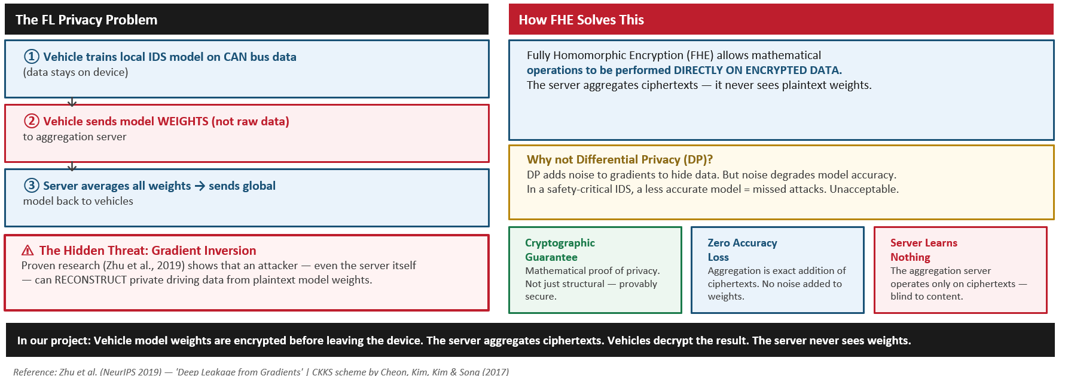
Why FHE in FL:

Slide 24
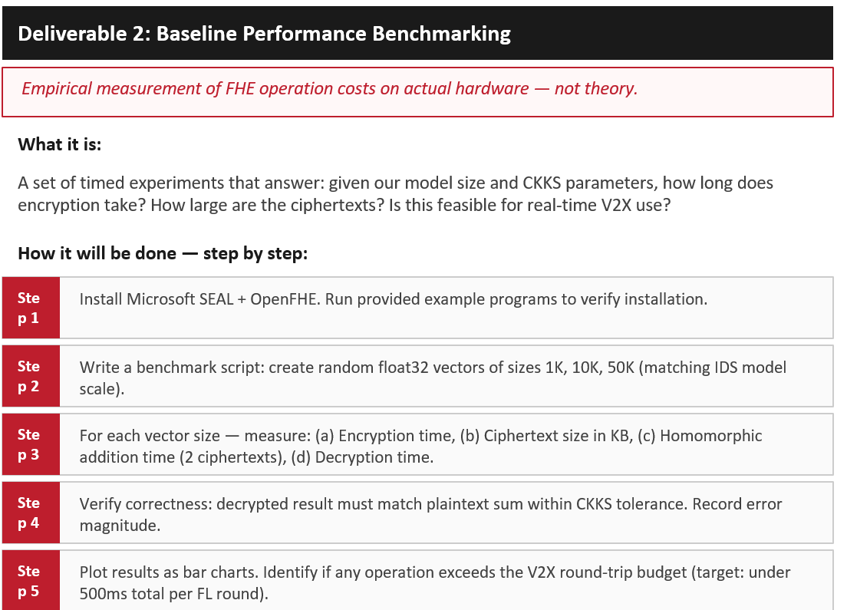
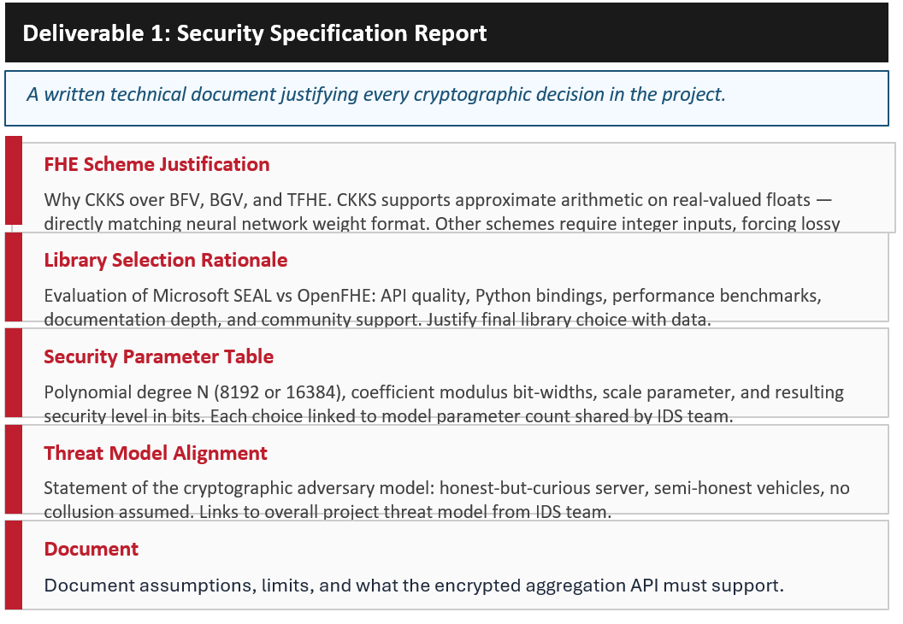
Security and Performance Report:

Slide 25
HE Scheme:
Scheme | Data Type | Top Strength | Main Limitation
BFV | Exact integers | Great for exact arithmetic and databases | Needs complex quantization for floats
BGV | Exact integers | Mature, strong integer support | Poor fit for float-valued model weights
CKKS | Approximate (Floats) | Best for neural networks & weighted sums | Requires careful error & parameter tuning
TFHE / FHEW | Bits / Boolean | Fast bootstrapping for small circuits | Way too slow for large vector aggregation
Hybrid | Mixed | Combines multiple schemes | High scheme-switching overhead
Threshold | Varies | Enables joint multi-party decryption | Unnecessary key-management complexity

Slide 26
FINDINGS:
Fully HE Is Impractical in Our Scenario
Latency: Real-time IDS requires 10–100 ms response times, but FHE delays processing to seconds or minutes.
Hardware Constraints: Resource-heavy FHE drains batteries and starves safety applications on low-power On-Board Units.
Ciphertext Size: FHE expands model weights into gigabytes of data, saturating limited V2X wireless networks.
Mobility: Slow FHE aggregation means fast-moving vehicles will likely drive out of network range before updates complete.
Algorithmic Limits: Approximating essential non-linear IDS functions (like ReLU) with FHE triggers unsustainable computational overhead.

Slide 27
Layered FHE
1. Full FHE encrypts all model parameters, making it too slow (seconds to minutes) and impractical for real-time IoV detection.
2. Layer-Wise FHE encrypts only the most sensitive layer of the KANConvNet model that captures vehicle-specific driving patterns.
3. All other layers (input, Fourier, activation, output) remain in plaintext to maintain speed and efficiency.
4. This approach maintains <60ms detection latency, keeps updates to kilobyte size, and runs on standard ECU-class hardware.
5. Key takeaway: Strong cryptographic privacy for critical vehicle data without sacrificing real-time performance.

Slide 28
Work Completed:
1. KANConvNet Classifier
Architecture: Implemented with the Kolmogorov-Arnold trick (learnable edge activations via Fourier basis).
Custom Layers: Built FourierKANLinear, KolmogorovActivation, and KANConv1d modules.
Backbone: Configured a CNN backbone to process windowed vehicular sequences.
2. Data Pipeline & Preprocessing
Datasets: Integrated loaders for CAN-VTC, Car-Hacking, CICIDS 2017, and VeReMi.
Feature Engineering: Unified 46-feature extraction (timing, DLC, payload stats, CAN-ID histograms).
Normalization: Applied automated Z-score scaling and signal clipping.

Slide 29
Work Completed:
3. Phase 1: Federated Setup
Distribution: Simulated realistic non-IID data via Dirichlet allocation (α=0.3) for 50-200 clients.
Security: Secured client-server channels with ECDH handshakes, AES-256-GCM, and mutual authentication.
Simulation: Built FederatedServer/Client classes and defined a Genetic Algorithm hyperparameter search space.
4. Infrastructure & Verification
Workflow: Built centralized train.py supporting full runs and rapid --smoke tests.
Orchestration: Automated the init sequence (partitioning → secure setup → broadcast) via phase1.py.
Validation: Integrated JSON training logs and best-weight checkpointing.

Slide 30
Next Step
The project is now ready to move into Phase 2 (Federated Training), which involves implementing the TOPSIS + Multi-Krum aggregation logic and the Genetic Algorithm evolution loop.
We will look into the aggregate function and its mathematical formulation in detail to ensure proper implementation of the TOPSIS + Multi-Krum pipeline.

